Slide 1

ACADEMIC PROJECT REVIEW
Employee Task Management
A shared MERN application for assigning, tracking, and managing employee work.
Presented by :
N . Sravan Kumar – 25MVCSMR0692
N . Kamal Raj – 25MVCSMR0694
L . Yashwanth Yadav – 25MVCSMR0672
G . Akhil Chaithanya – 25MVCSMR0645

Slide 2


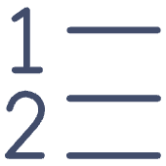

THE PROBLEM
Untracked work becomes missed work
When work is scattered, the team loses the thread between assignment, ownership, priority, and deadline.
Scattered assignments
Unclear ownership
Shifting priorities
Invisible deadlines
Requests live across chats, notes, and memory.
No single view shows who is responsible.
Urgent work can displace important work silently.
Late work is discovered after the deadline has passed.

Slide 3
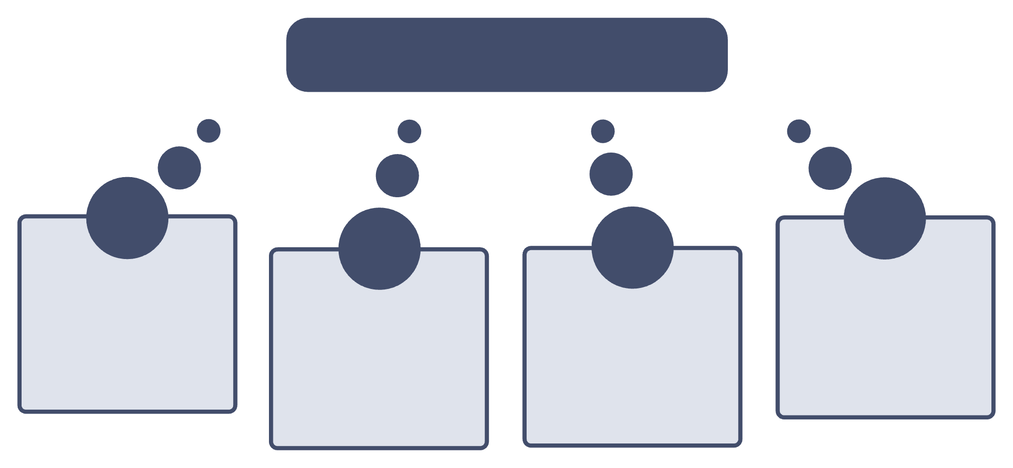




THE SYSTEM
One system connects people to progress
Shared task system
Employees
Status visibility
Clear responsibilities shown
Tasks
Priorities and deadlines
Managers see progress
Defined next actions listed
Due dates and urgency
Every assignment has an owner, a current state, and a next action that the team can see.

Slide 4
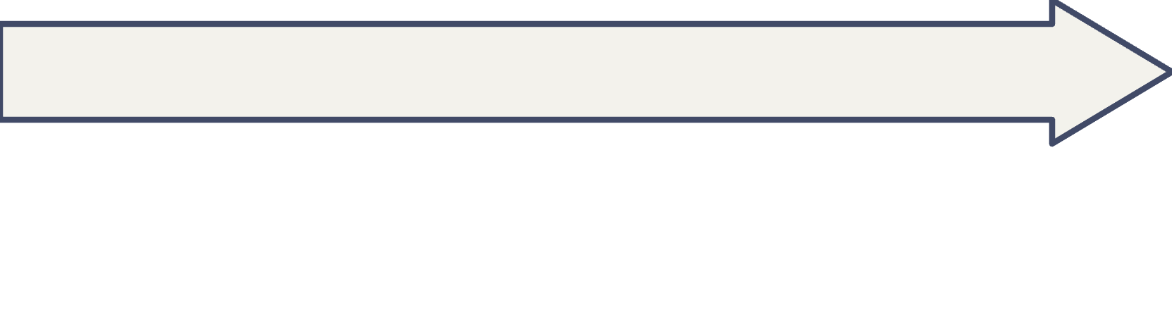
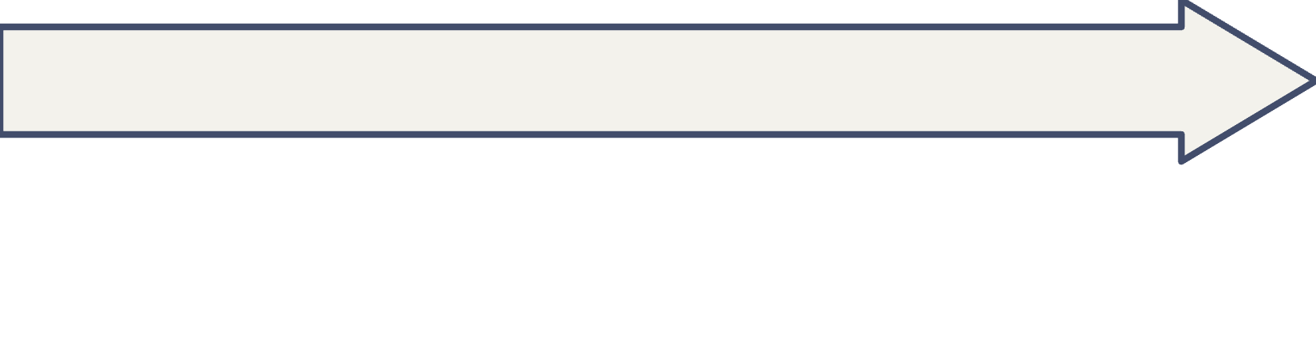
THE IMPLEMENTATION
The MERN stack fits the workflow
Each layer has a clear responsibility, from the employee-facing interface to the records behind it.
Node.js
React
Runs the server-side application logic.
Creates the focused interface for viewing and acting on work.
MongoDB
Express.js
Stores employee and task records flexibly.
Exposes REST APIs between the interface and data.

Slide 5
THE DATA MODEL
Task records carry the details that matter
A useful record turns an abstract request into work that can be owned, prioritized, and reviewed.
Field | What it captures | Why it matters
Employee | Who owns the work | Creates clear accountability.
Task | What needs to be done | Gives the team a shared description.
Priority and deadline | What matters first and when | Guides sequencing and follow-up.
Status | Where the work stands | Makes progress visible at a glance.

Slide 6




THE DAILY LOOP
CRUD turns daily actions into a reliable loop
View
Add
See assignments and current status.
Create employees and tasks.
Manage
Update
Keep records aligned as work changes.
Change priority, deadline, or progress.
Records stay useful because the system supports the full life of the work.

Slide 7


ACCESS CONTROL
Role-based access protects the workflow
Authentication separates manager capabilities from employee actions, so each person sees and changes only what their role requires.
Manager
Employee
Assign work and manage employee records
Set priorities and deadlines
Review progress across the team
View assigned tasks
Update progress and status
Focus on the next required action

Slide 8

THE USER EXPERIENCE
The dashboard makes status visible
A focused React interface brings assignments, priorities, deadlines, and task status into one scan-friendly view.
ASSIGNED TO ME
DUE SOON
IN PROGRESS
12
4
7
active tasks
next deadlines
tasks moving

Slide 9

PROJECT OUTCOME
Success means clarity from assignment to completion
Demonstrate
Implement
Deliver
Provide
Present
MERN Stack development
MongoDB CRUD operations
REST APIs with Node.js and Express.js
A usable React frontend
Project information and results clearly

Slide 10
THANK YOU

