Slide 1
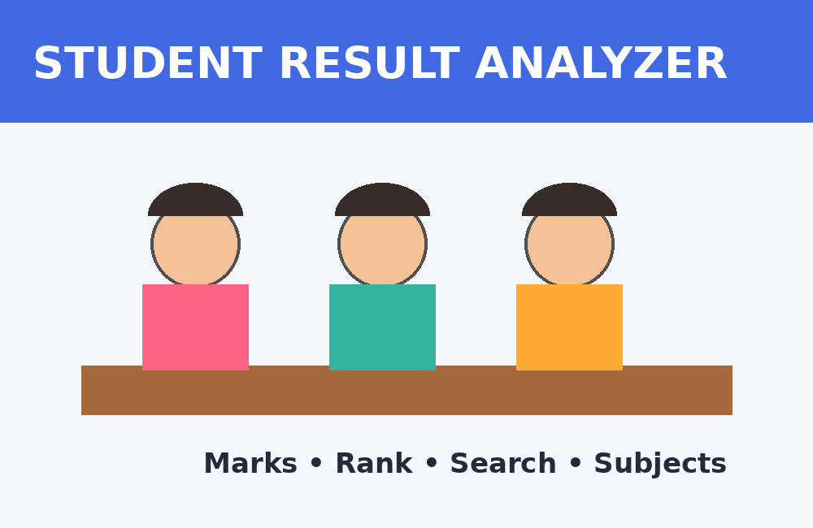
Student Result Analyzer
Smart • Explainable • Algorithm-Driven
Analyze marks, rank students, answer range queries, and visualize relationships between subjects.
One-Line Idea
A visual DAA-powered platform that turns raw marks into meaningful academic insights.
Team Members
Problem Domain
Nandyala Sravan Kumar – 25MVCSMR0692
Neela Kamal Raj – 25MVCSMR0694
Lambola Yeshwanth – 25MVCSMR0672
Gera Akhil – 25MVCSMR0645
Education / Academic Performance
1

Slide 2
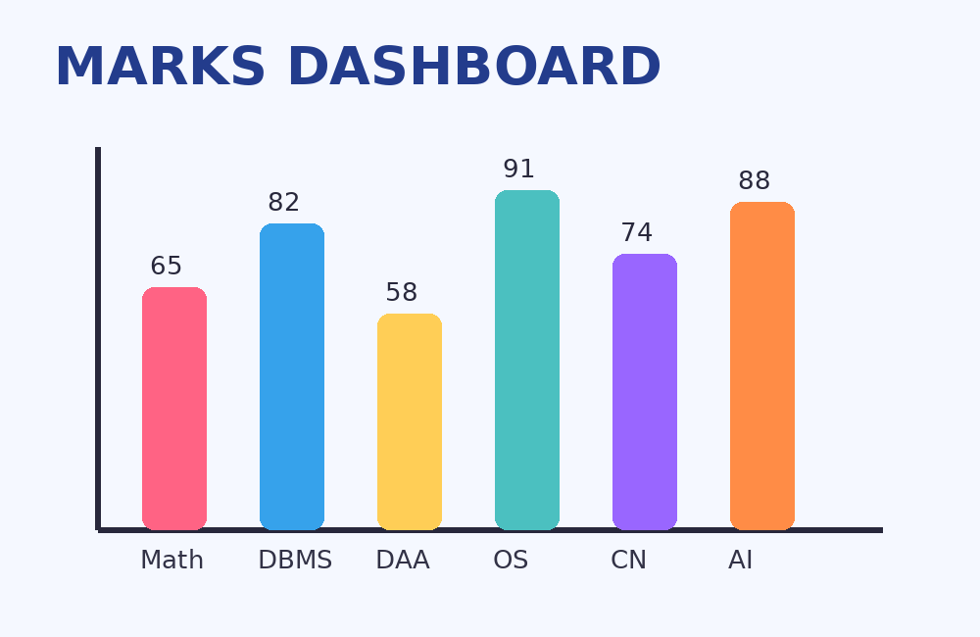
2. The Challenge
Why student result analysis needs a smarter approach
Real-World Problem
Why It Matters
Key Challenges
Student marks are often stored as raw records, making ranking, searching, and relationship analysis difficult.
Teachers need quick insights; students need understandable feedback; institutions need organized academic data.
Large student datasets • slow manual searching • difficult range queries • limited visualization.
• Manual sorting can become time-consuming as records grow.
• Searching unsorted data does not exploit the power of Binary Search.
• Subject relationships are difficult to understand from tables alone.
2

Slide 3
3. Our Innovation
A single platform that combines DAA algorithms with visual analytics
Smart Ranking
Fast Search
Range Queries
Automatically sort students by total / percentage.
Binary Search reduces the search interval step-by-step.
Find students within a marks or rank range.
Subject Graph
Explainable Results
Visual Dashboard
Visualize relationships using nodes and edges.
Show comparisons, search steps and traversal order.
Charts make academic patterns easy to understand.
Unique approach: DAA concepts are not hidden — the system makes algorithm decisions visible to the user.
3

Slide 4
4. How It Works
Simple workflow from student data to understandable results
1
2
3
4
INPUT
PROCESS
ALGORITHM
OUTPUT
Student marks, student details and subject relationships
Calculate totals / percentages and prepare sorted data
Sorting + Binary Search + BFS/DFS graph traversal
Ranks, search results, range results and visual charts
User Journey
Enter/upload marks → choose analysis → view algorithm steps → inspect rank/search/graph → understand results.
4

Slide 5
5. Technology & Algorithm
Tools chosen to keep the prototype practical and algorithm-focused
Tech Stack
Main Algorithms
Why These Algorithms?
Python
Flask
SQLite
Chart.js
Sorting — ranking records
Binary Search — fast search & ranges
BFS / DFS — subject graph traversal
Sorting prepares data for ranking/search.
Binary Search halves the search interval.
Graphs naturally model subject relationships.
Sorting
Binary Search
Graph Traversal
Typical efficient comparison sorting: O(n log n)
O(log n) search on sorted data
BFS / DFS: O(V + E)
Complexity depends on the exact implementation and input structure.
5

Slide 6
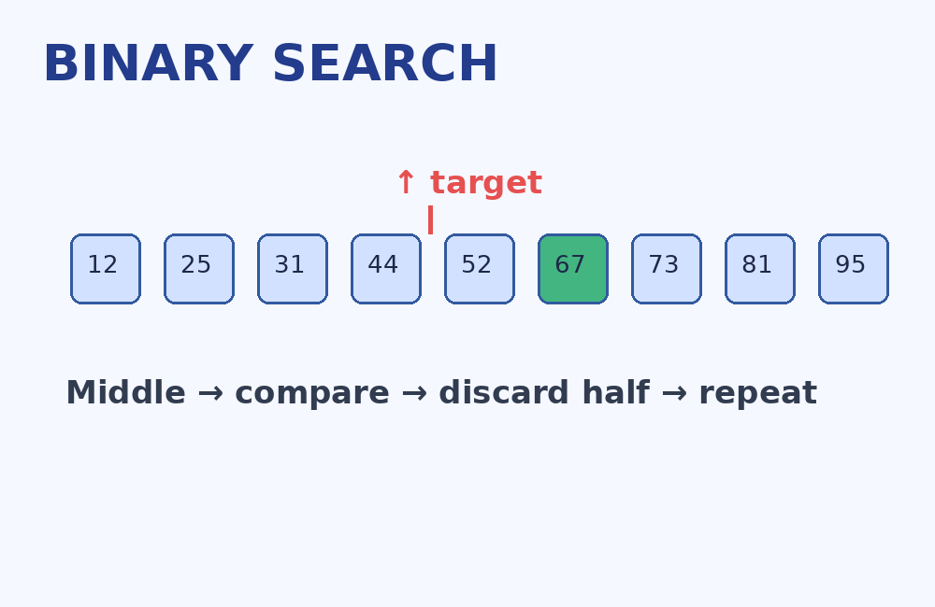
6. Demo & Impact
What the prototype produces for a user
Sample Output
Performance
Practical Benefits
Ranked student table with total, percentage and rank.
Search steps / comparisons can be displayed to explain efficiency.
Faster analysis • clearer insights • easier academic decision-making.
6

Slide 7
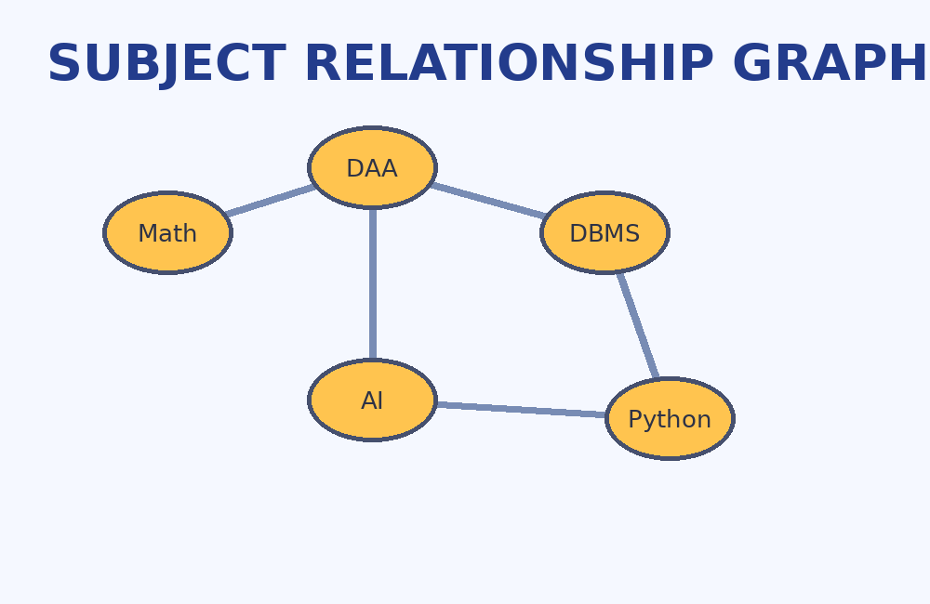
7. Future Vision
From a hackathon prototype to a scalable academic analytics platform
Current Achievement
Future Improvements
Scalability
Working concept combining student records, ranking, Binary Search, range queries, graph relationships and visual analytics.
AI-based performance insights
Personalized recommendations
Advanced dashboards
Role-based access
Cloud database integration
Large student datasets
Multiple institutions
Mobile-friendly interface
Final Takeaway
Student Result Analyzer demonstrates how DAA algorithms can solve a familiar real-world education problem in an explainable way.
THANK YOU
7

