Slide 1


ONLINE VOTING SYSTEM
Guided By :
Project By : U SRAVAN KUMAR

Slide 2
0NLINE SYSTEM
An online system is a software platform that allows groups to security conduct votes and elections high quality online voting systems balance ballot, accessibility
And the overall requirements of an organization’s voting event

Slide 3
Selenium
Electronic voting promises lots of benfits to the electoral systems to include
Timely delivery of elections minimize cost for running elections
Eliminate double multiple votes cast by an electorate reduce risks and violence associated
It is notable that electronic voting pave ways to so many security

Slide 4
Introduction
Online voting systems protect the integrity of your vote by preventing voters from being able to multiple times
They eliminate the need to gather in person cast votes using paper or by any other means email,insecure survey software
Voting system or electronic voting. These all make refrence to the same thing a secure voting.
Keep reading for access to the most comprehensive online voting system introduction you will find

Slide 5
Objectives Of The Study
Electronic voting has the potential to break down the geographic of traditional election system.
The election system is no longer by necessity confined to the local polling station
Thus increasing yhe potential number of attackers amd attack vectors dramatically
The election process is ana attractive target for malicious actions

Slide 6
Software Requirements
MOBILITY
CONVENIENCE
USER-INTERFACE
TRANSPARANCY
FLEXIBILITY

Slide 7
Design Methodology
In this day and age of developing cutting edge innvotations the traditional voting technique can be changed
The shortcomings of traditional approach the point of tis research work is to exhibit an electronic voting system
Oriented methodology for the development of the application

Slide 8
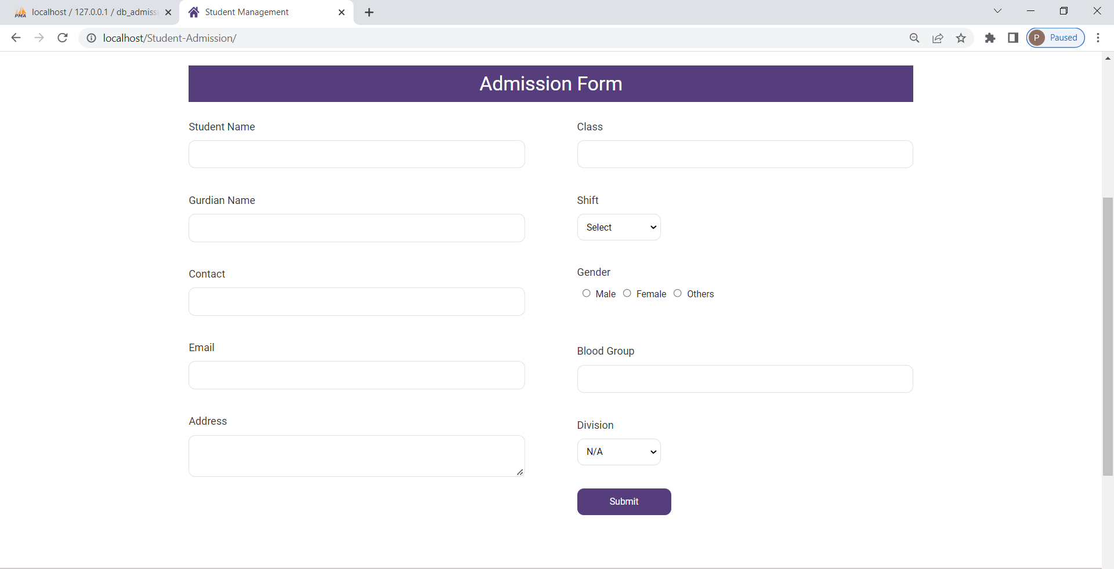
Admission Form

Slide 9
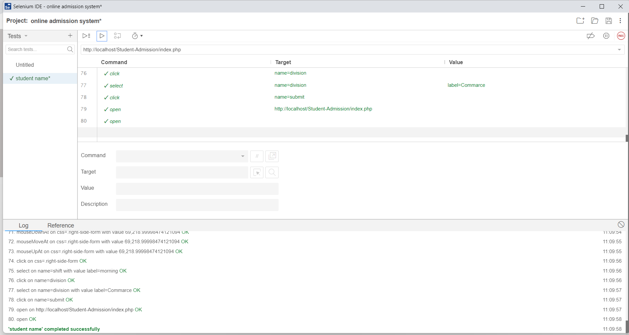
Testing the online admission form using Selenium IDE.

Slide 10
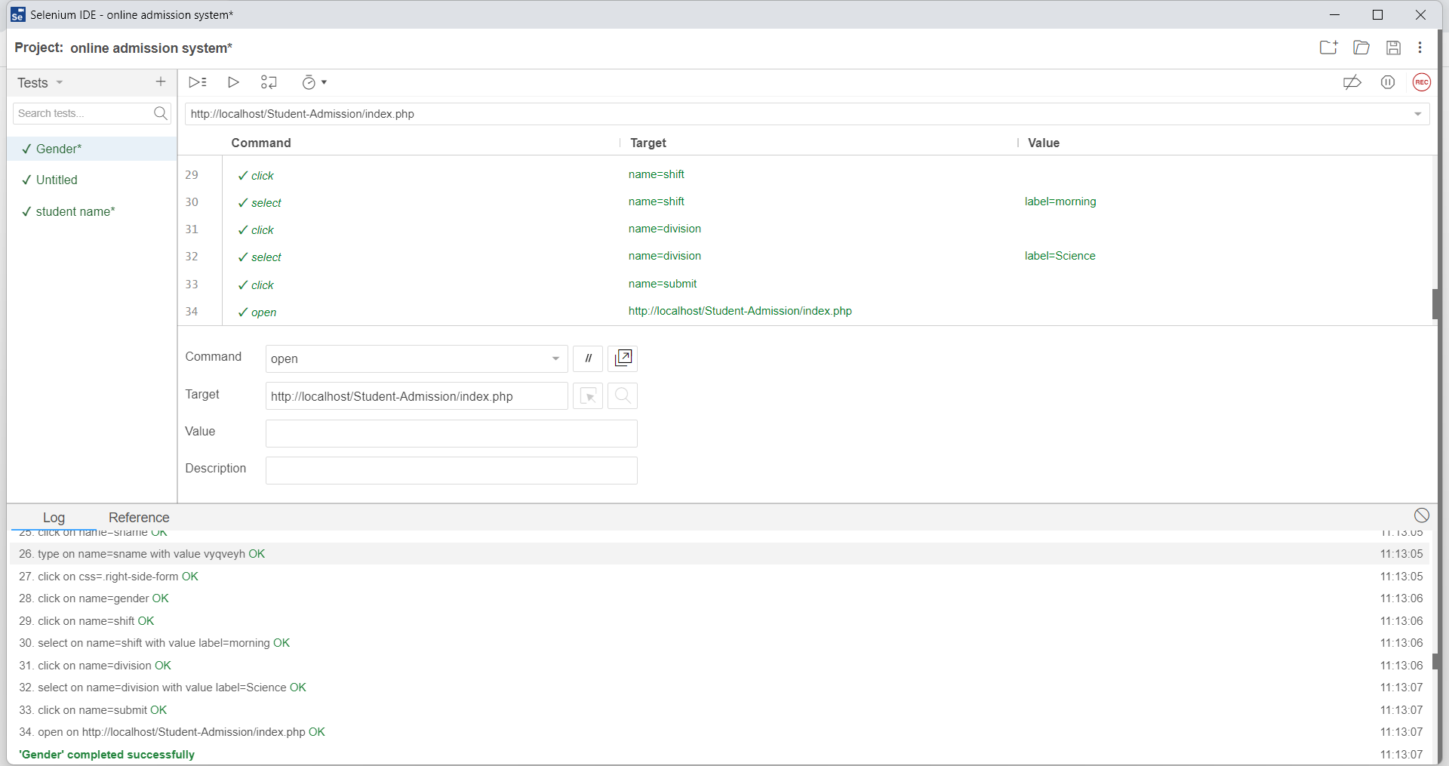
Testing the online votingform using Selenium IDE.

Slide 11
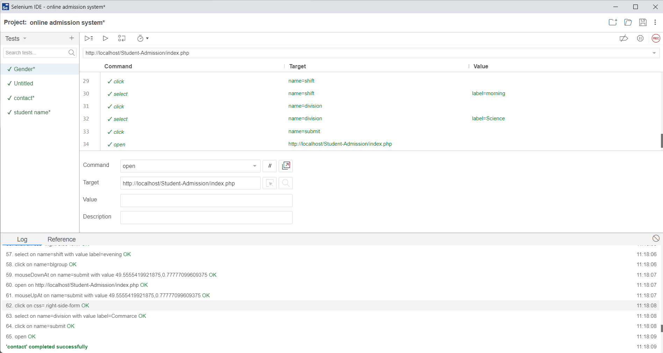
Testing the online voting form using Selenium IDE.

Slide 12
Future Scope
The challenge of developing electronic voting systems is not only security but also protecting the secrency of the ballot
Online voting presents numerous vulnerabilities and is fundamentally insecure
Online voting does not produce a paper trail for auditing

Slide 13
CONCLUSION
From the design amd implementation of the voting system based on the Ethereum block chain conclisions can be drawn
System can be store the data safely and reliably
Because the voting process is done in real time
The increasing of digital technology today has helped many people in its implementation

Slide 14
THANK YOU

