Slide 1
Java System RFID Software
Presenting By Vanishree Koshti

Slide 2
RFID : Radio Frequency Identification.
What is RFID
Application of RFID
What is inside in RFID
How RFID works ? (Operating Principle)

Slide 3
What is RFID
RFID technology working on a radio waves .
This technology used to identify automatically things or track things.
Here ‘Things’ can be any thing ex : book, items in a shopping mole or items in a warehouse etc.
RFID is not only to use identify things . But this technology used to track the animals also

Slide 4
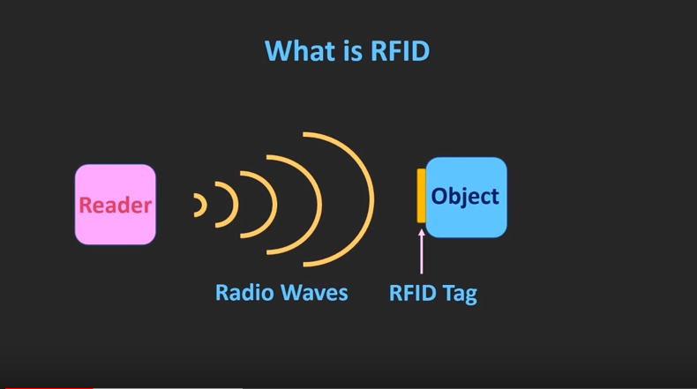

Slide 5
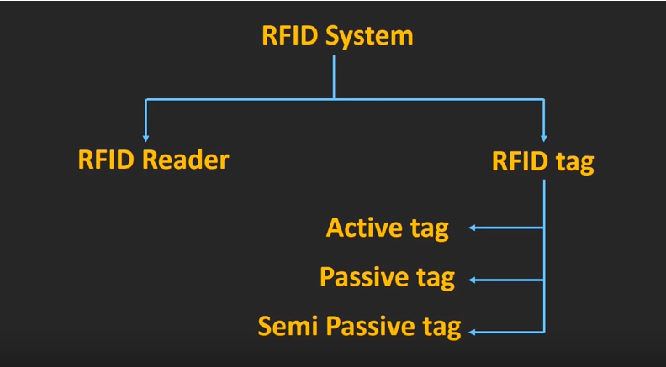
What is inside the RFID contains

Slide 6
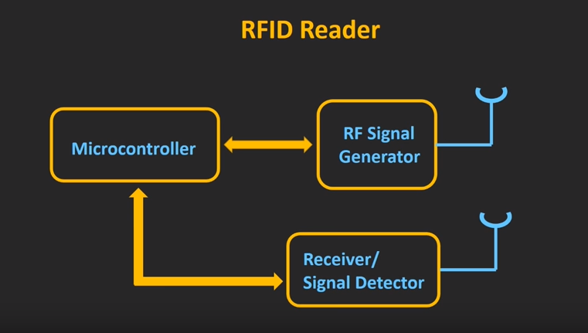

Slide 7
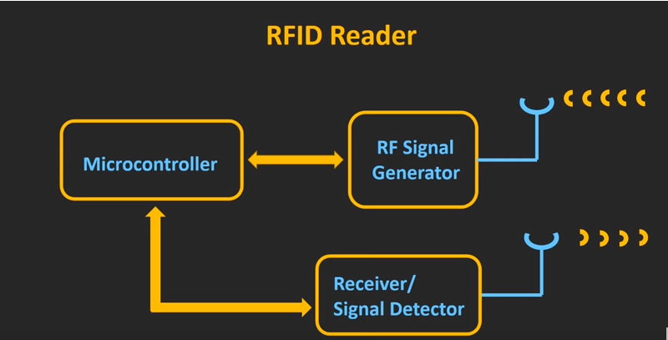

Slide 8
3 types of RFID Reader
A)Microcontroller: Processing singles from tags and it connect to computers.
B)RF Signal Generator: sends signal from antenna
C)Receiver/Signal Detector : receives singles from receiving antenna.

Slide 9
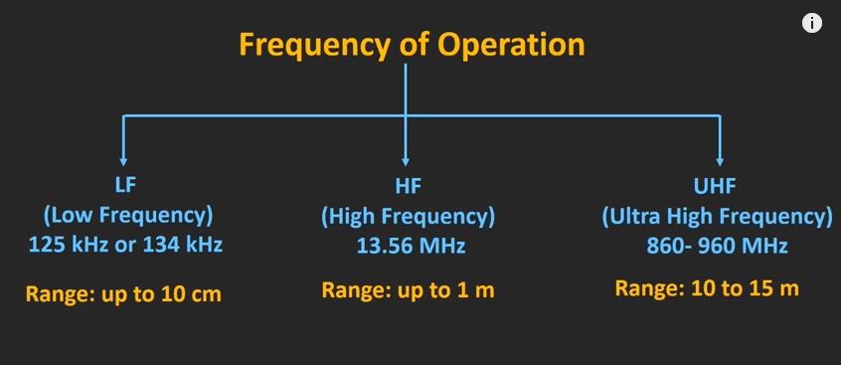
Working principle in RFID

Slide 10
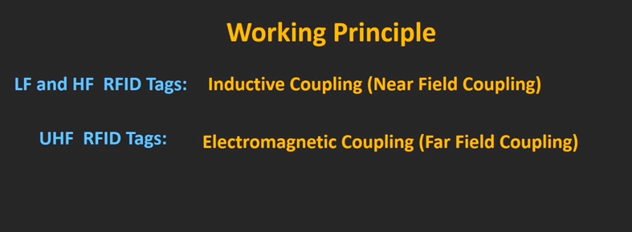
RFID works on above frequency ranges

Slide 11
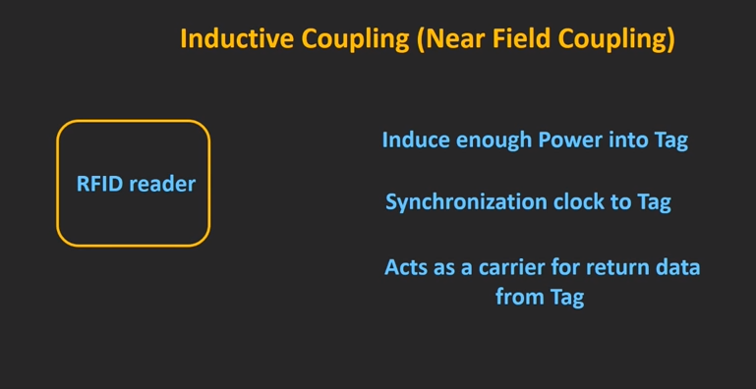

Slide 12
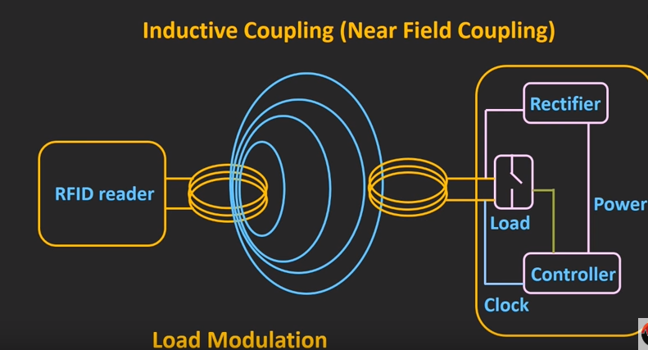

Slide 13
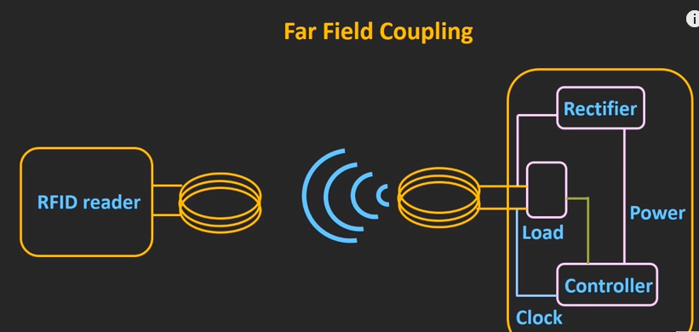

Slide 14
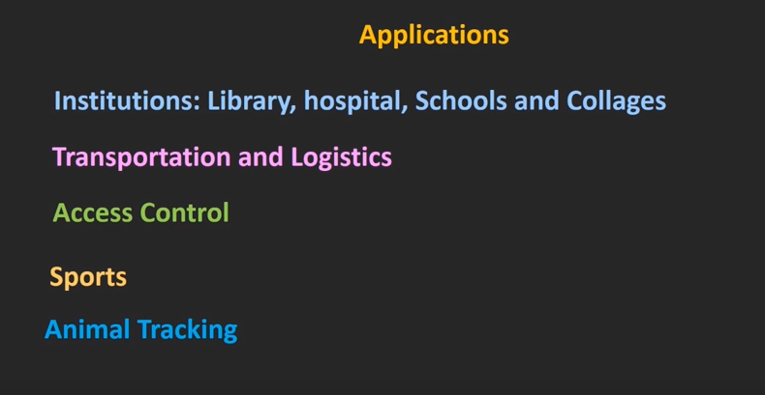

Slide 15
Storing Telemetry Data
In principle there is no restriction on the database technology used for storing remotely collected data
To scale up to thousands of devices (or more) and very large volumes of data, a distributed NoSQL database (such as Cassandra) would be appropriate together with distributed equivalents of the other components.

Slide 16
Security
Its necessary to secure sensitive data transmitted over the internet, and they are
transport security - With transport security (such as SSL) data is encrypted only during transit.
Message security - message security ensures that only the intended recipient can read the message,
Hashing - whereas hashing is used so the recipient can be sure that data has been sent by a trusted source.

Slide 17
IoT gateway architecture Clustering ensures reliability
IoT gateway clustering makes sense for large-scale implementations where uptime and scalability are critical
cluster by defining the geographic correlation of gateways, which are units placed near one another and connected remotely to the same set of sensor devices, enabling a backup for the neighboring gateway
During a failure, IoT gateways can transfer their applications and device connections to one another and at the time of a threshold limit
For example, if a gateway is connected to a ZigBee device, it cannot transfer applications to another gateway beyond a predefined distance. In this case, a geo-correlated gateway can help build redundancy into the system by shadowing the functionalities of the neighbor gateway. Hence it is important that the IoT gateway architecture and device layout are geographically correlated to achieve uninterrupted connectivity.

Slide 18
Horizontal scaling in a gateway cluster
Horizontal scaling is the ability of an IoT framework to add more gateways to an existing mesh network. To enable that, gateways need to be connected to each other through a common communication bus. (At eInfochips, we call this a "communication interface bus," which is a combination of OT buses.) With OT bus connectivity, any new gateway can be added without modification to the existing network of devices.
Vertical scaling in a gateway cluster
Any functional capability increment with memory, device software, OS, hardware, device configuration and APIs constitutes vertical scaling. Microservice application based architecture for gateways allow vertical scaling options. This enables you to add as many devices, resources and microservices to the gateway as your requirements change.

Slide 19
Note:- gateway clustering should be a consideration for large-scale IoT implementations where uptime and scalability are critical
http://www.ioti.com/infrastructure/iot-gateway-architecture-clustering-ensures-reliability

Slide 21
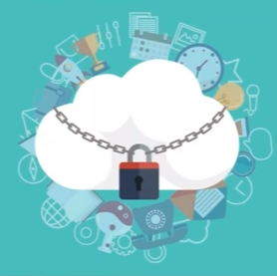
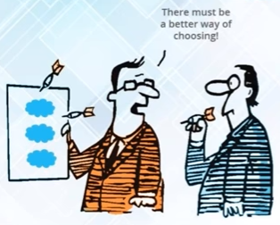
Security and Identity for AWS IoT

Slide 22
Each connected device must have a credential to access the message broker or the Device Shadow service.
All traffic to and from AWS IoT must be encrypted over Transport Layer Security (TLS). Device credentials must be kept safe in order to send data securely to the message broker.
AWS Cloud security mechanisms protect data as it moves between AWS IoT and other devices or AWS services.

Slide 23
You are responsible for managing device credentials (X.509 certificates, AWS credentials) on your devices and policies in AWS IoT. You are responsible for assigning unique identities to each device and managing the permissions for a device or group of devices.

Slide 24
Devices connect using your choice of identity (X.509 certificates, IAM users and groups, Amazon Cognito identities, or custom authentication tokens) over a secure connection according to the AWS IoT connection model.

Slide 25
When using AWS IoT authentication, the message broker authenticates and authorizes all actions in your account. The message broker is responsible for authenticating your devices, securely ingesting device data, and adhering to the access permissions you place on devices using policies.

Slide 26
When using custom authentication, a custom authorizer is responsible for authenticating your devices and providing an AWS IoT/IAM policy to authorize actions in your account.

Slide 27
The AWS IoT rules engine forwards device data to other devices and other AWS services according to rules you define. It uses AWS access management systems to securely transfer data to its final destination

Slide 28
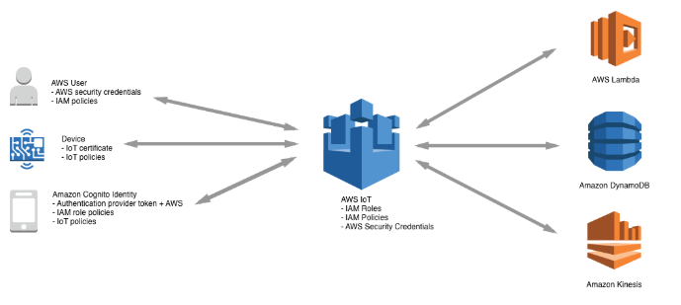

Slide 29


Extensibility
Opensource

Slide 30
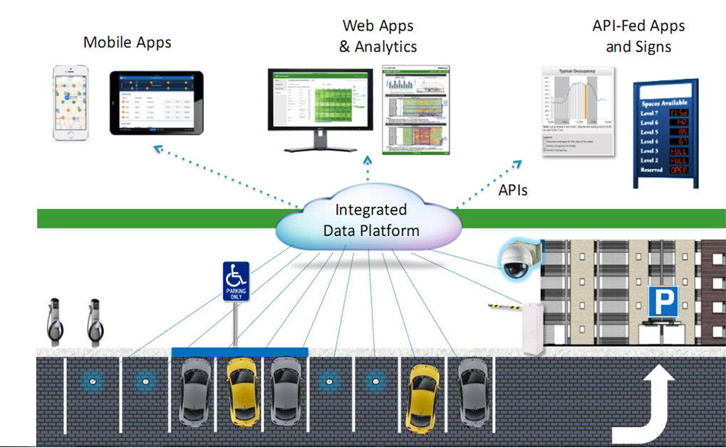

Slide 31
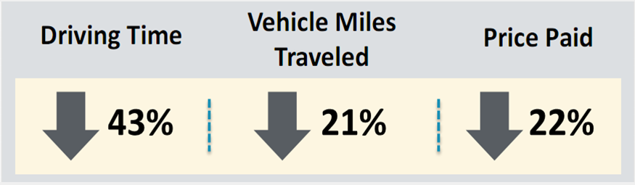

Slide 32
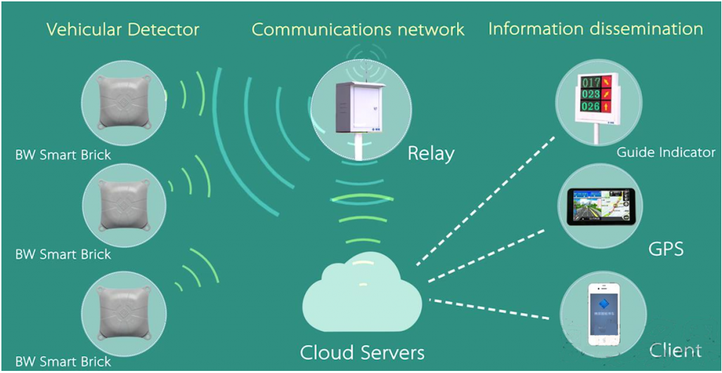

Slide 33
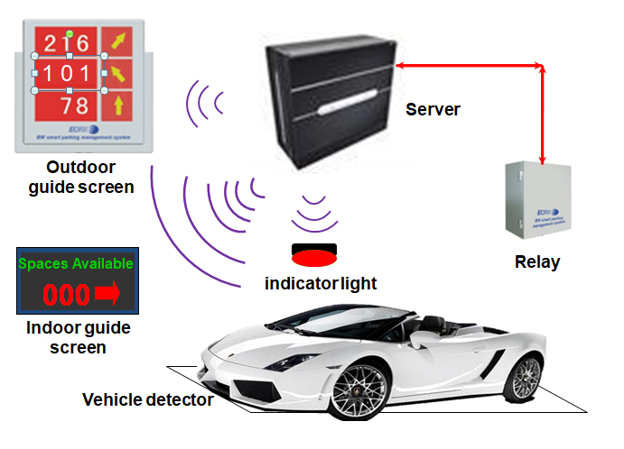

Slide 34
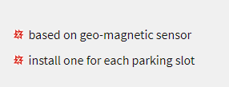
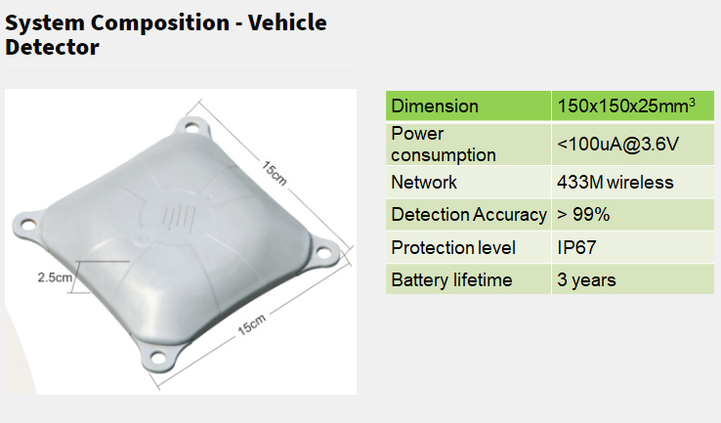

Slide 35

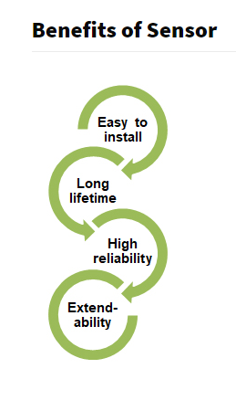
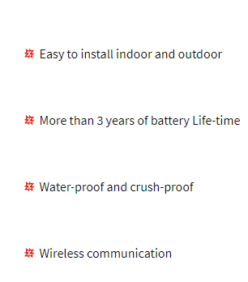

Slide 36

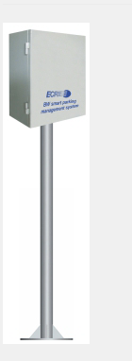
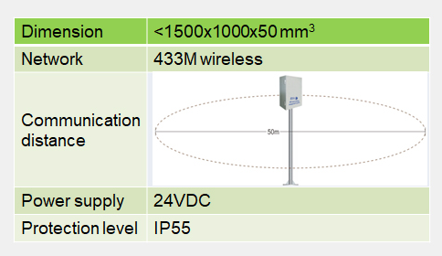


Slide 37
The EPCglobal Network is a set of technologies that enable immediate, automatic identification and sharing of information for items in the supply chain. RFID technology involves placing RFID tags on objects, reading the tags, ideally without human intervention, and then passing the information to a dedicated IT infrastructure. With such an infrastructure to automatically identify objects, computers can track, monitor, and trigger relevant events.
The RFID Software consists of two RFID software modules,
an event manager and an information server

Slide 38
--> https://aws.amazon.com/blogs/big-data/build-a-visualization-and-monitoring-dashboard-for-iot-data-with-amazon-kinesis-analytics-and-amazon-quicksight/ --> --> https://docs.oracle.com/cd/E19486-01/819-4684/RFID-intro.html --> -- https://create.arduino.cc/projecthub/KaustubhAgarwal/smart-parking-bdfa99 -- -- http://www.cohesivecomputing.co.uk/code-storm/arduino-iot-remote-data-visualization/ -- -- https://everydaylifein.net/tag/arduino - --- http://www.ioti.com/infrastructure/iot-gateway-architecture-clustering-ensures-reliability -- -- https://www.mips.com/blog/security-in-iot-devices/ -- -- https://www.fingent.com/blog/role-of-data-analytics-in-internet-of-things-iot -- -- https://www.xenonstack.com/blog/big-data-engineering/ingestion-processing-big-data-iot-stream/ -- -- https://www.zunchlabs.com/iot-systems/smart-parking-system/ --
20 mins
1 new message

Slide 39
http://iot-datamodels.blogspot.com/2013/10/
http://techblog.calvinboey.com/basic-mqtt-protocol-walk-through/
http://axelta.com/Home_Automation_MQTT.php

Slide 40
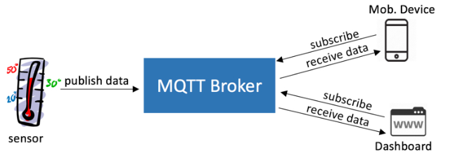

Slide 41
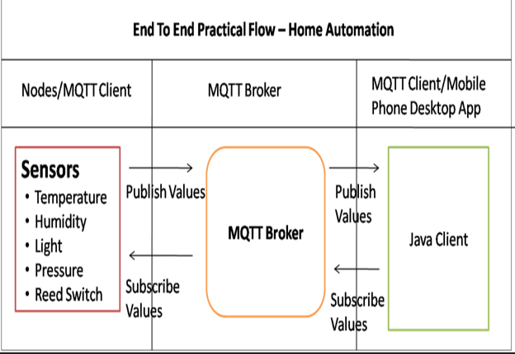

Slide 42
