Slide 1

node2vec: Scalable Feature Learning for Networks

Slide 2
What is node2vec
In simple terms, node2vec is an embedding algorithm that transforms graphs (or networks) into numerical representations.
This algorithm was introduced by Aditya Grover and Jure Leskovec in 2016 and it is regarded as one of the most effective graph classifiers.

Slide 3
Graph
Graph is a non-linear data structure which consists of nodes(also known as vertices) and edges(also known as links).
G = {V,E}
V- Vertices
E – Edges
Edge is a link which connects two vertices.
There are many different types of graphs, but I'll only cover the most important ones: directed, undirected, and weighted graphs.

Slide 4
Directed Graph
Edges in directed graphs have a direction. The edges represent a one-way relationship, as each edge can only be traversed in one direction.
Undirected Graph
Edges in undirected graphs do not have a direction. Each edge can be traversed in both directions, indicating a two-way relationship.
Weighted Graph
The graph in which have each edge is assigned a number is called weighted graph. These weights can represent distance between edges, costs or capacities.

Slide 5
Graph Embedding
Graph embeddings are the conversion of property graphs to a vector or set of vectors.
In this case, we represent the entire graph with a single vector. These embeddings are used when we want to make predictions at the graph level and when we want to compare or visualize entire graphs.

Slide 6
Why to use Graph Embedding
The application of machine learning to graphs is limited.
Embeddings are compressed representations of information.
Vector operations are simpler and faster than graph operations.
Challenges
Ensuring that the embeddings accurately describe the properties of the graphs.
Predict the most probable labels of nodes in a network or predict what class the node belongs to based on the node properties/features.(Node Classification)
Predict whether a pair of nodes in a network should have an edge/link connecting them.(Link Prediction)

Slide 7
Principles of node2vec
Learn representations that embed nodes from the same network community closely together(homophily).
Learn representations where nodes that share similar roles have similar embeddings(structural equivalence).
The significant element is to define flexible concept of node’s neighborhood developing a family of biased random walks that efficiently explore diverse neighborhoods of a given node.
Next, we will examine neighborhood sampling strategy which is a key to node2vec.

Slide 8
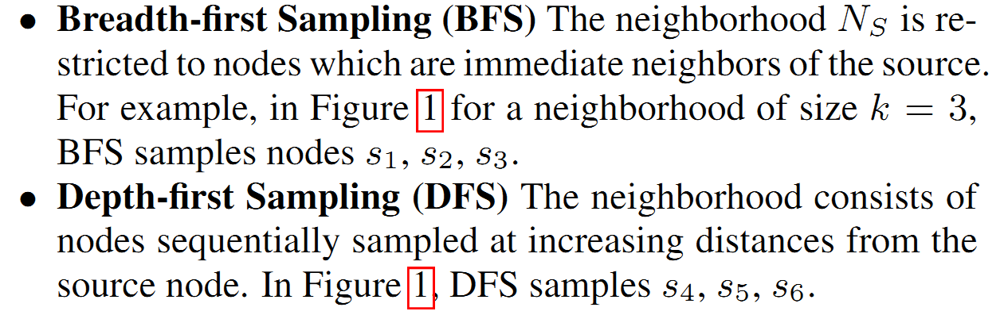
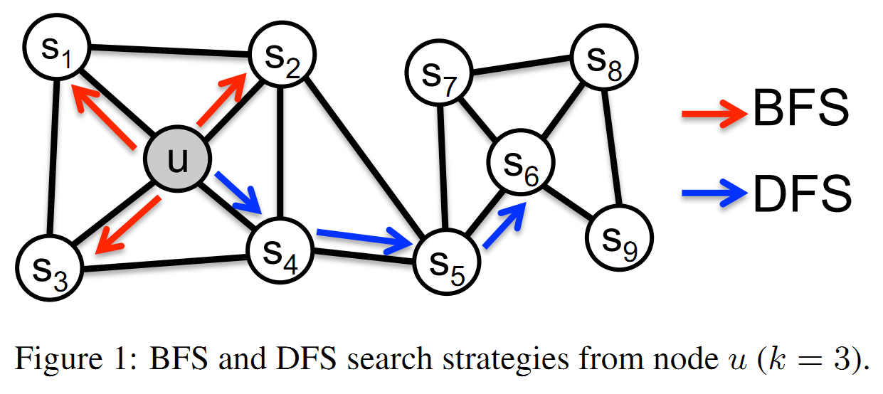
Neighborhood sampling strategy
Classic Approach:

Slide 9
Neighborhood sampling strategy
BFS:
inferring communities based on homophily
low variance in characterizing the distribution of 1-hop nodes with respect the source node
a very small portion of the graph explored
DFS:
leading to embeddings that correspond closely to structural equivalence
high variance due to the constrain on the sample size and large neighborhood
less representative when a sampled node is far from the source

Slide 10
Neighborhood sampling strategy
node2vec: a combination of DFS and BFS
a mixture of structural equivalence and homophily
Node2vec achieves the above by using 2nd order biased random walk.
What is Random Walk
A random walk on a graph can be imagined as a walker traversing the graph along its edges. The walker must decide where to go next and then move to the next state at each step. This is known as 1-hop transition.
There are 2 types of random walks: First order and second order.
First order random walk:
In first order random walk, the 1-hop transitions depends only on the current state with weights on each edge. It doesn’t take the previous state into account.

Slide 11
Second order random walk:
In second order, the 1-hop transitions also incorporates information of the previous state along with the current state.
node2vec applies a bias factor alpha(α), which is used to reweight the edge weights based on the previous state. So, this is called second order biased random walk.
If two nodes are not connected, then α = 1/q (q = in-out parameter)
If q is small, then it’s restricted to local neighborhood(homophily) and if q is large, structural equivalence is achieved.
If two nodes are identical, then α = 1/p (p = return parameter).
If two nodes are connected but not similar, then α = 1

Slide 12
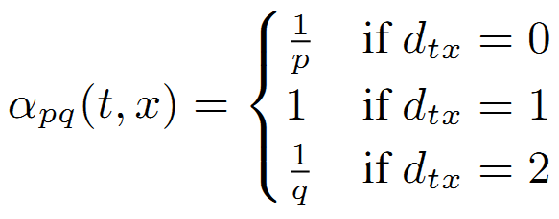
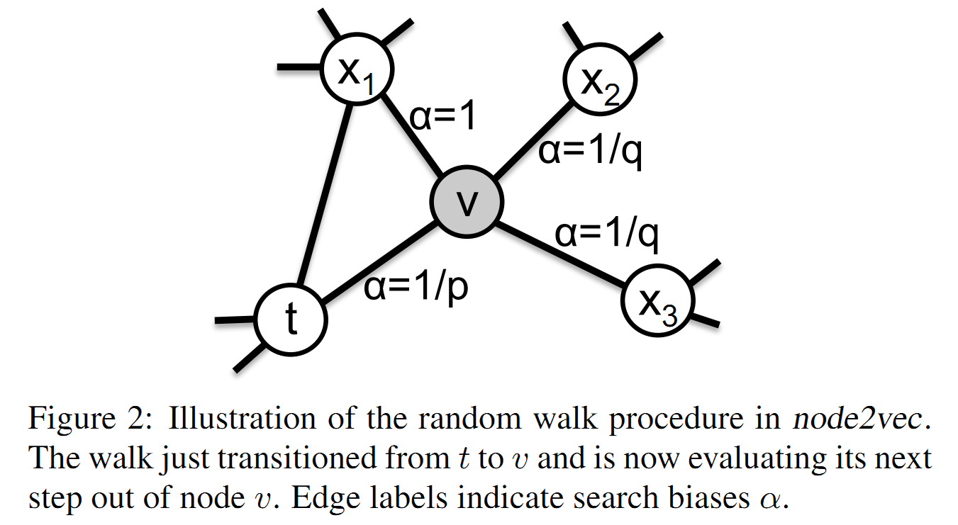

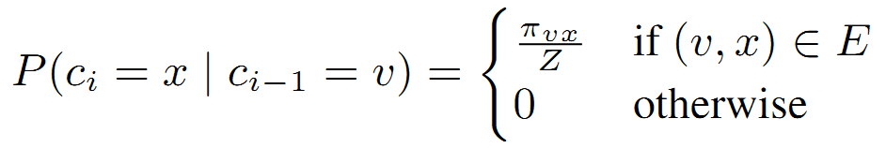
Neighborhood sampling strategy
Now bias(α) is multiplied with weights w for second order biased random walk

Slide 13

Neighborhood sampling strategy
Consider above graph with nodes u,v,t,x₁,x₂,x₃ and previous, current states as t and v respectively.
To find the probability of occurrence of choosing a node u as next state
P = (Favorable outcome weight) / (Total weights)

Slide 14
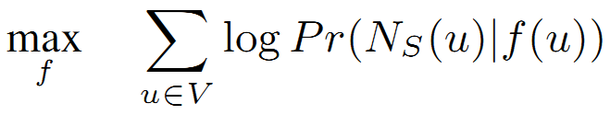
Feature learning
In the feature learning of a graph G ={V,E}, we wish to find a function f : V => R^{d},
where V is a vertex and represents it in a desired number of dimensions(d).
Then skip-gram(an approach used in word2vec) is used in node2vec to generate corpus.
The objective function(f) of feature learning is to optimize the log-probability of network neighborhood N_{s}(u).

Slide 15
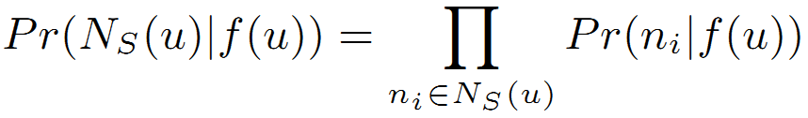
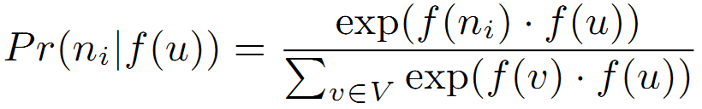
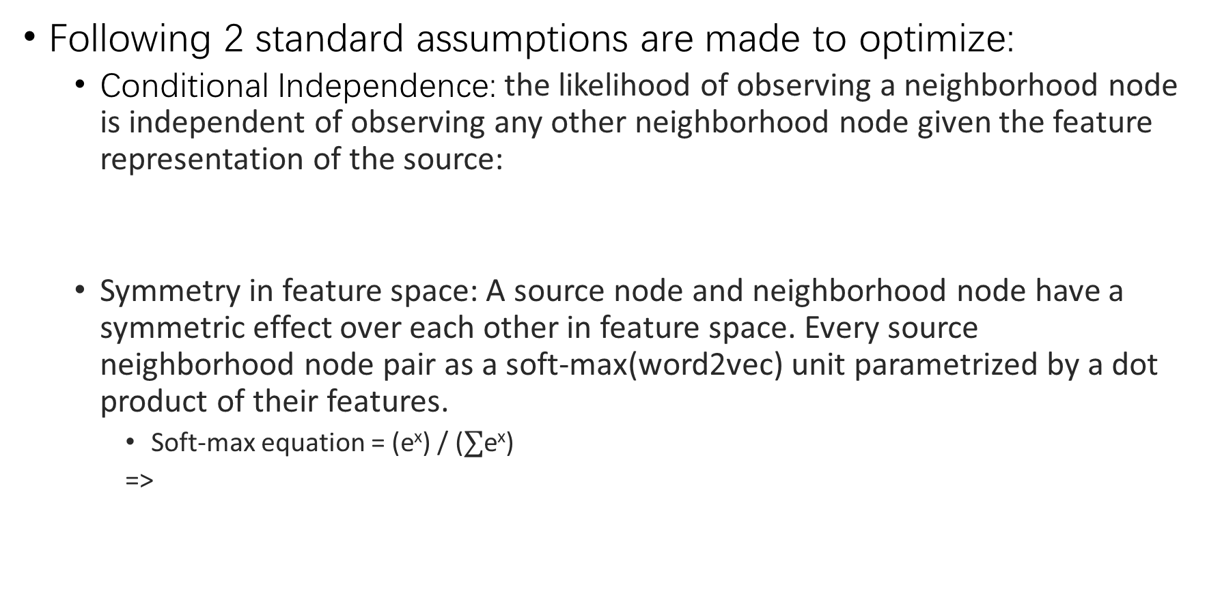
Feature Learning
Following 2 standard assumptions are made to optimize:
Conditional Independence: the likelihood of observing a neighborhood node is independent of observing any other neighborhood node given the feature representation of the source:
Symmetry in feature space: A source node and neighborhood node have a symmetric effect over each other in feature space. Every source neighborhood node pair as a soft-max(word2vec) unit parametrized by a dot product of their features.
Soft-max equation = (e^{x}) / ($∑$e^{x})
=>

Slide 16
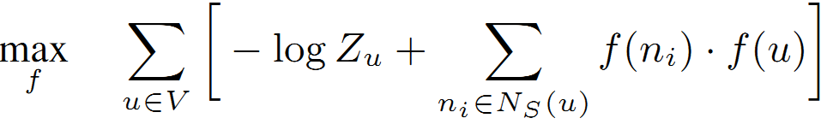

Feature learning
Plugging soft-max eq in equation 1, we get
Since log(a/b) = log(a) – log(b)
is approximated by negative sampling

Slide 17
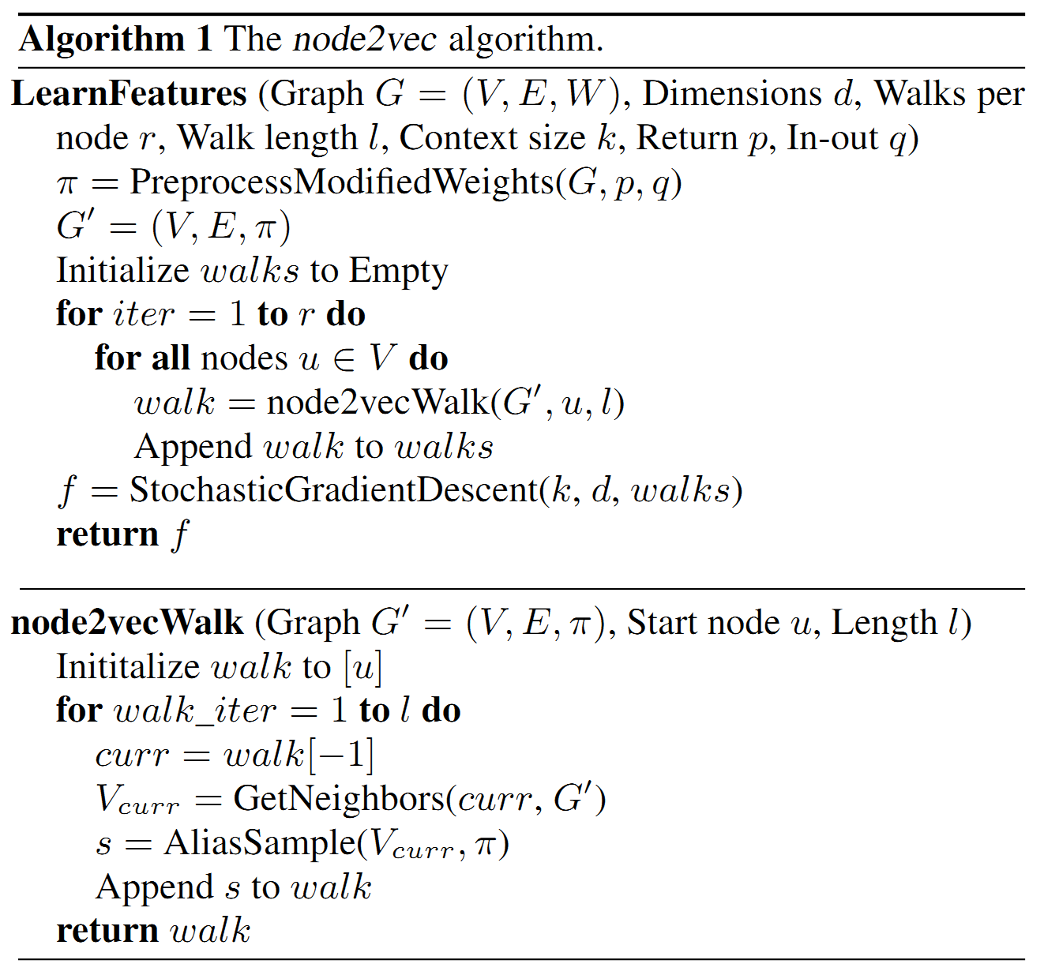
Pseudocode of node2vec

Slide 18
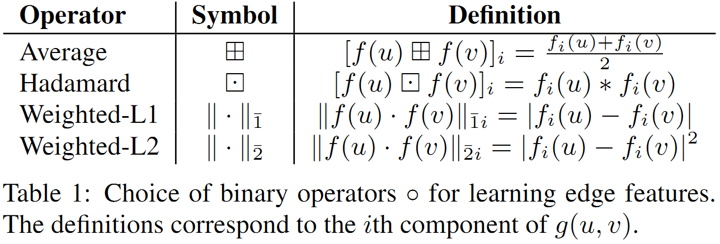
Link prediction & Node classification
After fetching the graph embeddings, node2vec uses binary classifier to predict a link between two nodes in a graph.
Deﬁning a binary operator ○ over the corresponding feature vectors.
Then it trains the model to which node it belongs to using node classification.

Slide 19
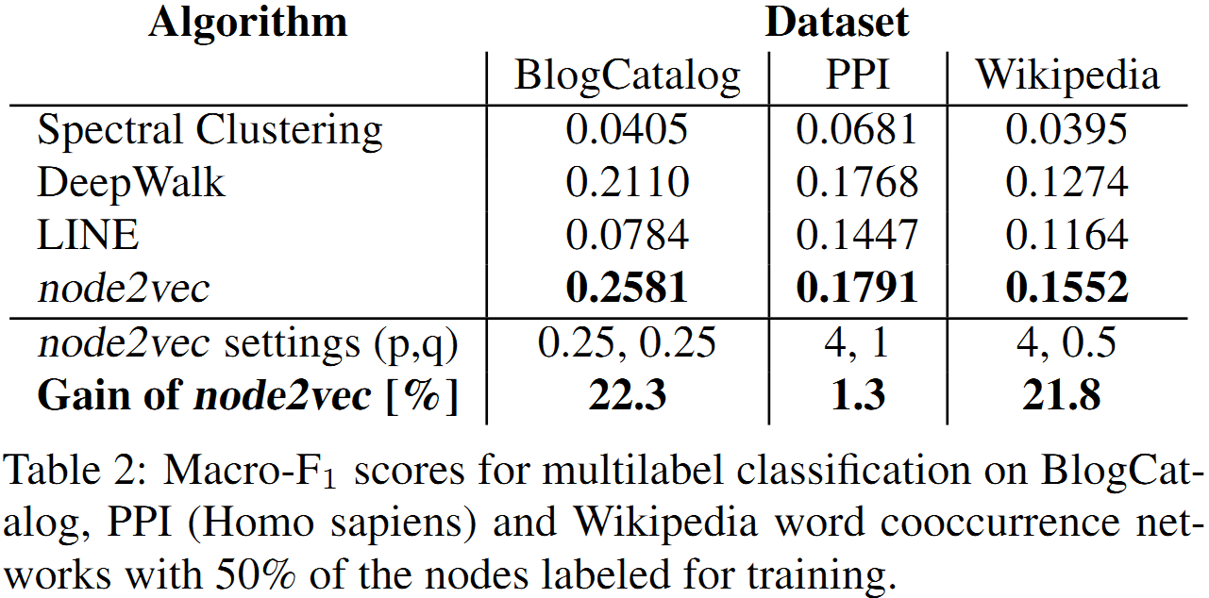
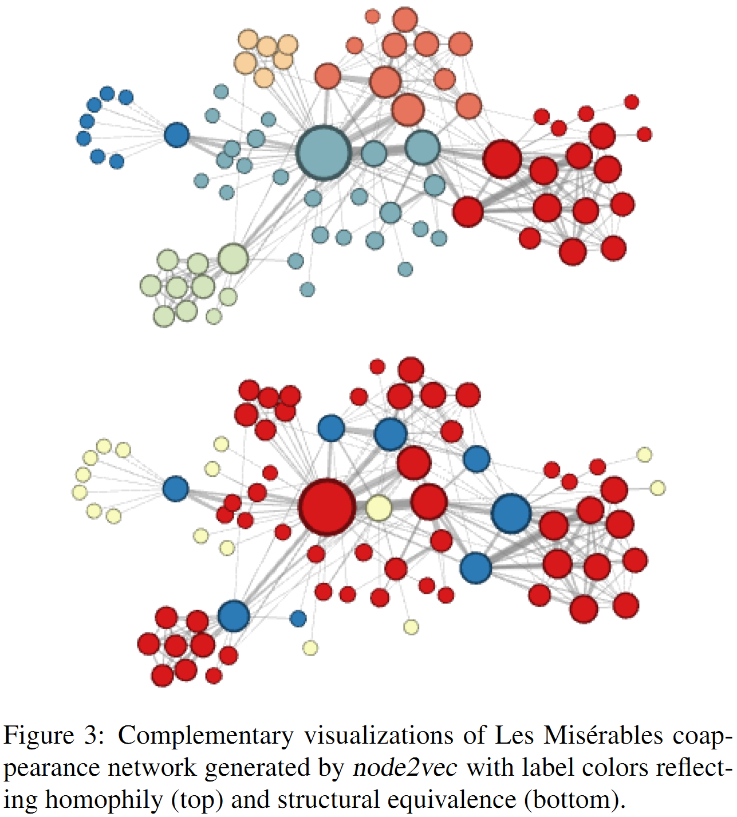
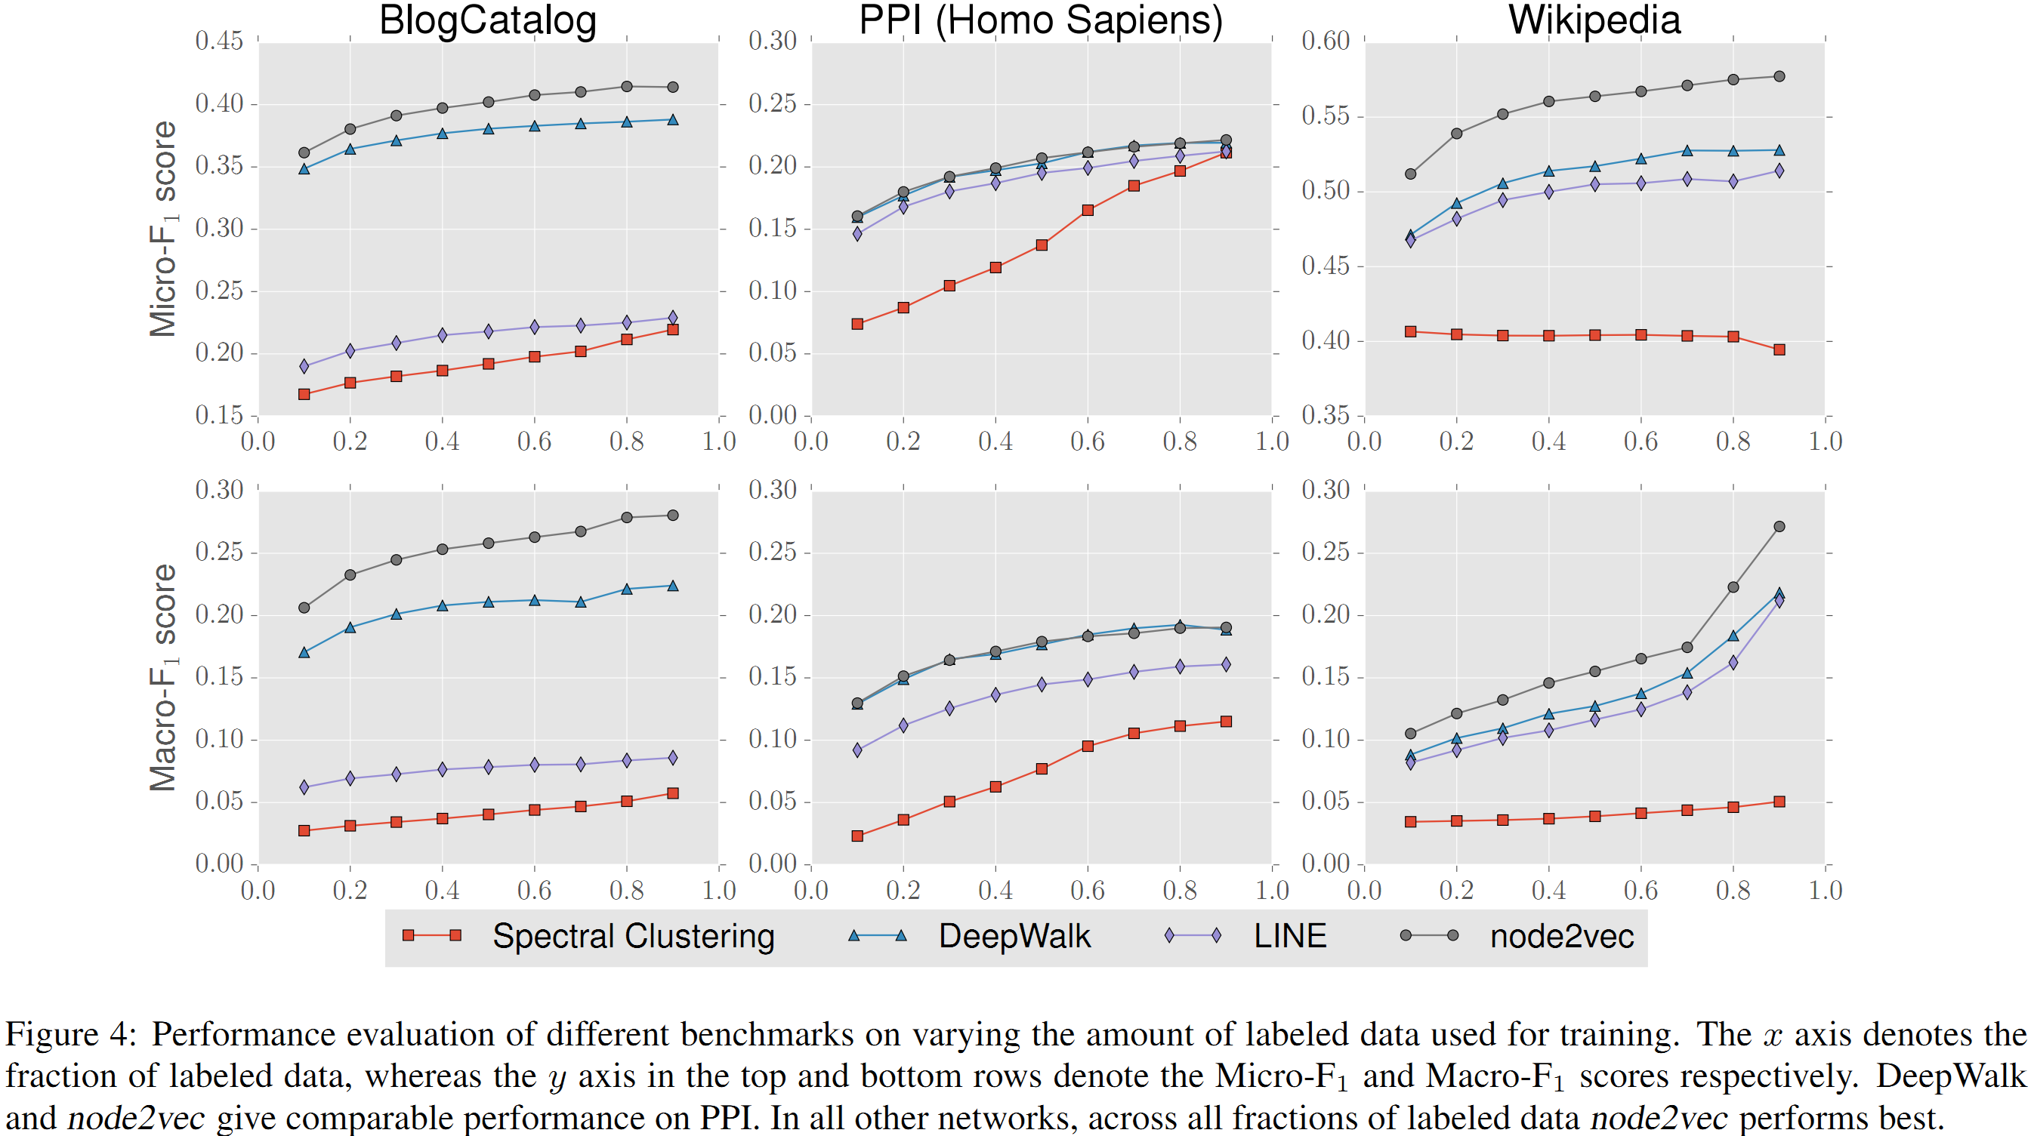
Experiment: node classification
Top: p = 1, q = 0.5
Bottom: p = 1, q = 2
Notes:
Spectral clustering [29]: This is a matrix factorization approach in which we take the top d eigenvectors of the normalized Laplacian matrix of graph G as the feature vector representations for nodes.
DeepWalk [24]: This approach learns d-dimensional feature representations by simulating uniform random walks. The sampling strategy in DeepWalk can be seen as a special case of node2vec with p = 1 and q = 1 .
LINE [28]: This approach learns d-dimensional feature representations in two separate phases. In the ﬁrst phase, it learns d=2 dimensions by BFS-style simulations over immediate neighbors of nodes. In the second phase, it learns the next d=2 dimensions by sampling nodes strictly at a 2-hop distance from the source nodes.

Slide 20
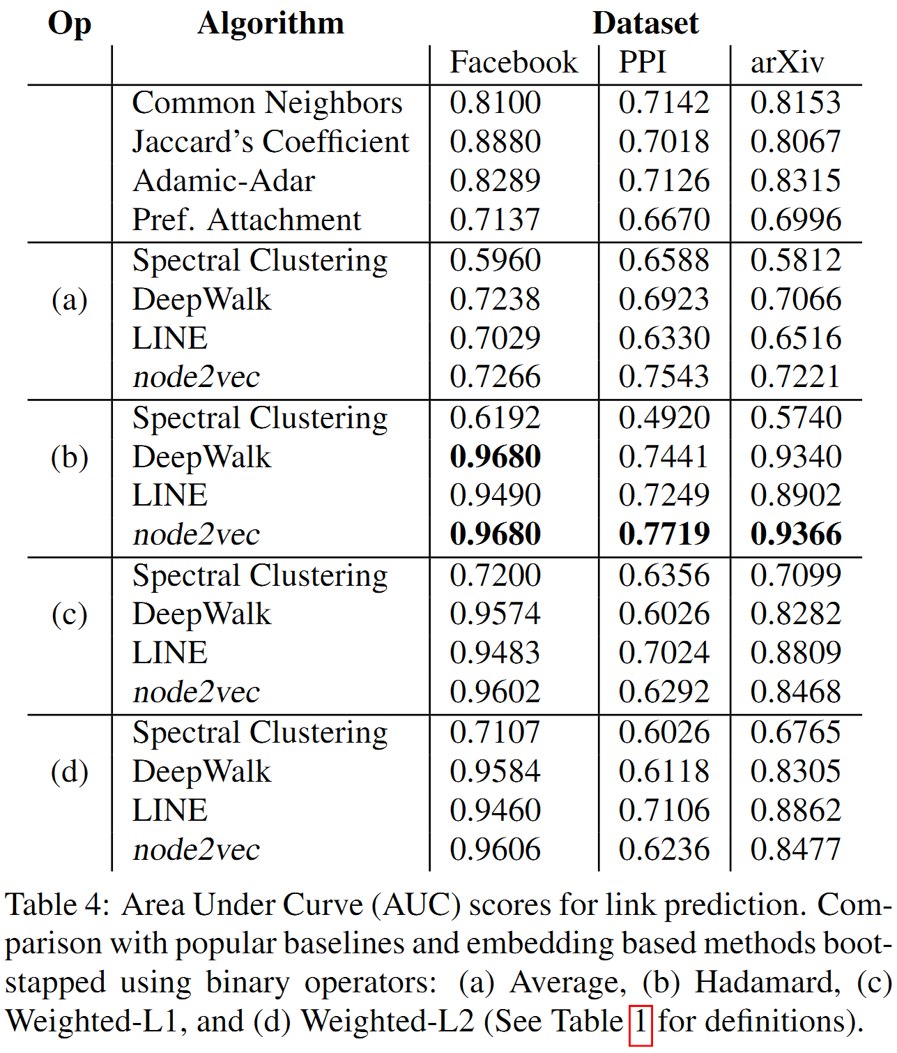
Experiment: link prediction

Slide 21
Diff between word2vec and node2vec
Even though node2vec uses skip gram model from word2vec, there’s once significant difference as follows.
In word2vec, each walk in the graph is composed only of named entities that appear together in a single item. This means that we are limited to walks that are no more than one distance from the starting node.
But in node2vec we don’t have the distance constraint of walk.

Slide 22
node2vec Applications:
node2vec is used in computational biology, often used for complex gene classifications.
It is used for sentiment analysis, recommender system subjective to persons interests.
It is used in social media networks where each person is a graph.
It is used in real networking systems.

Slide 23
Constraints
Despite the high performance of node2vec embeddings, the original implementations are not scalable due to memory constraints. As previously demonstrated, node2vec devises a 2nd order transition random walk that is dependent on both the current and previous states. As a result, the total number of transition probabilities scales quadratically with respect to the number of graph edges. For example, embedding a reasonably sparse network with 17k nodes and 3.6M edges required more than 100GB of memory. This memory issue is effectively addressed by a new implementation known as PecanPy, which requires less than 1GB of memory to embed the same network.

