Slide 1
Comparative Analysis of Optimizers to Improve the Model of Image Classification
Presented by
Shivani Challagulla
Sravan Sai Rahul Nalla

Slide 2
Abstract
Image classification is one of the prominent tasks in Computer Vision and it has numerous applications.
By taking its importance into account in various applications, it is crucial to achieve high accuracy while training image classification models.
Hyperparameters plays a crucial role in achieving high accuracy during training, and optimizers is one such hyperparameter that contributes to the better performance of the model.
Our project mainly focus on the choice of optimizers during training depending on the dataset and the architecture.
Our project provides insights on the impact of various optimizers on model performance and to assist in selecting the most effective algorithm for a particular model architecture and dataset.

Slide 3
Introduction
Image classification is defined as the process of categorizing an image into one or more classes based on its characteristics.
Image classification has wide range of applications such as Medical Imaging, Surveillance, Autonomous vehicles. Some of them can also have life-saving or life-threatening consequences.
To ensure high accuracy in the image classification models, it is crucial to choose right hyperparameters. One of such hyperparameters is Optimizer.
Optimizers are algorithms used to update the parameters of a model during training to minimize the loss function and improve its performance. They adjust the learning rate and update rules to converge to the global minimum of the cost function.

Slide 4
Introduction (cont.)
Optimizers are a subset of numerical analysis, as they utilize numerical techniques to iteratively search for the optimal solution.
In our project, we perform comparative analysis of various optimizers, including stochastic gradient descent (SGD), Adam, Adagrad, and RMSProp, to determine which optimizer is the best choice for image classification tasks.

Slide 5
Datasets
MNIST dataset
- 9 categories: handwritten digits from 0 to 9
- 70,000 grayscale images
Flowers dataset
- 5 categories: chamomile, tulip, rose, sunflower, and dandelion.
- 4,242 images
Pneumonia dataset
- 3 categories: normal, bacteria, virus
- 5,856 chest x-ray images
Water bottles dataset
- 3 categories: full water level, half water level, overflowing
- 486 images

Slide 6
Architectures
VGG16
ResNet50
InceptionResNetV2
Xception

Slide 7
Optimizers
Adam
Adagrad
RMSProp
SGD

Slide 8
Results
Architecture | Adam | Adagrad | RmsProp | SGD
VGG16 | 98.95 | 98.55 | 98.44 | 96.08
ResNet50 | 94.35 | 15.06 | 24.05 | 90.54
InceptionResnetV2 | 98.35 | 98.64 | 99.45 | 99.45
Xception | 94.36 | 91.54 | 83.09 | 83.09

Slide 9
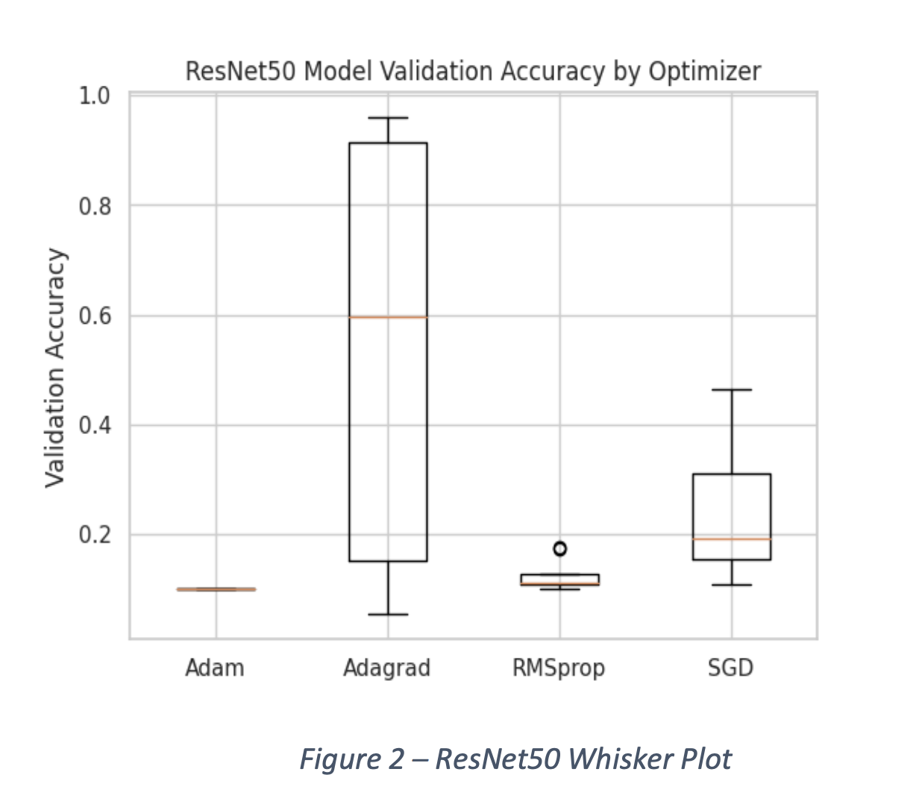
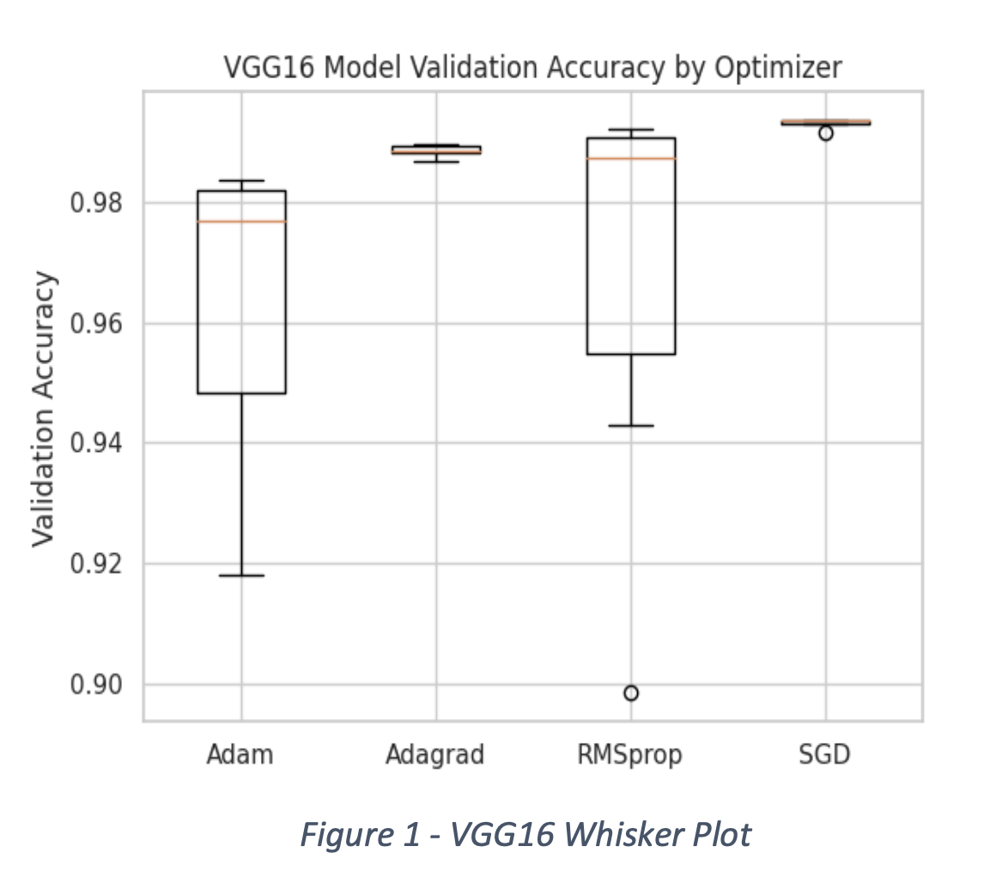
Results

Slide 10
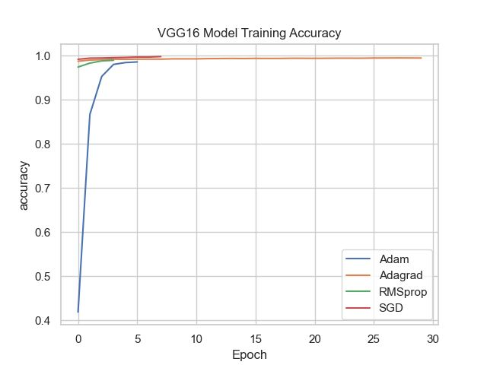
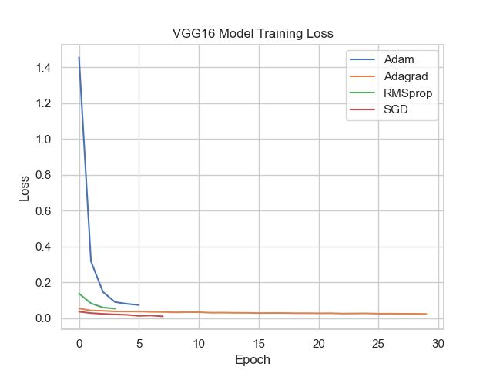
Results

Slide 11
Results (Manual-MNIST Dataset)
Architecture | Adam | Adagrad | RmsProp | SGD
VGG16 | 43.24 | 39.19 | 37.84 | 40.54
ResNet50 | 15.78 | 17.56 | 11.67 | 9.56
InceptionResnetV2 | 50.34 | 45.78 | 38.35 | 30.27
Xception | 24.55 | 27.84 | 25.54 | 29.24

Slide 12
Thank You

