Slide 1
Prediction for Bike Sharing Analysis
-Saivenkata Sravan Anne
(FQ45331)

Slide 2
Business Problem
It is critical for bike sharing firms to guarantee that enough bikes are available at stations, but not too many, so that stations do not become overcrowded.
Avoiding excess and bike shortages results in happier consumers, thus forecasting future demand is critical.

Slide 3
DATASETS USED
https://ride.capitalbikeshare.com/system-data ( This is the data from Capital bike share website)- 22544730 record , 9 columns
https://www.ncdc.noaa.gov/cdo-web/search
(Weather data) 268114
Holidays dataset during those years

Slide 4
Procedure
Merging all the 3 different dataset(Capital bike data, Weather data and Holidays dataset)
Data cleaning: 1 date feature, 19 categorical features (holiday and weather type features) and 6 numeric features (average, minimum, maximum, observed temperature, wind speed and precipitation) as well as the target variable (number of customers at t0) remained.
EDA
Pipeline & Implementation of ML models(Tree based: Random Forest, AdaBoost, XGBoost) to predict the number of customers for the next day.
Naive baseline model (last value method) has been used to compare the ML models' performances to a benchmark.

Slide 5
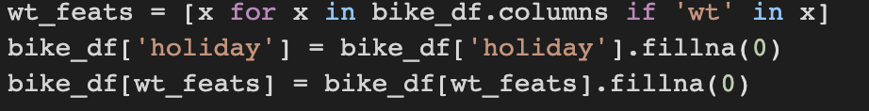
Data Cleaning
This includes dropping the columns in the dataset which are not suitable for future analysis.
In this project some of the columns which have been dropped are : 'date’( a new column has been created instead of this to change it from string format to the date format), 'temp_avg', 'registered', 'casual’,etc others are dropped after the EDA is done.

Slide 6
EDA
Exploratory data analysis has been performed for the following features to get more insights about the data:
Working days
Seasons
Holidays
Weekday
temp_min', 'temp_max', 'temp_observ', 'wind', 'precip', 'total_cust’,etc

Slide 7
Modelling
Tree-based ensemble models are used in this project.(Random Forest,XGBoost,ADABoost)
Advantages: Easy to understand, Handle mixed data types, robust against overfitting, outliers, noise, multi-collinearity, and input scaling

Slide 8
Modelling
AdaBoost, random forests and XG Boost are used to predict bike sharing demand
Goal: To determine which of these three models is best suited for this type of data set.
As a benchmark(Naïve baseline model is used for this) for the performance I used the last value approach which predicts that tomorrow’s demand (t0) will be the same as today’s (t-1).

Slide 9
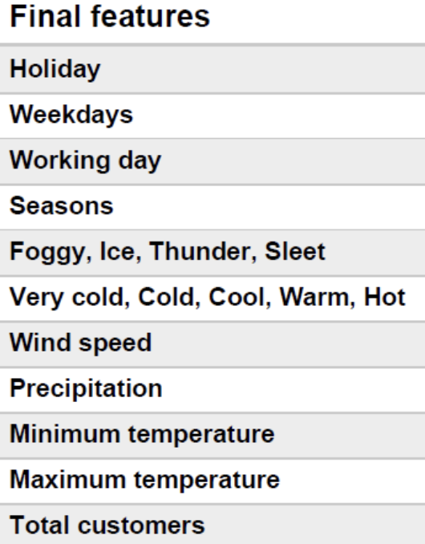
Feature which are used to predict the demand

Slide 10
Performance metrics to determine how well these models can predict bike sharing
MAE (mean average error):refers to the average of all the errors in a set.
RMSE (root mean squared error): calculations are performed over the data sample that was used for estimation and are called errors (or prediction errors) when computed out-of-sample.

Slide 11
Models used:
Naives Baseline( For comparison or to provide the benchmark for performance)
Random Forest
XGBoost
AdaBoost

Slide 12
Random Forest
Random forest, like its name implies, consists of a large number of individual decision trees that operate as an ensemble. Each individual tree in the random forest spits out a class prediction and the class with the most votes becomes our model’s prediction

Slide 13
XGBoost
XGBoost is an implementation of gradient boosted decision trees designed for speed and performance.
The two reasons to use XGBoost are also the two goals of the project:
Execution Speed.
Model Performance.

Slide 14
AdaBoost
AdaBoost is an ensemble learning method (also known as “meta-learning”) which was initially created to increase the efficiency of binary classifiers.
AdaBoost uses an iterative approach to learn from the mistakes of weak classifiers, and turn them into strong ones.

