Slide 1

EvidenceChain: IoT-Based Blockchain Evidence Management for Post-Collision
DEPARTMENT OF COMPUTER SCIENCE AND ENGINEERING
SRKR ENGINEERING COLLEGE (A)
ChinnaAmiram, Bhimavaram, West Godavari Dist., A.P.
[2025 – 2026]
Submitted By:
(Batch-16)
K.V.V.Sravanth Babu - 22B91A4725
Ch.Mahalakshmi - 23B95A4703
A.V.Sri Sathwika - 22B91A4701
A.N.S.R.K.Raju - 22B91A4702
Under the Guidance of
Mr. D.V.S.R.K.RAJU
Assistant Professor
Department of Computer Science and Engineering

Slide 2
INTRODUCTION
• Road traffic accidents are a major concern in modern transportation systems
• Accident investigation depends on accurate and reliable evidence
• Digital technologies are increasingly used in vehicle monitoring
• Secure data handling is essential for trustworthy analysis
• Emerging technologies enable improved evidence management

Slide 3
PROBLEM STATEMENT
Most existing systems depend on manual reporting after the accident has occurred.
Centralized storage of accident data increases the risk of data tampering and loss.
There is no reliable mechanism to automatically capture and preserve evidence at the exact time of collision.
Delays in evidence verification lead to disputes in insurance and legal processes.
Current systems do not provide a transparent chain-of-custody for accident evidence.

Slide 4
LITERATURE SURVEY
S.No | Title of the Paper | Year | Authors | Methods / Tools Used | Key Findings | Limitations
1 | Decentralized Post-Collision Evidence Management Using IoT and Blockchain | 2025 | Z. Ullah, M. Imran, A. Khan, S. Khan, N. Ahmad | IoT sensing, IPFS, blockchain | Provides a complete post-collision evidence framework with decentralized storage. | Prototype-level validation; real-world deployment not evaluated.
2 | Hybrid Edge–Blockchain System for Accident Evidence Verification | 2025 | J. Kim, S. Park, H. Lee, M. Choi, Y. Jung | Edge preprocessing, blockchain anchoring | Reduces verification delay using edge processing. | Edge synchronization and scalability challenges.
3 | TrustChain-VANETs: Blockchain and IPFS in Vehicular Networks | 2025 | Z. Ullah, M. Imran, A. Khan, S. Khan | VANET integration, IPFS, blockchain | Enables trustworthy vehicular data sharing. | Performance depends on network availability.
4 | Blockchain-Based Judicial Evidence Preservation System | 2024 | Y. Liu, J. Wang, H. Zhao, L. Chen | IPFS, blockchain anchoring | Provides legal-grade evidence preservation with chain-of-custody support. | High system complexity and operational cost.
5 | Secure Digital Evidence Storage for Smart Cities | 2024 | Rani Devi, S. Kumar, P. Sharma, A. Verma | Smart contracts, IPFS, blockchain | Enables scalable and controlled digital evidence storage. | Complex key management and access control.
6 | Evidence Lifecycle Management using Blockchain | 2024 | Multiple Authors | Blockchain lifecycle modeling | Supports full evidence lifecycle with integrity assurance. | Latency and storage overhead issues.

Slide 5
LITERATURE SURVEY(Contd..)
S.No | Title of the Paper | Year | Authors | Methods / Tools Used | Key Findings | Limitations
7 | Blockchain-Enabled IoT Forensic Framework | 2022 | A. Alharbi, M. Rahman, A. Hassan, S. Khan | Permissioned blockchain, forensic hashing | Ensures integrity of IoT forensic data. | Processing delay due to blockchain operations.
8 | Secure File Sharing using IPFS and Blockchain | 2020 | Y. Huang, J. Liu, Z. Wang, H. Chen | IPFS, blockchain hash anchoring | Demonstrates tamper-proof decentralized file storage. | Access control management is complex.
9 | End-to-End IoT Sensors to IPFS and Ethereum Prototype | 2020 | T. Nguyen, D. Tran, P. Hoang, N. Pham | IoT sensors, IPFS, Ethereum | Validates feasibility of IoT-to-IPFS evidence storage. | Scalability and gas cost issues.
10 | Edge-Based Processing for Real-Time Crash Detection | 2019 | Y. Chen, H. Zhou, K. Wang, J. Li | Edge computing, sensor fusion | Reduces collision detection latency. | No secure evidence storage mechanism.
11 | Tamper Detection using Hash Chaining for Sensor Data Streams | 2016 | J. Roberts, M. Clark, S. Lewis, D. Turner | Hash chaining, cryptographic hashing | Detects unauthorized modification of sensor data. | Synchronization overhead for large data streams.
12 | Car Accident Detection and Notification System using Smartphone | 2015 | S. Mohan Kumar, R. Anitha, P. Kumar, K. Suresh | Smartphone sensors, GPS | Low-cost accident detection and alerting. | High false positives and no evidence integrity support.

Slide 6
RESEARCH GAP
Detection-Focused Systems:
Most existing solutions prioritize accident detection and alerting rather than comprehensive evidence preservation and verification.
Centralized Data Storage:
Despite blockchain claims, several implementations still rely on centralized storage architectures vulnerable to tampering.
Lack of End-to-End Integration:
Seamless integration between IoT sensors, decentralized storage, and blockchain verification layers is missing.
Incomplete Chain-of-Custody:
Existing approaches do not fully support transparent and verifiable evidence lifecycle management.

Slide 7
PROPOSED SYSTEM
• EvidenceChain is an IoT-based blockchain system for post-collision evidence management
• ESP32 with sensors detects accidents and collects real-time data
• Backend processes data and generates structured digital evidence
• IPFS is used to store large evidence files securely
• Blockchain stores hash and metadata for tamper-proof verification
• A web dashboard enables authorized users to access and verify evidence

Slide 8
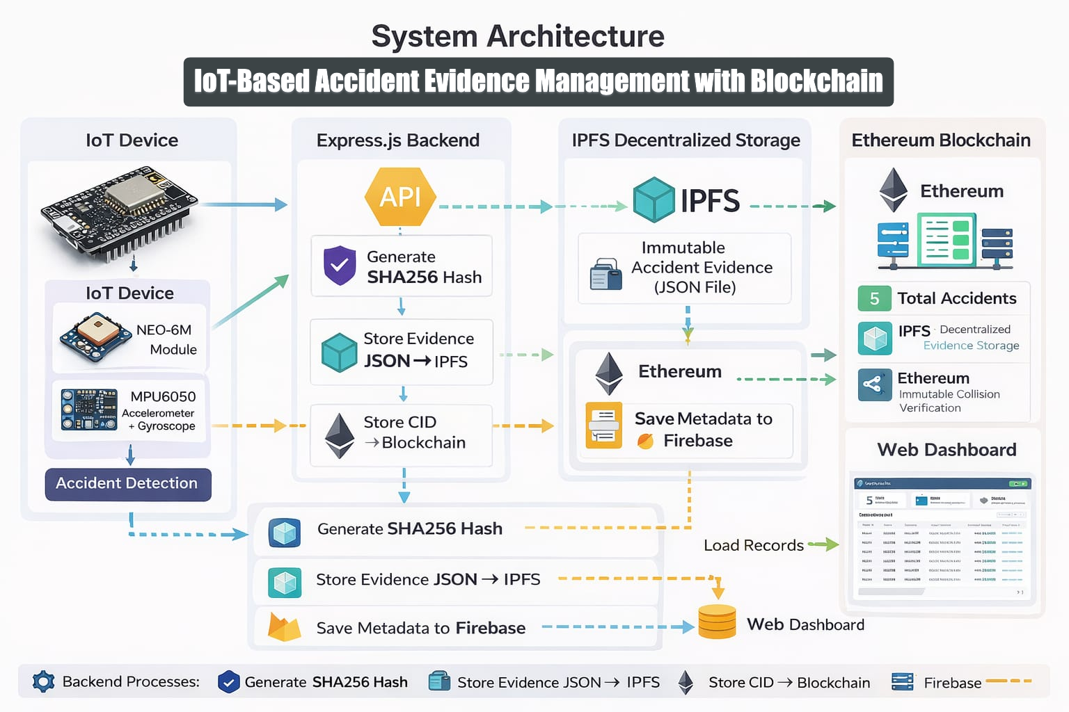

Slide 9
ARCHITECTURE EXPLANATION
• The IoT layer uses ESP32 with MPU6050 and GPS to detect collision events and collect real-time data
• The backend (Node.js/Express) processes sensor data and generates structured evidence with SHA-256 hash
• Evidence files are stored in IPFS, which provides decentralized and tamper-resistant storage
• The generated hash and IPFS CID are stored on the Ethereum blockchain for immutable verification
• Firebase is used to store metadata and support efficient data management
• A web dashboard allows authorized users to access, view, and verify evidence records

Slide 10
TOOLS AND TECHNOLOGIES USED
Hardware Components
• ESP32 – Microcontroller for sensor data collection and communication • MPU6050 – Accelerometer and gyroscope for motion and collision detection • NEO-6M GPS Module – Captures location and timestamp of accident
Software / Platforms
• Arduino IDE – Programming ESP32 and interfacing sensors • Node.js & Express.js – Backend for data processing and API handling • React.js – Frontend dashboard for visualization and verification • IPFS (Pinata) – Decentralized storage for accident evidence • Ethereum (Sepolia) – Blockchain for storing hash and metadata • Firebase – Database and authentication for system management

Slide 11
ALGORITHMS USED
• Threshold-Based Collision Detection Algorithm
Detects collision when sensor values exceed predefined thresholds
• Event-Triggered Data Freezing Algorithm
Freezes sensor data immediately after collision to preserve evidence
• SHA-256 Hashing Algorithm
Generates a unique hash to ensure data integrity and prevent tampering
• IPFS Content-Addressed Storage
Stores evidence using content-based addressing and generates a unique CID
• Blockchain Integrity Verification
Stores hash on blockchain to ensure immutability and enable verification

Slide 12
TESTING
ID | Test Case | Action | Expected Result | Actual Result | Status
1 | Collision Detection | Threshold exceeded | Collision detected | Collision detected | PASS
2 | Cooldown Period | Multiple triggers in 30 sec | Second trigger suppressed | Second trigger suppressed | PASS
3 | End-to-End Pipeline | Send impact data | Full pipeline executed | Evidence stored & verified | PASS
4 | IPFS Storage | Upload JSON to IPFS | CID generated | CID generated successfully | PASS
5 | Blockchain Recording | Store hash | Transaction confirmed | Transaction confirmed | PASS
6 | Tamper Detection | Modify evidence | Hash mismatch detected | Tampering detected | PASS

Slide 13
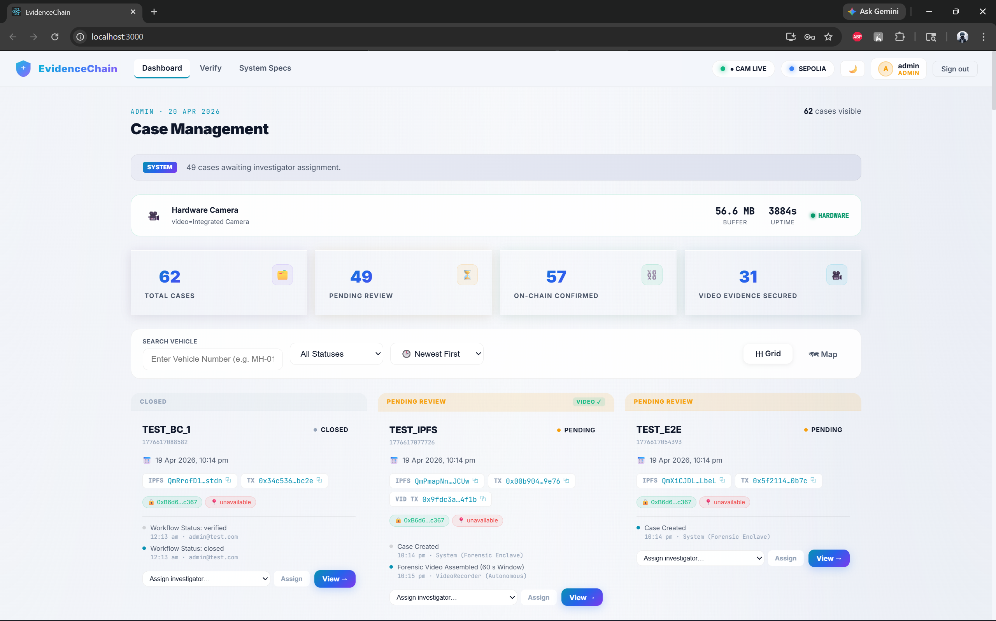
RESULTS
Admin Dashboard

Slide 14
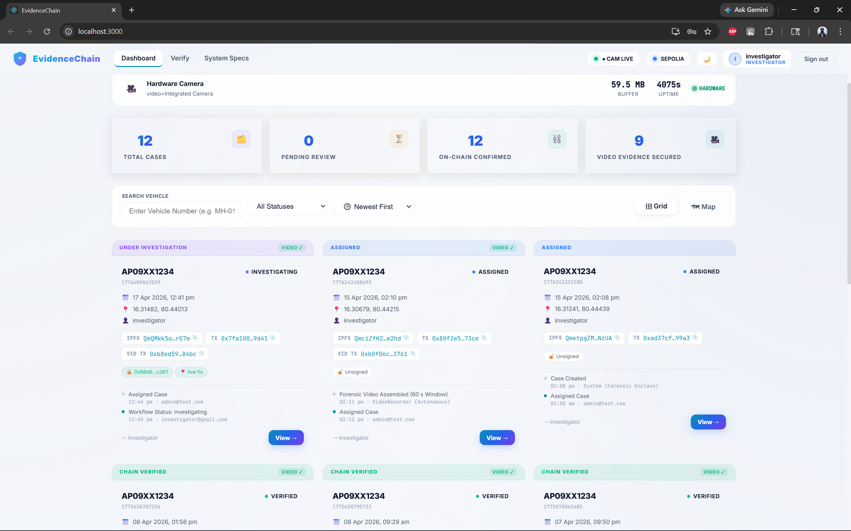
RESULTS
Investigator Dashboard

Slide 15
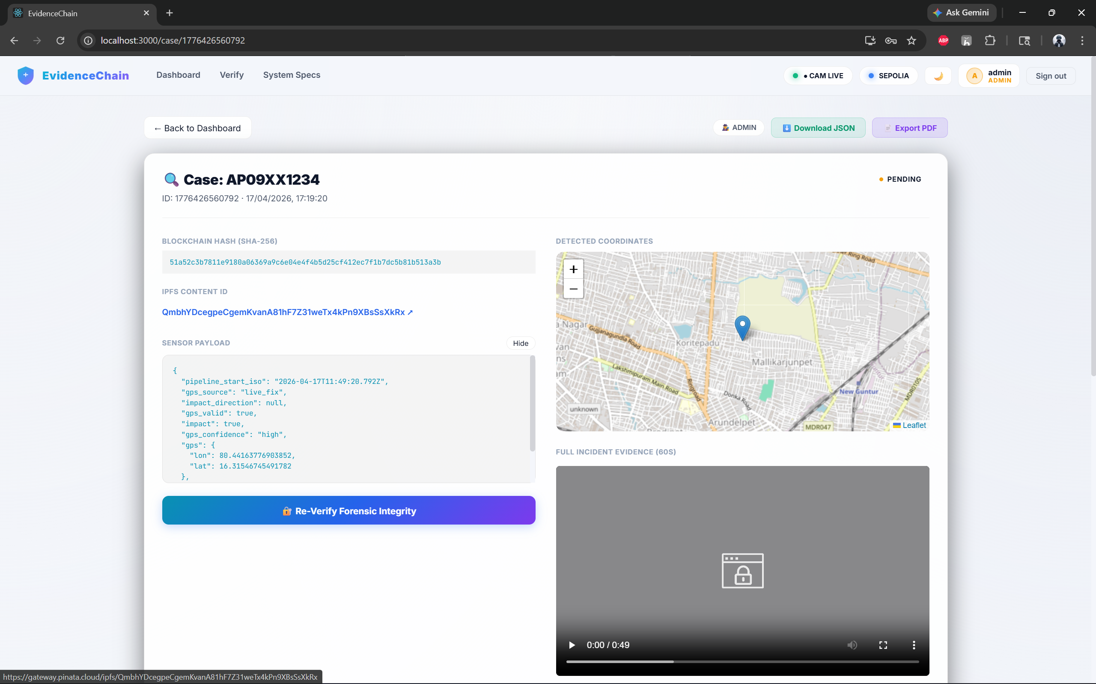
RESULTS
Individual Case Page

Slide 16
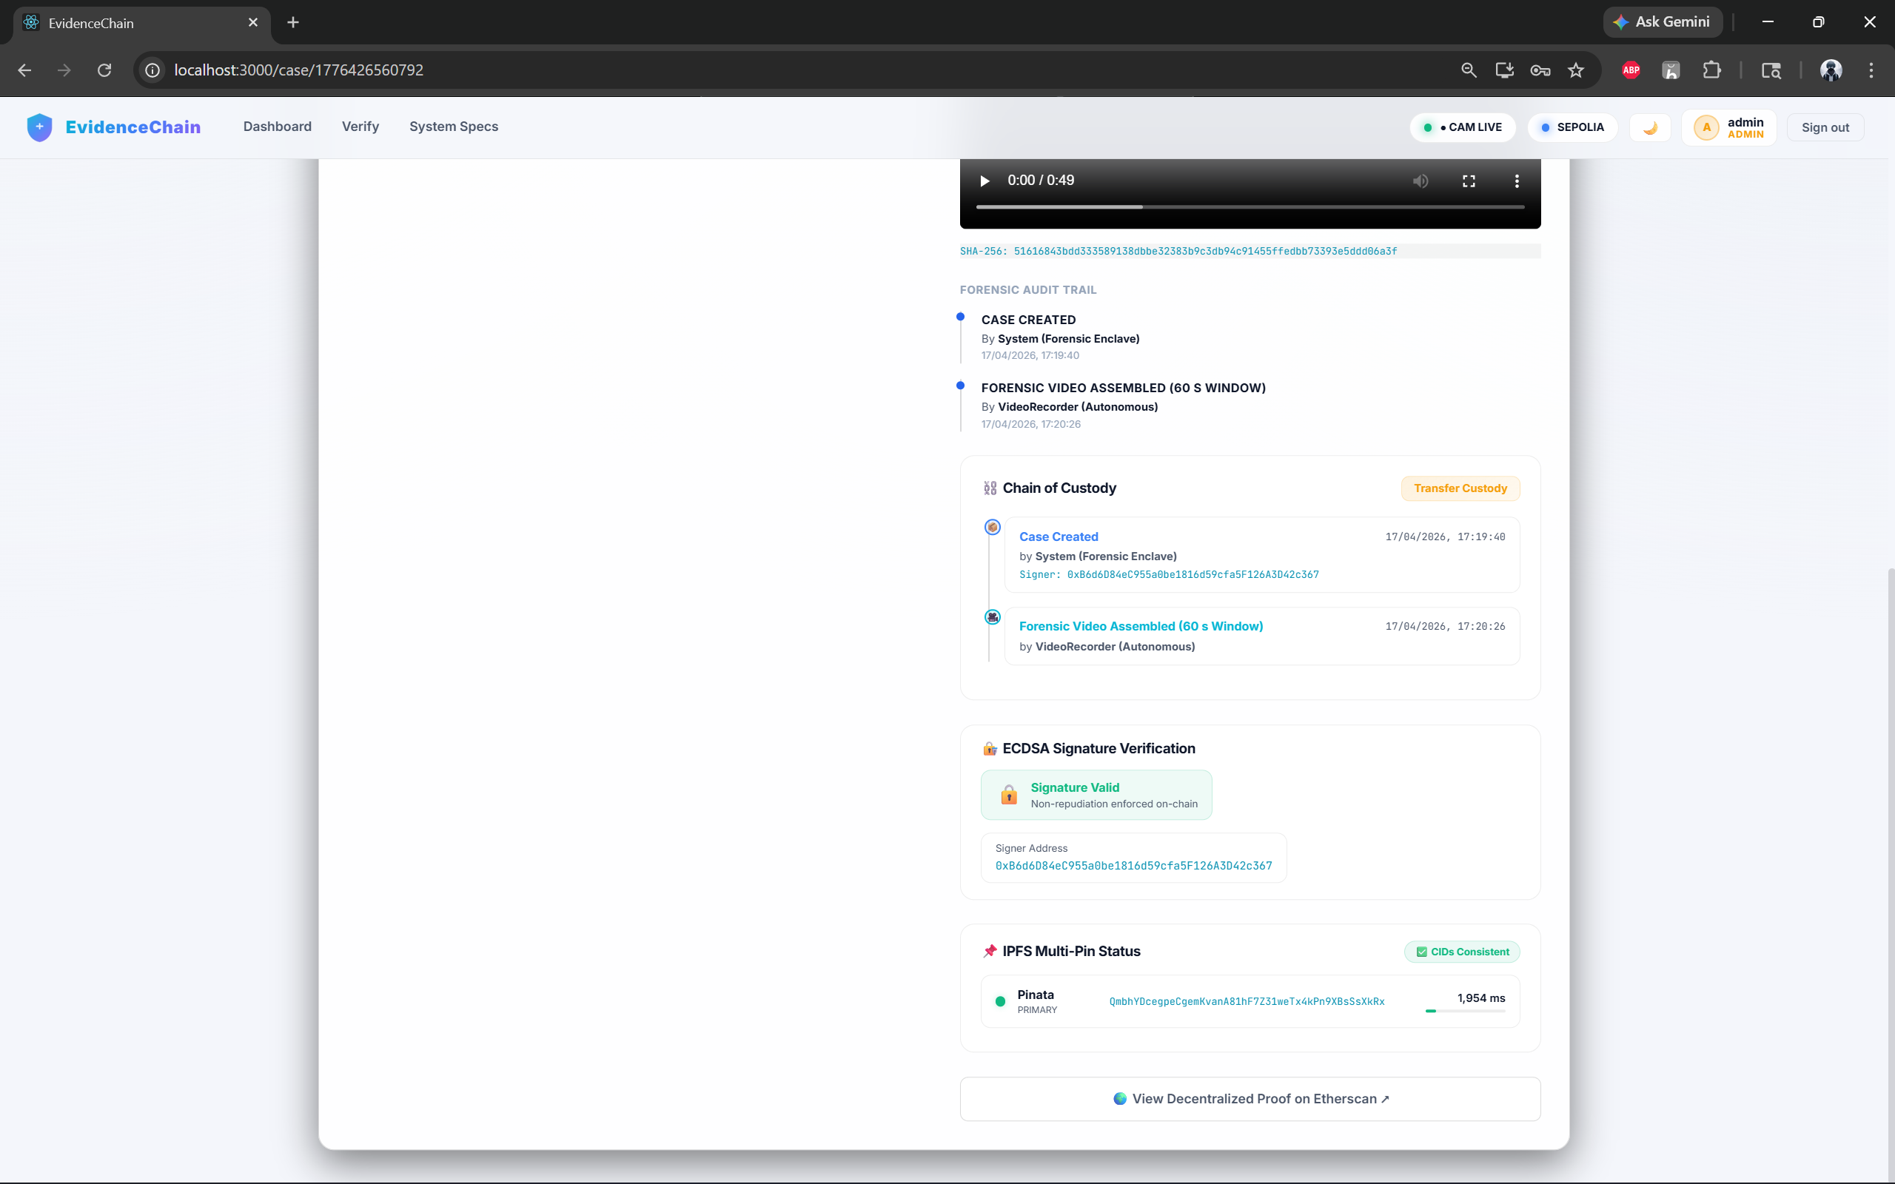
RESULTS
Individual Case Page(cntd..)

Slide 17
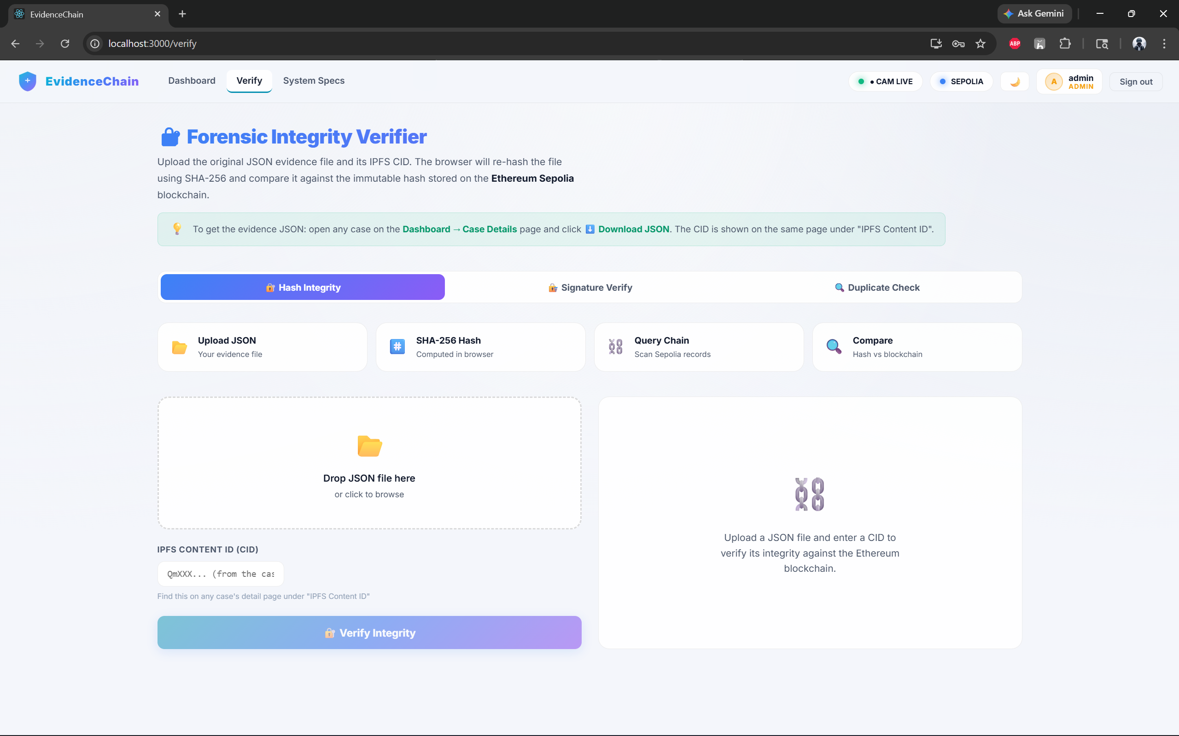
RESULTS
JSON Integirty Verifier page

Slide 18
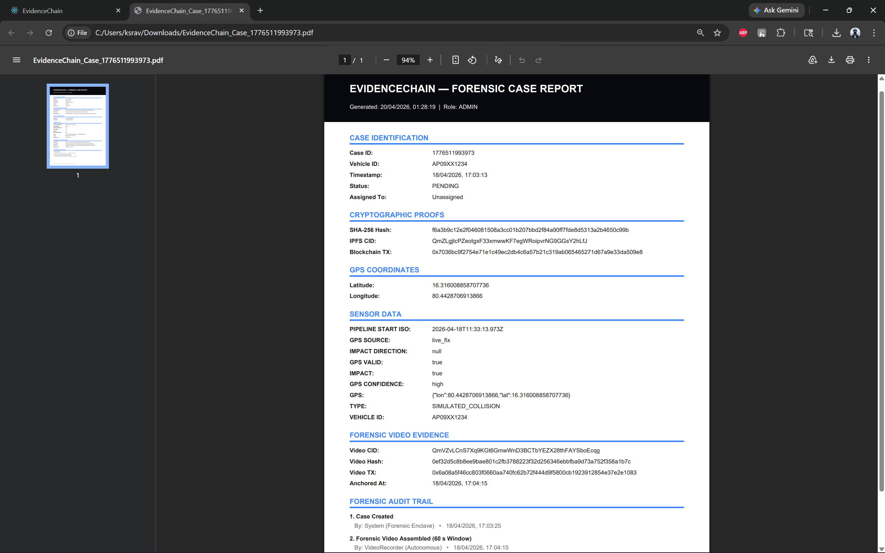
RESULTS
Generated Case Report

Slide 19

RESULTS
Data Stored in IPFS

Slide 20
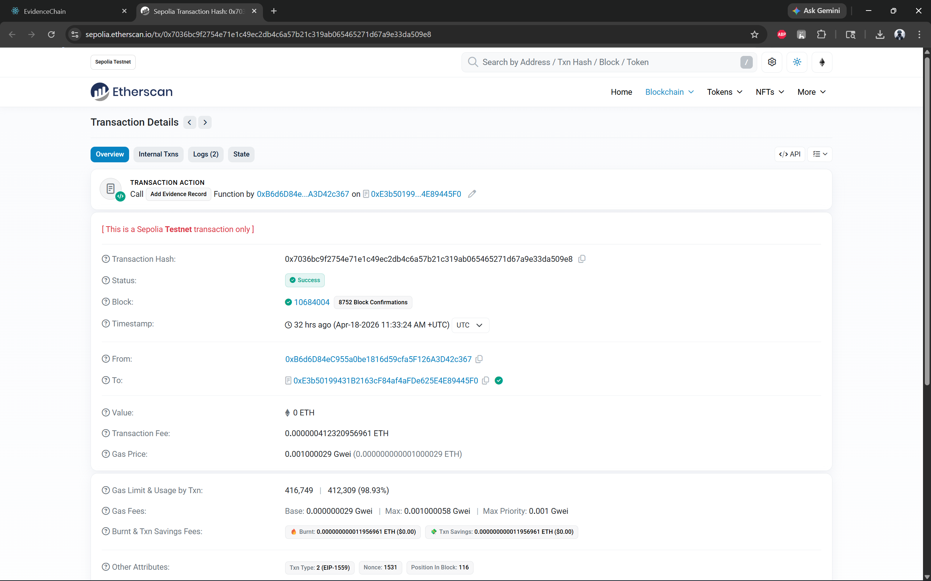
RESULTS
Transaction in Blockchain(Sepholia)

Slide 21
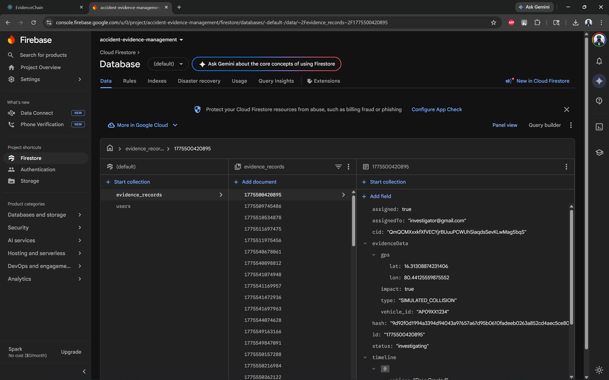
RESULTS
Records Stored in Firestore Database

Slide 22
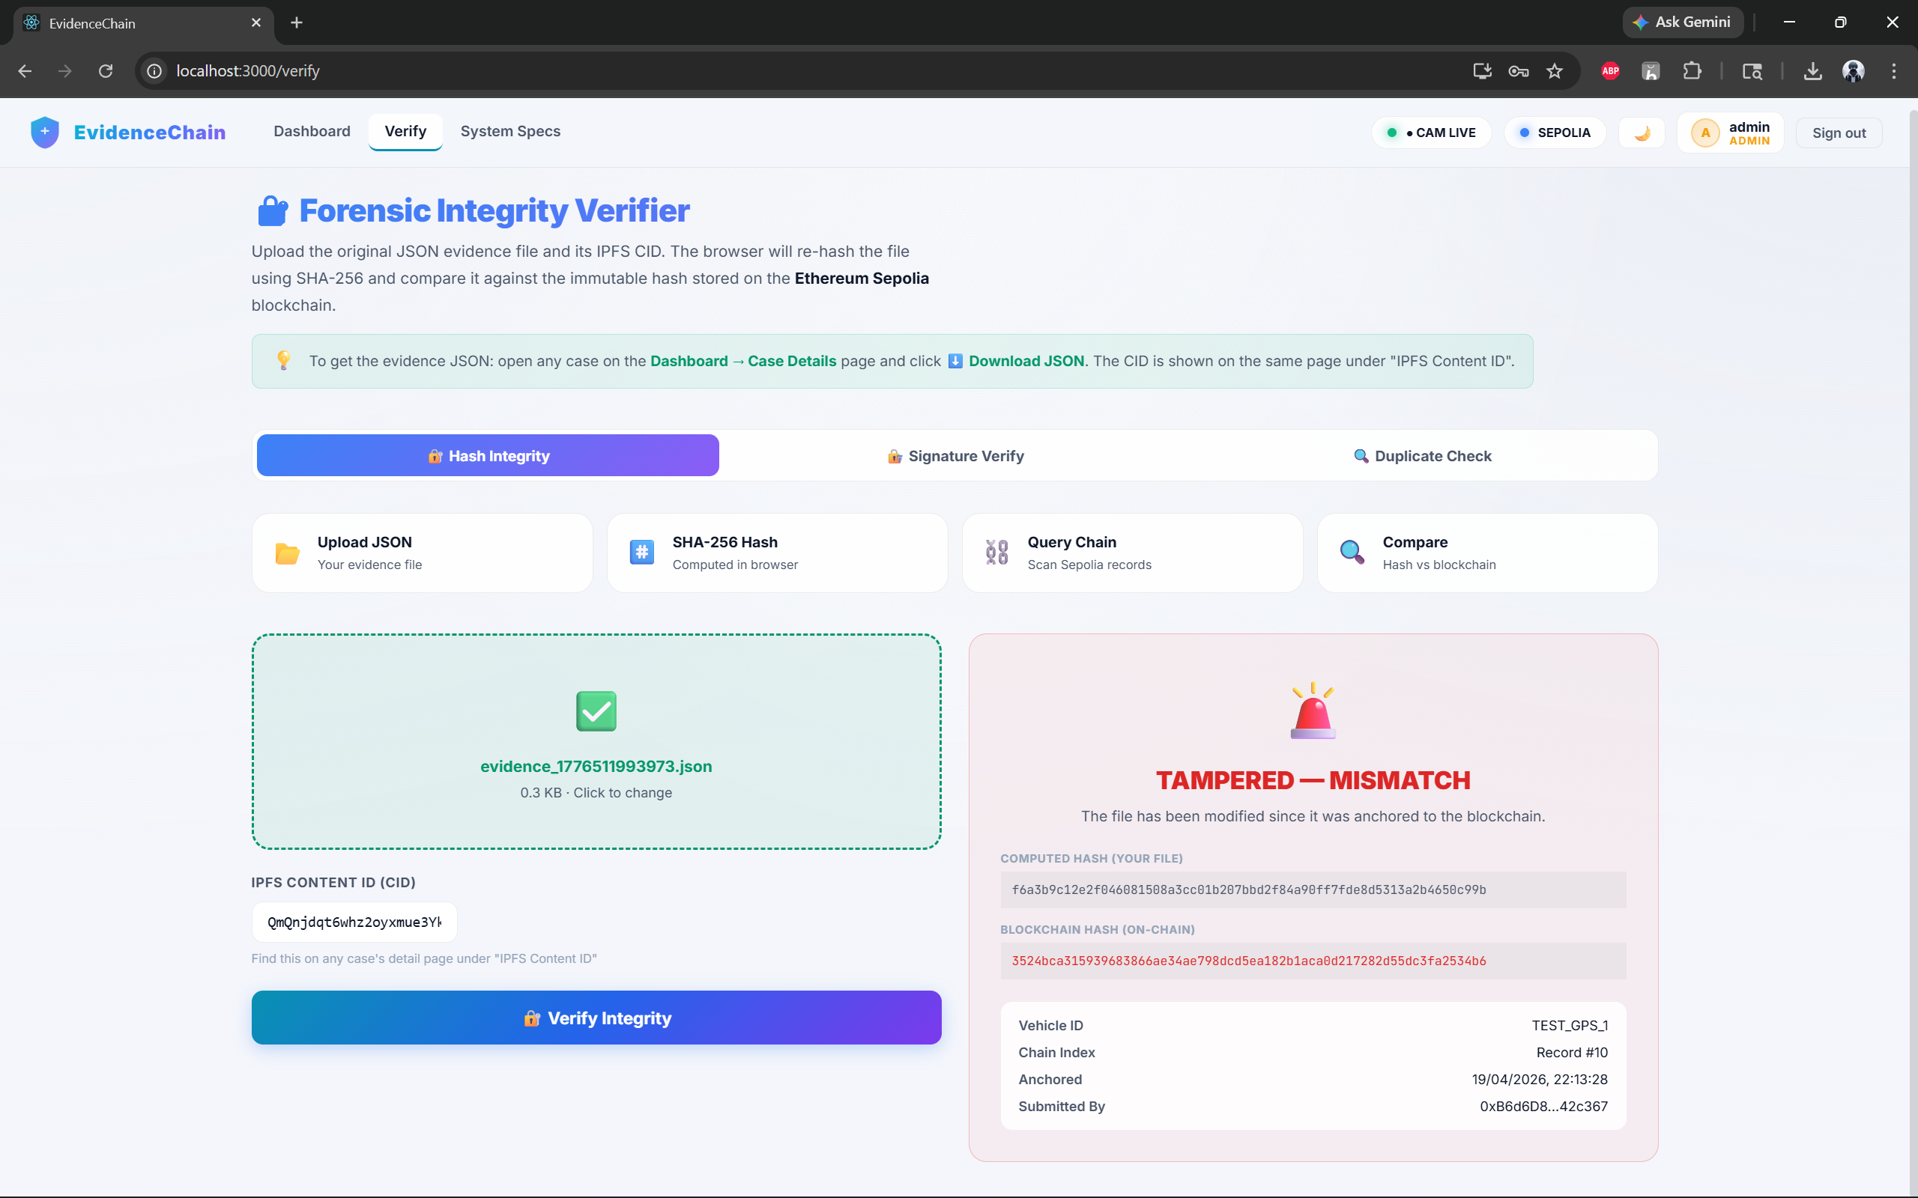
RESULTS
Verifier Detecting Tampered Evidence

Slide 23
RESULT ANALYSIS
• The system successfully detected collision events using sensor threshold logic with minimal false triggers
• Evidence generation pipeline worked efficiently, producing structured JSON data without loss
• IPFS storage ensured secure and decentralized handling of evidence with unique CID generation
• Blockchain anchoring provided immutable verification, preventing any modification of stored evidence
• Tamper detection mechanism accurately identified modified data through hash comparison
• Role-based access and custody tracking improved transparency and accountability in evidence handling

Slide 24
CONCLUSION
• EvidenceChain provides a secure and reliable system for post-collision evidence management
• The integration of IoT, IPFS, and blockchain ensures real-time data capture and tamper-proof storage
• Blockchain anchoring guarantees data integrity and transparent verification
• The system improves trust in forensic investigation, insurance claims, and legal processes
• Overall, the proposed solution demonstrates an effective approach for secure and verifiable evidence handling

Slide 25
FUTURE SCOPE
• Integration with real-time emergency response systems to notify police and medical services
• Deployment of edge computing for faster on-device processing and enhanced data security
• Development of a mobile application for real-time alerts and evidence management
• Automation of insurance claim processing using blockchain smart contracts
• Support for multi-chain blockchain to improve scalability and reduce transaction costs

Slide 26
THANK YOU

