Slide 1

ShipSecure: Intelligent Shipment Tracking System
This presentation outlines the ShipSecure system, an intelligent solution for tracking shipments using a combination of hardware and software components. We will cover the system architecture, hardware selection, power consumption analysis, communication protocols, and integration challenges, providing a comprehensive overview of the system's design and functionality.

Slide 2
System Architecture Overview
Microcontroller
Sensors
Communication
ESP32-WROOM-32 manages sensor data and communicates with Azure IoT Hub via MQTT.
NEO-6M GPS for location tracking and DHT22/Tilt Switch for environmental and tamper detection.
Wi-Fi (802.11 b/g/n) for direct Azure IoT Hub integration.
The ShipSecure system architecture integrates several key components to provide real-time tracking and monitoring of shipments. The ESP32 microcontroller serves as the central processing unit, collecting data from GPS, temperature, and tamper sensors. This data is then transmitted to Azure IoT Hub via Wi-Fi, enabling seamless integration with cloud-based services.

Slide 3
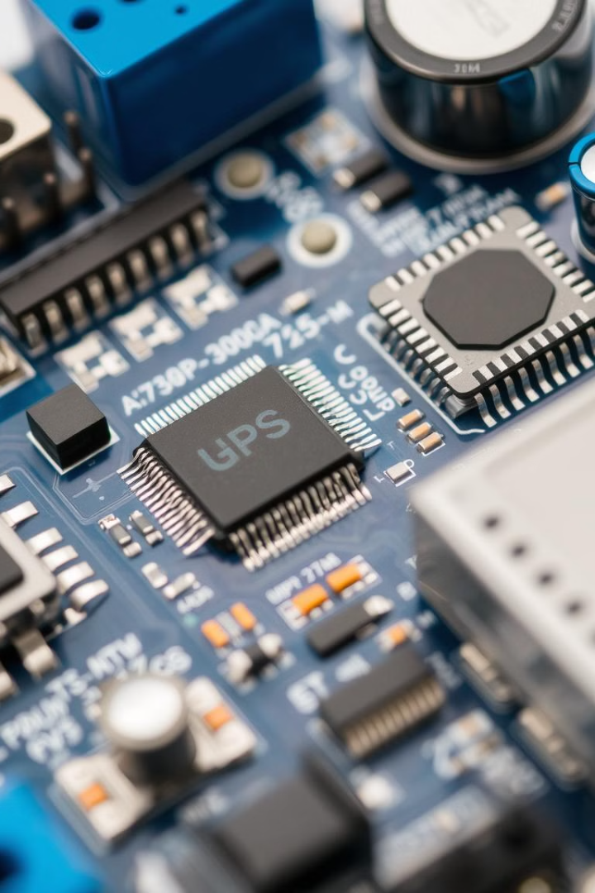



Hardware Component Selection
ESP32-WROOM-32
NEO-6M GPS
DHT22 + Tilt Switch
Dual-core, Wi-Fi/Bluetooth, low power consumption.
2.5m accuracy, UART communication.
Temperature/humidity and tamper detection.
The ShipSecure system utilizes carefully selected hardware components to ensure optimal performance and reliability. The ESP32-WROOM-32 microcontroller was chosen for its dual-core processing capabilities, integrated Wi-Fi/Bluetooth, and low power consumption. The NEO-6M GPS module provides accurate location tracking, while the DHT22 and tilt switch enable environmental monitoring and tamper detection.

Slide 4
Power Consumption Analysis
33.06
69.3
ESP32
NEO-6M
mW (average)
mW (average)
0.134
102.494
DHT22
Total
mW (average)
mW (average)
The ShipSecure system is designed for low power consumption to maximize battery life. The ESP32 microcontroller consumes an average of 33.06 mW, while the NEO-6M GPS module consumes 69.3 mW. The DHT22 temperature sensor has a minimal power consumption of 0.134 mW. The total average power consumption is 102.494 mW, enabling extended operation on a single battery charge.

Slide 5





Communication and Data Flow
Sensors to ESP32
UART (GPS), Single-wire (DHT22), Digital (Tilt Switch)
ESP32 to Azure IoT Hub
Wi-Fi (MQTT with TLS)
Cloud to Blockchain
Azure Functions (HTTPS)
Cloud to Web App
RESTful APIs (HTTPS)
The ShipSecure system utilizes a multi-layered communication architecture to ensure reliable data transmission. Sensors communicate with the ESP32 microcontroller via UART, single-wire, and digital protocols. The ESP32 then transmits data to Azure IoT Hub using Wi-Fi and MQTT with TLS security. Azure Functions facilitate communication between the cloud and blockchain, while RESTful APIs enable data retrieval by the web application.

Slide 6



Data Processing and Transmission
Processing
2
Structure JSON format
Acquisition
1
Collect sensor data
Transmission
3
MQTT to Azure IoT Hub
The ShipSecure system follows a structured data processing sequence to ensure accurate and timely information delivery. Data is acquired from sensors at regular intervals and processed into a structured JSON format. This data is then transmitted to Azure IoT Hub via MQTT, enabling real-time tracking and monitoring of shipments. The system also implements data compression and power-saving modes to optimize performance.

Slide 7
System Integration Challenges and Solutions
Hardware
1
Voltage levels, pin configuration
Power
2
Battery life, consumption
Latency
3
Connectivity, data verification
The ShipSecure system faces several integration challenges, including hardware compatibility, power limitations, and latency issues. To address these challenges, the system utilizes components operating at 3.3V, maximizes deep sleep mode, and implements on-device buffering. Alternative communication modules, such as LoRa, can be integrated for remote areas, while QoS 1 in MQTT prioritizes critical messages.

Slide 8
Key Takeaways and Next Steps
Robust Tracking
Efficient Power
Seamless Integration
ShipSecure offers reliable shipment tracking.
Optimized for extended battery life.
Designed for easy deployment.
The ShipSecure system provides a robust and efficient solution for intelligent shipment tracking. By carefully selecting hardware components, optimizing power consumption, and implementing a multi-layered communication architecture, the system offers reliable real-time tracking and monitoring capabilities. Future steps include further testing and refinement of the system, as well as exploring additional features and integrations.

