Slide 1
Provisioning a new EC2 instance using Ansible Playbook

Slide 2
Prerequisites
For working on Ansible we need to first set up a few things,
AWS user account
Ansible
Python
Boto
need to create the IAM user (As we will need a secret key and secret ID).

Slide 3
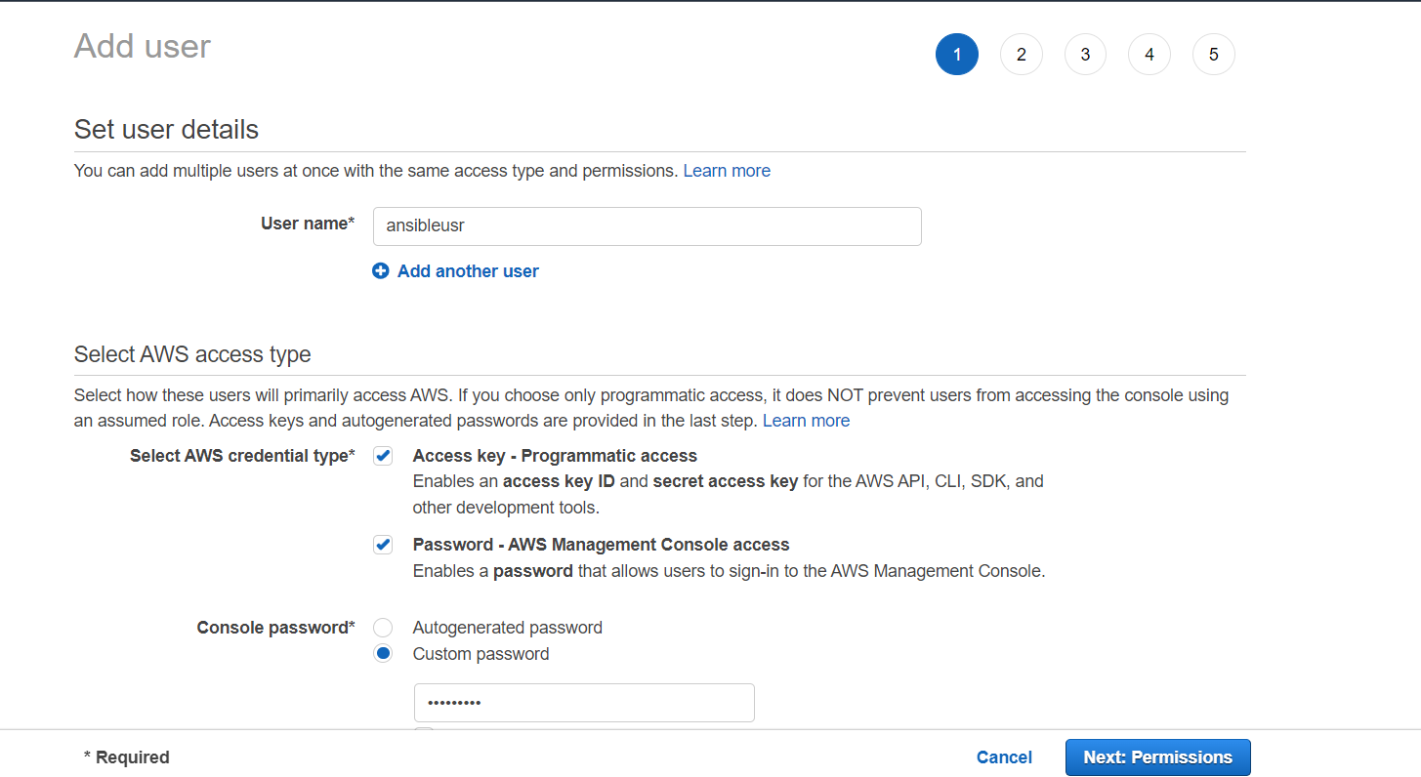

Slide 4
Need to create a file with the extension .yml or .ymal, add below script and save it
# Basic provisioning example
- name: Ansible test
hosts: localhost
tasks:
- name: launching AWS instance using Ansible
ec2:
key_name: aws_instance_Ansible
instance_type: t2.micro
image: ami-0dacb0c129b49f529
region: us-east-2
wait: yes
group: Ansible
count: 1
vpc_subnet_id: default
assign_public_ip: yes
aws_access_key: ***********xxxxxxxx
Aws_secret_key: ***********xxxxxxxx

Slide 5
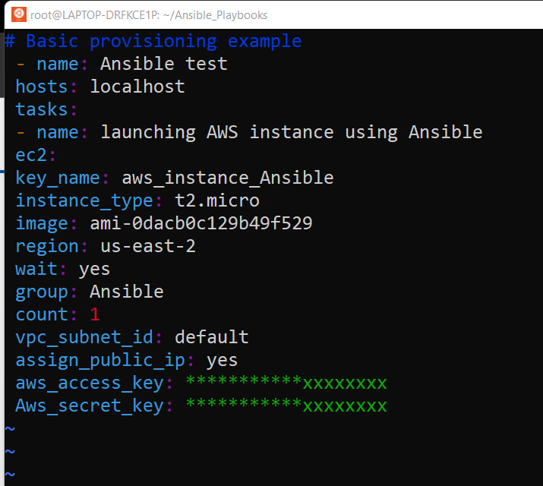

Slide 6


Hosts: add [webserver] localhost in /etc/Ansible/hosts file as my internet is running on the local server. If the file does not exist create one at the same location then add.

Slide 7
Key_name: Go to EC2 dashboard -> Key pairs -> Create key pair -> Copy key pair name
Instance_type: You can select the instance type whichever you want to launch. Go to EC2 dashboard -> Launch instance -> Check instance type.
Image: Go to EC2 dashboard -> Launch instance -> ami id (Image id)
IMG- CLICK HERE
Vpc_subnet_id: I made it default as I don’t have any VPC configuration.
Add your aws_access_key and aws_secret_key which you got from IAM user creation.

Slide 8
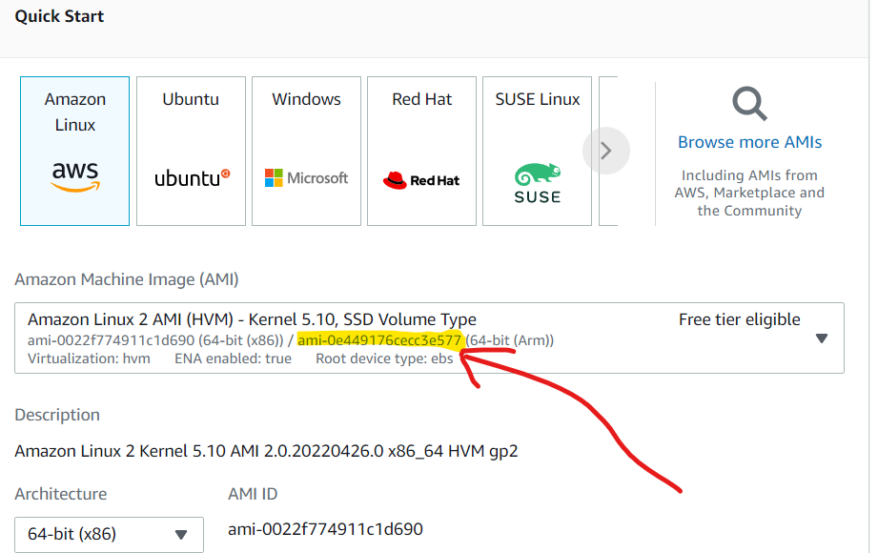

Slide 9
Now our Ansible file is ready.
Run the below command to check whether Ansible is ready to launch EC2 or not.
ansible-playbook -C <FILENAME>.yml
Where -C will check if everything is ready or not.
Once everything looks good, run the below command, and within a minute your EC2 server will be launched.
ansible-playbook <FILENAME>.yml
Amazon console you will see the server is launched successfully.

Slide 10


