Slide 1
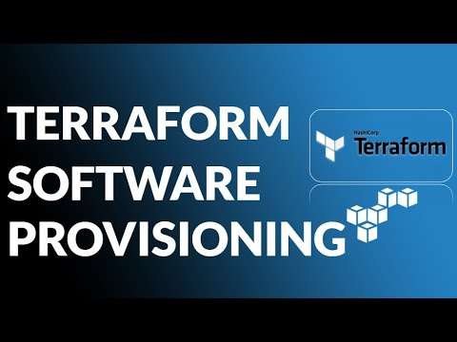

Slide 2
What is a software provisioning in terraform
Install the software, edit files, and provision machines created with Terraform. Use Packer or Cloud-Init to automatically provision SSH keys and a web server onto a Linux VM created by Terraform in AWS.

Slide 3
Simple File Upload Script
resource "aws_instance" "web" {
provisioner "file" {
source = "conf/myapp.conf"
destination = "/etc/myapp.conf"
}

Slide 4
provisioner "file" {
source = "conf/configs.d"
destination = "/etc"
}

Slide 5
provisioner "file" {
source = "apps/app1/"
destination = "D:/IIS/webapp1“
}

Slide 6


