Slide 1

WEB SCRAPING AND EXPLORATORY DATA ON
AC

Slide 2

TEAM MEMBERS :-
D.K.L. Durgavathi Qualification :- Bachelor Of Technology
V. Sravanthi Qualification :- Bachelor Of Arts

Slide 3


Contents
Selection of website
Problem Statement
Libraries used
Data frame Creation
Data Cleaning
Descriptive Statistics
Univariant Analysis
Bivariant / Multi-variant analysis
Final Conclusion

Slide 4
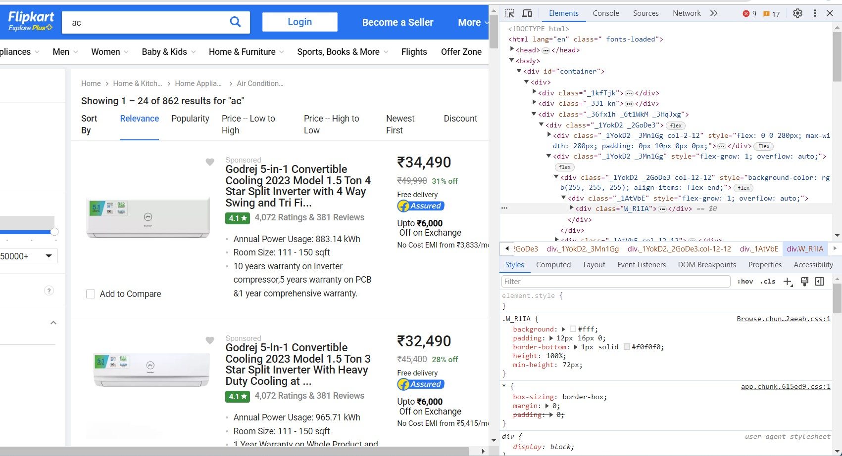
WEBSITE :-
https://www.flipkart.com/search?q=ac&otracker=search&otracker1=search&marketplace=FLIPKART&as-show=on&as=off

Slide 5
PROBLEM STATEMENT
The problem statement for analyzing air conditioner
To understand customer reviews, ratings, features, prices, and sales data to identify the most popular brands, models, and specifications.
The customer satisfaction and specific product attributes, as well as providing insights into potential improvement for manufacturers and retailers.

Slide 6

LIBRARIES USED:
Numpy
Pandas
Matplotlib
Seaborn
Requests
Beautiful Soup

Slide 7
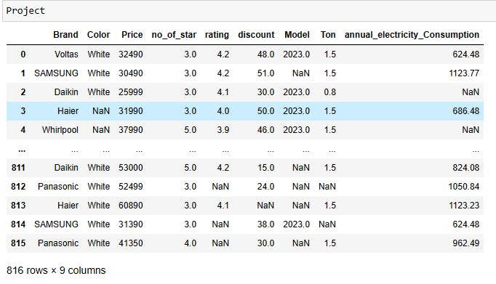
RAW DATA FRAME

Slide 8
DATA CLEANING
Identifying Null values.
Identifying Missing values.
Null values will replaced with mean(it is a numerical column).
Treating rows and columns with null values and missing values.
Extracting required data from columns using regular expressions.
Treating columns and converting required columns from object to int or float datatype.

Slide 9
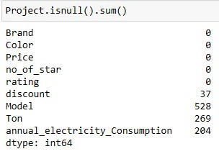
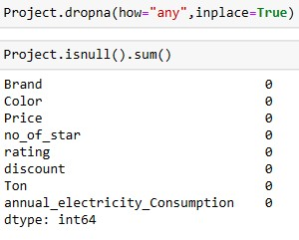

Insights :
From the data we will find the null values are discount, Ton and annual_electricity_Consumption.
Insights :
After finding the null values we will replace the Null values with Mean, Median, Mode Depends up column data Type.

Slide 10
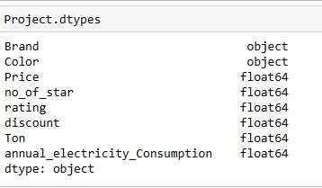
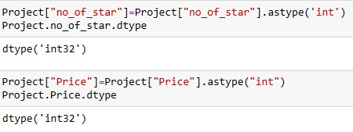
Insights :
From the beside table , Data types of data taken from websites are wrong data types .
Insights :
These code used for change the data type of columns in data collection.

Slide 11
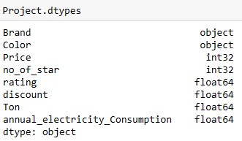

Insights :-
After changing the data type of column from the data. Resultant data types of columns is presented in beside figure.
Insights :-
after convention of data types we will find any duplicate values are exists or not.

Slide 12
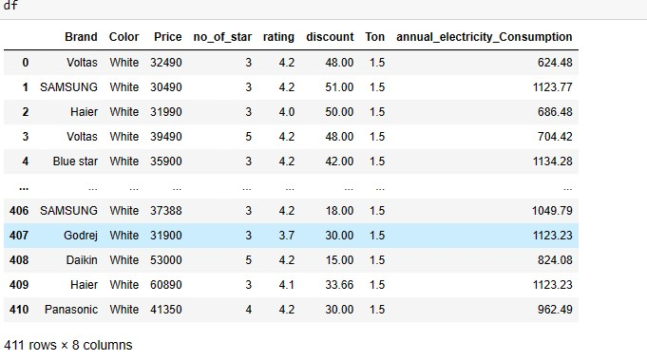
FINAL DATA FRAME :

Slide 13
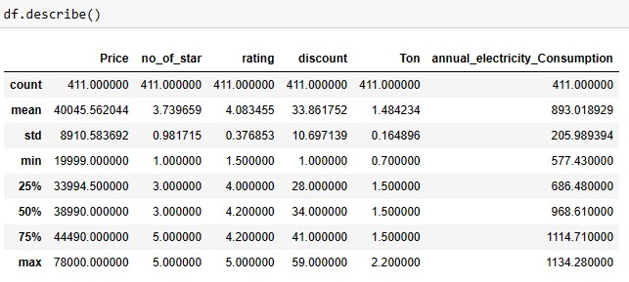
DESCRIPTIVE STATISTICS:

Slide 14

DATA VISUALIZATION

Slide 15
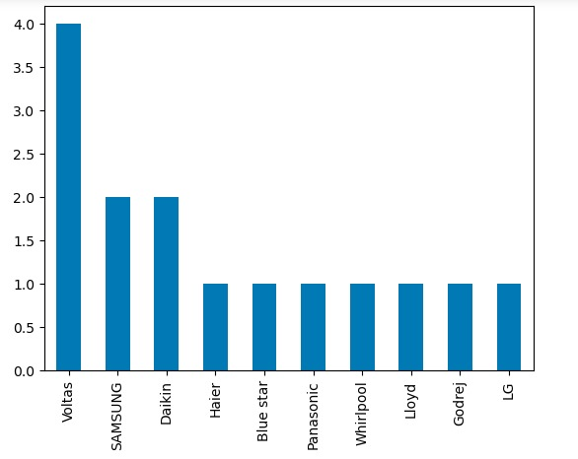
UNIVARIATE ANALYSIS
CATEGORICAL DATA
Top 10 Brands in AC
Insights :-
In this graph has which brand is highest sales on the given data the voltas brand sales was increased with compared to other brands.

Slide 16
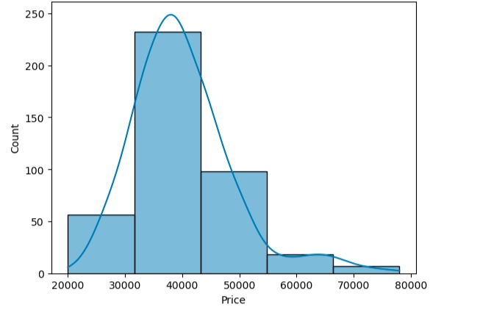
NUMERICAL DATA
Insights :-
By Using Histogram Plot, We Observed That Most Of The Price Of Ac’s Are In the range of 30000 to 40000 .
Histogram

Slide 17
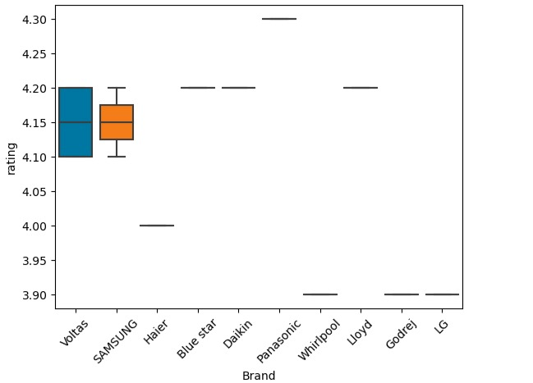
BIVARIATE ANALYSIS
CATEGORICAL VS NUMERICAL DATA
Insights :-
A Box Plot Analysis Reveal Shows Ac Brands Are Distributed In Terms Of Rating Revenue, Providing Insight Into Range Median Outliers With In Each Brand Category.

Slide 18
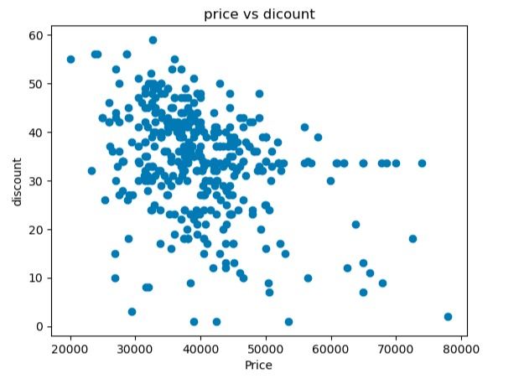
SCATTER PLOT
NUMERICAL DATA VS NUMERICAL DATA
Insights :-
By scatter plot shows that most of the price of the discounts with in the range between 30000 to 50000

Slide 19
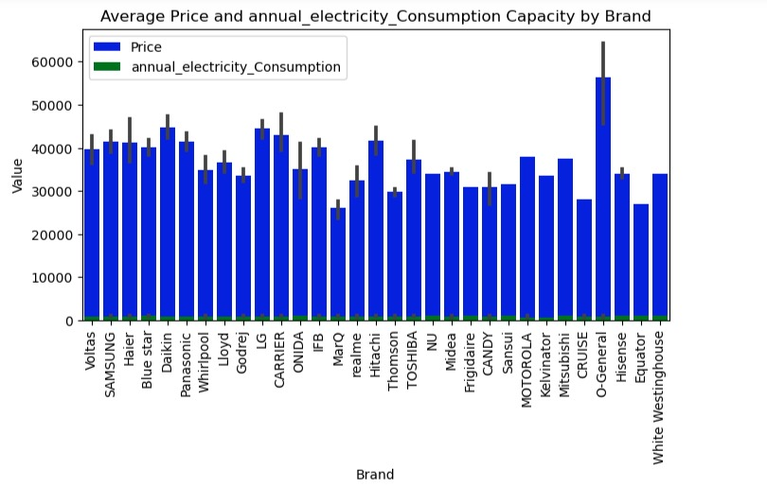
NUMERICAL DATA VS CATERGORICAL DATA
Insights :-
we observed that o-general brand of Ac’s have the highest price

Slide 20
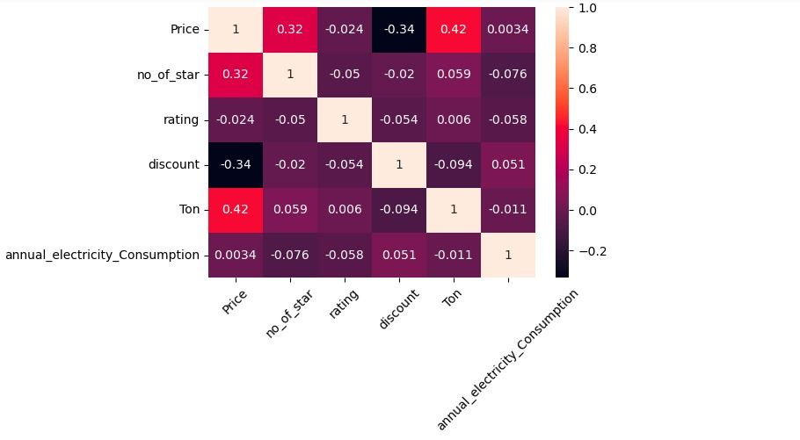
MULTIVARIATE ANALYSIS
Insights :-
A heatmap visualization of a Ac’s dataset reveals the correlations and trends between various AC attributes, offering valuable insights into factors influencing a Ac's success.

Slide 21
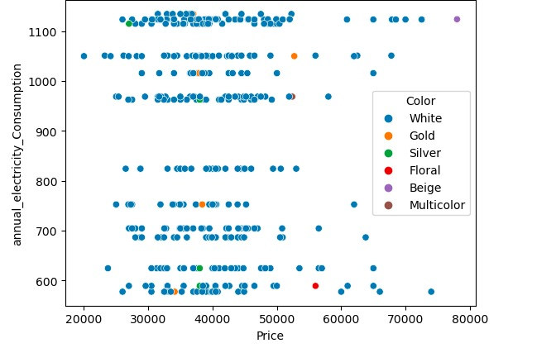
Insights :-
Most of the annual electricity consumption
Is for white color Ac’s

Slide 22
CHALLENGES FACED :
While I was collecting data from the websites I had to go through each page and do separately.
Every page has Null values and Data missing even through it is presenting web page .
I had gone through each page and checked for any data present but is missing when extracted and added them manually using Python.
If I had to replace more data I just have done any operation on that particular column.

Slide 23
Conclusion:
I here by conclude by sharing my observations in this particular project is:
Here my problem statement was recommending To analyze the Rating Wise from various Brand and also analyze that how Price will be going in.
Considering that to my observations I analyze that the Voltas Ac’s Brand is highest viewed by peoples and collect highest sales than other Ac’s Brand.
By this we conclude that the highest sales Ac’s Brand Is Voltas.
When we compared with Brand and Price we will find that the highest peoples were vote for O-General Brand.

Slide 24


