Slide 1
Security and Layer 2 Optimization
CSA0712-Computer Networks
CO1_AT3_Technical Presentation
Presented by
C.Sravanthi
192525463

Slide 2
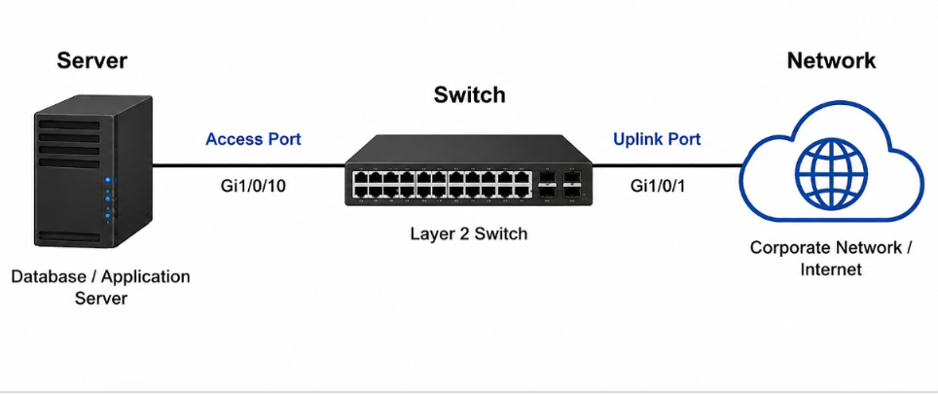
Introduction
Layer 2 security protects the network from unauthorized access and attacks.
Secure switchport configuration improves network reliability.
Layer 2 optimization increases performance and availability.
LACP provides redundancy and load balancing.
PortFast reduces startup delay for servers.
BPDU Guard prevents switching loops.
Disabling unused ports improves network security.

Slide 3
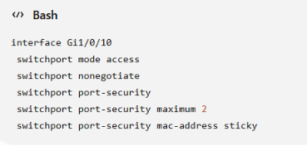
Defensive Switchport Configuration
Title: Defensive Configuration Steps
Include:
Configure switchports as Access Ports.
Disable Dynamic Trunking Protocol (DTP).
Enable Port Security.
Use Sticky MAC Address learning.
Limit the number of MAC addresses.
Disable unused services.
Cisco CLI

Slide 4
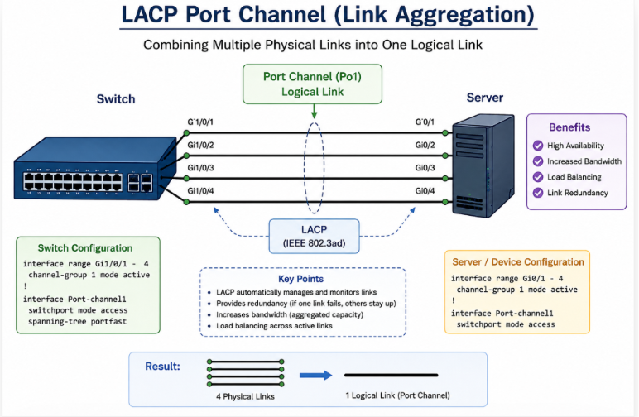
Layer 2 Optimization with LACP
Title: Link Aggregation (LACP)
Include:
Combines multiple links into one logical link.
Provides redundancy.
Increases bandwidth.
Supports load balancing.
Prevents single-link failure.

Slide 5

Spanning Tree PortFast
Title: Why Use PortFast?
Include:
Eliminates STP waiting time. Cisco CLI:
Immediately transitions to Forwarding State.
Reduces server startup delay.
Improves DHCP and database connectivity.
Recommended only for end devices.

Slide 6
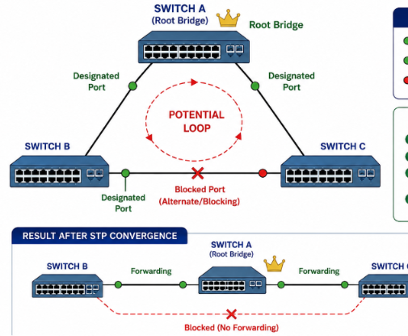

Why Port Fast is Safe
Title: PortFast with BPDU Guard
Include:
Safe for servers and PCs.
Prevents accidental network loops.
BPDU Guard disables the port if a BPDU is received.
Protects Layer 2 topology.
Cisco CLI

Slide 7
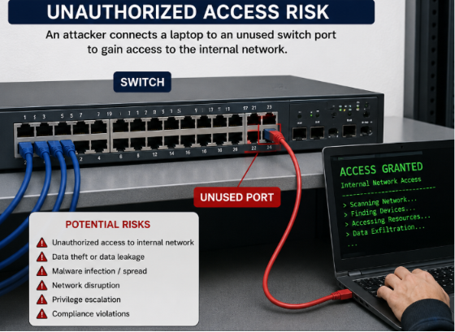
Risks of Unused Ports
Title: Security Vulnerabilities
Include:
Unauthorized access.
MAC flooding attacks.
VLAN hopping.
Rogue devices.
Malware spread.
Data theft.
Insider attacks.

Slide 8
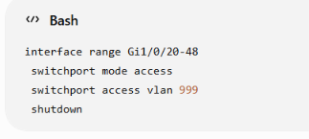
Securing Unused Ports
Title: Best Practices
Include:
Shut down unused ports.
Assign unused ports to Dead VLAN (VLAN 999). Cisco CLI
Disable DTP.
Enable Port Security.
Disable PoE (if unnecessary).
Regularly audit switch ports.

Slide 9
Conclusion
Secure switchports protect network devices.
LACP improves availability and performance.
PortFast speeds up server connectivity.
BPDU Guard prevents switching loops.
Dead VLANs secure unused ports.
Layer 2 security reduces attacks and downtime.
Following best practices ensures a secure and reliable network.

Slide 10
THANK YOU

