Slide 1
IBM University Engagement Project Submission
“Exploring the Power of Agentic AI with IBM Granite and IBM Bob”

Slide 2

Project Tile – NutriAgent AI — IBM Granite-Powered Nutrition Assistant
Domain of Project – Health care → Nutrition & Dietetics
Student Name | Recent Passport Photo | Email ID | Mobile number [WhatsApp]
MANDA SRAVANTI |  | sravanti9475@gmail.com | 8978396676
Recommended font style and size:
Font Style: Arial
Font Size (Heading): 28
Font Size (Content): 20

Slide 3
Problem Statement :
Maintaining a balanced diet requires reliable nutritional information, personalized meal planning, and regular monitoring of food intake. However, individuals often face difficulties in understanding their nutritional needs and making appropriate dietary choices. To address these challenges, NutriAgent AI is developed as an IBM Granite-powered multi-agent system that integrates RAG-based nutrition information retrieval, personalized diet recommendations, preventive health guidance, and food intake tracking through an interactive dashboard.
Objectives :
To retrieve relevant nutritional information using RAG and a curated nutrition knowledge base.
To generate personalized meal plans based on user preferences, health conditions, and dietary goals.
To provide preventive dietary guidance for selected health conditions.
To track food intake and provide nutritional feedback through specialized AI agents.
To visualize daily and weekly nutritional intake and progress through an interactive dashboard.
To integrate IBM Granite, ChromaDB, and Flask to deliver an intelligent nutrition assistance system.

Slide 4
Proposed Solution -
Proposed Solution
NutriAgent AI is an IBM Granite-powered multi-agent nutrition assistance system designed to provide personalized dietary guidance through an integrated application. The system consists of four specialized agents:
Nutrition Knowledge Agent: Retrieves relevant nutritional information, including calories, proteins, carbohydrates, fats, vitamins, and minerals, using Retrieval-Augmented Generation (RAG), ChromaDB, and a curated nutrition knowledge base.
Diet Recommendation Agent: Generates personalized meal plans and portion suggestions based on user preferences, dietary goals, nutritional requirements, and available information about health conditions and allergies.
Health Advisory Agent: Provides general preventive nutrition guidance and dietary suggestions for selected health conditions, such as diabetes and hypertension, to support healthier food choices.
Food Log & Feedback Agent: Records user-entered meals, analyzes nutritional intake, tracks food and water consumption where supported, and provides feedback on daily dietary progress.
The system uses IBM Granite through IBM watsonx.ai to generate contextual responses, while a Flask-based backend integrates the agents and supports an interactive dashboard for visualizing nutritional intake and progress. Overall, NutriAgent AI aims to simplify nutrition management, improve access to relevant dietary information, and support informed, healthier eating habits.

Slide 5
Technology Used
Programming Language: Python
Large Language Model (LLM): IBM Granite
LLM Platform: IBM watsonx.ai
AI Architecture: Multi-Agent System
Retrieval Technique: Retrieval-Augmented Generation (RAG)
Vector Database: ChromaDB
Backend Framework: Flask
Embeddings: Text embedding models for semantic search
Frontend: HTML, CSS, and JavaScript (if used in the current interface)
Data Visualization: Dashboard charts and graphical representations
Development Tools: Git and GitHub

Slide 6
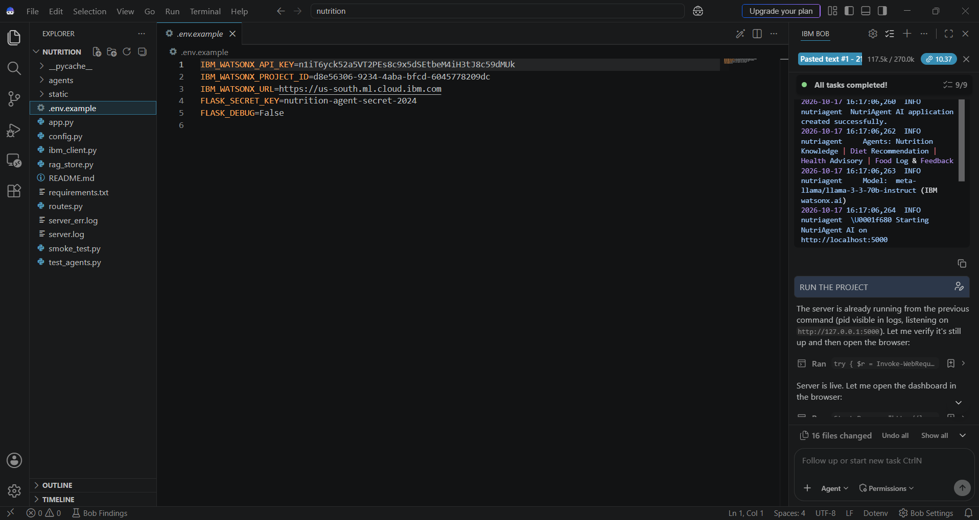
Required Files created using IBM bob -

Slide 7
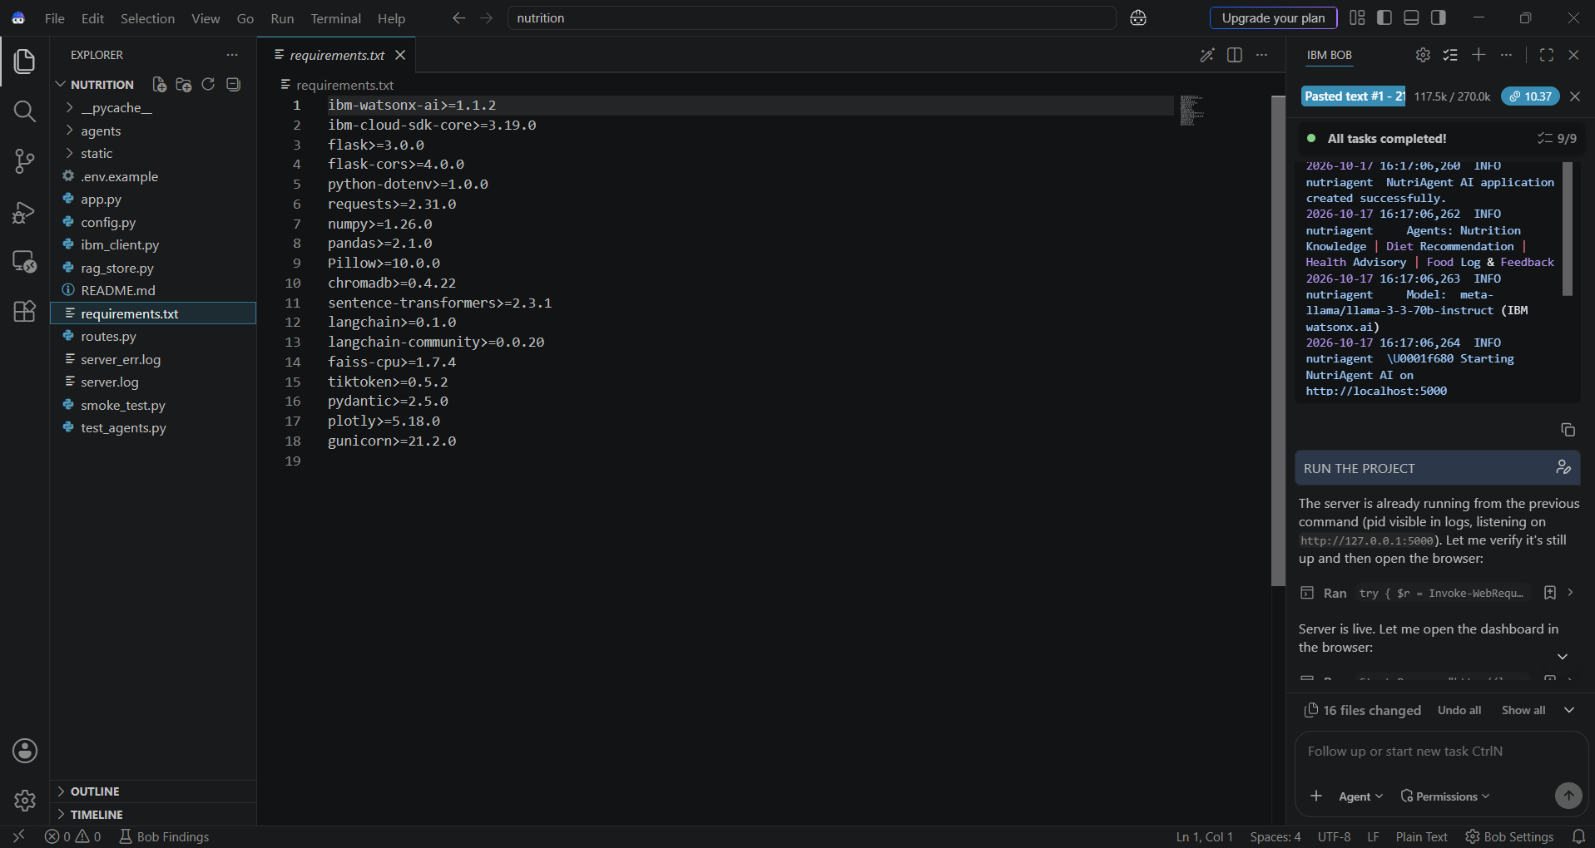
IBM Bob Screenshots:

Slide 8
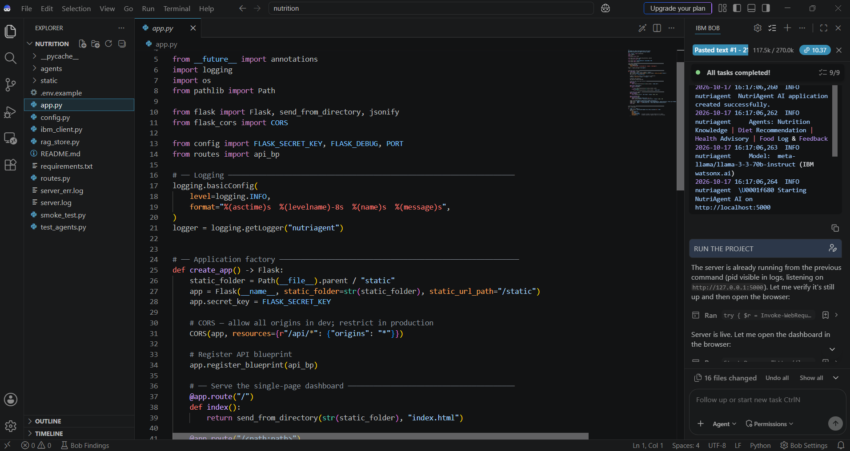

Slide 9
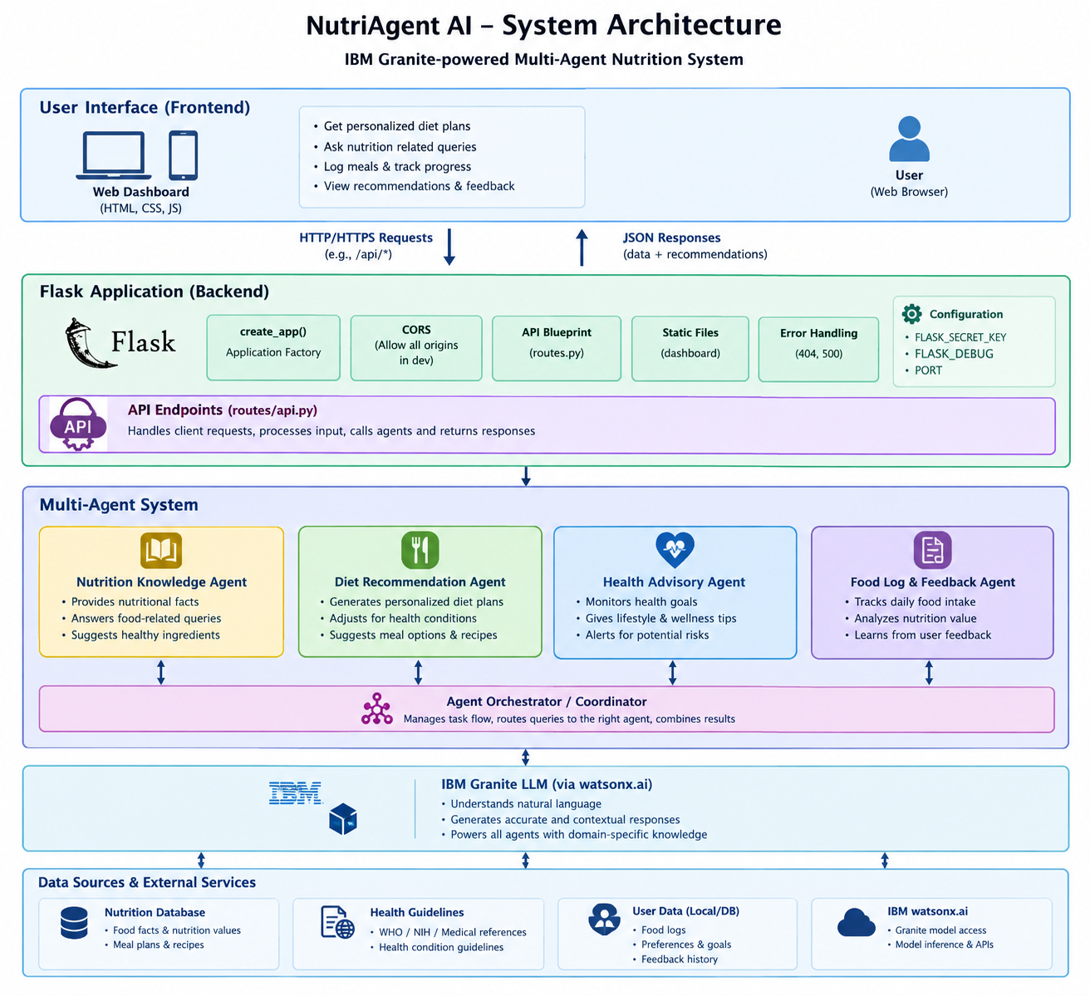

Slide 10
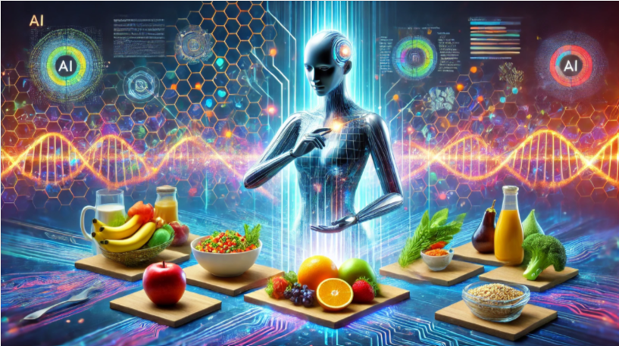
Role of Agentic AI in the solution
NutriAgent AI is a multi-agent nutrition system that uses Agentic AI to provide personalized nutrition recommendations. The system consists of four specialized agents: Nutrition Knowledge, Diet Recommendation, Health Advisory, and Food Log & Feedback. The Nutrition Knowledge Agent provides nutritional facts and food information. The Diet Recommendation Agent suggests personalized meal plans based on user preferences and available information. The Health Advisory Agent provides general wellness guidance and dietary safety precautions.
The Food Log & Feedback Agent records food intake and uses feedback to improve future recommendations. IBM watsonx.ai provides the large language model (LLM) capabilities for understanding user queries and generating natural-language responses. Flask serves as the backend web framework, while API routes connect the frontend with backend functionalities. An agent coordinator can route user requests to the appropriate agents and combine their outputs. By integrating these components, NutriAgent AI aims to deliver intelligent, personalized, and user-friendly nutrition support.

Slide 11
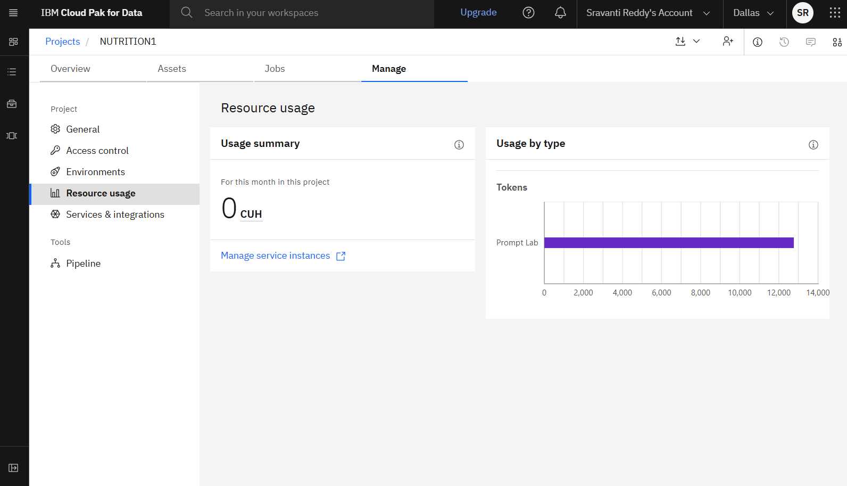
Token Usage
12769 tokens used
·
·
·

Slide 12
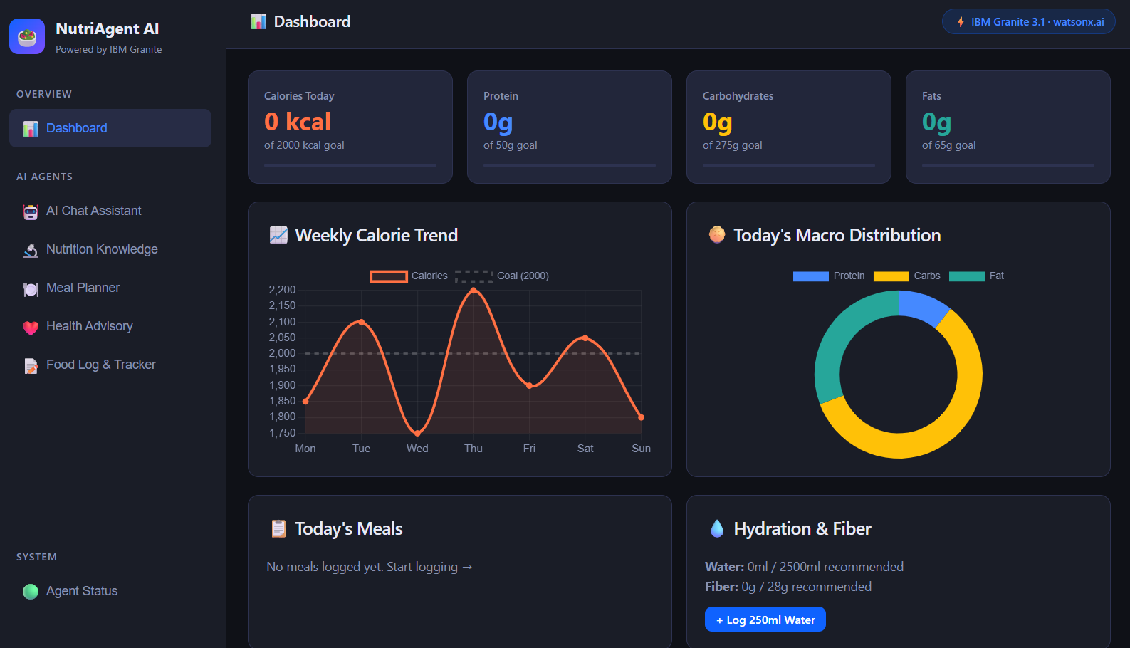
Project Output Screenshot
Please put IBM Bob output screenshots with 2-3 prompts.
You can take 2-3 more slides for each screenshot
·
·
·

Slide 13
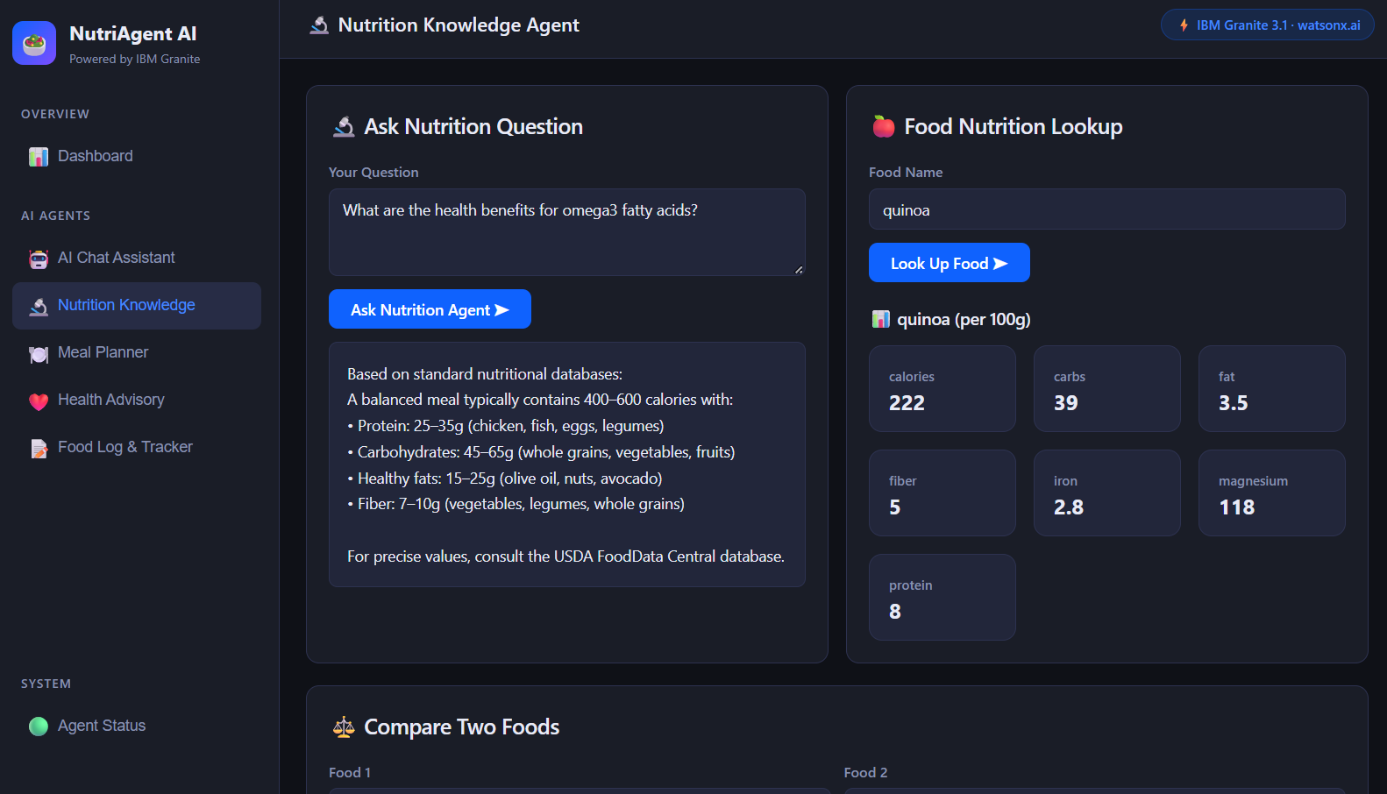
Project Output Screenshot
Please put IBM Bob output screenshots with 2-3 prompts.
You can take 2-3 more slides for each screenshot
·
·
·

Slide 14
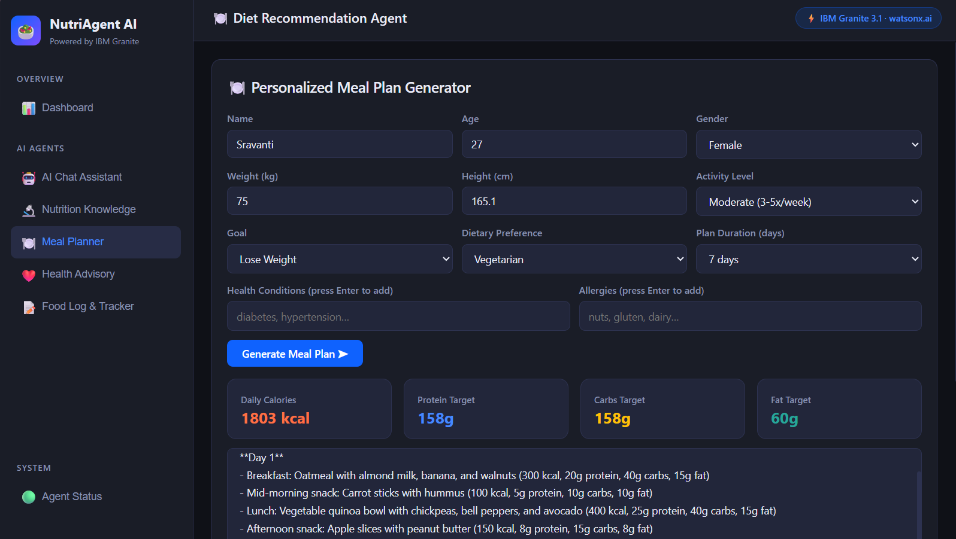
Project Output Screenshot
Please put IBM Bob output screenshots with 2-3 prompts.
You can take 2-3 more slides for each screenshot
·
·
·

Slide 15
Novelty and Uniqueness
Nutrition Knowledge Agent: Provides information about food nutrients, calories, proteins, carbohydrates, vitamins, and minerals using IBM Granite.
Diet Recommendation Agent: Generates personalized meal plans based on user preferences, dietary goals, and nutritional requirements.
Health Advisory Agent: Offers general dietary guidance and preventive nutrition suggestions for selected health conditions, such as diabetes and hypertension.
Food Log & Feedback Agent: Records user-reported food intake, analyzes nutritional consumption, and provides feedback to help users monitor their eating habits.

Slide 16
Git Hub Link
https://github.com/sravantireddy/NUTRIAGENT-AI
·
·
·

Slide 17
Future Scope
1.Integration with Wearables & Health Devices –
The system can be integrated with smartwatches and fitness trackers to collect real-time data such as steps, calories burned, heart rate, and sleep patterns. This will enable the Nutrition Agent to provide more accurate and dynamic diet recommendations based on actual user activity and health metrics.
2.AI-Powered Voice Assistant & Multilingual Support –
Enhancing the system with a voice-enabled assistant and support for multiple languages will improve accessibility. Users can interact naturally in their preferred language, making the solution more inclusive and suitable for diverse populations, especially in regions with varied linguistic backgrounds.
·
·
·

Slide 18
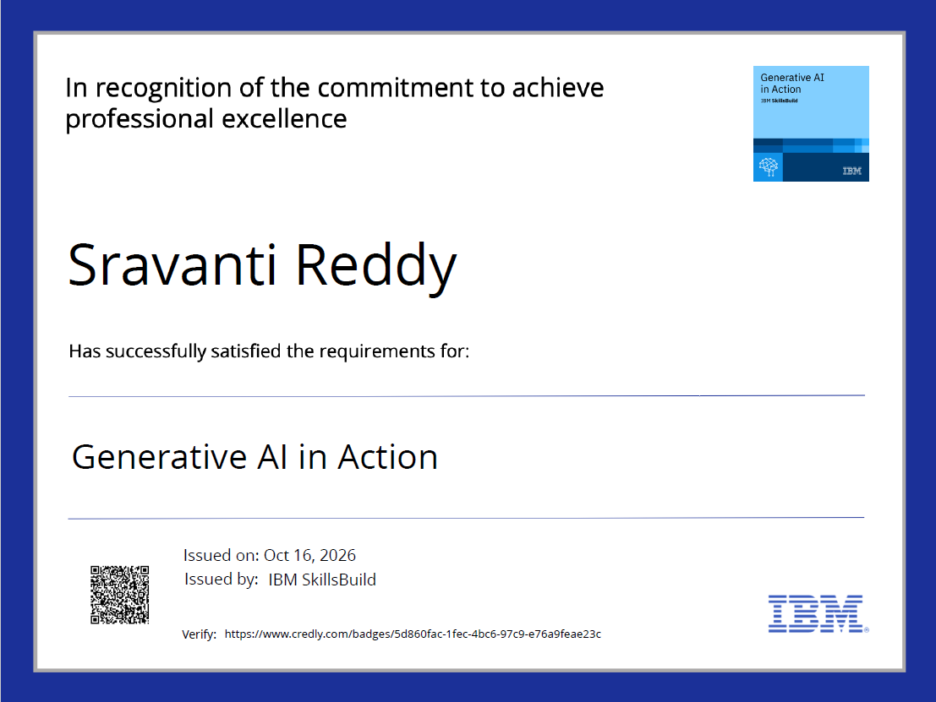
Certificates Earned:
Please add your credly certificate

Slide 19
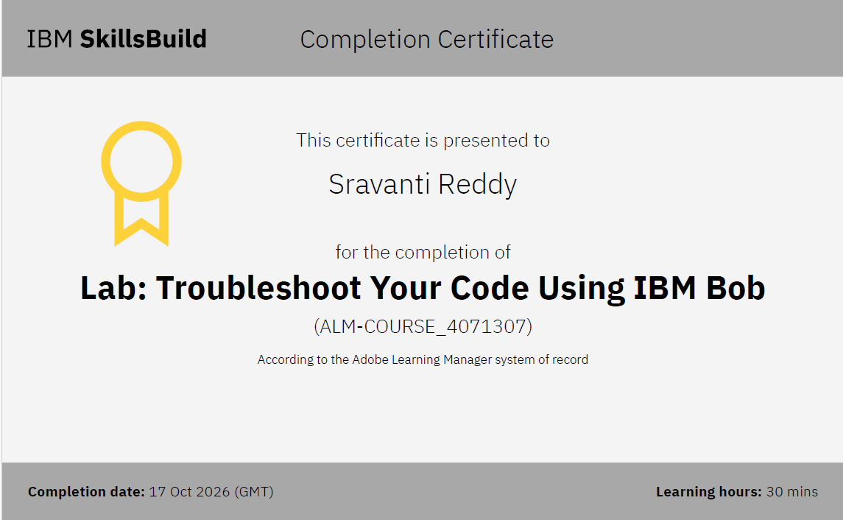
Certificates Earned:​
Add your IBM BOB Certificate

Slide 20


