Slide 1


Department of Information Technology
JNTUGV-CEV (A)
Exploring Advanced Compression Techniques for efficient SAR data management and analysis
Under the Guidance of
-PROF.DR.G.JAYASUMA
Batch-22 :
Ch.Sravani (21VV1A1217)
P.Mani Supriya (22VV5A1272)
J.Sahithi (21VV1A1229)

Slide 2
Project Goal:
To develop a system that can effectively compress Synthetic Aperture Radar (SAR) images and translate them into corresponding optical images using advanced deep learning techniques.

Slide 3
SAR data
Always the data be in TIFF format
SAR images store intensity valves (Digital Numbers)
So we need to convert them to backscatter (Sigma Nough) for measure for backscatter.
DN
Calibration fractor
Saved the backscatter image in Geotiff format Visualized the SAR image in grayscale.
Backscatter =

Slide 4
How SAR images are created:-
Sending a microwave pulse
Reflection from the Earth's surface.
Recording the reflected signal
time delay
Strength of reflection
Creating a 20 image
Sensor Collects 1000 of pulses

Slide 5
How is back scatter measured?
SAR satellite sends a radar signal, some of the energy bounces back to sensor
> Strength of this returned signal (Called back scatter) recorded as pixel intensity in SAR image
⇒ Intensity represented in terms of Sigma Nought.

Slide 6
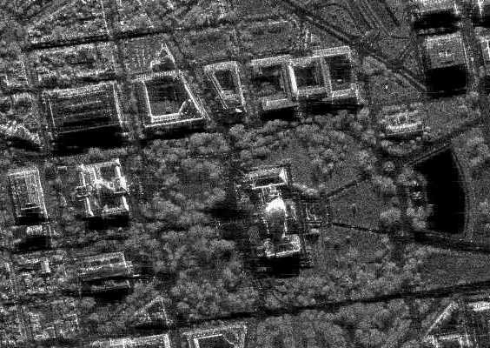
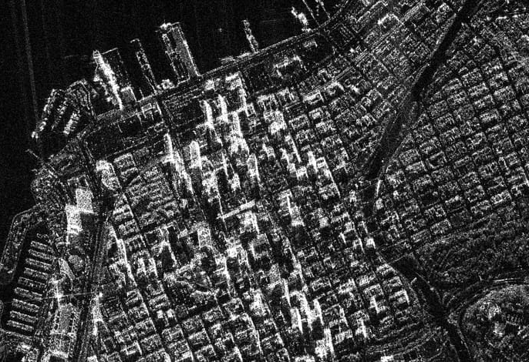
SAR Images

Slide 7
Autoencoders :
Autoencoders are unsupervised neural networks that compress input data into a lower-dimensional latent space & reconstruct it with minimal information.

Slide 8
Methods: Autoencoders:
These are unsupervised neural networks that learn to compress and reconstruct data.
The process involves:
Encoder: Reducing the dimensionality of the SAR image by extracting key features.
Bottleneck: Storing the compressed representation in a lower-dimensional latent space.
Decoder: Reconstructing the SAR image from the latent space.
The goal is to minimize information loss during compression and reconstruction.

Slide 9
Flowchart of Autoencoders based Compression:
Input SAR Image (high dimensional)
Encoder (convolutional layer & activation function)
Latent space representation (compressed form)
Decoder (Transposed convolutional layer)
Reconstructed SAR image (lower size minimal loss)

Slide 10
Project Breakdown:
The project is structured into three main stages, followed by an image translation process:
SAR Image Compression:
Objective: To reduce the size of SAR images while preserving essential information.

Slide 11
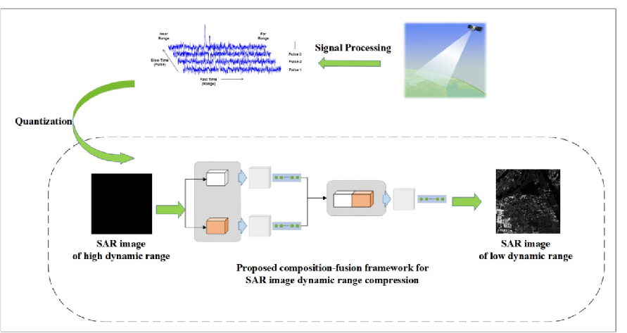

Slide 12
Wavelet Transform (JPEG 2000):
A frequency-domain technique that decomposes the image into multiple sub-bands.This allows for efficient compression while preserving edge details.
The steps include:
Applying a discrete wavelet transform to the original SAR image.
Splitting the transformed image into frequency sub-bands (LL, LH, HL HH).

Slide 13
Quantization and entropy coding to compress the data.
JPEG 2000 is highlighted for its ability to maintain high fidelity in compressed images and handle high-resolution data effectively.

Slide 14
Flowchart of Wavelet Transform:
Original SAR image
Apply Discrete wavelet transform
Split into frequency Sub-bands(LL,LH,HH,HL)
Quantizational encoding (entropy coding)
Compressed SAR image

Slide 15
Why JPEG 200?
Because maintains high fidelity in compressed images
More efficient than traditional DCT-based JPEG Compression.
Handles high resolution SAR data better.

Slide 16
Variational Autoencoders (VAEs) for learning Compressed Representations:- for final Compresion & Denoising.
Intro to VAE-(Efficient Storage & Denoising)
VAE's improve upon standard autoencoders by learning a probabilistic distribution in latent space. They generate Compressed representetions that are useful for better reconstruction & denoising SAR images.

Slide 17
Architecture:
Encoder:- Maps input SAR image into a probabilistic latent distribution (mean & variance)
Latent space sampling: A stochastic proces using the reparameterization trick.
Decoder. Reconstructs the image from sampled latent Variables.

Slide 18
Flowchart:
Encoding:
Latent Space Sampling:
Decoding:
SAR image
Sample from Gaussian
distribution
Generate compressed Representation
Convolutional layer
Reconstruct Image using
CNN Layers
mean & variance
estimation

Slide 19
Why use VAEs for SAR image impression?
Leaves compact representations with generativie capabilities.
Helps in viewing noise during compression.
Can generate SAR images from learned latent space.

Slide 20
After compression I want to convert SAR images to optical images.
Before that we have to done preprocess:
Denoising(reduce speckle noise inherent in SAR images)
Normalization (standardize pixel values)
Resizing(ensure uniform input dimensions)

Slide 21
Denoising: (speckle noise reduction):
SAR images contain speckle noise due to coherent nature of radar Signals. This noise can affect the performances of deep learning models.
Use a median filter to reduce speckle noise while Preserving edges

Slide 22
2.Normalization (Pixel value standardization)
It helps scale the image intensity values between a fixed range,
Usually [0,1] or [-1,1] to improve model convergence.
Ex: Min-Max Normalization-Transforms pixel valves to range [0,1]

Slide 23
3.Resizing (uniform input dimensions) :-
Deepleaming models require fixed image sizes for batch Processing
Ex. Resizing to 256x256
bez deep learning requires uniform size images

Slide 24
Flowchart :
SAR image
Denoising (speckle reduction)
Normalization ([0,1] scaling)
Resizing(256*256)
Model Input

Slide 25
SAR to Optical Image Translation (using Pix2Pix and GANs):
Objective: To generate corresponding optical images from SAR images.
Methods: Pix2Pix Model (U-Net Architecture):This model uses a U-Net architecture for image translation.

Slide 26
The U-Net consists of:
Encoder: Convolutional layers.
Bottleneck: Compresses information.
Decoder: Transposed convolutions.
Skip connections: Link encoder and decoder layers.

Slide 27
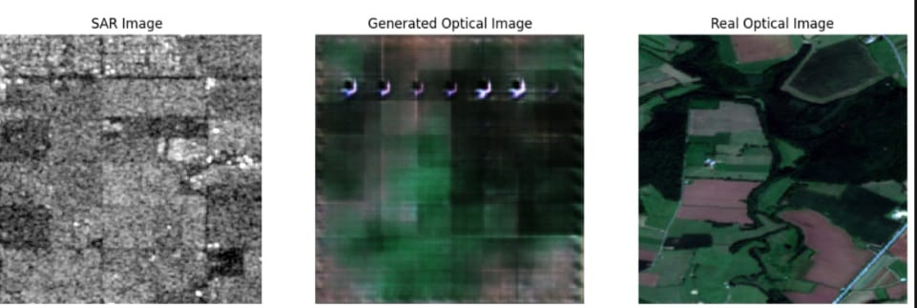

Slide 28
Loss Functions:
Adversarial loss: Measures the realism of the generated images.
Reconstruction loss: Measures the difference between the generated and real optical images.

Slide 29
Preprocessing :
Importance: Essential for optimal model performance.
Denoising: SAR images contain speckle noise, which can be reduced using median filtering.
Normalization: Pixel values are standardized (e.g., Min-Max normalization) to improve training stability.
Resizing: SAR images are resized to a uniform dimension for input into the Pix2Pix model.

Slide 30
Applications:
Remote sensing
environmental monitoring
disaster management
urban planning.

Slide 31
Conclusion :
The project successfully developed a system for SAR image compression and translation.
Autoencoders and wavelet transforms were effective for compression.
Pix2Pix and GANs achieved accurate SAR to optical image translation.

