Slide 1

Task Planner
7/5/2016
TimeLords
Sergiy Ravnyago-Scrum Master
Julia Moffitt-Product Owner
Brian Houts-Team Member
Jeff Wagenseller-Team Member
Michaela Molina-Team Member
TP
TP
Notes:
Brian

Slide 2
Project Release Plan
Task Planner (TP)
TP is an android application in which the user can add tasks to designated projects including certain attributes about this task. The first release includes a search bar, and certain list pages which prioritize and display tasks in useful ways (quick tasks, urgent, completed tasks).
Notes:
Brian

Slide 3
Project Release Plan: User Stories
Task Planner--Sprint 1-- part 1
High Level Goal: The release will be able to add tasks to a project with certain attributes, namely: task name, associated project, start date, due date, finished date, whether completed, notes, estimated task length and a tag to group tasks from different projects together.
As a user I want to be able to schedule a due date for my task so I know when to get it done.
As a user I want to be able to add notes to each task so I can have a place to put other relevant information not provided by the pre-existing list of attributes
As a user I want the app to REMEMBER my tasks when I exit the app
As a user I want to be able to quickly make new tasks so that I can engage in “brain dump” quickly when I think of a task.
As a user I want to add Task attributes, and easily edit them to distinguish them.
As a user I want to be able to mark tasks as done so that I know what tasks I have completed
Notes:
Jeff and Michaela

Slide 4
Project Release Plan: User Stories
Task Planner--Sprint 1-- part 2
High Level Goal: When adding a task a user can add it to a specific project
As a user I want to be able to create a new project so that I can organize my tasks into groups.
As a user I want to be able to organize my tasks into projects so that I can separate tasks and view them more easily.
High Level Goal: The sleek and minimalistic design will incorporate the homepage which will always be available open a leftward swipe.
As a user I want an android app user interface to open and use my app
As a user I want an user interface that allows me to swipe from the menu page to other pages flawlessly, so I can navigate through the application
High Level Goal: The homepage will have a drop-down file tree displaying the projects
As a team member I want to have a super class that holds all instances of projects so that later it will be easier to create a collapsible project list in our menu.
Notes:
Jeff and Michaela

Slide 5
Project Release Plan: User Stories
Task Planner--Sprint 2-- part 1
High Level Goal: The task defaults into the “Dump”
As a user I want a “dump” page to hold all of my tasks that are not organized into a project so that I can create tasks not assigned to a specific project (the default project will be the dump)
High Level Goal: homepage will have the search bar, a drop-down file tree displaying the projects
As a user I want a collapsible list of projects in my menu so that I can navigate the application easily
High Level Goal: link to a list of “Quick Tasks,” a link to Urgent tasks
As a team member I want “QuickTasks”, and “Urgent” placeholders to be on the home-page
As a user I want to be able to attribute an estimated length to my tasks so I (and later the app itself) can identify quick tasks easily
High Level Goal:universal button present on all the app pages such that a user can add tasks/projects from all locations
As a user I want to be able to add tasks/projects from all pages so that I have to do less navigating
High Level Goal:Completing a task, by checking a box, will result in an awesome, satisfying animation!
As a user I want to be able to have a satisfying animation when I “complete” a task so that I can feel good about myself and my accomplishments.
Notes:
Sergiy and Brian

Slide 6
Project Release Plan: User Stories
Task Planner--Sprint 2-- part 2
High Level Goal:This homepage will have the search bar
As a user I want to be able to “tag” my tasks so I can search and find all tasks with that tag.
High Level Goal: Add tasks to a project with certain attributes
As a user I want to be able to attribute an estimated length to my tasks so I (and later the app itself) can identify quick tasks easily
As a user I want to be able to set priority levels for each of my tasks so I know what the most important tasks are.
High Level Goal:Tasks and projects can be deleted and completed
As a user I want to be able to delete tasks to declutter lists.
As a user I want to be able to delete projects in case I fux up
Notes:
Brian and Sergiy

Slide 7
Project Release Plan: User Stories
Task Planner--Sprint 3
High Level Goal: Sleek and minimalistic design
As a user I want a sleek and intuitive graphic interface so that I can use the app efficiently.
High Level Goal: It will have a search function to find tasks quickly
As a user I want a search bar in my menu to easily search through and find tasks/projects.
As a user i want to be able to search for projects (via drop down and typing and based on name and tags) and create a new project from the new task page so that I can organize my tasks into projects.
High Level Goal: User may filter and sort his/her tasks list
As a user I want to be able to filter all tasks regardless of project by other attributes (start date, due date, urgency, tags, etc) and view all the tasks of that attribute so that I am aware of my urgent tasks quickly.
High Level Goal: User may search and explore completed tasks and projects
As a User I want access to a list of recently completed tasks so I can reflect on my productivity .
As a User I want to access a list of completed projects so I can look at what I’ve been doing with my life and either cry with joy or sadness
As a user I want my completed tasks to be removed from the list after a user defined period of time so my lists remain uncluttered
Notes:
Julia and Sergiy

Slide 8
Project Release Plan: User Stories
Task Planner--Product Backlog
As a user I want to be able to Merge projects together.
As a user I want the app to notify me when a start date attribute for a task has happened.
As a user I want to make tasks that repeat every scheduled number of days so that I don’t have to keep entering recurring tasks
As a user I want to be able to place tasks onto a “defer” list so that I can keep track of tasks where I am waiting for someone else to complete something before I can take the next step to “complete” the task
As a user I want to be able to sync my task list with google calendar (such that my task list app populates google calendar) so that I don’t have to waste time entering all of these tasks into my multiple scheduling tools.
As a user I want to be able to sync my gmail with my task app (such that emails show up in my “dump”) so I can schedule emails as tasks.
As a user I want to be able to schedule tasks via a “this date + this amount of time (e.g. 4 days) so that I can more generally schedule a task to be done within a time frame rather than a specific date/time
As a user I want to be able to specify tasks as parallel or sequential so I know if there are any dependencies in my task list.
Notes:
Julia and Sergiy

Slide 9
TimeLords - Task Planner
Project Release Plan - Architecture

Slide 10
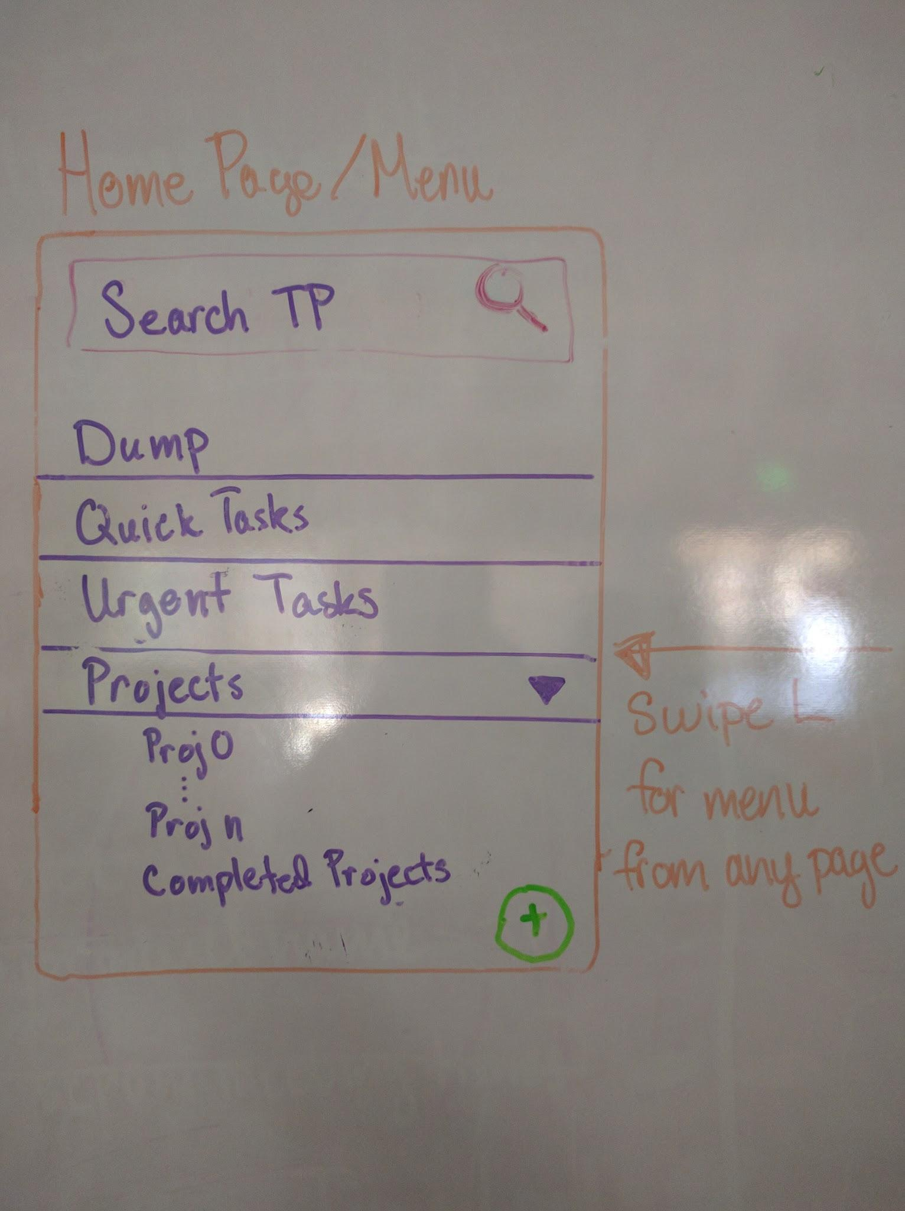
Notes:
Jeff
4 pages:
Menu with list of projects, dump, quick tasks, urgent tasks, and completed tasks
app opens in menu page
swipe left from any other page to access menu
search bar--can search by name keyword or tag
Project page
contains list of tasks-- “to do” and “completed”
Edit Project page
can edit project name or delete
can decide how long completed tasks stay in list before auto delete
other settings to come? ideas anyone?
Task Edit page
edit task name or delete task
set attributes (there are many!)
Other Features:
global task/project addition button
fancy task completion animation

Slide 11
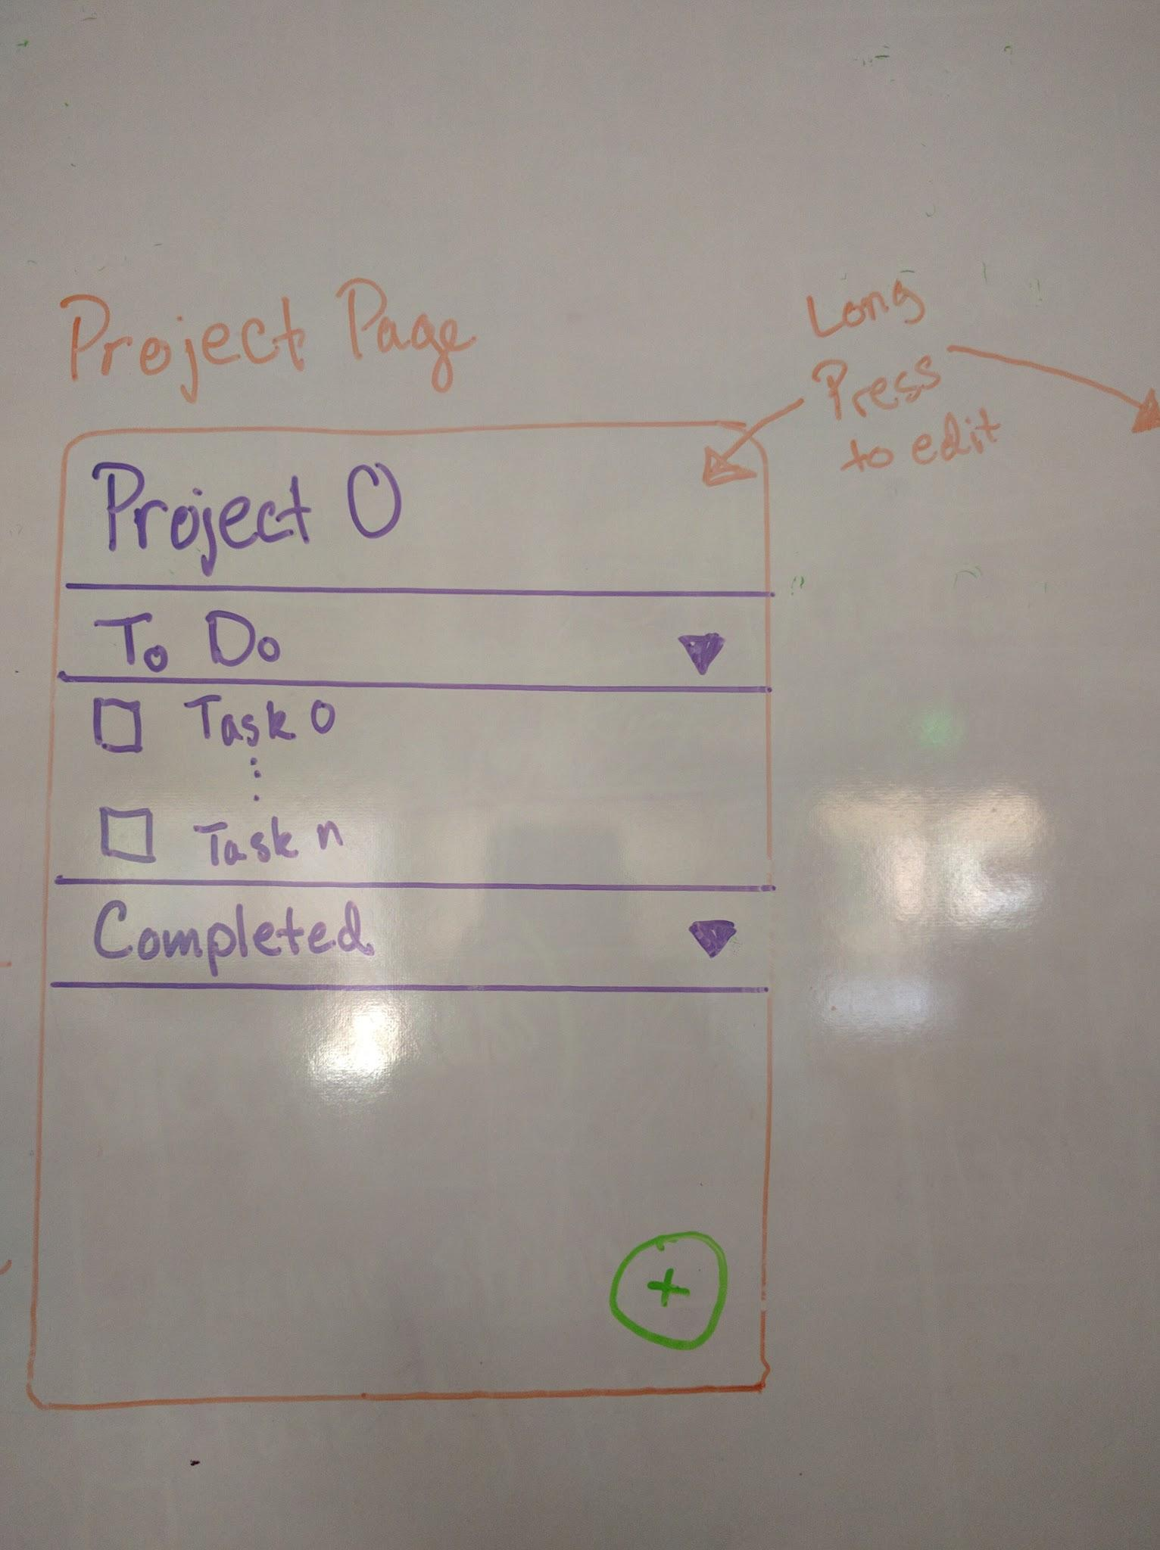
Notes:
Jeff
4 pages:
Menu with list of projects, dump, quick tasks, urgent tasks, and completed tasks
app opens in menu page
swipe left from any other page to access menu
search bar--can search by name keyword or tag
Project page
contains list of tasks-- “to do” and “completed”
Edit Project page
can edit project name or delete
can decide how long completed tasks stay in list before auto delete
other settings to come? ideas anyone?
Task Edit page
edit task name or delete task
set attributes (there are many!)
Other Features:
global task/project addition button
fancy task completion animation

Slide 12
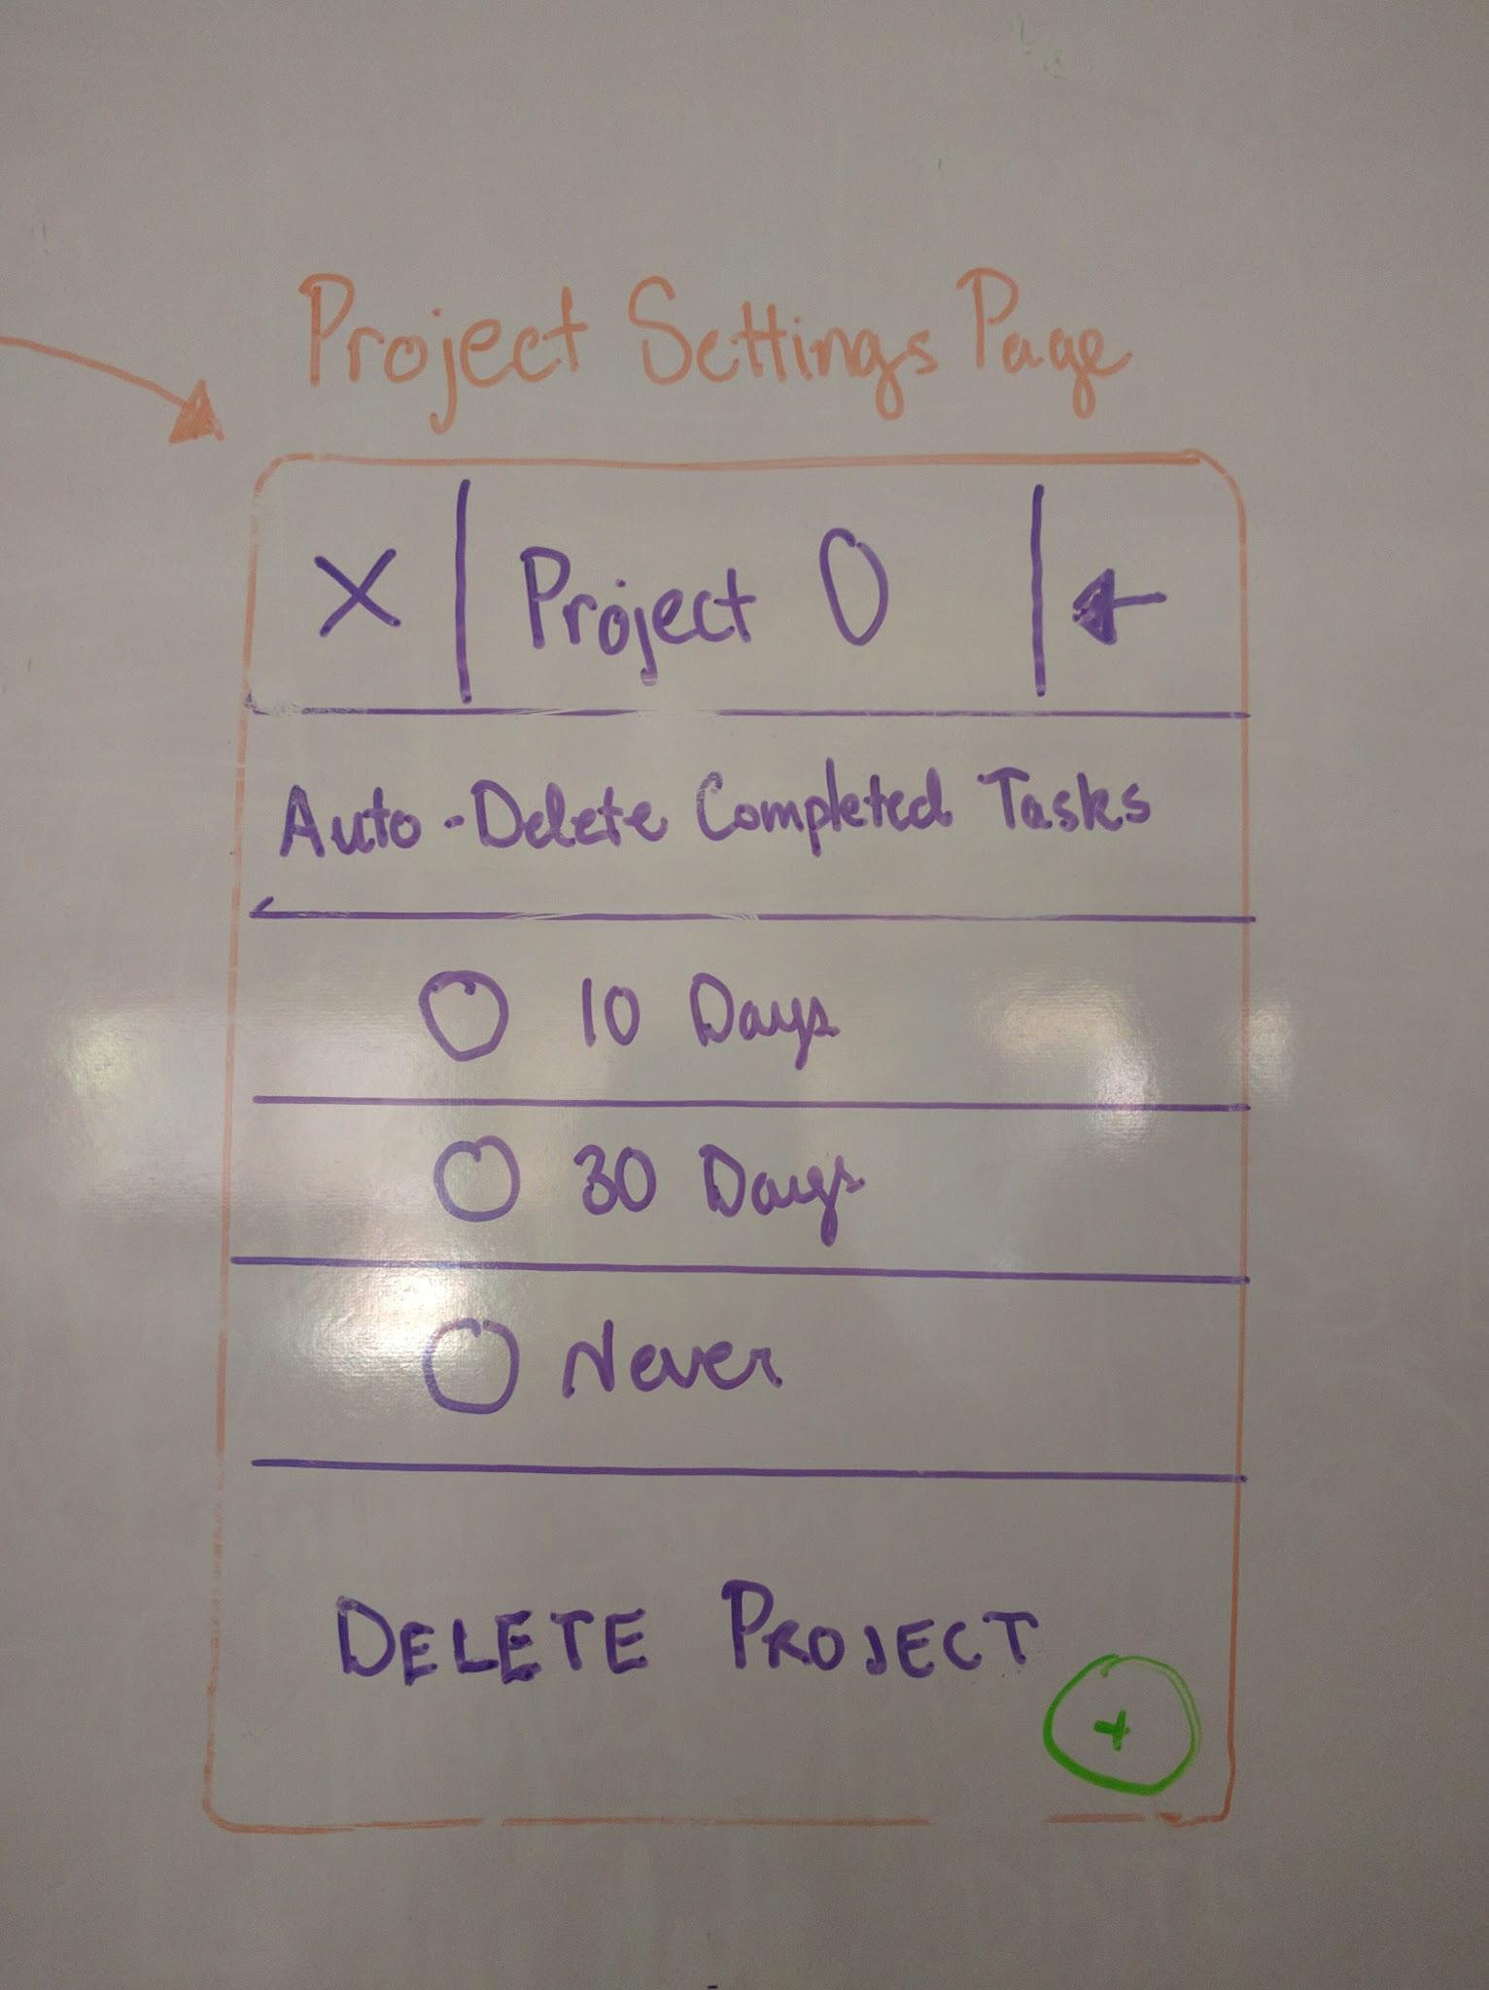
Notes:
Julia
4 pages:
Menu with list of projects, dump, quick tasks, urgent tasks, and completed tasks
app opens in menu page
swipe left from any other page to access menu
search bar--can search by name keyword or tag
Project page
contains list of tasks-- “to do” and “completed”
Edit Project page
can edit project name or delete
can decide how long completed tasks stay in list before auto delete
other settings to come? ideas anyone?
Task Edit page
edit task name or delete task
set attributes (there are many!)
Other Features:
global task/project addition button
fancy task completion animation

Slide 13
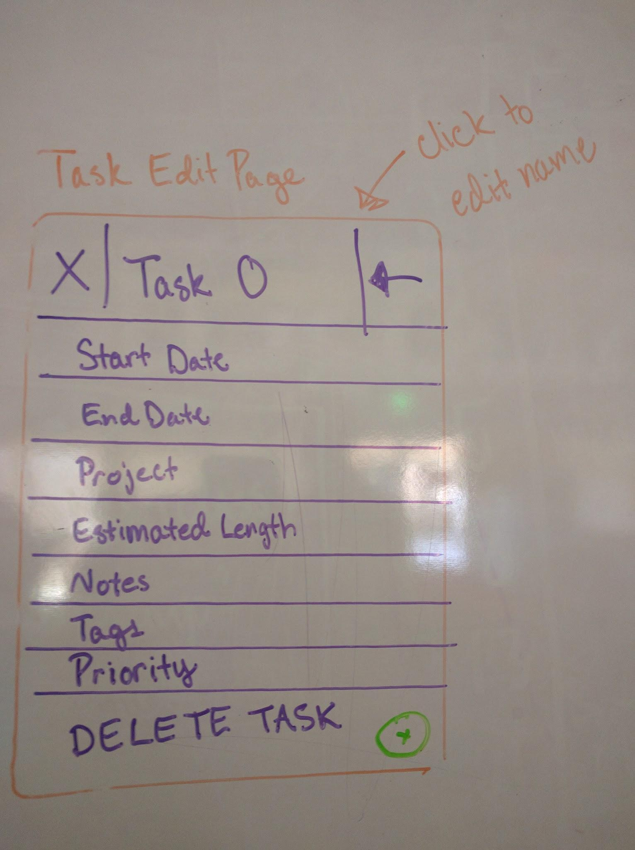
Notes:
Julia
4 pages:
Menu with list of projects, dump, quick tasks, urgent tasks, and completed tasks
app opens in menu page
swipe left from any other page to access menu
search bar--can search by name keyword or tag
Project page
contains list of tasks-- “to do” and “completed”
Edit Project page
can edit project name or delete
can decide how long completed tasks stay in list before auto delete
other settings to come? ideas anyone?
Task Edit page
edit task name or delete task
set attributes (there are many!)
Other Features:
global task/project addition button
fancy task completion animation

Slide 14
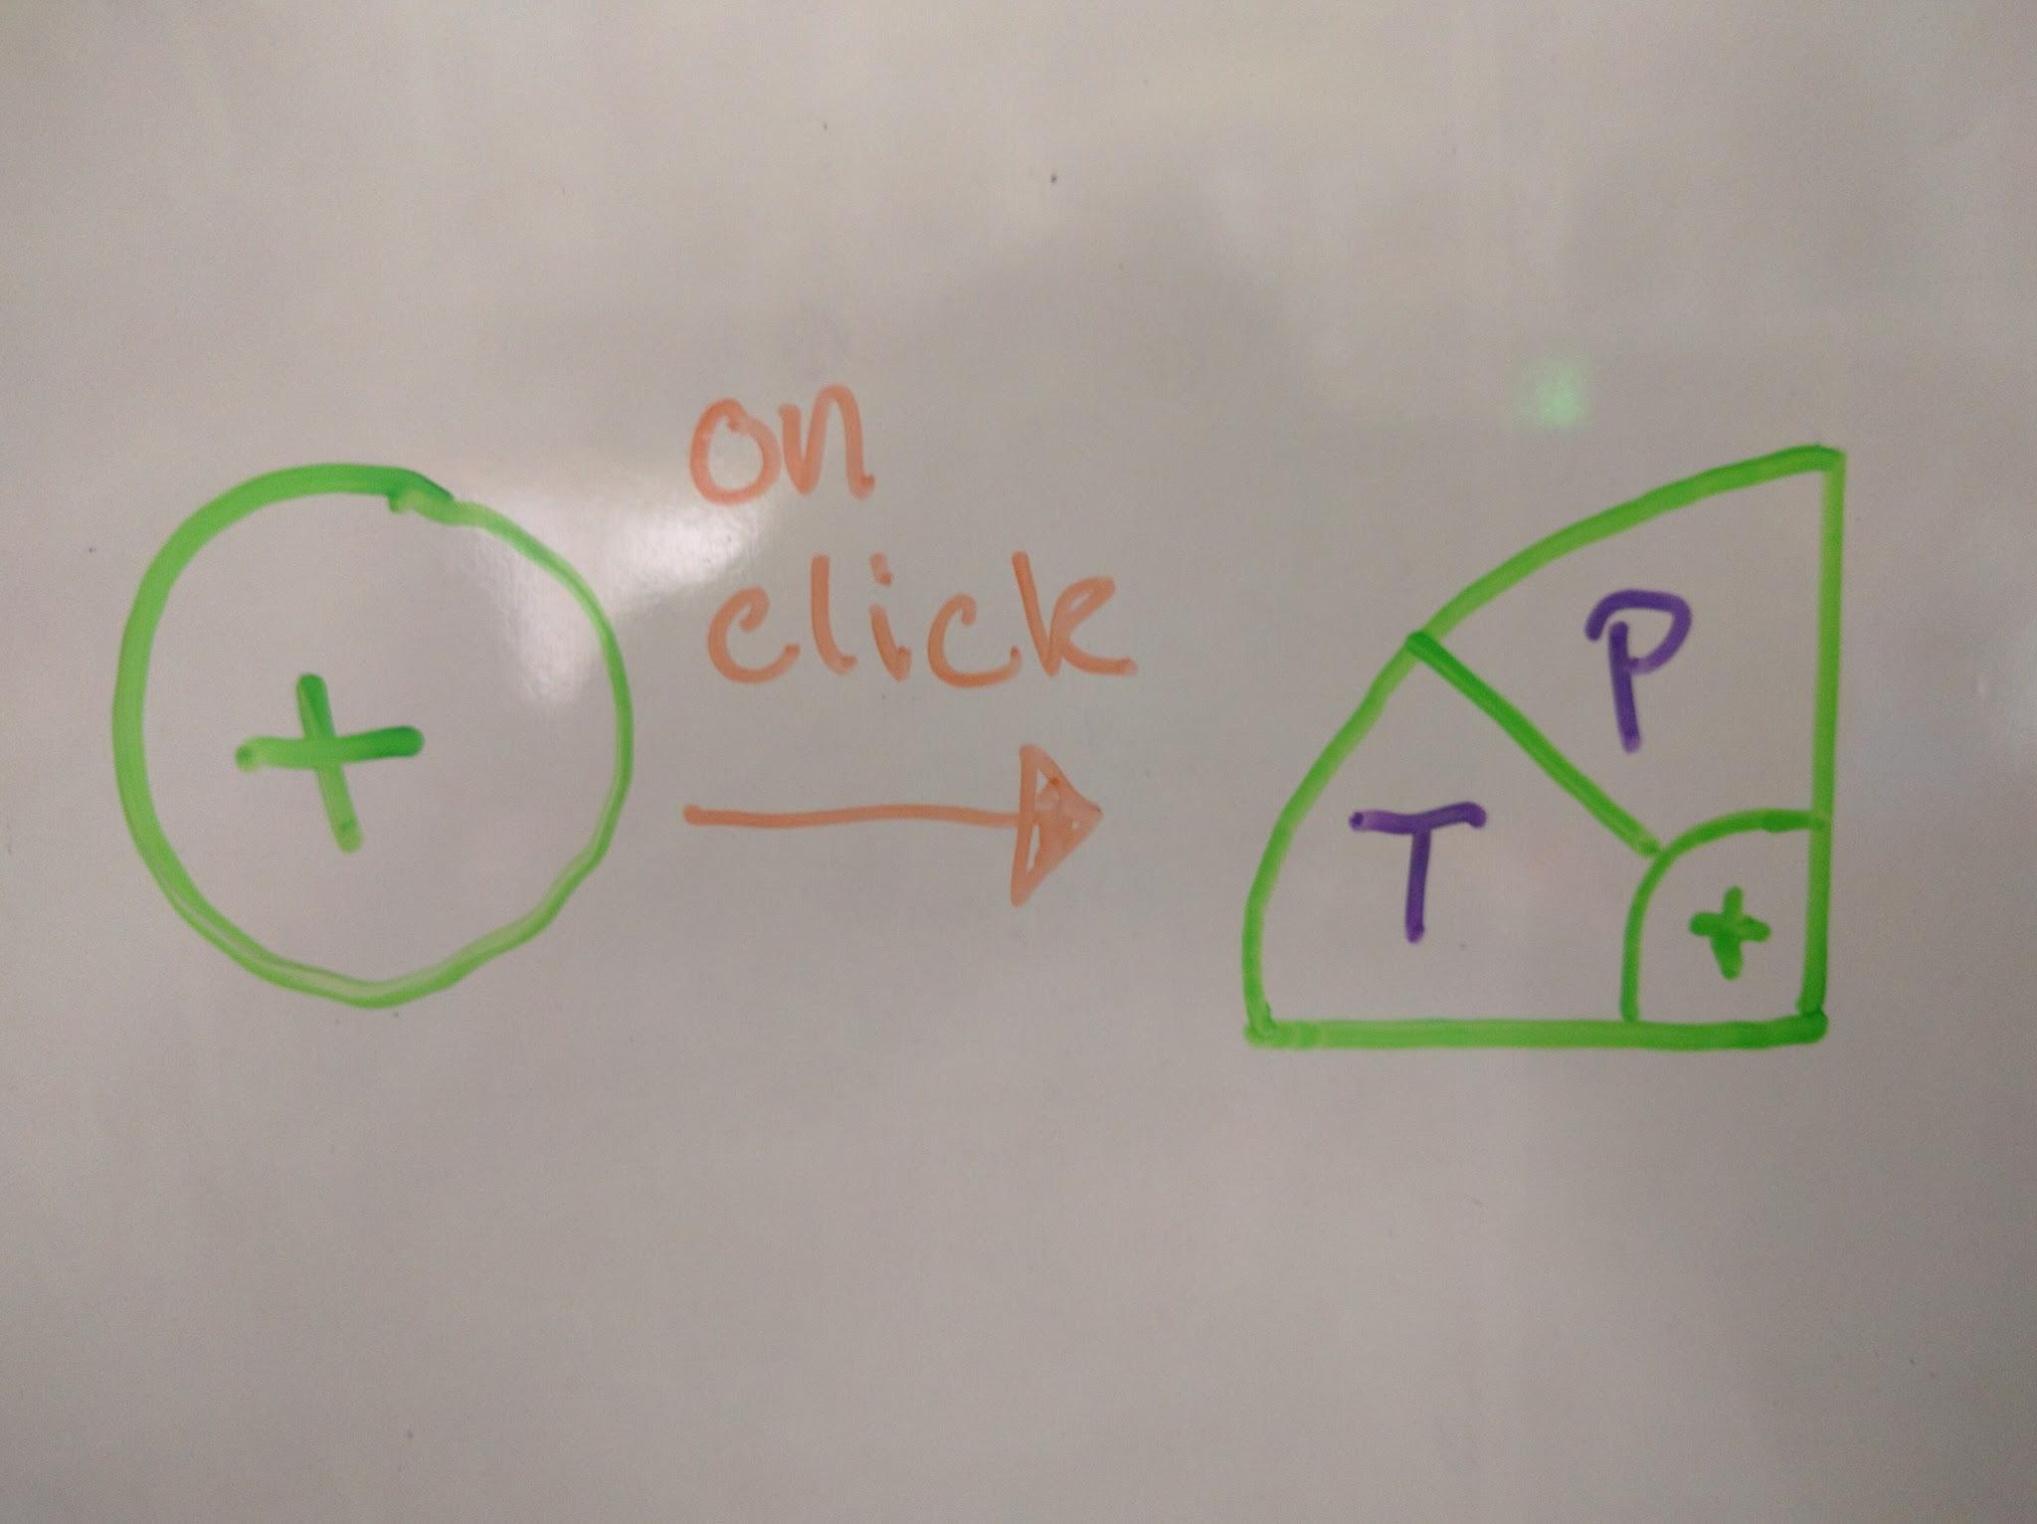
Notes:
Michaela
4 pages:
Menu with list of projects, dump, quick tasks, urgent tasks, and completed tasks
app opens in menu page
swipe left from any other page to access menu
search bar--can search by name keyword or tag
Project page
contains list of tasks-- “to do” and “completed”
Edit Project page
can edit project name or delete
can decide how long completed tasks stay in list before auto delete
other settings to come? ideas anyone?
Task Edit page
edit task name or delete task
set attributes (there are many!)
Other Features:
global task/project addition button
fancy task completion animation

Slide 15
Project Release Plan: Challenges/Risks
We are all new to Android Studio and app development. For most of us this our first time making a mobile application.
Our goal is to make a sleek and intuitive graphic user interface.
We want to provide search functionality to find specific tasks/projects.
We want to provide Filtering and Sorting for all tasks regardless of the project it is associated with, for an example: All quick tasks or tasks that take 10mins or less to accomplish.
We want our app to store data efficiently, and quickly retrieve it.
We want a user to retrieve a list of recently completed tasks in only few clicks.
Notes:
all get one challenge

Slide 16
Project Release Plan: Technologies
Task Planner
JAVA programming language
Android Studio IDE
AVD Android Emulator
Android SQLite Database
Notes:
Michaela

Slide 17
Project Release Plan
Task Planner
Any Questions?
TP
TP
Notes:
Michaela

