Slide 1


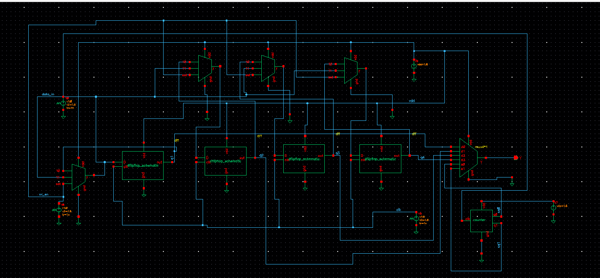
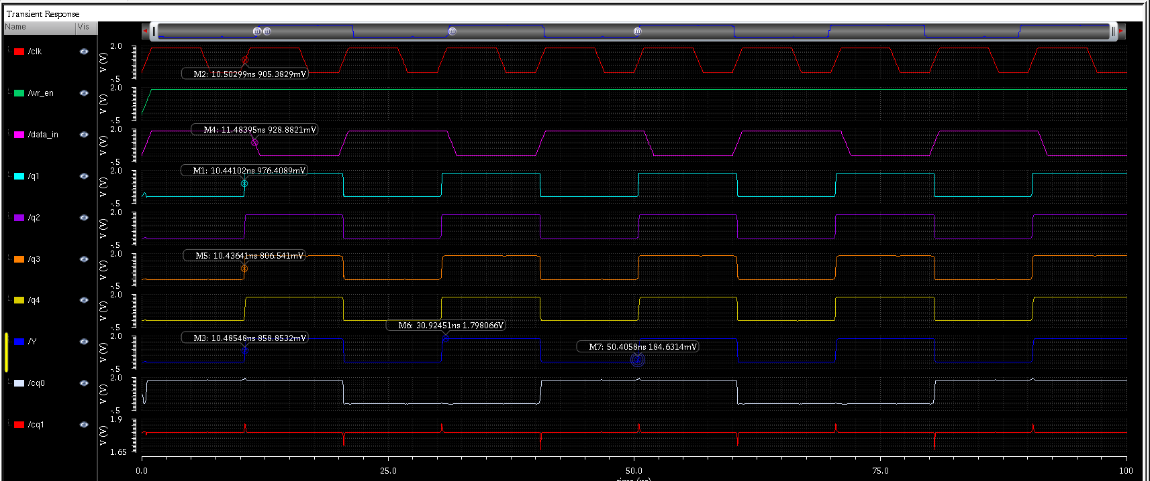
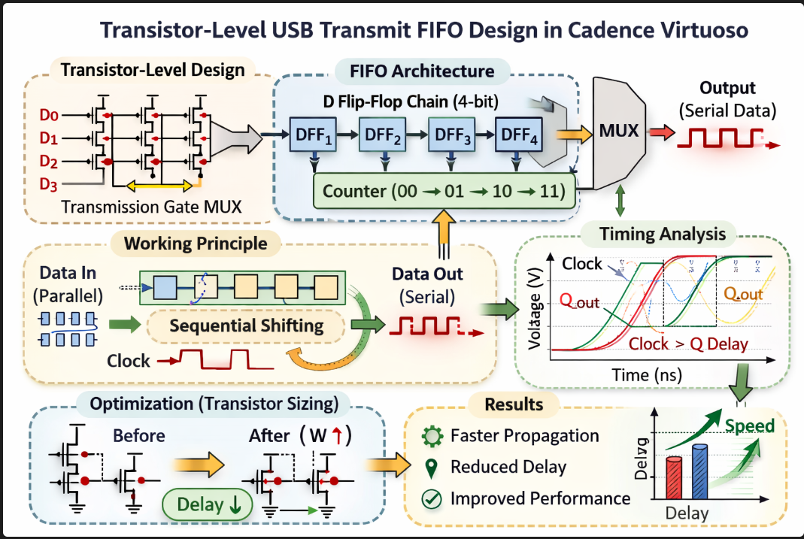
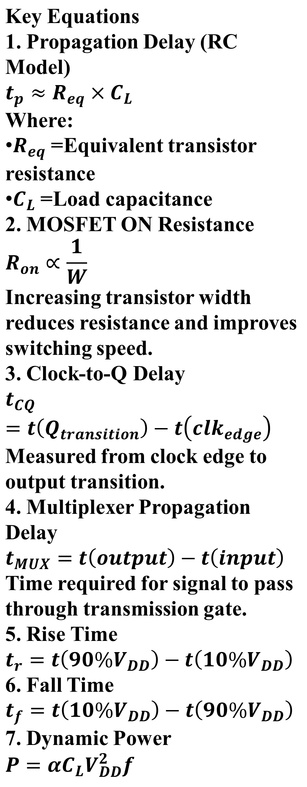
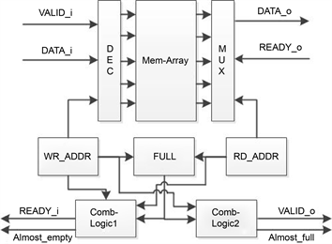
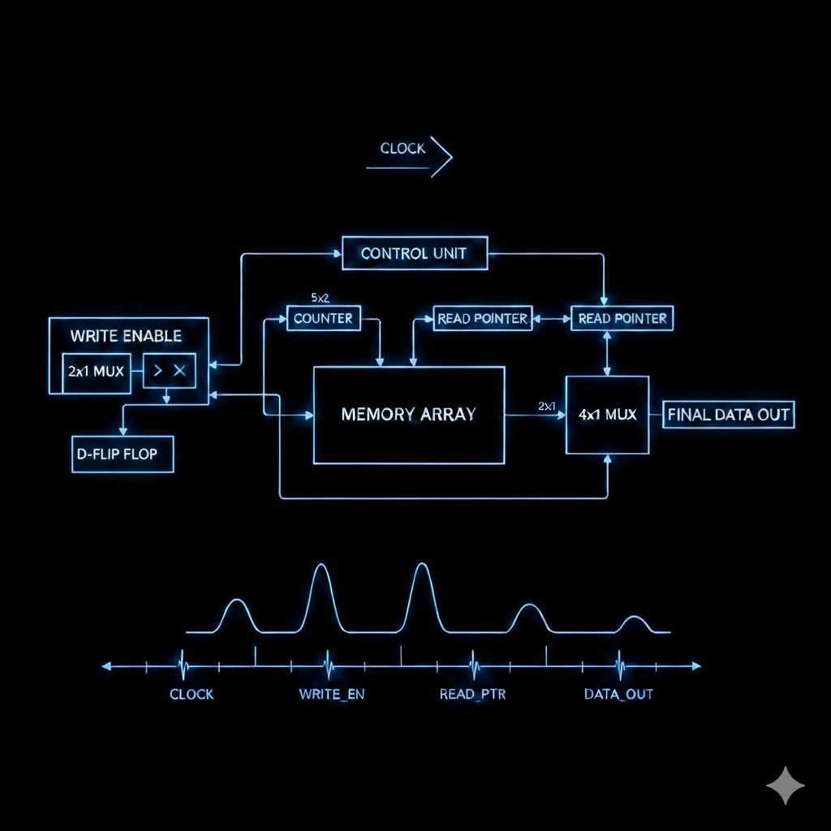
TRANSISTOR-LEVEL TIMING ANALYSIS AND OPTIMIZATION OF USB TX FIFO
2310040032(M. Sravya), 2310040077(T. Tejaswini Reddy)
Courses: VLSI DESIGN AND AUTOMATION(23VLS3303A), VLSI SUBMICRON DESIGN AND VERIFICATION(23SDEC18A)
TESTING AND VERIFICATION OF VLSI CIRCUITS(23VLS3202R)
Electronics and Communication Engineering Department, Aziz Nagar, Hyderabad, Telangana, India
Supervised by
Dr. Phalguni Singh, Dr. Kasi Bandla, Dr. Vivek Singh, Dr. Kayam Sai Kumar
Abstract
Performance Analysis and Discussions
Designed a USB transmit FIFO at transistor level using Cadence Virtuoso to study sequential data flow and analyze timing behavior in digital communication systems.
Implemented transmission-gate based multiplexer, master–slave D flip-flop chain, counter-based selection logic, and output multiplexer to achieve FIFO architecture.
Verified correct FIFO operation through transient simulations, demonstrating sequential data shifting and proper output selection using counter-controlled multiplexer.
Performed timing analysis by measuring clock-to-Q delay, multiplexer propagation delay, and rise/fall times to evaluate circuit speed and signal integrity.
Applied transistor-level optimization through transistor width resizing, reducing propagation delay and improving switching performance for high-speed USB transmission applications.
Demonstrated how transistor sizing impacts RC delay and drive strength, highlighting trade-offs between speed improvement, power consumption, and circuit stability in FIFO design.
Fig.3: Schematic Design of USB TX FIFO
Introduction
Parameter | Before Optimization (ns) | After Optimization (ns)
tCQ | 0.059ns | 0.057 ns
tMUX | 0.062 ns | 0.044ns
Rise Time | 0.6975 ns | 0.5186ns
Fall Time | 0.052 ns | 0.183 ns
USB communication systems require reliable high-speed data transmission, making buffering structures like FIFO essential for maintaining correct data order and timing synchronization.
FIFO (First-In First-Out) architecture temporarily stores data and ensures that information exits the system in the same order as received.
In digital communication interfaces, FIFO helps manage differences between data input rate and output transmission rate, preventing data loss and improving system stability.
Transistor-level design provides detailed control over switching behavior, enabling accurate timing analysis and optimization beyond gate-level or behavioral design approaches.
Fig.5: Transient Analysis of USB TX FIFO Fig.6: Circuit Diagram of USB TX FIFO
Functional verification confirmed correct FIFO operation, showing sequential data shifting through D flip-flop stages and accurate output selection controlled by counter signals.
Before optimization, multiplexer propagation delay contributed significantly to total latency due to higher transmission gate resistance and weaker driving capability.
Rise and fall times improved after optimization, resulting in sharper signal transitions and enhanced waveform quality suitable for high-speed USB transmission.
Clock-to-Q delay remained stable, indicating that optimization targeted only multiplexer performance without introducing timing instability inside flip-flop stages.
Overall results show transistor-level optimization effectively enhances FIFO timing performance, proving that selective resizing improves speed while maintaining reliable digital operation.
Fig.1: Graphical Abstract USB TX FIFO
Conclusion
Proposed Methodology and Design
Successfully designed a USB transmit FIFO at transistor level using transmission-gate based modules, ensuring accurate sequential data storage and controlled output selection.
Functional verification through transient simulation confirmed correct FIFO behavior, demonstrating proper data shifting across flip-flop stages and correct multiplexer output.
Detailed timing analysis measured clock-to-Q delay, propagation delay, and rise/fall times to evaluate overall switching performance and signal integrity.
Transistor-level optimization through resizing transmission gate widths significantly reduced multiplexer propagation delay and improved switching speed without affecting functionality.
The project highlights importance of transistor-level timing optimization for enhancing high-speed digital communication circuits such as USB transmission and buffering architectures.
The proposed design is analyzed using an equivalent transistor-level model to study switching behavior and timing performance in FIFO architecture.
Each module, including multiplexers and flip-flops, is modeled using MOS transistors to capture real electrical characteristics and delay effects.
The design considers parasitic resistance and capacitance, which influence propagation delay and signal transition speed in high-speed digital circuits.
RC delay modeling is used to approximate switching performance and identify critical timing paths within the FIFO data transmission structure.
Future work can include layout-level implementation and parasitic extraction analysis to study real interconnect effects and further optimize timing and power performance.
Advanced technology nodes such as FinFET or nanoscale devices can be explored to achieve higher speed, lower power consumption, and improved scalability for high-speed FIFO designs.
References
https://doi.org/10.54254/2755-2721/121/2025.19491
https://ieeexplore.ieee.org/document/ETCS.2009.759
https://www.ijitee.org/wp-content/uploads/papers/v8i7S/G10240587S19.pdf
https://www.ece.ucdavis.edu/~vojin/CLASSES/EEC281/CMOS-VLSI-Design.pdf
https://www.electronics-tutorials.ws/combination/comb_7.html
https://www.allaboutcircuits.com/textbook/digital/chpt-10/edge-triggered-d-flip-flops/
https://ptolemy.berkeley.edu/projects/embedded/asves/dic-book.pdf
https://cmosedu.com/jbaker/courses/ee421L/f23/students/readings/CMOS_Circuit_Design.pdf
https://www.synopsys.com/glossary/what-is-static-timing-analysis.html
https://www.ti.com/lit/an/scaa013/scaa013.pdf
https://www.fpga4student.com/2017/01/verilog-code-for-fifo-memory.html
https://ieeexplore.ieee.org/document/4378472
https://ocw.mit.edu/courses/6-374-analysis-and-design-of-digital-integrated-circuits/
https://support.cadence.com/apex/ArticleAttachmentPortal?id=a1Od0000000nUu3EAE
https://www.electronicshub.org/multiplexer/
https://www.allaboutcircuits.com/technical-articles/introduction-to-static-timing-analysis/
Fig. 1: Values before and after Optimization
Fig.2: Architecture of USB TX FIFO

