Slide 1
newrepository>intiallize with readme>start
\\file creation
create new file>edit it>>commit--------->in server repo
//upload file------->upload anything
upload>commit changes
//to clone or download
clone>copy link>rght click on desktop>git clone>ok
We can push frolocal repo to-→ server Repo
We can pull ←-

Slide 2
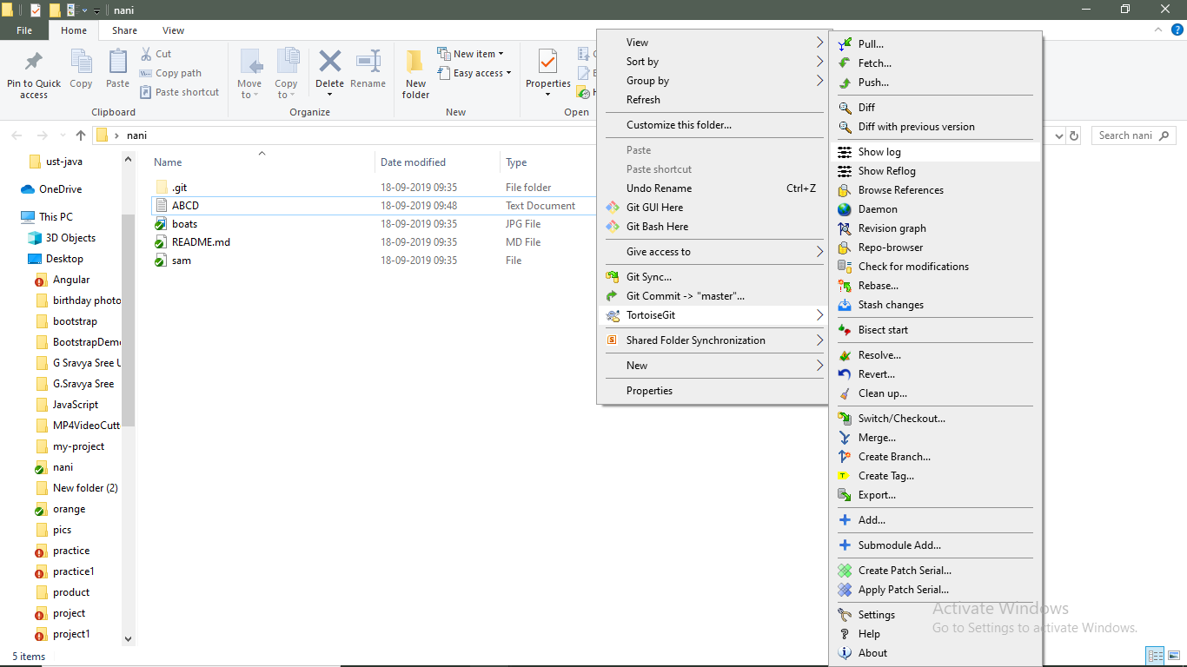

Slide 3
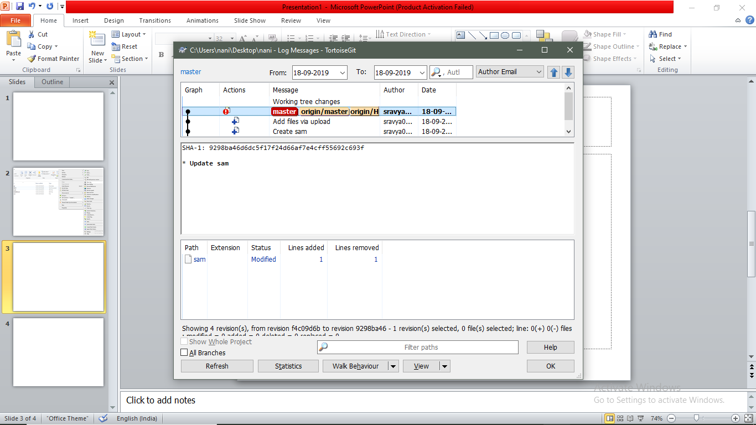

Slide 4
Git

Slide 5
upload/ and commit

Slide 6
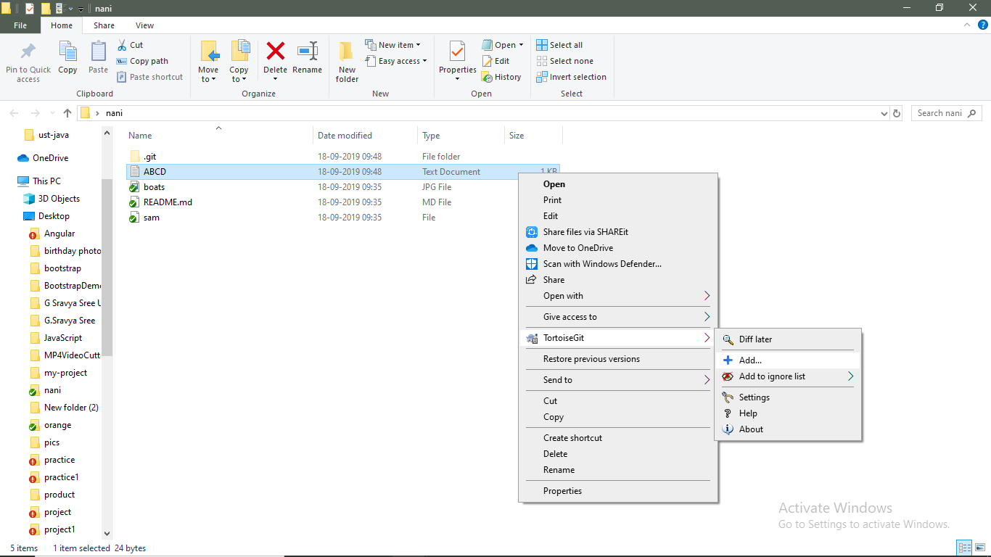

Slide 7
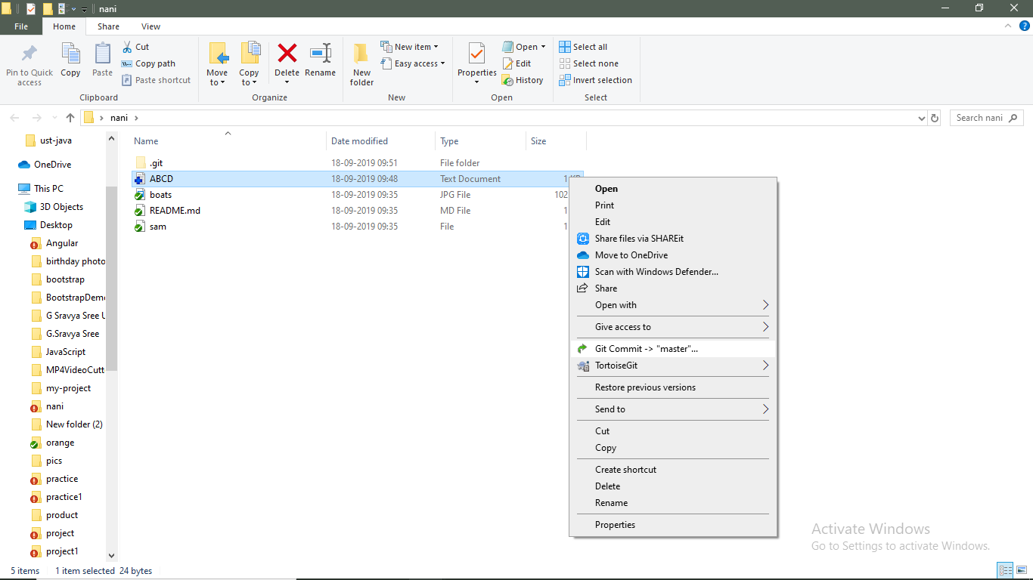

Slide 8
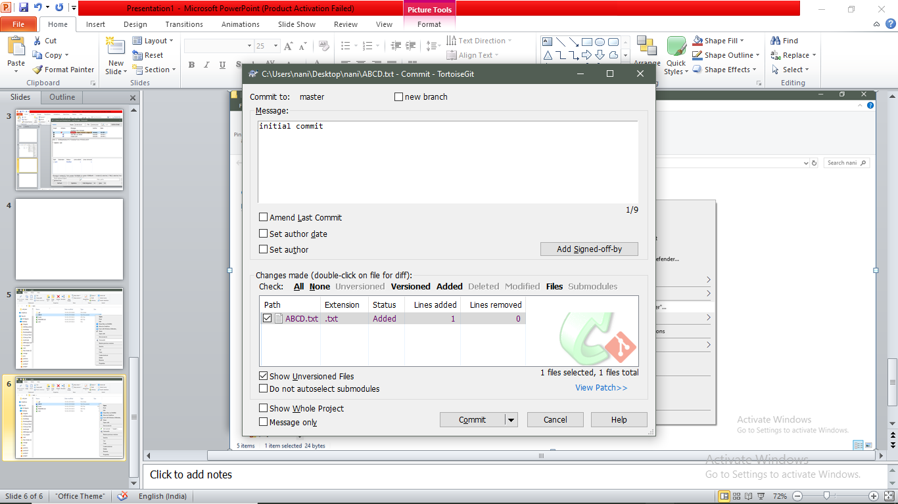

Slide 9
