Slide 1
AIAPS
Artificial Intelligence based Accident Prevention System
Team - 24
Computer Science and Engineering Department,
Sri Vasavi Engineering College.
Vamsi Krishna
Teja Sri
Sravya
Vaishnavi

Slide 2
Problem Statement
Cause of Accidents
Detecting the cause of accident and try to prevent the accident
Drowsy Driving
Distracted Driving
Using mobiles while driving

Slide 3
Motivation
According to NHTSA
10,874 people died in crashes in 2017 in America due to drowsy driving.
3,166 people died in distracted driving in 2017 alone in America.
1,47,913 people were died in road accidents in 2017 due to drivers dozing off in India.
According to Institute of Insurance Society,
In 2018, 467044 road accidents in India with increase of 0.5% from 464910 in 2017

Slide 4
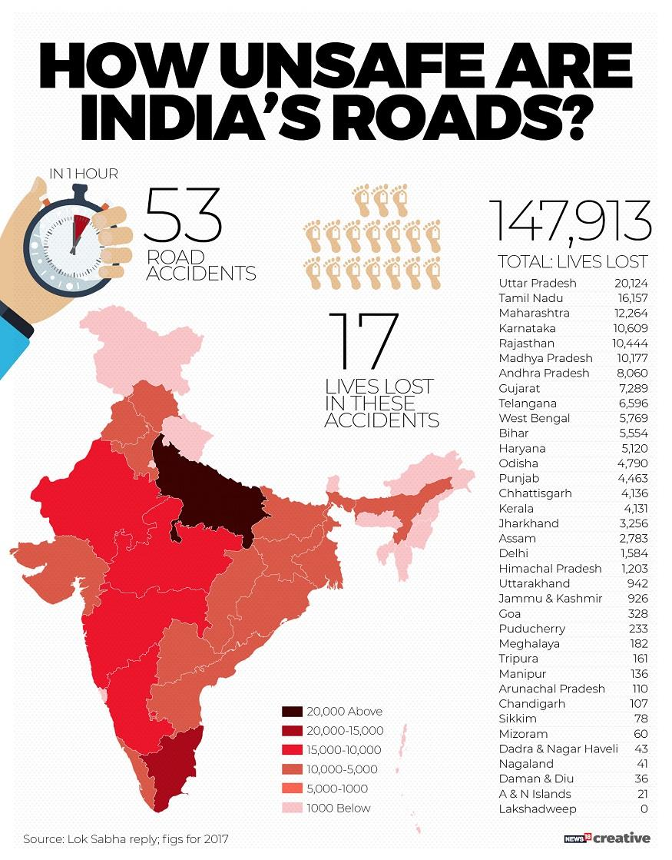

Slide 5
Technology Stack
Python
Tensorflow 2.0
Keras
OpenCV
Matplotlib
Numpy
Pandas
gTTS

Slide 6
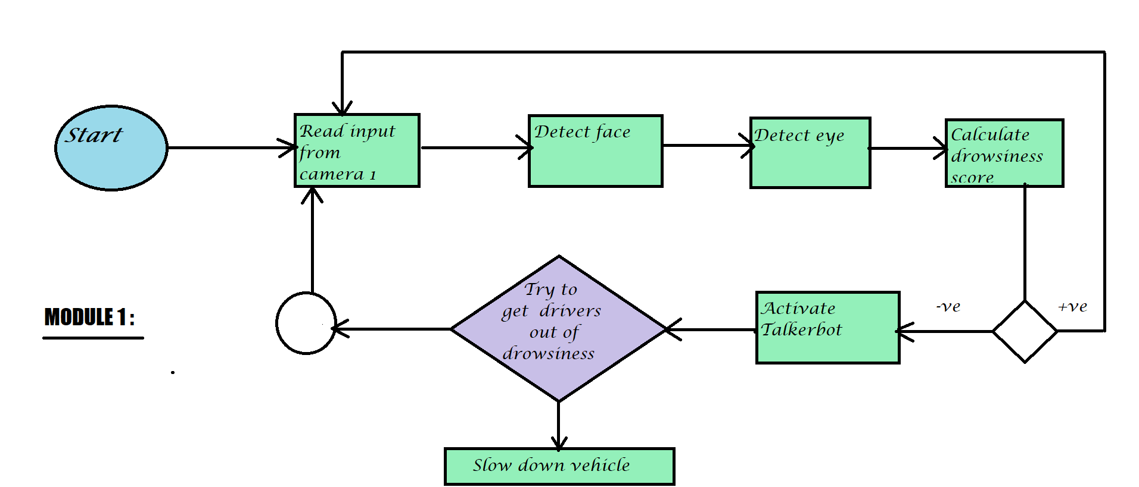
Methodology

Slide 7
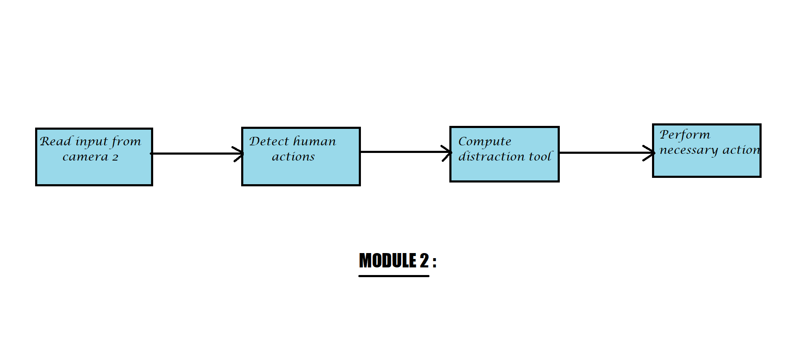
Methodology

Slide 8
Modules
Step-1 : Build drowsiness detection model.

Slide 9
Modules
Step-1 : Build drowsiness detection model.
Step-2 : Build distraction of driver detection model.

Slide 10
Modules
Step-1 : Build drowsiness detection model.
Step-2 : Build distraction of driver detection model.
Step-3 : Develop a talker-bot using python with NLP, which interacts with driver.

Slide 11
Drowsiness Detection
Using deep learning techniques, we will do continuous video processing and detect the face, eyes of the driver and compute the eye closing score and based on that necessary actions will be performed.

Slide 12
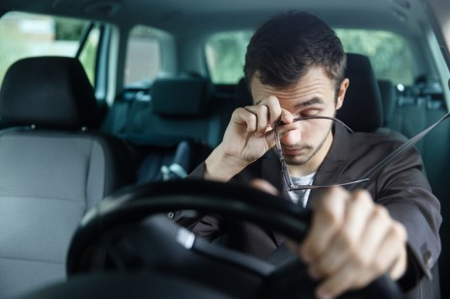
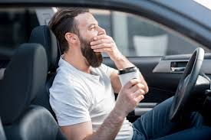

Slide 13
Distraction Detection
Using deep learning techniques, we will do continuous video processing and detect whether the driver is distracting or not? (like he/she using phones,having food,etc.,) and based on that necessary actions will be performed.

Slide 14
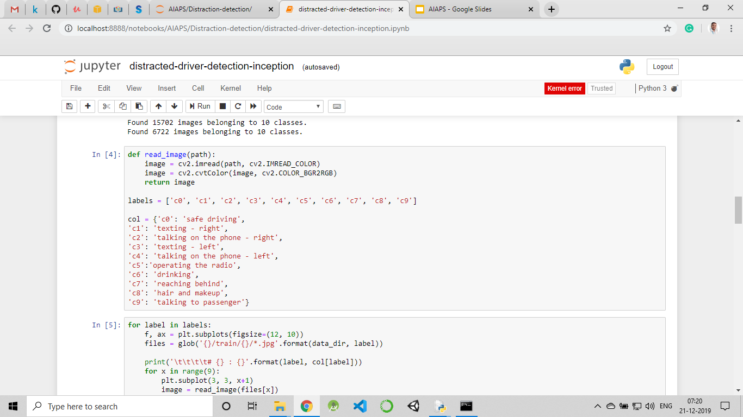

Slide 15
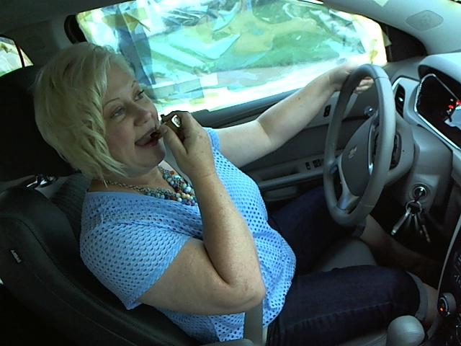
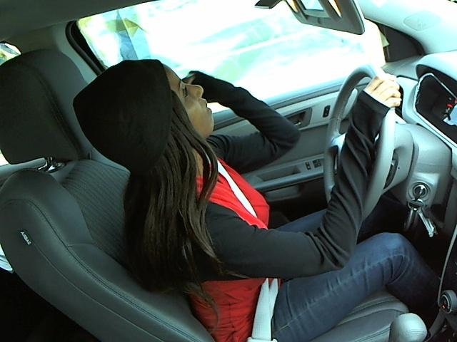

Slide 16
Talkerbot
In this module, a chatbot (which will speak) is developed using python and NLP techniques,
By using the Speech-Recognition, text-to-speech, and PyAudio, this module is going to work.

Slide 17
Outcomes
Drowsiness, Distractions are the major causes of accidents. And in some cases it may lead to death.
By using this AIAPS in automobiles, we can save many people.

Slide 18
Let’s have a look at working model

Slide 19
Extensions
Internet Of Things :
We would like to add some hardware like water sprinklers to spray some water on driver’s face, and speed controllers of automobiles to slow down the vehicle even though driver can’t control.

Slide 20
Extensions
Blockchain :
Since, the vehicle speed is controlled by the system. It should be highly secured such that no hacker can control the vehicle and trouble the people.

Slide 21
Time for queries!

Slide 22
Thank you
:-)

