Slide 1
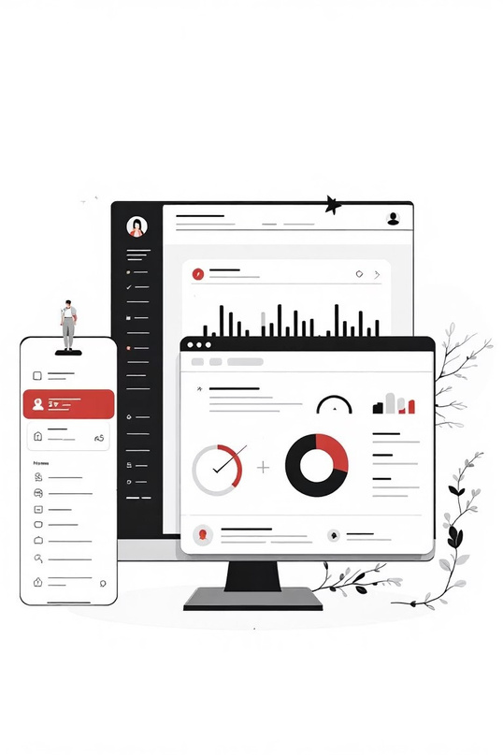
Student Record Management System

Slide 2

GROUP MEMBERS
R. Sravya - AP24110010547
G. Sowmya - AP24110010623
R. Sushma Sri - AP24110010718 B. Nishwitha - AP24110010759
J. Jhansi - AP24110010812

Slide 3
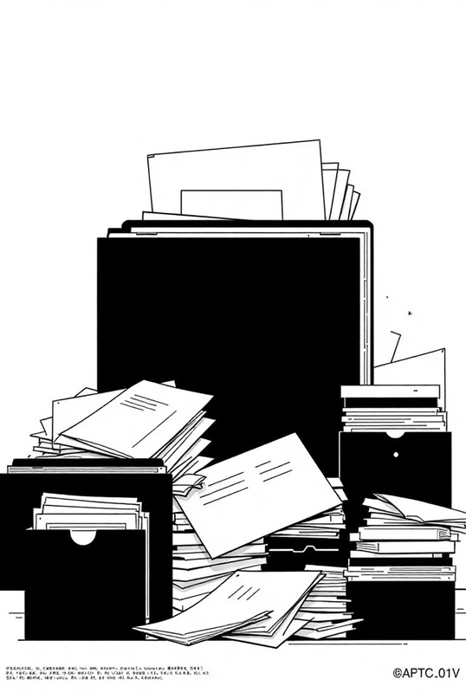

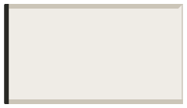
The Challenge: Manual Student Record Management
Data Loss & Inefficiency
Time-Consuming Tasks
Traditional paper-based systems are prone to data loss, slow retrieval times, and significant security risks.
Administrative staff spend excessive
hours on repetitive tasks such as attendance tracking and manual grade entry, diverting resources from
more critical activities.
Fragmented Information
Records spread across various
departments hinder efficient access, comprehensive reporting, and holistic student overview.

Slide 4

What Is a Student Record Management System?
A Student Record Management System (SRMS) is a sophisticated, centralized
digital platform engineered to securely store, track, and manage all aspects of student data throughout their academic journey.
Automates critical processes including admissions, attendance, grade
management, fee collection, and behavioral records.
Provides granular, role-based access for students, teachers, administrators,
and parents, ensuring data privacy and relevance.
Streamlines workflows and enhances communication across the educational
ecosystem.

Slide 5
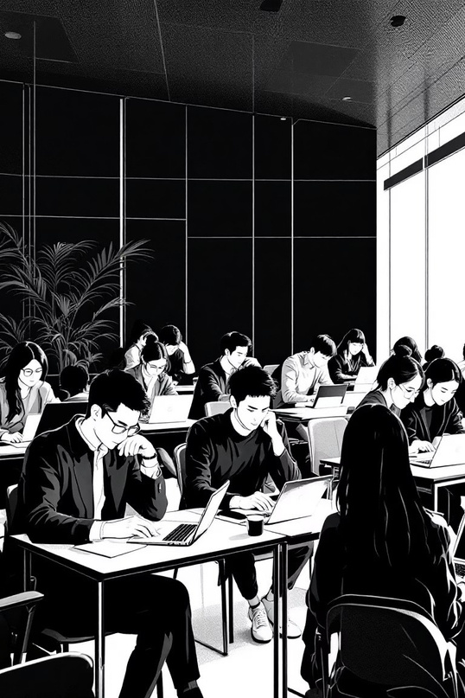
Key Features of Our System
Online Registration & Profiles
Seamless cloud-based storage for student records, accessible from anywhere with secure online registration.
Automated Attendance
Advanced attendance tracking, with options for biometric integration for enhanced accuracy and efficiency.
Reporting & Retrieval
Generate comprehensive reports and quickly search and retrieve data with intuitive interfaces.
Secure Role-Based Access
Robust security protocols with password and OTP encryption, ensuring data integrity and privacy for different user roles.

Slide 6

Technical Overview
01
Web-Based Application
Our system operates as a responsive web application, providing accessibility anytime, anywhere, on any device.
02
Robust Database Design
Structured database architecture with dedicated entities for students, courses, fees, and staff, ensuring data integrity and relationships.
03
User-Friendly Interface
An intuitive and streamlined user interface (UI) tailored for all user types, minimizing training requirements and maximizing adoption.
04
Scalable Architecture
Designed with a modular and scalable architecture capable of supporting multiple departments, campuses, and expanding student populations.

Slide 7
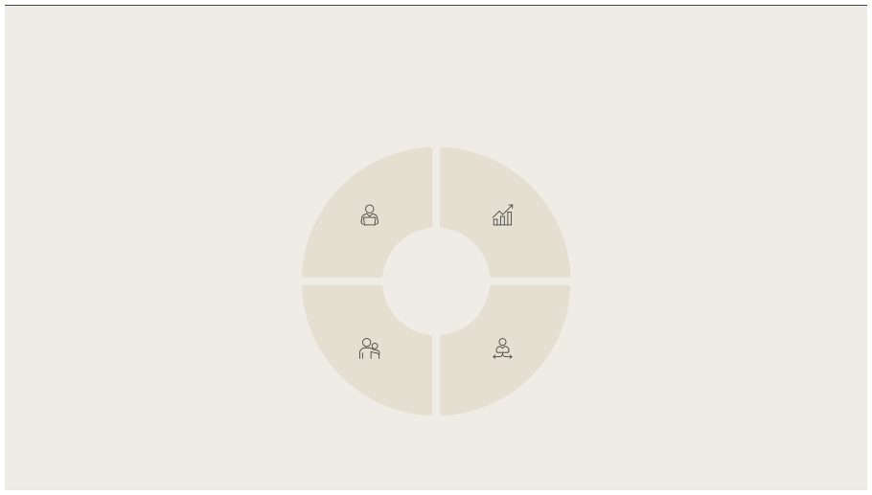
Benefits & Impact
Reduced Paperwork
Improved Data Integrity
Dramatically decreases reliance on physical documents and significantly
Enhances the accuracy, security, and
accessibility of student records, mitigating risks of loss or error.
lightens administrative workload.
Faster Decision-Making
Eco-Friendly Operations
Provides real-time access to
Supports a greener, paperless
comprehensive data, empowering administrators and educators to make informed decisions swiftly.
operational model, contributing to
environmental sustainability.

Slide 8
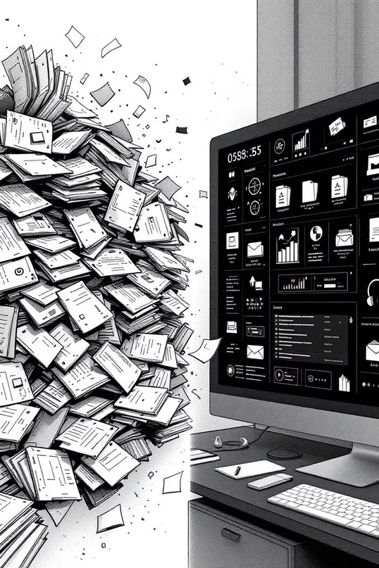
Real-World Transformation Example
1
Before SRMS: Manual Method
During critical periods like
2
admission and examination seasons, the reliance on manual files led to
significant delays, errors, and long
queues, creating immense stress for
After SRMS: Instant Efficiency
With the Student Record
staff and students.
Management System, instant data retrieval and automated report generation now save countless
hours weekly, transforming chaotic
processes into smooth operations.
Administrators and teachers are now freed from tedious paperwork, allowing them to redirect their focus to what truly matters: fostering student success and engagement.

Slide 9

Conclusion: Empowering Education Through Technology
Modernized Administration
Enhanced Efficiency
Join the Digital Shift
Our Student Record Management System is designed to usher in a new era of modernized school administration.
It significantly enhances transparency, operational efficiency, and communication among all educational stakeholders.
Join us in transforming education with smarter,
more agile, and completely digital record management solutions.

Slide 10


