Slide 1
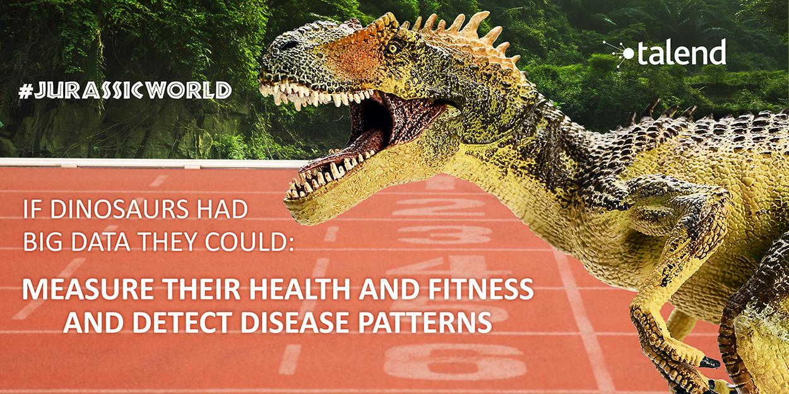


Data Dinosaurs

Slide 2
Problem Solving Approach

Slide 3
Algorithms used
We used R, Tableau and Excel for data analysis and visualization
Combined the tables using R (“sqldf” package)
visitation_join <- sqldf("Select * From Member_Visitation Join MedianMeanIncomebyZipCode using (Zip_Code)")
Pivot tables to group data by months and visualize it through Tableau

Slide 4
Summary Stats

Slide 5
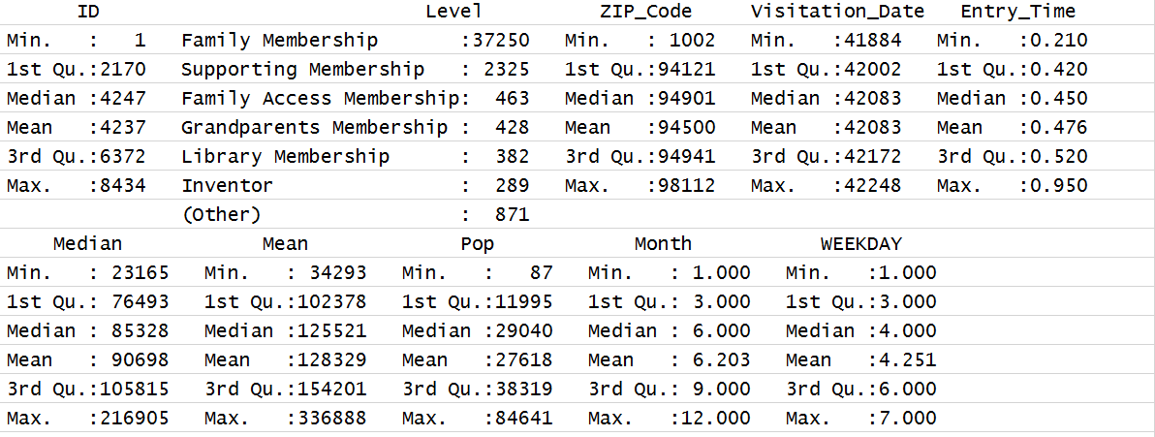
Summary stats

Slide 6
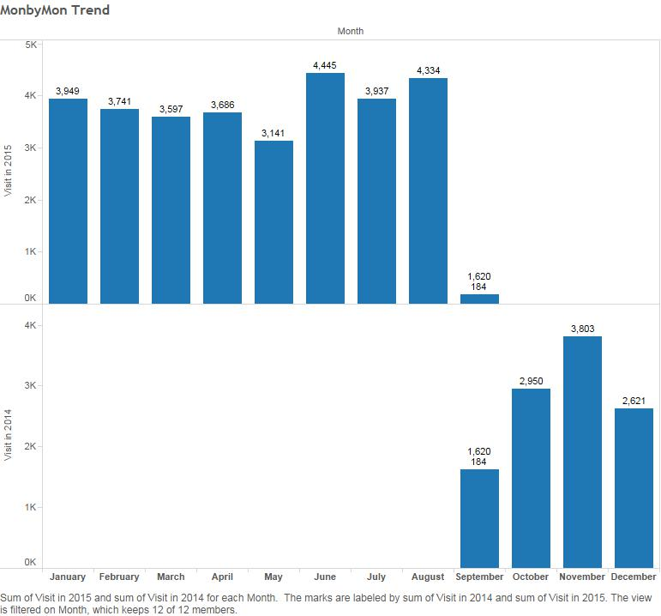
Month by Month Visitor Analysis

Slide 7
Recommendations
Which time (month / week) should be recommended to people with children?
Depends on holidays in schools
Depending on location, how to recommend?
Zip codes converted to city names
The farthest city
Incentivise them for a open session on a holiday.

Slide 8
Data Cleaning

Slide 9
ZIP CODES
Convert zipcodes table to a table that associate zipcodes with city names using grep and cut and curl
$curl http://ziptasticapi.com/53703
{"country":"US","state":"WI","city":"MADISON"}
zip=”53703”
>command=paste("curl http://ziptasticapi.com/",zip, " ","| cut -d',' -f3 | cut -d':' -f2 | cut -d'\"' -f2 ", sep="")
> command
[1] "curl http://ziptasticapi.com/53703 | cut -d',' -f3 | cut -d':' -f2 | cut -d'\"' -f2 "
> system(command)
MADISON

Slide 10
Future ideas
Use “hclust” R package for hierarchical agglomerative clustering based on the city
Find the top-k word in the event description and then use the “TwitterR” package to find the top tweets related to event and recommend event to users
Find the time intervals that the museum has most of the visits and have more open hours in those periods using predictive analytics

