Slide 1
ServiceNow fires an outbound event (REST call) on hire/term to Sailpoint IIQ.
Service Now
Sailpoint IIQ 8.5
Non-Employee Onboarding Form

Slide 2
Requested For
Requested Phone
--None--
Identity Type
* Time Zone:
--None--
--None--
Vendor Organization
Green Security Status
Section 1
--None--
--None--
Salutation
--None--
* Legal First Name
Preferred Name
Legal Middle Name (Optional)
* Legal Last Name
Suffix
Section 2
--None--
* Personal Email (Non-Novant Domain)
* Mobile Phone (Used for MFA Registration)
US
Service Now FieldType (Phone Number (E.164))
* Birth Month:
* Birth Year:
--None--
--None--
* Last 4 SSN:
* NPI:
--None--
Reporting Manager
Job Code
--None--
--None--
Section 3
Organization Unit (Department)
* Location:
--None--
--None--
* Start Date
* End Date
--None--
--None--
Remote Access Required?
--None--

Slide 3
What type of workspace is needed?
--None--
Physical Workstation, Virtual Desktop, Both?
Branch A ((If Type of Workspace is Physical or Both)
Onsite Contact for Installation (If not Requested for)
Onsite Contact Phone (Pull from Contact Record)
Onsite Contact Email (Pull from Contact Record)
--None--
Standard Laptop, High-Performance/Developer Laptop, Desktop Tower
Shipping Required
Who’s cost center will payment be applied to
Device Type?
--None--
--None--
--None--
Home Address 1
Home Address 2
Section 4
Home City
Home State
--None--
Home Postal
Home Country
--None--
Branch B (If Type is Virtual.
Profile Type
--None--
Dropdown: Standard Corporate User, Developer/Power User, External Vendor/Contractor
Primary Reason for Virtual Desktop
--None--
Dropdown: Remote Work, Accessing Secure Network, Third-Party Vendor Access
Operating System Required
--None--
Dropdown: Windows 11, Linux/Ubuntu
Duration of Access
--None--
Dropdown: Permanent, Temporary/Contract End Date
Contract End Date
--None--
Date Field; Mandatory if “Temporary is selected”
Additional Software Packages
List of
Section 5

Slide 4
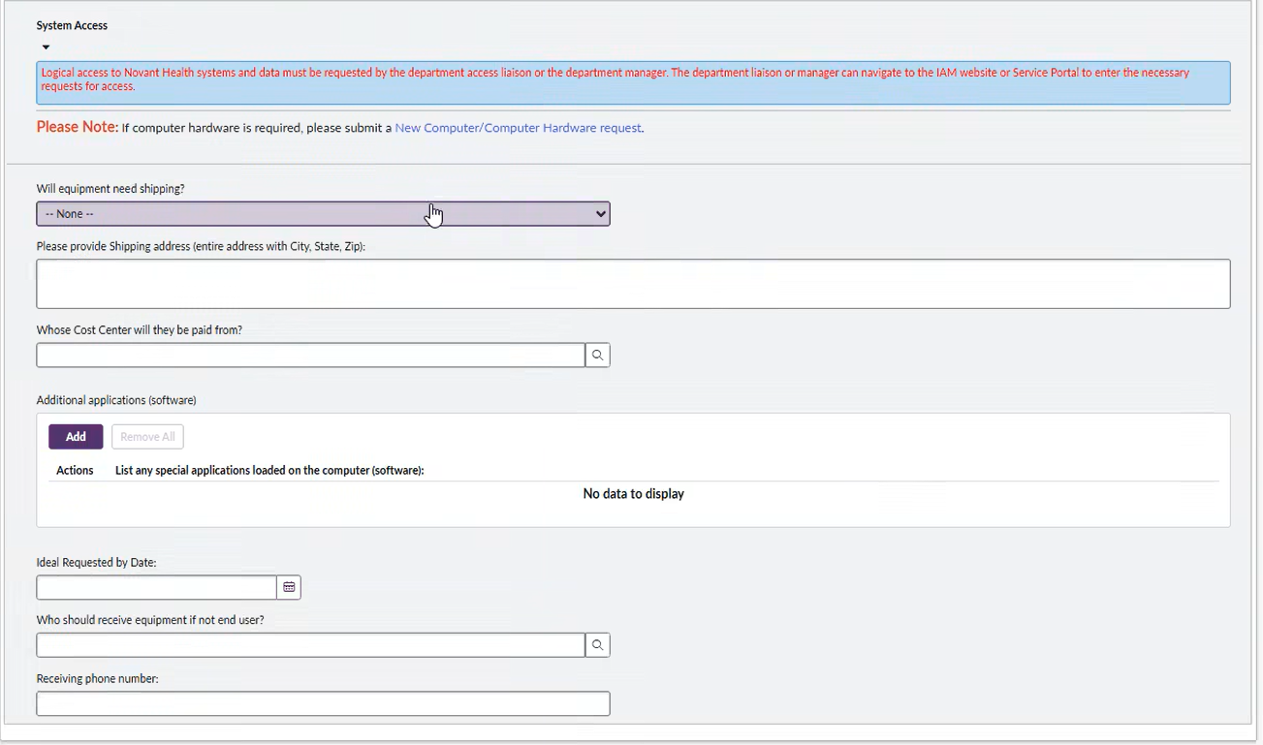
Notes:
Non-Novant Worker onboarding Request
Non-Novant Worker Change Onboard Request

Slide 5
Change

Slide 6
Requested For
Requested Phone
--None--
Select User
Search Filter should only find direct reports
Identity Type
* Identity Status:
--None--
--None--
Vendor Organization
Green Security Status
Section 1
--None--
--None--
Salutation
--None--
* Legal First Name
Preferred Name
Legal Middle Name (Optional)
* Legal Last Name
Suffix
Section 2
--None--
* Work Email
* Personal Email (Non-Novant Domain)
* Mobile Phone (Used for MFA Registration)
US
Service Now FieldType (Phone Number (E.164))
* Birth Month:
* Birth Year:
--None--
--None--
* Last 4 SSN:
* NPI:
--None--
* Time Zone:
--None--

Slide 7
Reporting Manager
Job Code
--None--
--None--
Section 3
Organization Unit (Department)
* Location:
--None--
--None--
* Start Date
* End Date
--None--
--None--

Slide 8
Leaver

Slide 9
Requested For
Requested Phone
--None--
Select User
(Read Only)
Display Name
* Walkout Termination
* White Glove Termination
* Date/Time
If Walkout is selected, set Date time to current time.
* Termination Reason
Remote Access Required?
--None--

Slide 11
Access Request Form (Separate from Above)
Simple Search
Step 1 – Select Action
--None--
Step 2 - Requested For
--None--
Self-; Multiple Users, Someone Else
Step 3 – Role/Entitlement Search
--None--
Lookup
Step 4 – Business Justification
--None--
Context Search
Step 1 – Select Action
--None--
Step 2 - Requested For
--None--
Self-; Multiple Users, Someone Else
Step 3 - Access Type
--None--
Dropdown: Application, Identity, Functional, Location, Job
Step 4 - Select Access Target
--None--
Shown if Category is Application
Step 5 – Select Available Roles/Entitlements
--None--
Filtered List of Roles
Step 6 – Business Justification
--None--

