Slide 1


Laptop Price Prediction
Done by:
Gude Vasundhara( M.Sc)
Degala Sravya( M.Sc)

Slide 2


Table of Contents
Introduction
Problem Statement
Data Exploration
Feature Selection
Model Selection
User Interface
Conclusions

Slide 3

Introduction:
Laptop price prediction is a challenging task due to the dynamic nature of the market and the many factors that can affect pricing. The goal of this model is to accurately predict the prices of laptops based on various features.
Laptop price prediction is important for both buyers and sellers. Buyers can use the model to predict the prices of laptops and make informed purchasing decisions, while sellers can use the model to set appropriate prices for their products.

Slide 4

Problem Statement:
Elon Musk, founder of Tesla Laptop, seeks to establish a competitive presence in the laptop market, challenging industry giants like Apple, Alienware, and HP.
To achieve this, he needs to accurately estimate laptop prices based on key features such as RAM size, RAM type, SSD, OS, and more.
Musk requires a data-driven solution to understand the pricing dynamics in the laptop market and build a price prediction model. Additionally, he wants to evaluate and fine-tune the model to ensure it achieves the best fit.
The goal is to empower Tesla Laptop with insights and a predictive model that enables strategic pricing decisions in a highly competitive landscape.

Slide 5

Data Cleaning:
Most of the columns in a dataset are noisy and contain lots of Information. But with feature engineering , We will get more good results.
Basic understanding of data is an important step for the prediction like shape, there are any NULL values present in the dataset.
As there are Null values, filling them and we need little changes in features. So we will get correct types of features.

Slide 6

Data Exploration:
EDA helps to understand what impact it creates on the target feature.
At the required step, we will also perform preprocessing and feature engineering tasks.
Our aim in performing in-depth EDA is to prepare and clean data for better ML modeling to achieve high performance and generalized models.
So, Let’s get started with analyzing and preparing the data for prediction.

Slide 7
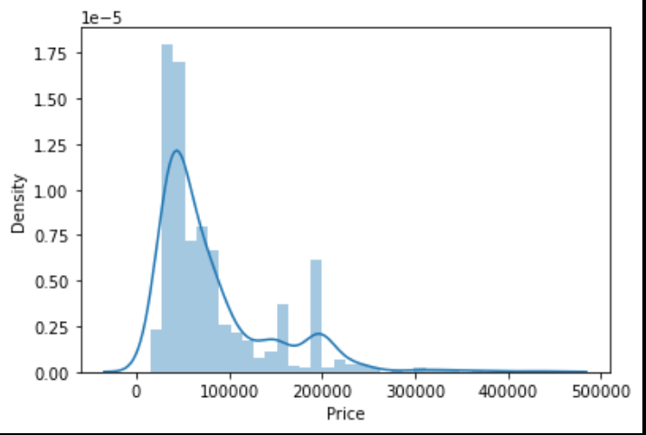
Distribution of Target feature:
Working with regression problem statement target feature distribution is important to understand.
The distribution of the target feature is skewed and it is obvious that commodities with low prices are sold and purchased more than the branded ones.

Slide 8
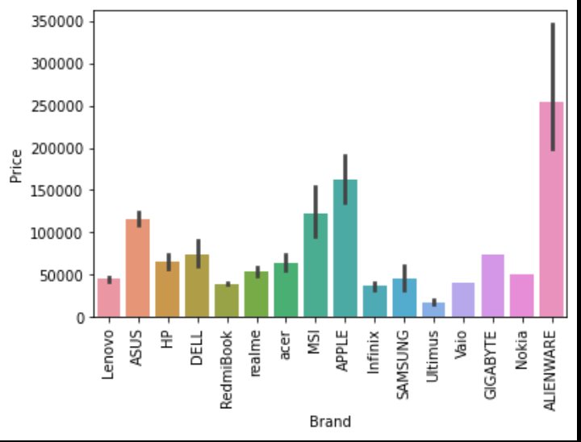
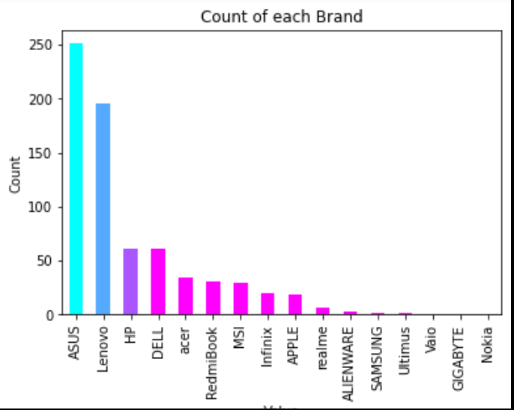
what is the average price of each laptop brand?
We want to understand how does brand names impacts the laptop price.
The major categories present are ASUS, Lenovo, HP, DELL.
ALIENWARE, APPLE, MSI, ASUS laptops are expensive, and others are in the budget range.

Slide 9
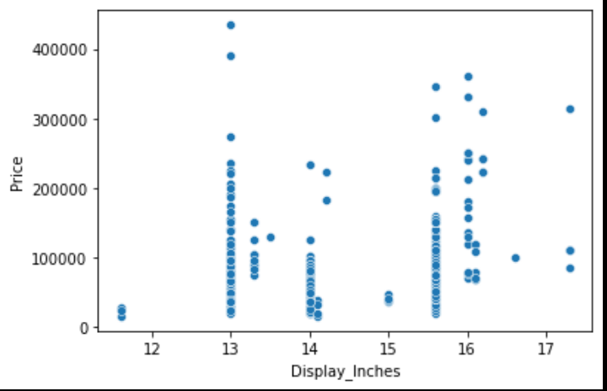
Does the price vary with laptop size in inches?
There is a relationship but not a strong relationship between the price and size column.
Larger and high-resolution displays can contribute to higher prices.

Slide 10
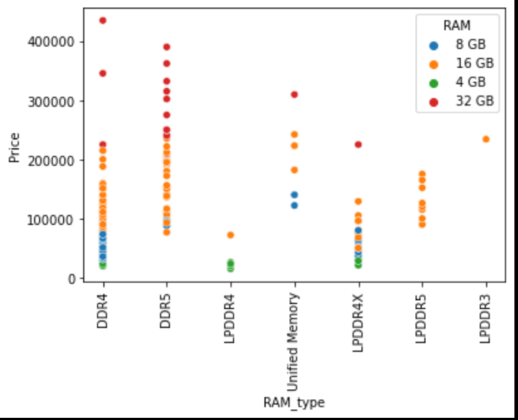
Does the price vary with RAM and RAM-type?
There is a strong relationship between RAM, RAM-type and Price.
LPDDR5 is the expensive RAM-type.
Unified Memory < DDR4 < DDR5 < LPDDR3 < LPDDR4 < <LPDDR4X < LPDDR5

Slide 11
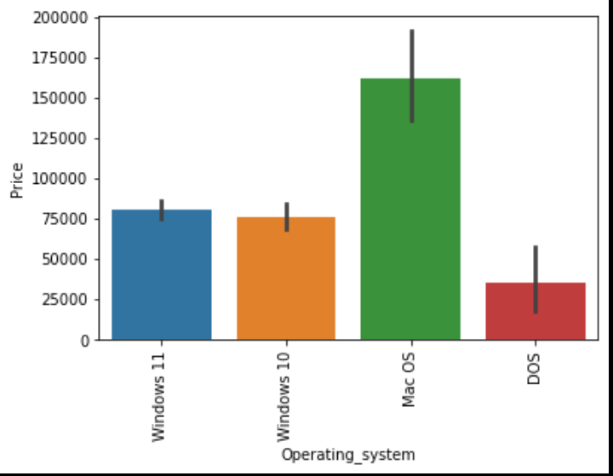
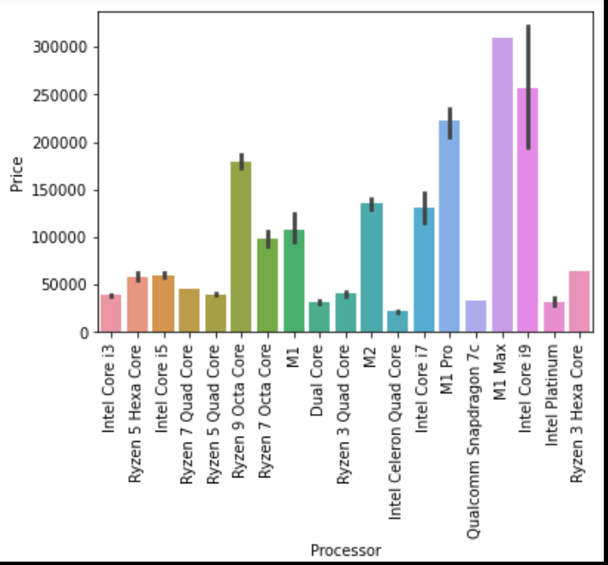
Does the price vary with Processor and OS?
The choice of processor significantly affects the price.
High-performance processors from brands like Intel and Ryzen tend to increase the cost of a laptop.
Processors like M1 Max, Intel Core i9, M1 Pro is highly effecting the price.
Proprietary operating systems like macOS are often associated with premium pricing.

Slide 12
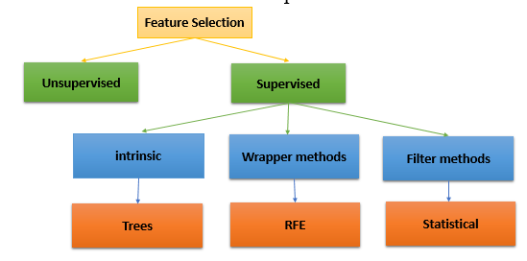
Feature Selection
Feature selection is the process of selecting a subset of the most relevant features from a larger set of features for use in building a prediction model.
The goal of feature selection is to identify the most informative and relevant features that have the greatest impact on the target variable, while reducing the dimensionality of the data and decreasing the risk of over fitting.
Reasons why it is important:
Reducing the dimensionality of data.
Improving Model performance.
Identifying important features.
Reducing Overfitting.

Slide 13
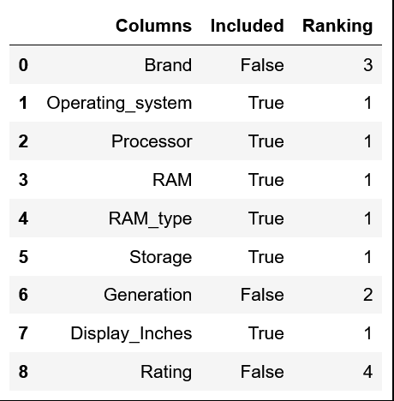
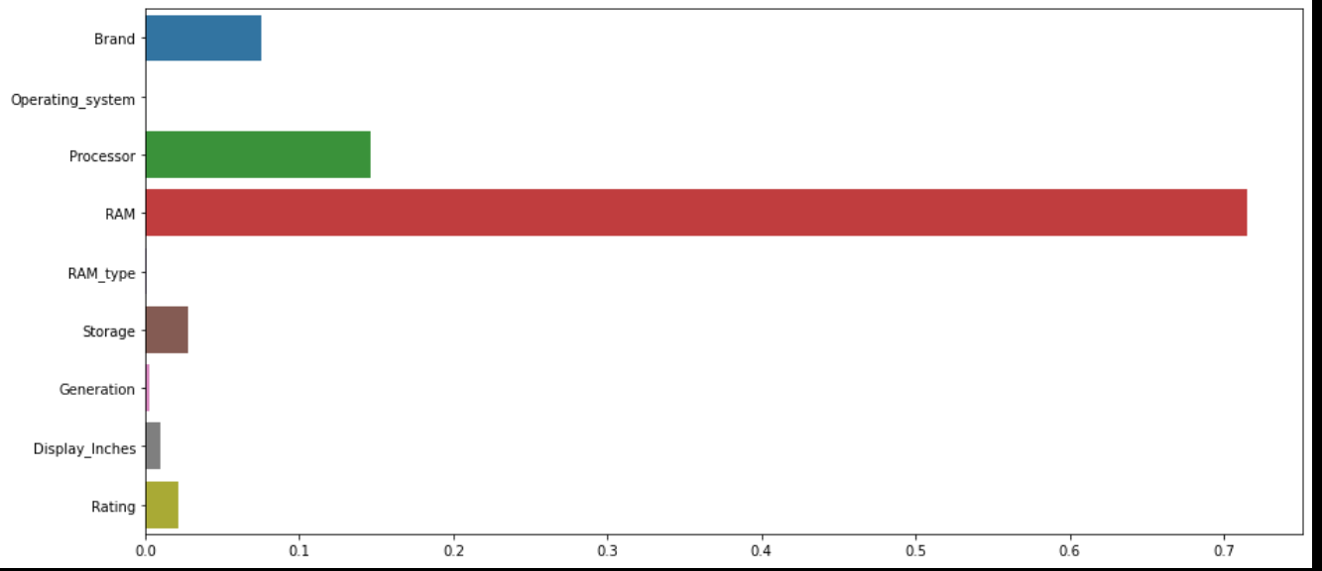
Feature selection using RFE
Feature selection using DT
n_features_to_select=6
Features>0.025

Slide 14
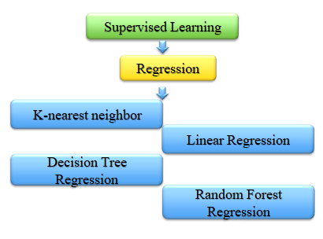
Model Selection
Now we have prepared our data and hold a better understanding of the dataset. So, let’s get started with machine learning modeling and find the best algorithm with the best hyper parameters to achieve maximum accuracy.
Typical Flow to build a ML model:
Identify dependent and independent features.
Split the data into train and test: 85-15
Transform non-numerical into numerical format.
Train the model and evaluate on train data.
Predict unseen data and evaluate on test data.
Find the best model.

Slide 15
Model Selection
KNN performs well, with high training (91%) and test (89%) scores. It demonstrates consistent performance on both the training and test datasets.
Decision Tree model improved in prediction by doing hyperparameter tuning .
Even though they improved in performance, KNN performance before hyper parameter tuning.
Therefore, the best accuracy I got is with KNN model.
Algorithms | Train-score | Test-score | After Hyper parameter tuning
Linear Regression | 67% | 59% | 59%
KNN | 91% | 89% | 89%
Decision Tree | 80% | 75% | 84%
Random Forest | 97% | 90% | --

Slide 16
User Interface

Slide 17

Conclusion
Processor, RAM, RAM-type, Storage, Brand, Operating System plays a crucial role for the laptop price.
Display-Inches also impacts the price but not that much.
Remaining features like Generation, Rating, Warranty directly won’t impact the Price.
Finally, we have developed and deployed a machine learning application for the prediction of laptop price.
We have learned about the complete machine learning project lifecycle with practical implementation and how to approach a particular problem.
We hope that our project motivates and encourage you to develop similar more applications to enhance your understanding of various methods and algorithms to use and twin with different parameters.

Slide 18


