Slide 1
AquaWatch
Real-time water quality monitoring with an ESP32 and a live web dashboard
The problem: manual water testing is slow and gives no early warning when water becomes unsafe.
2510040070 – Sania Khan
2510040083 – P Srija
2510040109 – K Sravya
2510040120 – B Gowri
Notes:
Introduce the project and the problem: manual testing is slow and there is no early warning.

Slide 2
Objective and architecture
1
Monitor pH, turbidity and TDS
2
Raise alerts when a reading leaves the safe range
3
Show live data on a web dashboard
Sensor
(pH probe)
ESP32
WiFi
MQTT
broker
Web
dashboard
Alerts
The hardware prototype runs the pH path end to end. Turbidity and TDS run in the simulation.
Notes:
Walk left to right through the flow. Stress that the pH path is real hardware and the rest of the system is shown in the simulation.

Slide 3
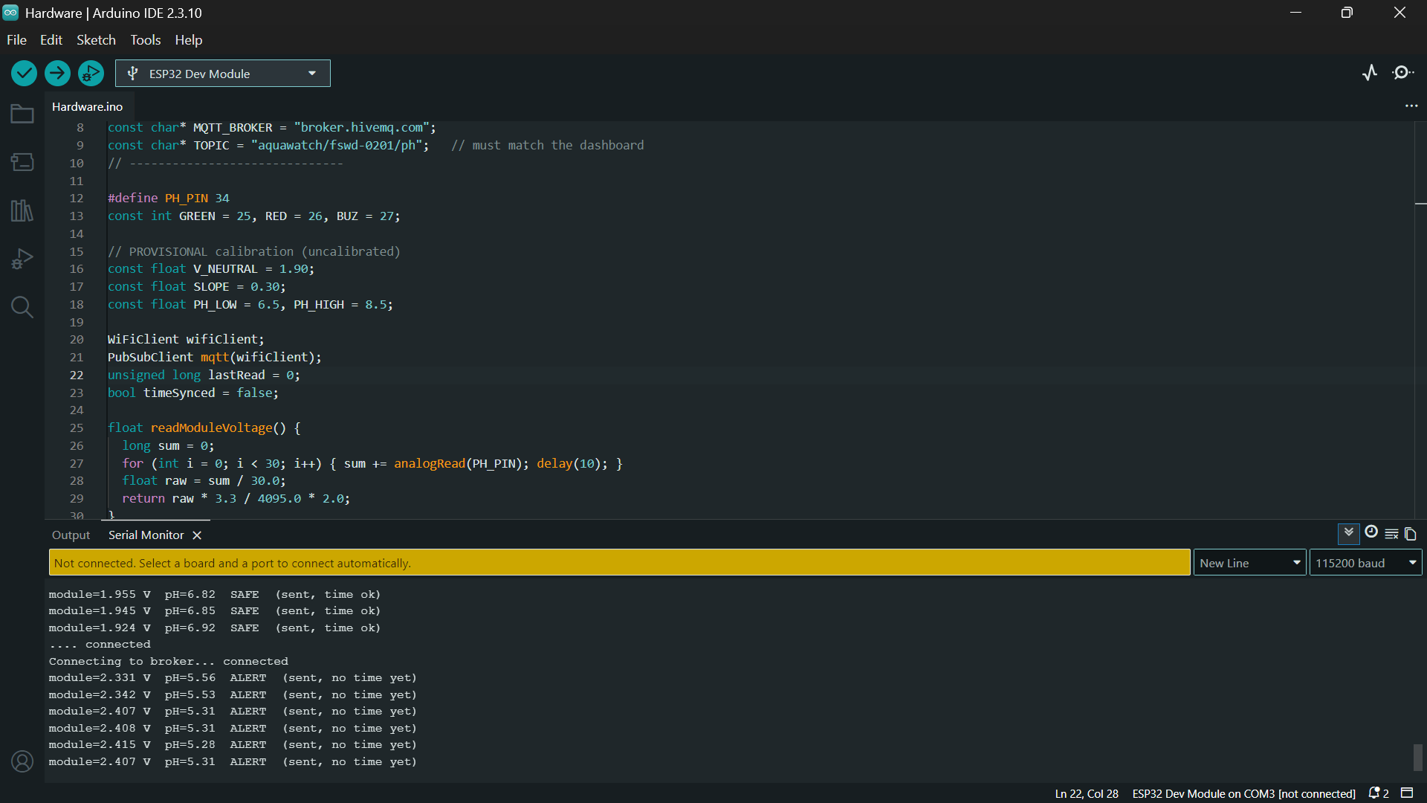
Simulation: the full system
All three parameters: pH, turbidity and TDS
Simulated readings published over MQTT
Dashboard shows live values and alert states
Thresholds decide Safe or Alert
Notes:
Show the simulation dashboard. Say clearly that turbidity and TDS are demonstrated here.

Slide 4
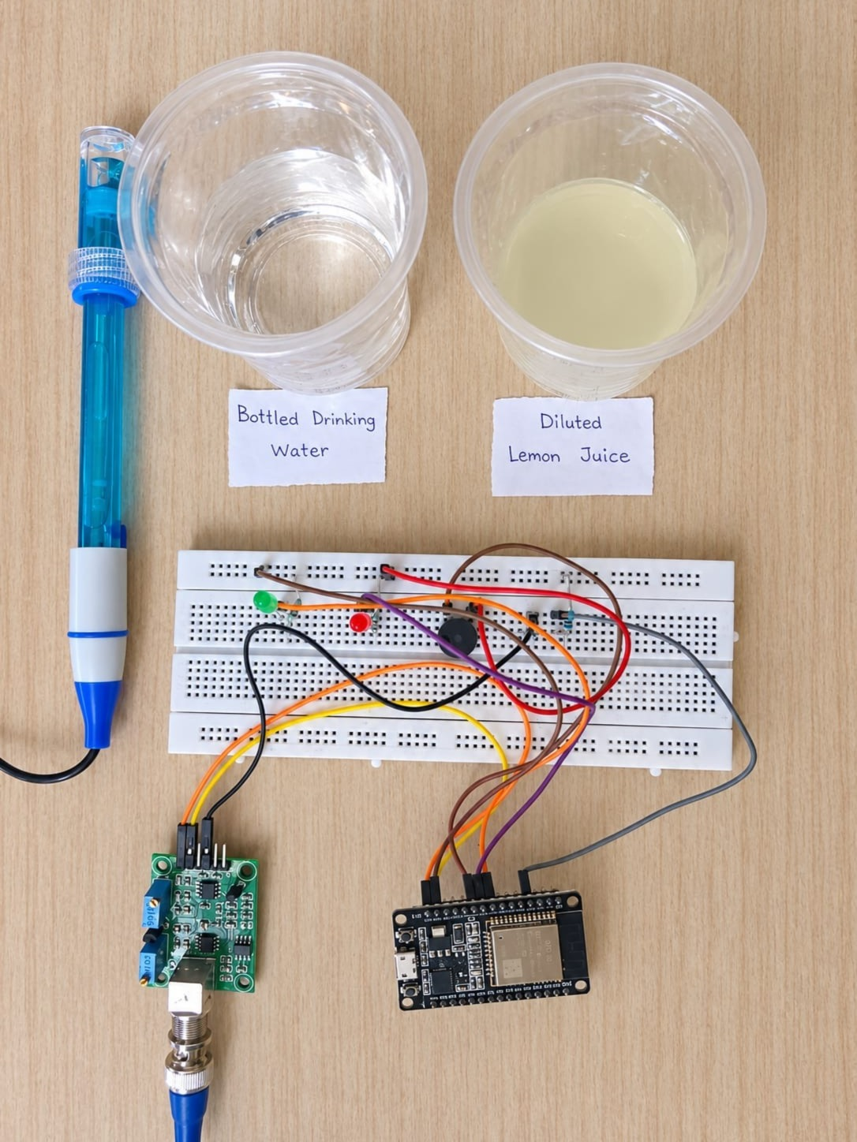
Hardware prototype
Add photo:
your circuit
Sensing
pH probe and PH-4502C module, read by the ESP32 on GPIO 34 through a 10k divider
Alerts
Green LED when safe, red LED and buzzer outside pH 6.5 to 8.5
Scope
pH only because of cost; turbidity and TDS stay in simulation
Notes:
Point at the photo: probe, module, ESP32, LEDs and buzzer. The voltage divider protects the ESP32 input.

Slide 5
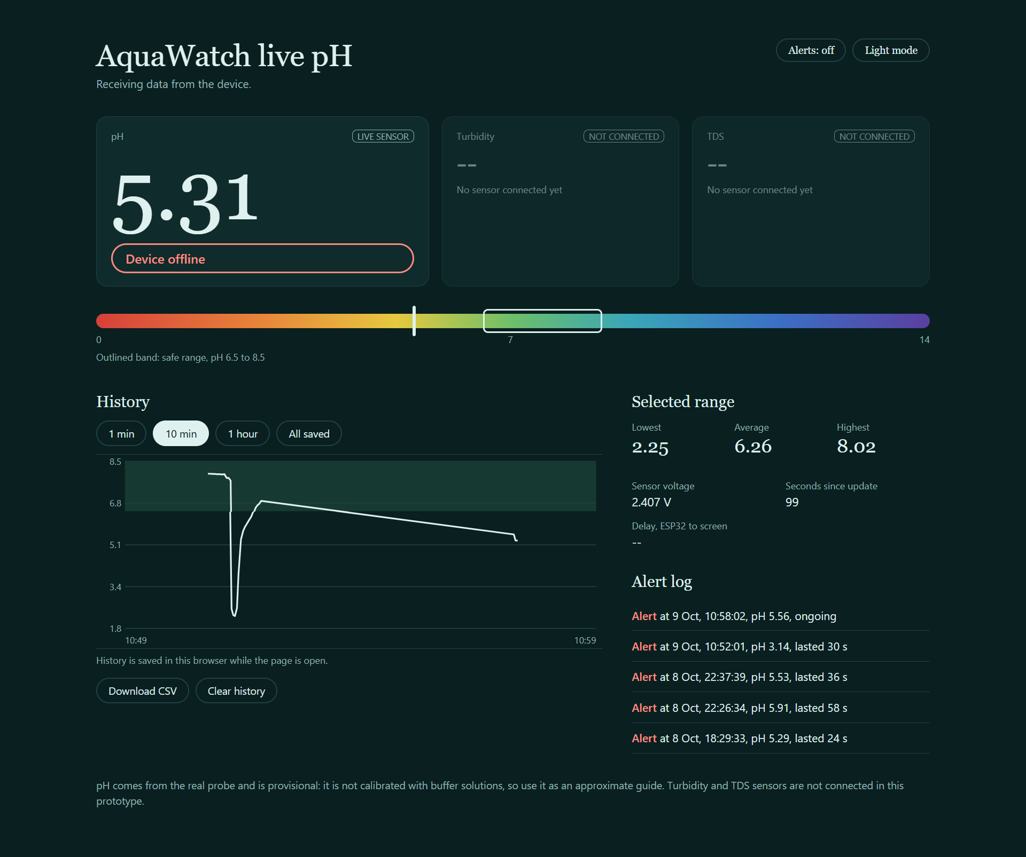
Live dashboard and demo
Add screenshot:
live dashboard
Probe in water
Safe, green LED
1
Probe in lemon juice
Alert: red LED, buzzer, phone alert
2
Rinse, back in water
Returns to Safe
3
Page features: live pH, history chart, alert log, CSV download
Notes:
Do the live demo here: water, then lemon juice, then rinse. Keep a screen recording ready as a backup.

Slide 6
Results and limitations
≈ 1.9 V
Clean water, module output
≈ 3.35 V
Diluted lemon juice (acid)
___ ms
Delay, ESP32 to screen (fill in your average)
What works
Limitations
Alert fires outside pH 6.5 to 8.5
Voltage rises with acidity, as expected
Dashboard works on a phone over mobile data
pH is provisional: no buffer calibration yet
Turbidity and TDS not connected in hardware
Public MQTT broker, no login
Notes:
Be upfront that pH values are approximate until calibrated with pH 4 and pH 7 buffers. Replace the ___ ms with your measured delay.

Slide 7
Hardware Cost Breakdown
Components | Qty | Total (₹)
ESP32 dev board + USB cable | 1 | 450/-
pH sensor kit (probe + PH-4502C module) | 1 | 1170/-
Full-size breadboard | 1 | 113/-
Jumper wires (F-F, M-F, M-M) | 1 set | 40/-
Resistors (10k ×2, 220Ω ×2) | 8 | 10/-
Active Buzzer | 1 | 10/-
LEDs (red, green) | 10 | 10/-
Total |  | 1803/-
Notes:
Be upfront that pH values are approximate until calibrated with pH 4 and pH 7 buffers. Replace the ___ ms with your measured delay.

Slide 8
Future work and conclusion
Next steps
Conclusion
AquaWatch shows the full chain working on real water: a probe reading, an ESP32 alert, and a live dashboard anyone can open from their phone.
Two-point calibration with pH 4 and pH 7 buffers
Real turbidity and TDS sensors
Cloud database for 24/7 history
Private broker with login and encryption
Waterproof enclosure and app alerts
Notes:
Close with what the prototype proves and what you would do next. Then take questions.

