Slide 1
Arc Diagram using Micro Strategy
Presented by
Sravya Kandepu
44-599 Introduction to Data Visualization
April 11, 2017

Slide 2
Outline
Introduction to Arc Diagram
Arc Diagram Graphical Representation
Micro Strategy
Applications of Micro Strategy
Goals of the data
Demonstration
Lessons Learned

Slide 3
Arc Diagram
Arc Diagram is a graphical display to visualize graphs or networks in a one-dimensional layout.
The main idea is to display nodes along the single axis, while representing the edges or connections between nodes with arcs.
The thickness of each arc line can be used to represent frequency between the source and target node.
Arc Diagrams can be useful in finding the co-occurrence within data.

Slide 4
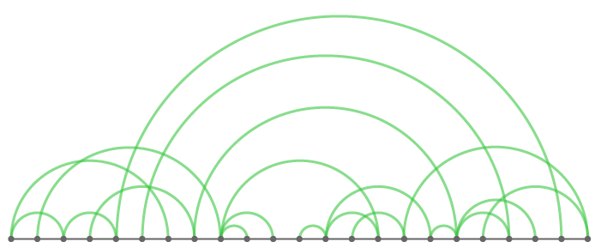

Arc Diagram Graphical Representation
Statistical Research
Data Processing
Data Science
Machine Learning

Slide 5

Explanation
1234djsfasdsdda1234dasfdfafdafd

Slide 6


Example

Slide 7

Example (contd…)

Slide 8

Example

Slide 9
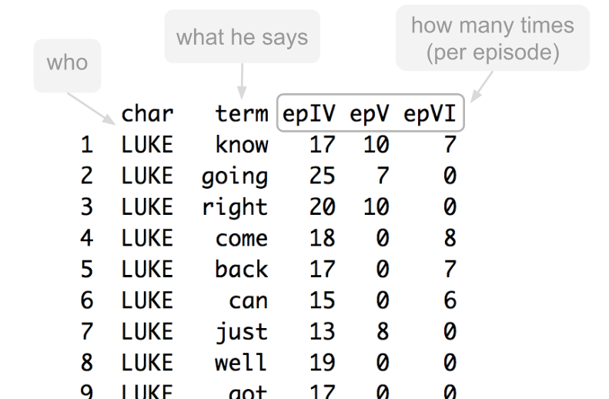
Example

Slide 10

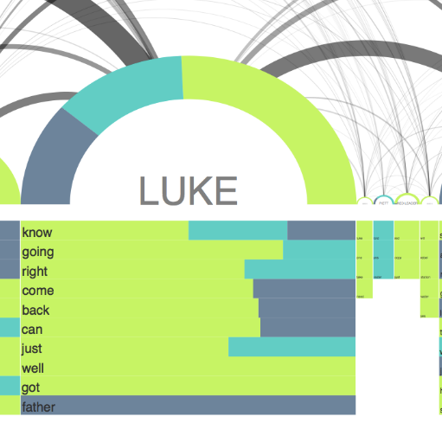
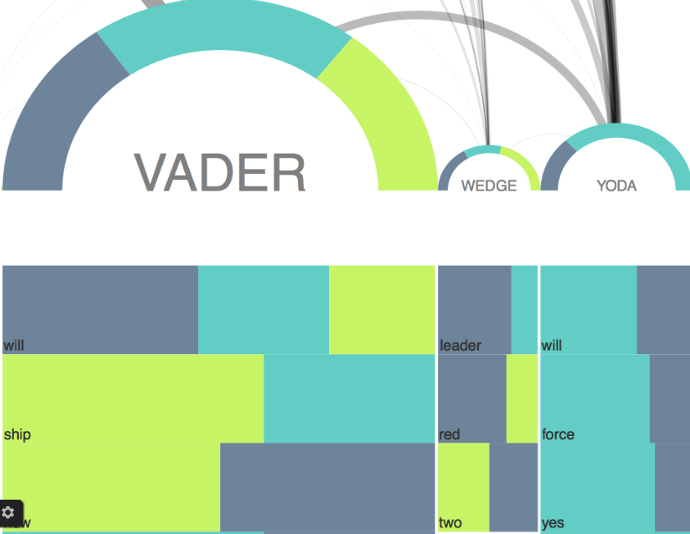

Slide 11
Tools used to generate Arc Diagrams
D3.js
Prtotovis
Micro strategy (we are using)

Slide 12
Micro Strategy
MicroStrategy is an enterprise business intelligence (BI) application software vendor.
It supports interactive dashboards, scorecards, highly formatted reports, ad hoc query, thresholds and alerts, and automated report distribution.
Interfaces include web, desktop (for developers) and Microsoft Office integration. MicroStrategy Mobile also supports mobile BI.

Slide 13
Pros of Micro Strategy
It is advantageous as it accommodates different data format
It also have mobile version where we can use it anywhere and anytime
Mobile version also exists in blackberry phones, apple iPhone, iPad
The desktop version have different file formats including json,csv,txt, excel and sas

Slide 14
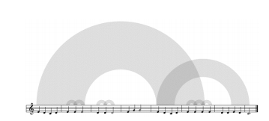
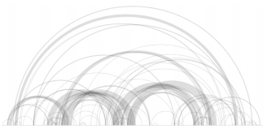
Real Time Applications
Music
Structured data and java byte code

Slide 15
Data Source
Link to data Source :
Causes of death in absolute number from years ranging 2001-2010. Found this data source in EUROSTAT website.
Below is the link to the data source:
http://appsso.eurostat.ec.europa.eu/nui/show.do?dataset=hlth_cd_anr&lang=en

Slide 16
Goals
To represent number of people died in different countries in Europe during the years 2000-2010.
GEO/TIME | Year | Metric
EU28 - European Union (28 countries) | 2001 | 9,165
EU15 - European Union (15 countries) | 2001 | 3,985
DE - Germany (until 1990 former territory of the FRG) | 2001 | 536
IT - Italy | 2001 | 439
UK - United Kingdom | 2001 | 494
FR - France | 2001 | 1,061
FX - France (metropolitan) | 2001 | 1,049
PL - Poland | 2001 | 1,061
ES - Spain | 2001 | 490

Slide 17
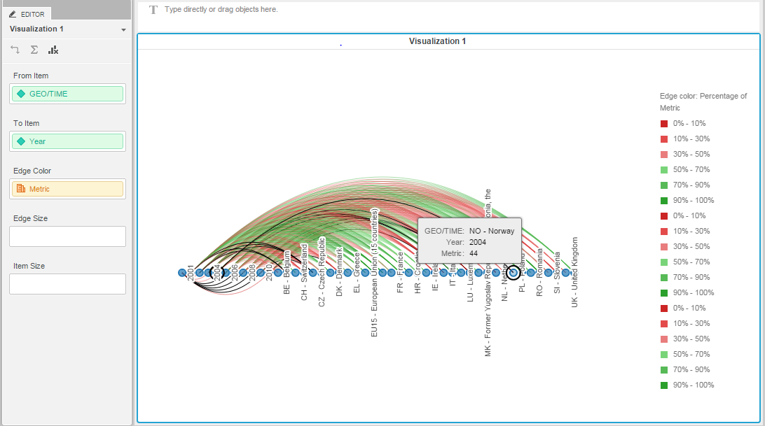
Arc Diagram Generated

Slide 18

Demonstration

Slide 19
Lessons Learned
Learned about data visualization tools like : Micro Strategy, D3.js
Learned to find data appropriate for the diagram.
Also learned how to sort and filter data.
Time management

Slide 20


Slide 21


