Slide 1
SQL PROJECT
LIBRARY
MANAGEMENT
SYSTEM
A relational database project using MySQL
MYSQL | DATABASE DESIGN | SQL QUERIES
SRAVYA MATTA
BATCH • PFS-ONR-006

Slide 2
Introduction
OVERVIEW
• The Library Management System is a database project designed to manage library operations.
• It stores information about members, books, suppliers, book issues and fines.
• MySQL is used to create tables, define relationships and retrieve information.
• The project demonstrates how a relational database supports organized record management.
SQL PROJECT | LIBRARY MANAGEMENT SYSTEM
02

Slide 3
Problem Statement
OVERVIEW
• Managing library records manually can be time-consuming.
• Searching for book and member details may become difficult as records increase.
• Tracking issued books, returns and fines requires accurate information.
• A structured database helps store and retrieve these records efficiently.
SQL PROJECT | LIBRARY MANAGEMENT SYSTEM
03

Slide 4
Project Objectives
OVERVIEW
• Maintain member registration and membership details.
• Store book information such as title, author, category and publication.
• Record which books are issued to which members.
• Maintain supplier details and fine information.
• Retrieve useful information through SQL queries.
SQL PROJECT | LIBRARY MANAGEMENT SYSTEM
04

Slide 5
Tools & SQL Concepts Used
IMPLEMENTATION
• Database: MySQL
• Interface: MySQL Workbench
• SQL operations: CREATE, INSERT, SELECT, UPDATE and ALTER TABLE.
• Database concepts: Primary Key, Foreign Key and constraints.
• Query concepts: WHERE, AND, ORDER BY, GROUP BY, aggregate functions and JOIN.
SQL PROJECT | LIBRARY MANAGEMENT SYSTEM
05

Slide 6
Database Tables
DATABASE DESIGN
• LMS_MEMBERS – stores member details and membership status.
• LMS_BOOK_DETAILS – stores book details and supplier reference.
• LMS_BOOK_ISSUE – records book issue and return information.
• LMS_FINE_DETAILS – stores fine ranges and fine amounts.
• LMS_SUPPLIERS_DETAILS – stores supplier contact information.
SQL PROJECT | LIBRARY MANAGEMENT SYSTEM
06

Slide 7
Primary Keys & Foreign Keys
DATABASE DESIGN
• A Primary Key uniquely identifies each record in a table.
• A Foreign Key connects a record to a related record in another table.
• LMS_BOOK_ISSUE references LMS_MEMBERS through member_id.
• LMS_BOOK_ISSUE references LMS_BOOK_DETAILS through book_code.
• LMS_BOOK_DETAILS references LMS_SUPPLIERS_DETAILS through supplier_id.
• LMS_BOOK_ISSUE references LMS_FINE_DETAILS through fine_range.
SQL PROJECT | LIBRARY MANAGEMENT SYSTEM
07

Slide 8
SQL Operations Demonstrated
IMPLEMENTATION
• CREATE DATABASE and CREATE TABLE define the database structure.
• INSERT adds member, book, issue, fine and supplier records.
• ALTER TABLE adds or modifies constraints and relationships.
• UPDATE changes existing records when required.
• SELECT retrieves records based on specified conditions.
SQL PROJECT | LIBRARY MANAGEMENT SYSTEM
08

Slide 9
Query Examples
SQL QUERIES
• WHERE filters records using conditions.
• AND combines multiple conditions in one query.
• LIKE searches for text patterns, such as author names beginning with P.
• GROUP BY groups records by a common value, such as book category.
• COUNT calculates the number of matching records.
SQL PROJECT | LIBRARY MANAGEMENT SYSTEM
09

Slide 10
Using JOIN
SQL QUERIES
• JOIN combines related information stored in different tables.
• The LMS_BOOK_ISSUE table contains member_id and book_code.
• The LMS_MEMBERS table provides member names and other member details.
• The LMS_BOOK_DETAILS table provides book titles and author information.
• Matching common columns allows the required details to be displayed together.
SQL PROJECT | LIBRARY MANAGEMENT SYSTEM
10

Slide 11
Example: Books Issued on a Date
SQL QUERIES
• The query displays book_code and book_title for books issued on 1 April 2012.
• LMS_BOOK_ISSUE and LMS_BOOK_DETAILS are joined using book_code.
• The WHERE condition filters the issue date.
• This query demonstrates JOIN and date-based filtering.
SQL PROJECT | LIBRARY MANAGEMENT SYSTEM
11

Slide 12
Membership Date Queries
SQL QUERIES
• Query 9 displays members who registered before March 2012 and have Temporary membership status.
• It uses the date_register condition together with membership_status = 'Temporary'.
• Query 10 displays members whose membership expiry date is before April 2013.
• It uses the date_expire column to filter the required records.
SQL PROJECT | LIBRARY MANAGEMENT SYSTEM
12

Slide 13
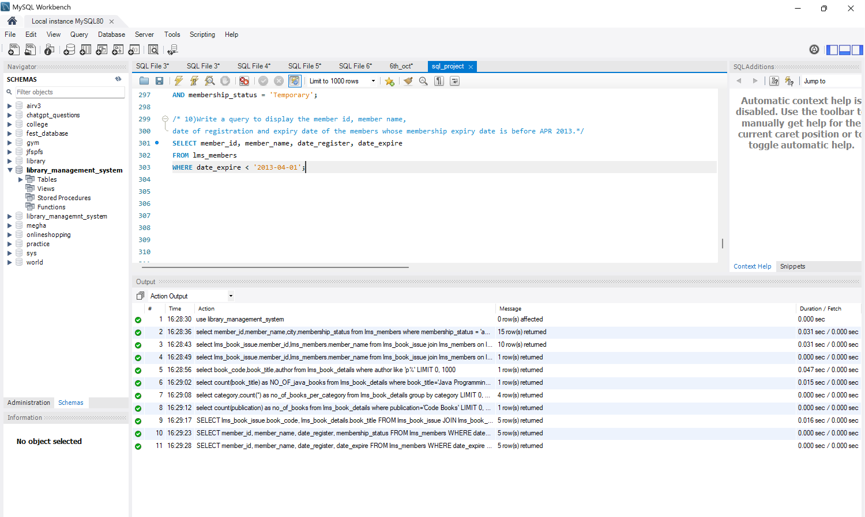
MySQL Workbench – SQL Project
PROJECT EVIDENCE
Screenshot of the executed SQL queries and Action Output
SQL PROJECT | LIBRARY MANAGEMENT SYSTEM
13

Slide 14
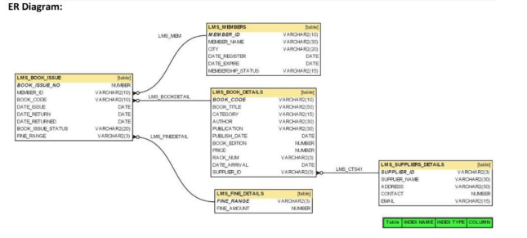
Entity Relationship (ER) Diagram
DATABASE DESIGN
The ER diagram shows the five tables and how their keys connect.
SQL PROJECT | LIBRARY MANAGEMENT SYSTEM
14

Slide 15
Conclusion
SUMMARY
• The project organizes library information into related database tables.
• Primary Keys and Foreign Keys maintain relationships between records.
• SQL queries help retrieve, filter and summarize library information.
• This project provided practical experience with relational database design and MySQL.
SQL PROJECT | LIBRARY MANAGEMENT SYSTEM
15

Slide 16

THANK YOU!
Library Management System
Presented by
SRAVYA MATTA
BATCH • PFS-ONR-006
SQL PROJECT
PFS-ONR-006

