Slide 1
Hackathon
Team Pegasus
Sravya
Prathyusha
Sai Kumar
sasleen

Slide 2
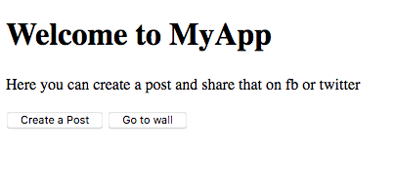
Welcome page

Slide 3
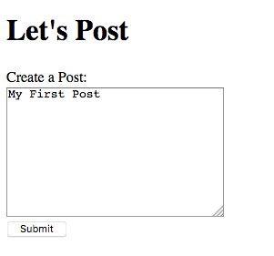
Lets post
After clicking on create post, it will redirect you to create a post

Slide 4
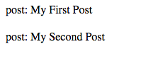
My posts
After clicking submit , you can see your posts on the wall

Slide 5
Thank you

