Slide 1

FACE RECOGNITION ATTENDANCE SYSTEM
Group-14
Sravya Parankusham(2792970)
Sathyanarayanan Sivaramakrishnan(2793009)
Yashwanth Reddy(2819758)
Sri Harish Reddy Alla(2824635)

Slide 2
INTRODUCTION:
The traditional attendance system involves teachers marking registers, which introduces human error and requires a lot of upkeep. In this system, time usage is a major area of concern.
We have considered employing modern digital tools, such as face recognition, to overhaul it. Our project will guarantee greater accuracy and minimal manual labor.
Our process entails face recognition before attendance is recorded. When a student's face is displayed from the folder containing the database of all the pupils in the class, attendance is registered if the face matches one of the faces in the saved image; otherwise, the face is dis regarded and attendance is not marked.
The model has an accuracy of 99.38% on the Labelled Faces in the Wild benchmark.
Any organization, including businesses and educational institutions, places a high value on attendance. Therefore, keeping a record of attendance is crucial.

Slide 3
Problem Definition
Traditionally, student's attendances during lecture session are taken manually by using attendance sheet given by the faculty in class, which is a time-consuming event.
Moreover, it is very difficult to verify one by one student in a large practical lab with distributed branches whether the authenticated students are actually responding or not.

Slide 4
What is Face Recognition
Face recognition is a method of identifying or verifying the identity of an individual using their face
A facial recognition system is a technology capable of identifying or verifying a person from a digital image or a video frame from a video source.
There are multiple methods in which facial recognition systems work, but in general, they work by comparing selected facial features from given image with faces within a database.

Slide 5
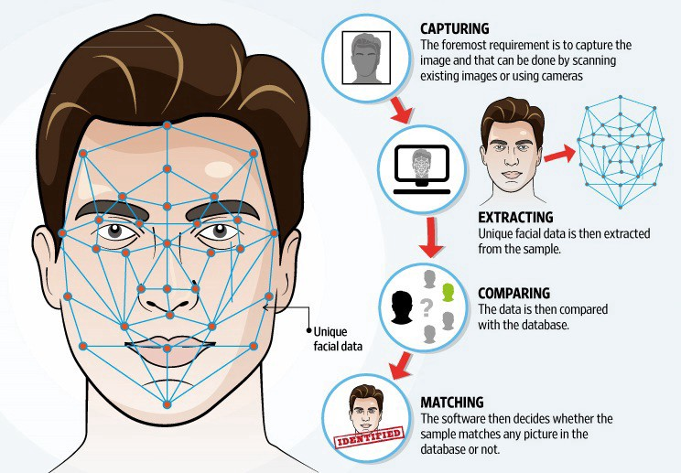
How Face Recognition Works

Slide 6
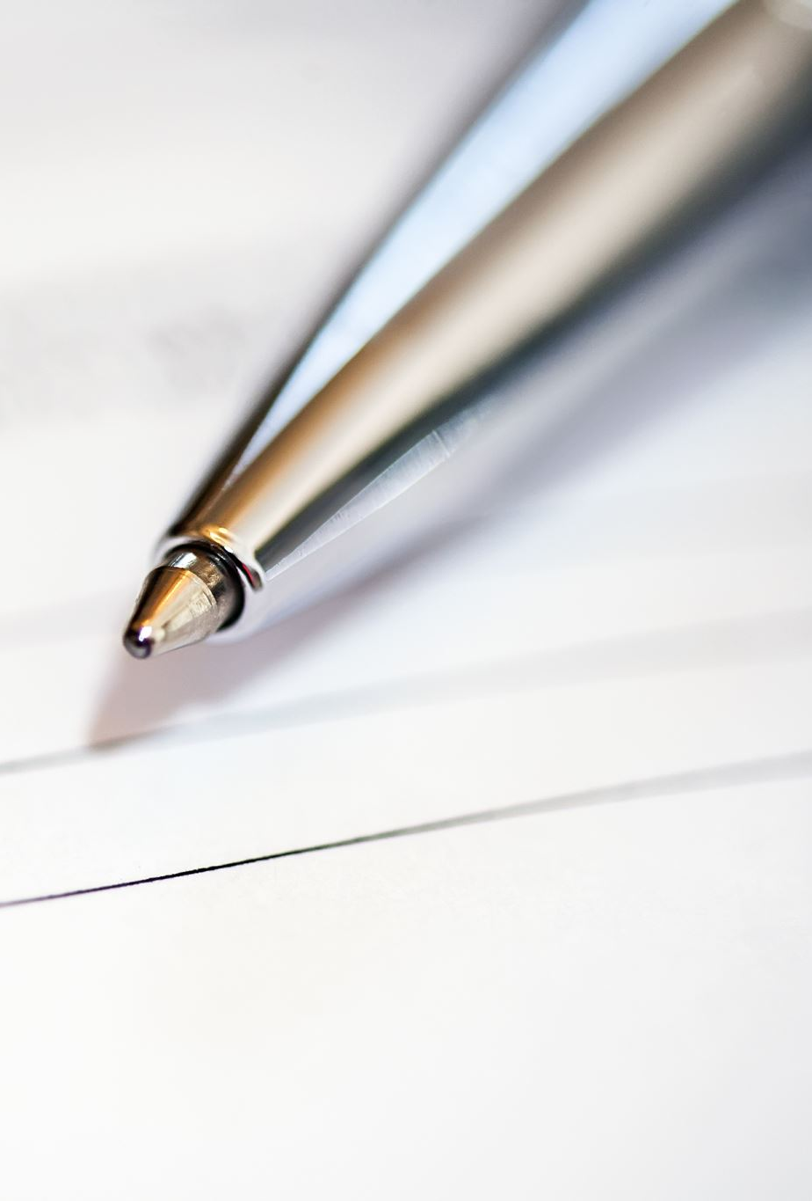
Goals and Objectives:
Goal:
The main goal of this system is to accomplish digitization of the traditional system of taking attendance by calling names and maintaining pen-paper records.
Objectives:
Reduce manual processing
Produce monthly report
Flexibility and liability
Send an Email to the student if required

Slide 7
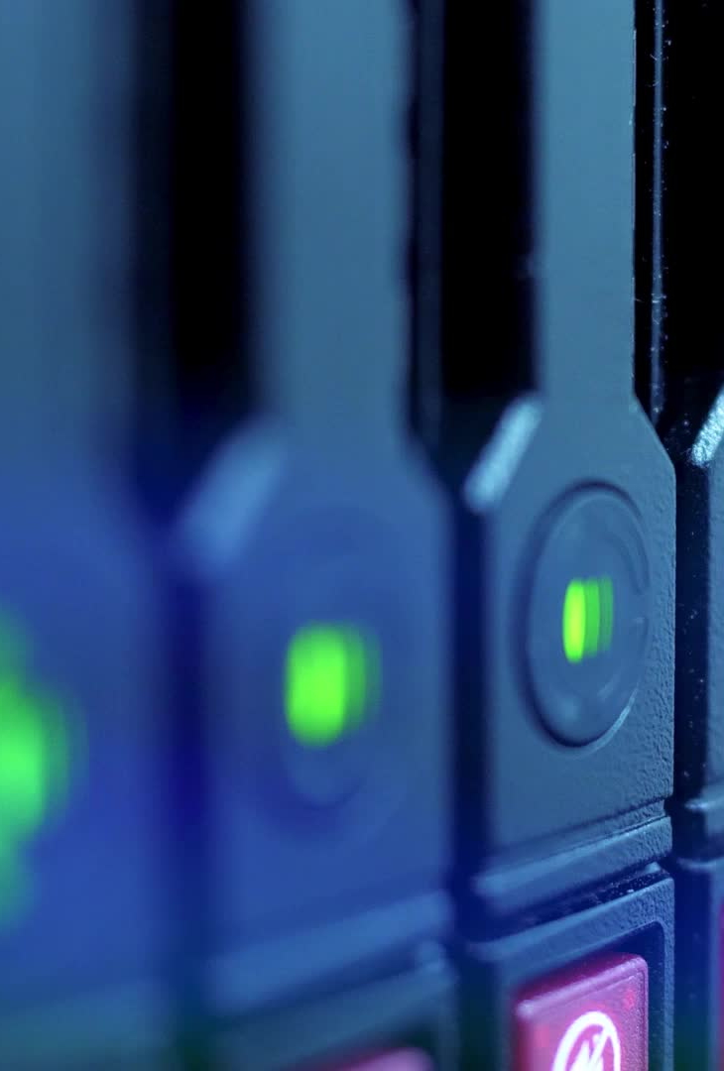
TOOL AND TECHNOLOGY
Open cv python: it is used to access the web camera.
VS Code: It’s a platform to develop code(IDE)
Python: It is a programming language
Django: It is a fame work. It has built-in database.

Slide 8
Django Framework
High-level framework for rapid web development.
Data modelled with python classes.
Flexible template language that can be used to generate HTML, CSV, Email or any other format.
It includes middleware, csrf protections, sessions, caching, authentication.
Middleware: It is a framework of hooks into Django request/response processing.

Slide 9
Database description
The related data stored on this system uses sqlite3, which is a relational database
The information in the database mainly contains the basic personal information of students, as well as the facial feature pictures selected by students, punch card records, overtime, leave records and student logs, etc.
The personal information table is stored separately from the facial feature table for more efficient reading and search performance.
Facial features are an important part of face recognition. The background will take all the face data in the table at one time, package it into a byte number, and provide it to the face module for comparison.

Slide 10
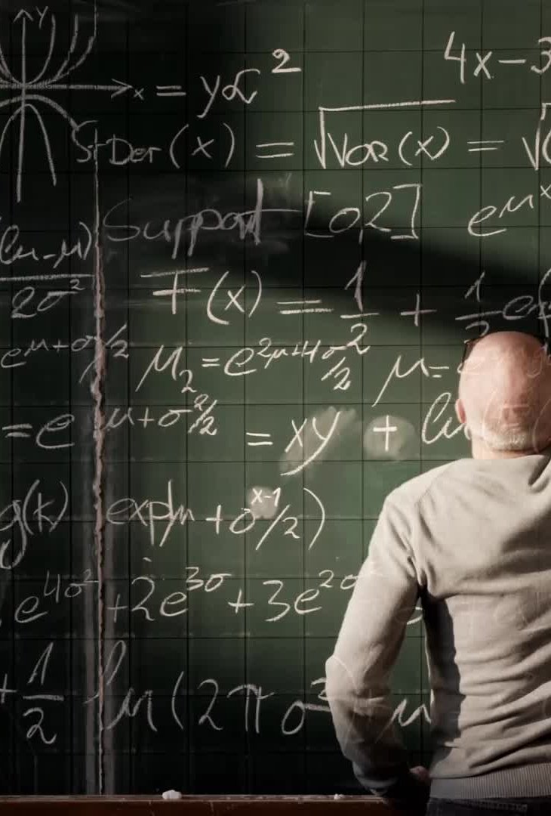
Implementation
The proposed model is based on face recognition mechanism. The basic methodology is presented Whenever a student enters the class and comes across the camera module of the system his image is captured in the system and is recognized and validated if he is a student of the class.
If recognized, then his attendance is automatically marked via post processing of the system.
The system architecture consists of various stages and steps ranging between creating dataset and updating of the database.

Slide 11
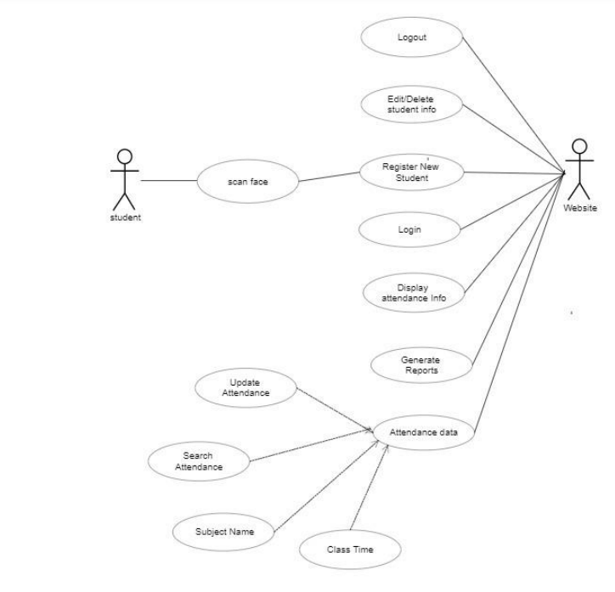
Use case diagram

Slide 12
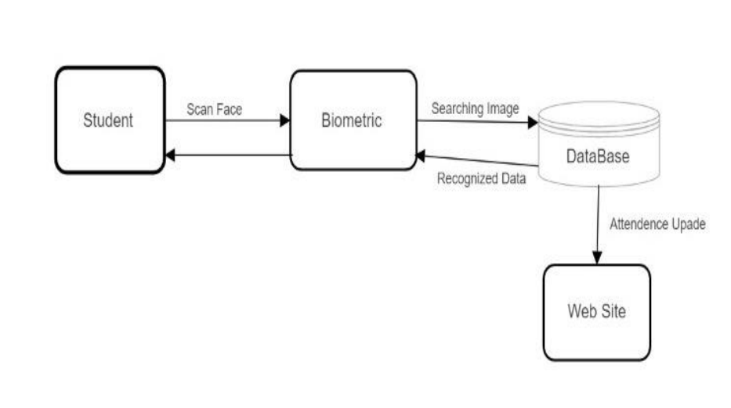
Static Model

Slide 13
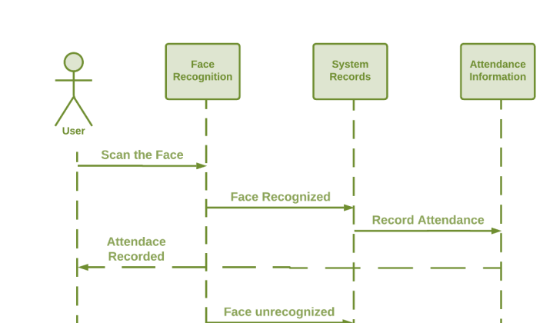
Dynamic Model

Slide 14
Software to be tested
The software here to be evaluated simply comprises of what and where in the facial recognition attendance system to be examined.
The testing exclusivities include tests that have not yet been fully developed and hence require extra time to implement and merge modifications
Authentication of the student will be managed
Authentication of the admin will be managed
Registering new student data in database
facial recognition algorithm will be tested
compare the capture data with the database will be tested
marking attendance will be managed
API gateway will be tested

Slide 15
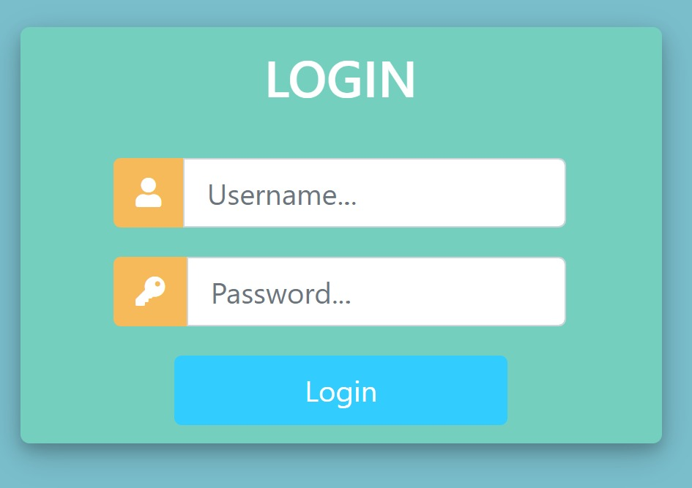
Sample Output
Login Page

Slide 16
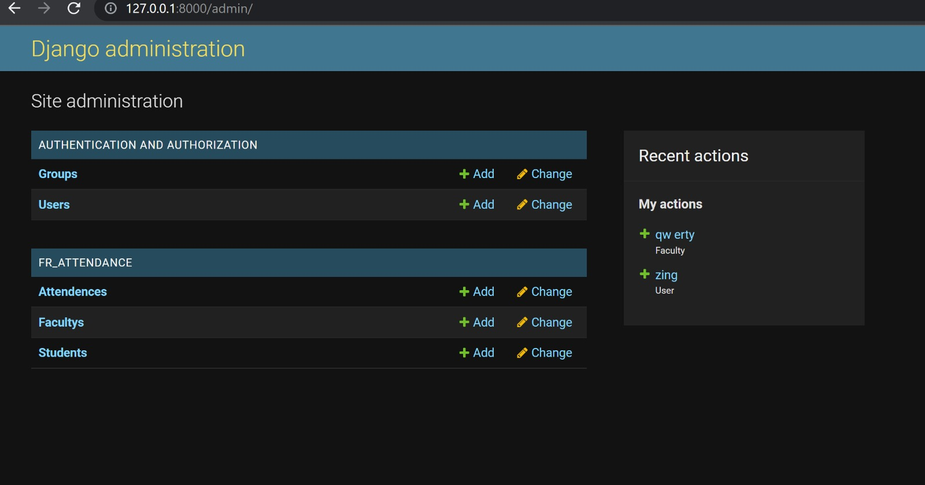
Admin-User Page

Slide 17
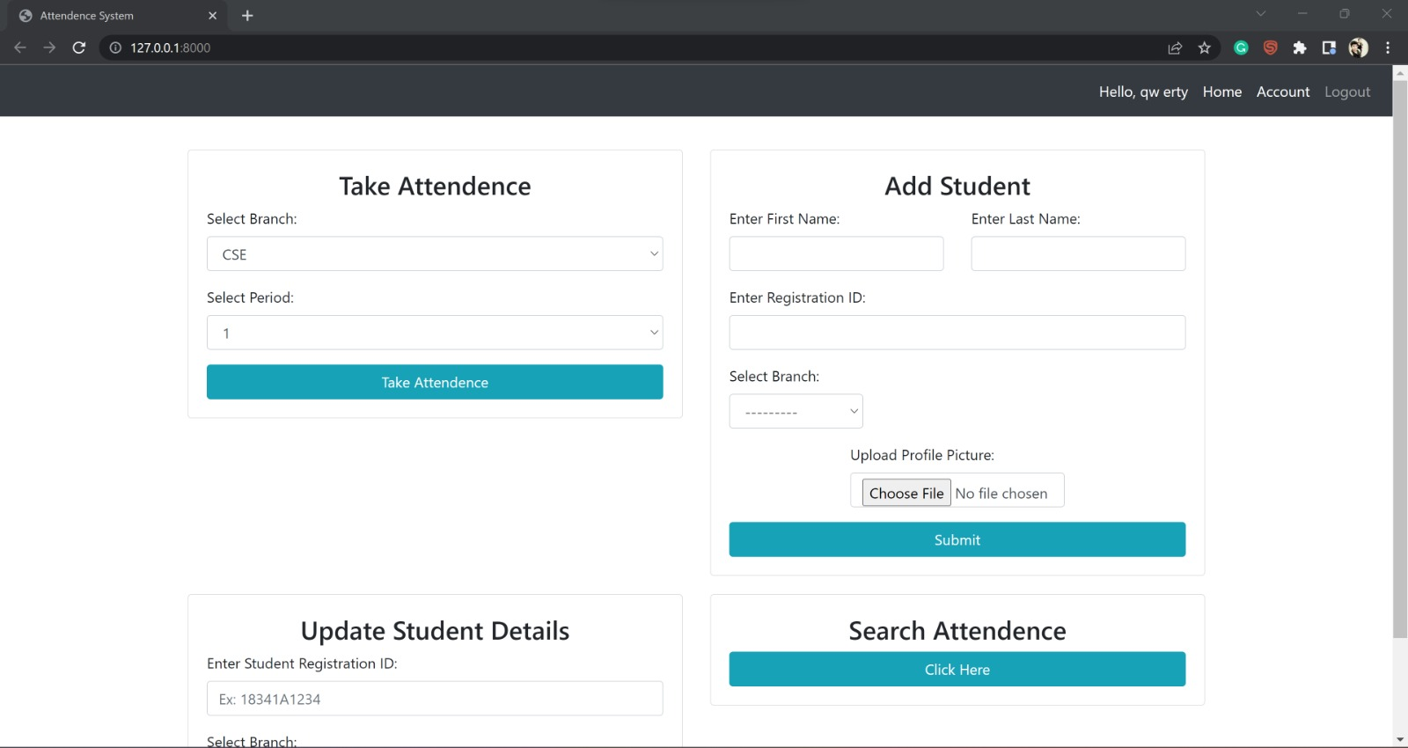
Home Page

Slide 18
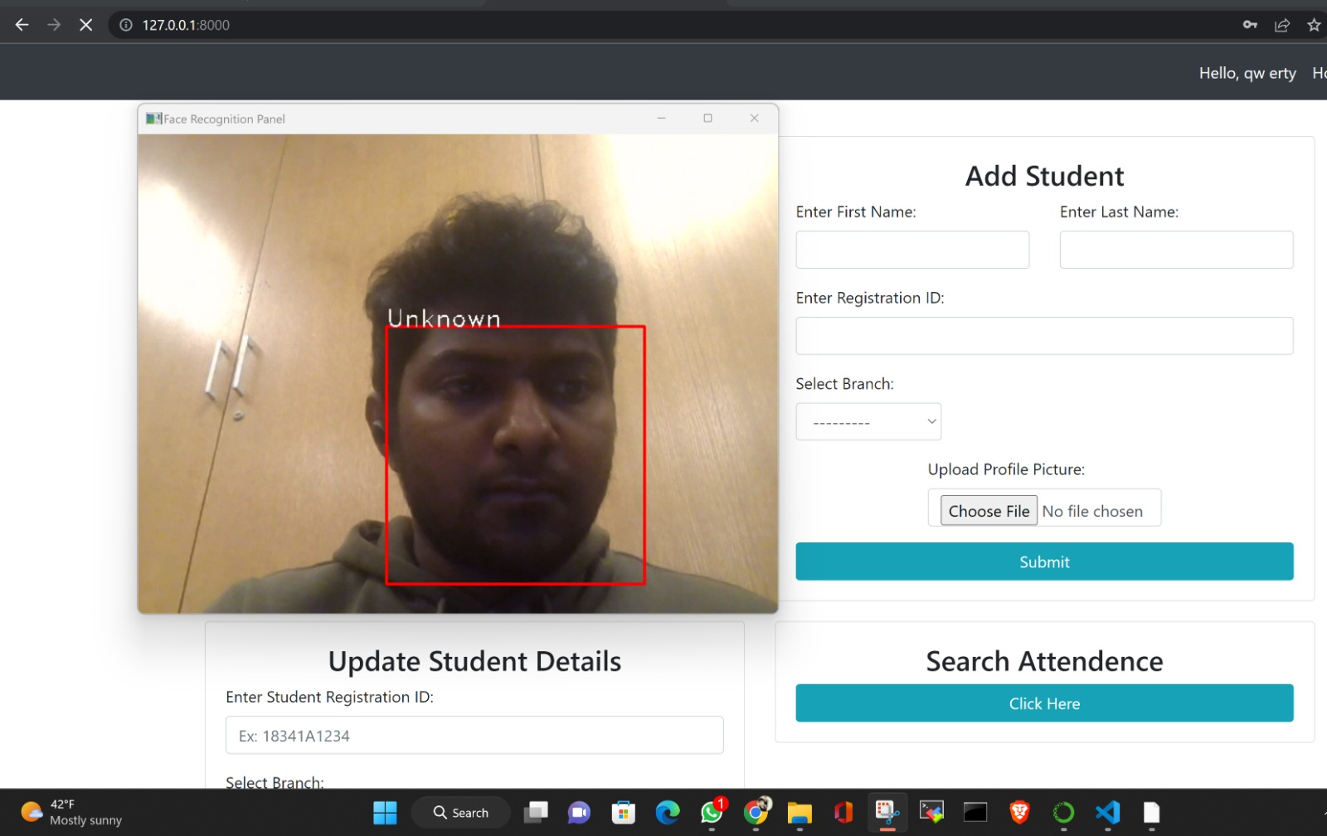
Face Recognition Window

Slide 19
Conclusion
From our experiment, we noticed the face recognition was sensitive to face background, light, and head orientations.
This technique described the accurate and efficient method of automatic attendance in the classroom which could replace the traditional method.
An automatic attendance has many advantages, most of the existing systems are time consuming and require semi manual interference from lecturers, our system seeks to solve these issues by using face recognition in the process to save the time and labor.
And No need for installing complex hardware for taking the attendance in classroom, all we need is a camera and laptop. We used algorithms that can detect and recognize faces in the image.

Slide 20
Future Work
Automatic attendance system can be improved by increasing the number of features which can be extracted to increase accuracy of face recognition.
Once the software is developed and tested properly, it could be improved to cover full institutions such as the faculty of engineering.

