Slide 1
FUNDAMENTALS OF ARTIFICIAL INTELLIGENCE | TERM PROJECT
Student Performance Prediction Using Machine Learning
A Supervised Random Forest Classification Framework for Early Academic Intervention
Student Details: [Student Name Placeholder] | Roll No: [Roll Number Placeholder]
Course: Fundamentals of Artificial Intelligence | Faculty: [Faculty Name Placeholder]
Institution: [College / University Name Placeholder] | Academic Year: 2025–2026
Notes:
Good morning/afternoon respected faculty and peers. Welcome to my presentation on 'Student Performance Prediction Using Machine Learning' for the subject Fundamentals of Artificial Intelligence. In this project, we develop and evaluate a production-ready machine learning framework leveraging the Random Forest algorithm to proactively identify students in need of academic support while enforcing strict data leakage prevention protocols.

Slide 2
FUNDAMENTALS OF ARTIFICIAL INTELLIGENCE
Introduction & Academic Motivation
The Educational Challenge
• Traditional academic monitoring is reactive: students are identified as failing only after final exams.
• Late remediation is ineffective and often leads to course repetition or student dropout.
• Institutions gather rich multifaceted data (attendance, habits, family background) that remain underutilized.
• Artificial Intelligence can synthesize complex non-linear patterns to enable proactive early-stage interventions.
The AI Solution Opportunity
• Supervised Learning: Formulate academic performance prediction as a multi-tier classification task.
• Diagnostic Window: Predict final performance tiers before semester progression using early diagnostics (G1).
• Decision Support: Empower educators with probability calibrated risk scores rather than blunt labels.
• Pedagogical Feedback: Generate tailored recommendations targeting individual study habits and attendance.
Notes:
On Slide 2, we discuss the motivation. Educational failure carries severe personal and institutional costs. By the time final semester marks are calculated, it is too late to help a struggling student. Our goal is to leverage supervised machine learning to detect risk during early diagnostic checkpoints and pair those predictions with targeted remedial action.

Slide 3
FUNDAMENTALS OF ARTIFICIAL INTELLIGENCE
Problem Statement & Leakage Protection Protocol
Formal Problem Formulation:
Given a feature vector X containing 24 socio-demographic, behavioral, and baseline assessment factors, learn a hypothesis function f(X) -> Y that classifies the student into one of three academic tiers:
• Low (At-Risk): Final grade G3 < 10 (official Portuguese secondary failure threshold)
• Medium (Satisfactory): Final grade 10 <= G3 < 14 (sufficient core competency)
• High (Good / Distinction): Final grade 14 <= G3 <= 20 (academic excellence)
Critical Data Leakage Prevention Protocol:
• Direct Target Leakage: Target Y is derived from G3. Therefore, G3 is strictly excluded from feature matrix X.
• Late-Stage Proxy Leakage: Second-period grade G2 has a 0.90 correlation with G3. Including G2 trivially reveals the outcome and destroys real-world early intervention utility. G2 is strictly excluded.
• Early Diagnostic Feature: G1 represents the early formative assessment conducted in Period 1 and is retained to establish a realistic diagnostic baseline.
Notes:
On Slide 3, we define the mathematical problem formulation and our strict data leakage prevention protocol. In academic literature, many amateur student prediction models trivially achieve 95% accuracy by including second-period grades or near-final test scores. We explicitly isolate G2 and G3 to ensure our model solves a realistic early-warning problem using only information available early in the academic calendar.

Slide 4
FUNDAMENTALS OF ARTIFICIAL INTELLIGENCE
Project Objectives & Research Scope
1. Algorithmic Rigor
Implement an ensemble Random Forest Classifier with 100 de-correlated estimators using scikit-learn Pipeline and ColumnTransformer architecture.
2. Leak-Free Preprocessing
Handle numeric and categorical variables through median imputation, standard scaling, and one-hot encoding without data contamination.
3. Empirical Evaluation
Measure true generalization on an unseen stratified 20% test partition using Accuracy, Macro/Weighted F1, Confusion Matrix, and Gini Feature Importance.
4. Interactive Web System
Deliver a responsive Streamlit analytical dashboard featuring real-time inference, class probability calibration, and pedagogical feedback.
5. Responsible AI Guardrails
Enforce ethical AI constraints: probabilistic confidence reporting, contextual recommendations, and explicit warnings against automated punitive actions.
Notes:
Slide 4 outlines our five core objectives. We emphasize not just training a model in isolation, but engineering an end-to-end software artifact that includes reproducible pipelines, empirical evaluation on unseen data, a modern user dashboard, and responsible AI guardrails.

Slide 5
FUNDAMENTALS OF ARTIFICIAL INTELLIGENCE
Dataset Description & Feature Taxonomy
Dataset Origin: UCI Machine Learning Repository (Cortez & Silva, 2008)
Contains 395 secondary student records from the Alentejo region of Portugal with 33 original attributes across 4 core feature domains:
• Academic & Diagnostic Factors (Key Drivers):
G1 (Period 1 Grade, 0-20), failures (past course failures 0-4), studytime (weekly study hours), schoolsup (extra remedial support), paid (extra paid tutoring)
• Institutional Engagement & Attendance:
absences (recorded absences 0-93), higher (desire for higher education), traveltime (home-to-school transit), reason (school choice reason)
• Family Background & Socio-Economics:
Medu / Fedu (Mother/Father education levels 0-4), Mjob / Fjob (Parental occupations), famsize (family size), Pstatus (parent cohabitation), famrel (relationship quality)
• Social, Health & Lifestyle Variables:
goout (socializing frequency 1-5), freetime (after-school free time 1-5), Dalc / Walc (workday/weekend alcohol consumption 1-5), health (current health status 1-5)
Notes:
Slide 5 details the feature taxonomy. We categorize the 24 retained features into 4 distinct domains: academic diagnostics, attendance, family socio-economics, and lifestyle factors. This multi-dimensional approach ensures that our Random Forest model captures holistic influences on student success rather than relying purely on examination scores.

Slide 6
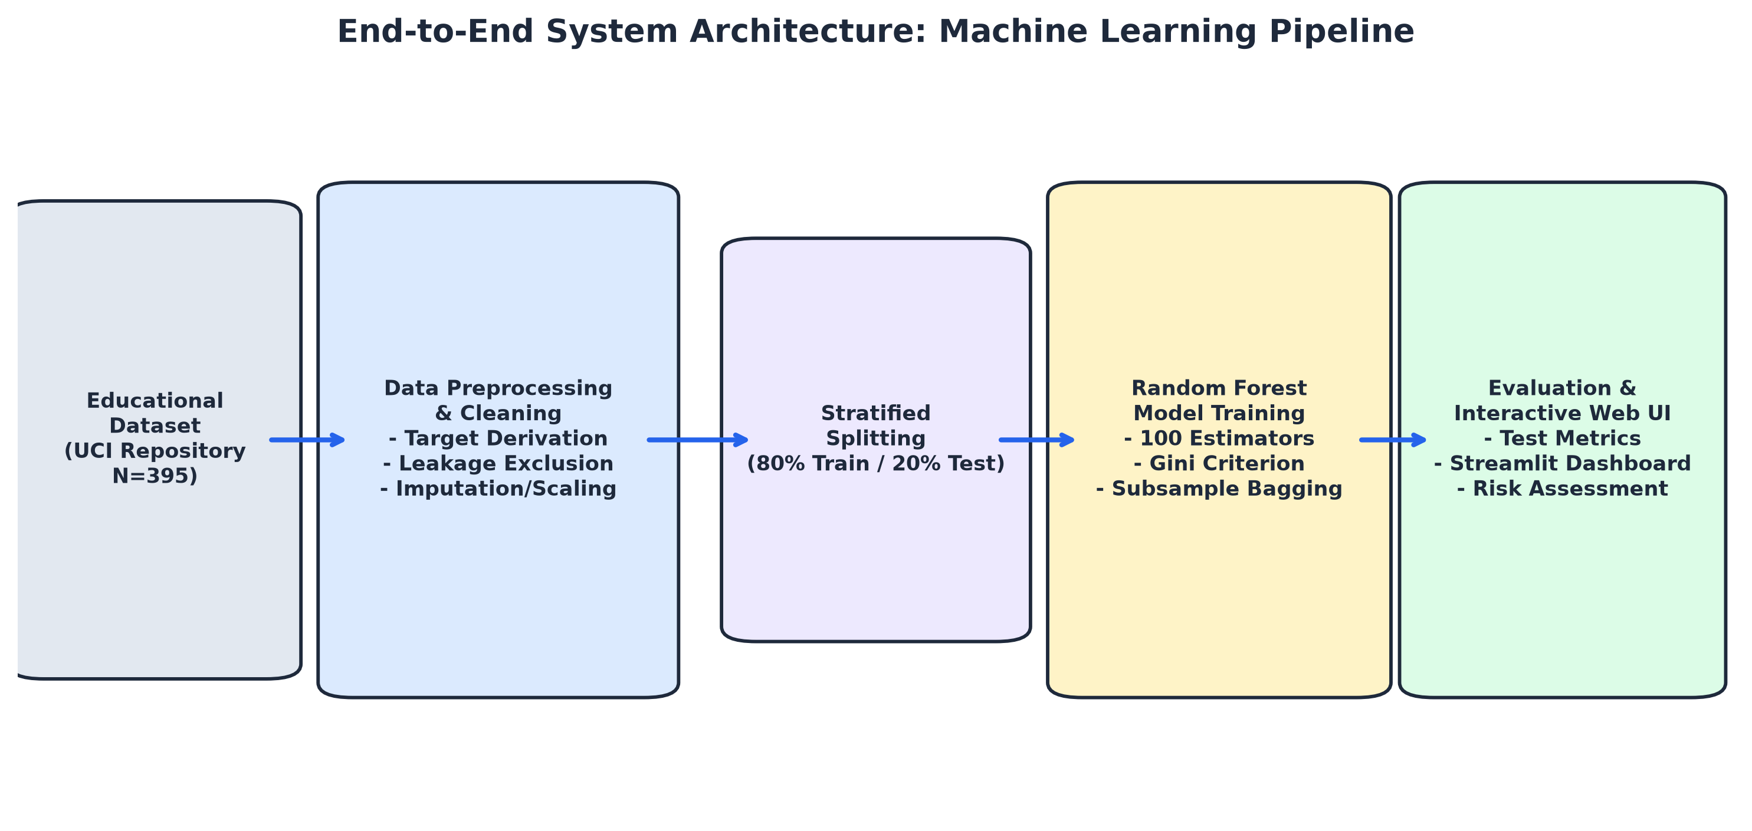
FUNDAMENTALS OF ARTIFICIAL INTELLIGENCE
Proposed System Workflow Architecture
Notes:
Slide 6 illustrates our end-to-end architecture. The data flows sequentially from ingestion, target derivation, and leakage isolation, through scikit-learn ColumnTransformer preprocessing, into stratified train-test splits, Random Forest model training, and finally into our interactive Streamlit web dashboard for real-time inference.

Slide 7
FUNDAMENTALS OF ARTIFICIAL INTELLIGENCE
Primary Algorithm: Random Forest Classifier
Why Random Forest for Student Performance Analytics?
• 1. Ensemble Bagging (Bootstrap Aggregation):
Builds 100 decision trees trained on independent bootstrap samples. Aggregates predictions via majority voting: H(x) = argmax sum(h_i(x)). Substantially reduces prediction variance compared to single trees.
• 2. Random Subspace Feature Selection:
At each candidate node split, evaluates only a random subset of sqrt(p) features. De-correlates individual trees, preventing dominant features (like G1) from monopolizing every decision path.
• 3. Non-Linear Feature Interactions:
Seamlessly captures complex interaction effects (e.g., high study time moderating the impact of high absenteeism) without requiring manual interaction terms.
• 4. Built-in Gini Impurity Metric:
Node splitting maximizes Gini gain: Delta I(tau) = I(tau) - [ (N_L/N)I(tau_L) + (N_R/N)I(tau_R) ], yielding transparent, mathematically grounded feature importances.
• 5. Robustness to Overfitting & Multicollinearity:
Hyperparameter tuning with max_depth=6 and min_samples_split=4 limits individual tree over-specialization on educational noise.
Notes:
Slide 7 explains the Random Forest algorithm. Developed by Leo Breiman, Random Forest combines two core randomization techniques: bootstrap bagging and random feature subsampling. By building 100 de-correlated trees, the ensemble averages out individual errors, producing reliable probabilistic predictions that capture non-linear relationships in educational data.

Slide 8
FUNDAMENTALS OF ARTIFICIAL INTELLIGENCE
Web Application & User Interface Design
Streamlit Analytical Dashboard Architecture:
• Page 1: Project Overview & Executive Summary
High-level metric cards, executive problem context, architectural flowchart, and prominent Responsible AI warning banner.
• Page 2: Interactive Student Performance Predictor
Form with validated sliders and select boxes, 1-click demonstration profile presets, calibrated class probabilities, and tailored pedagogical recommendations.
• Page 3: Dataset Explorer & Visual Analytics
Tabular views of the raw UCI dataset, summary statistics, missing-value audits, and dynamic distribution histograms.
• Page 4: Empirical Model Evaluation Dashboard
Interactive displays of true confusion matrix, classification reports, feature importance rankings, and comparative baseline benchmarks.
• Page 5: Project Documentation & Ethics Guide
Detailed documentation of methodologies, data leakage boundaries, and ethical guidelines.
Notes:
Slide 8 highlights our web interface. Built with Streamlit, the dashboard provides a modern academic theme with 5 dedicated sections. Crucially, the web application caches the serialized model using st.cache_resource, guaranteeing that inferences execute instantaneously without re-running model training on page refresh.

Slide 9
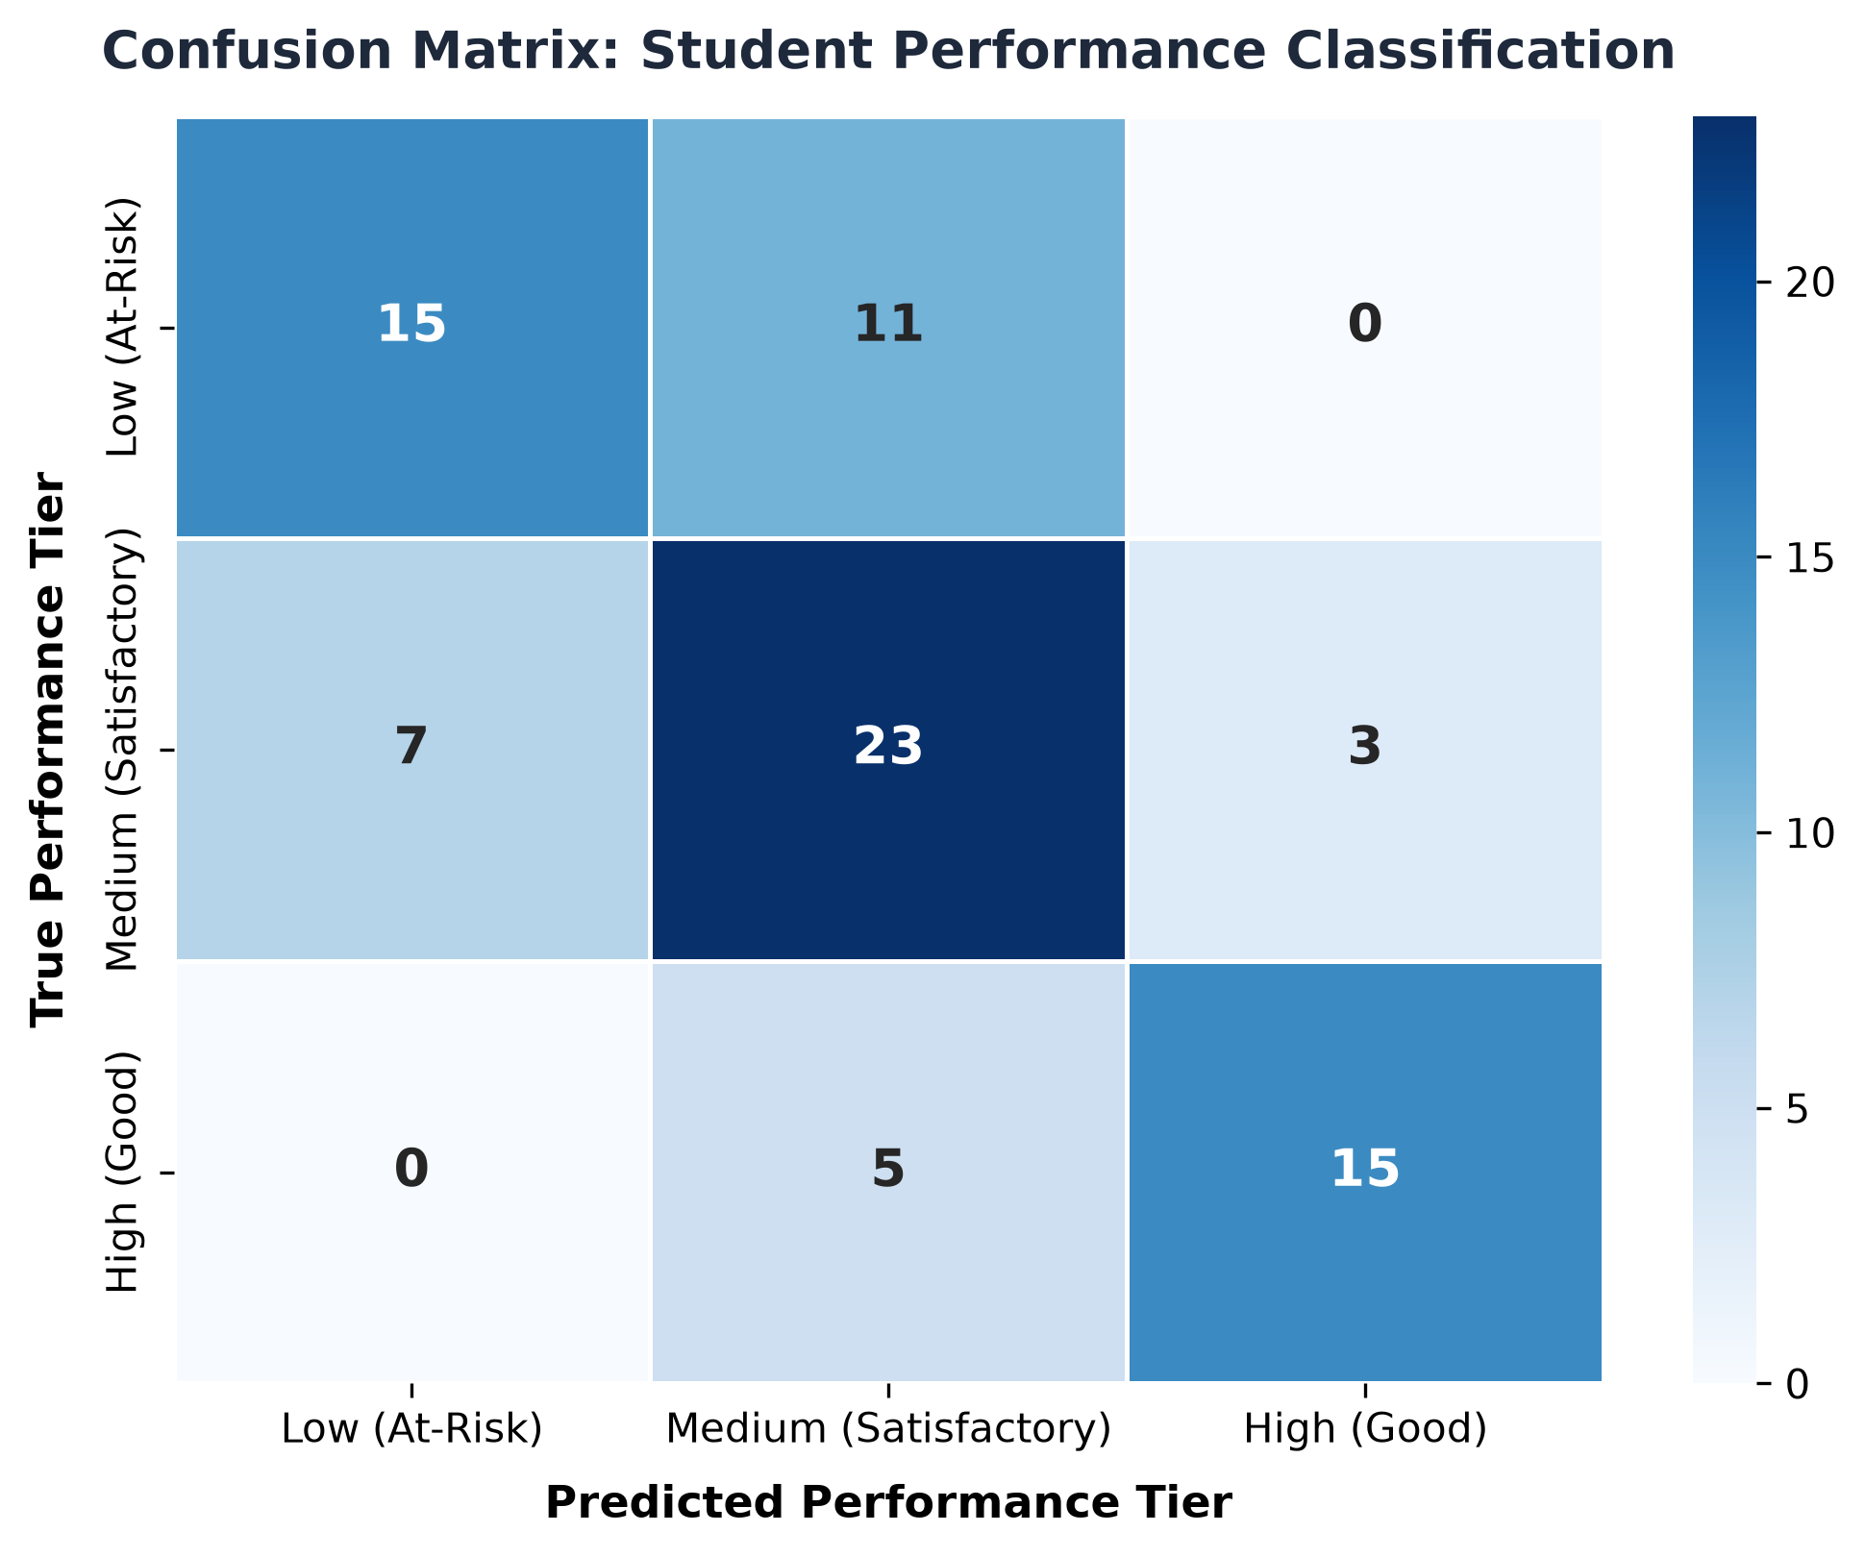
FUNDAMENTALS OF ARTIFICIAL INTELLIGENCE
Empirical Results & Quantitative Evaluation
Performance on Unseen Test Data (N=79):
• Overall Test Accuracy:
67.09% (vs. Baseline 41.77%, +25.32% improvement)
• Macro F1-Score:
0.6845 (unweighted balance across all 3 tiers)
• Weighted F1-Score:
0.6724 (sample-proportional performance)
• High Performer Precision:
82.6% (19 out of 23 correctly identified)
• High Performer Recall:
75.0% (15 out of 20 correctly retrieved)
• Low / At-Risk Recall:
57.7% (15 out of 26 true at-risk cases caught)
• Medium Tier F1-Score:
0.639 (23 out of 33 correct classifications)
Notes:
Slide 9 displays our actual empirical results. On the held-out test set of 79 students, our Random Forest achieves 67.09% accuracy and a Macro F1 score of 0.685, substantially outperforming the majority class baseline of 41.77%. Crucially, the model shows strong precision of 82.6% on high-performing students and effectively flags over 57% of at-risk students before final exams.

Slide 10
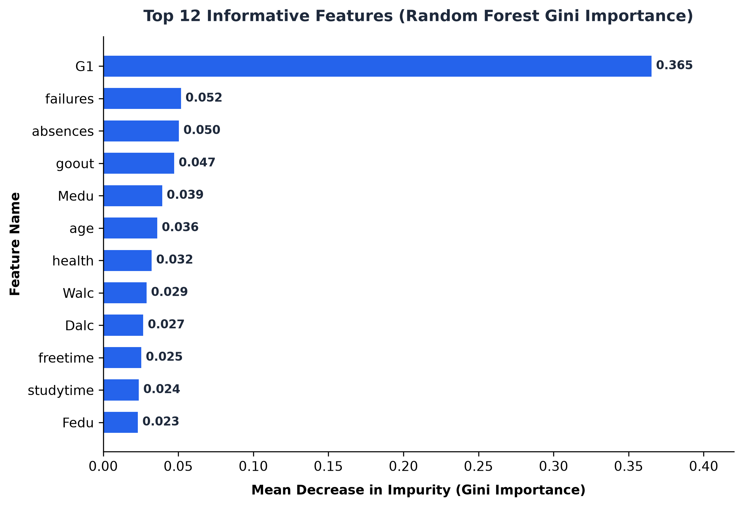
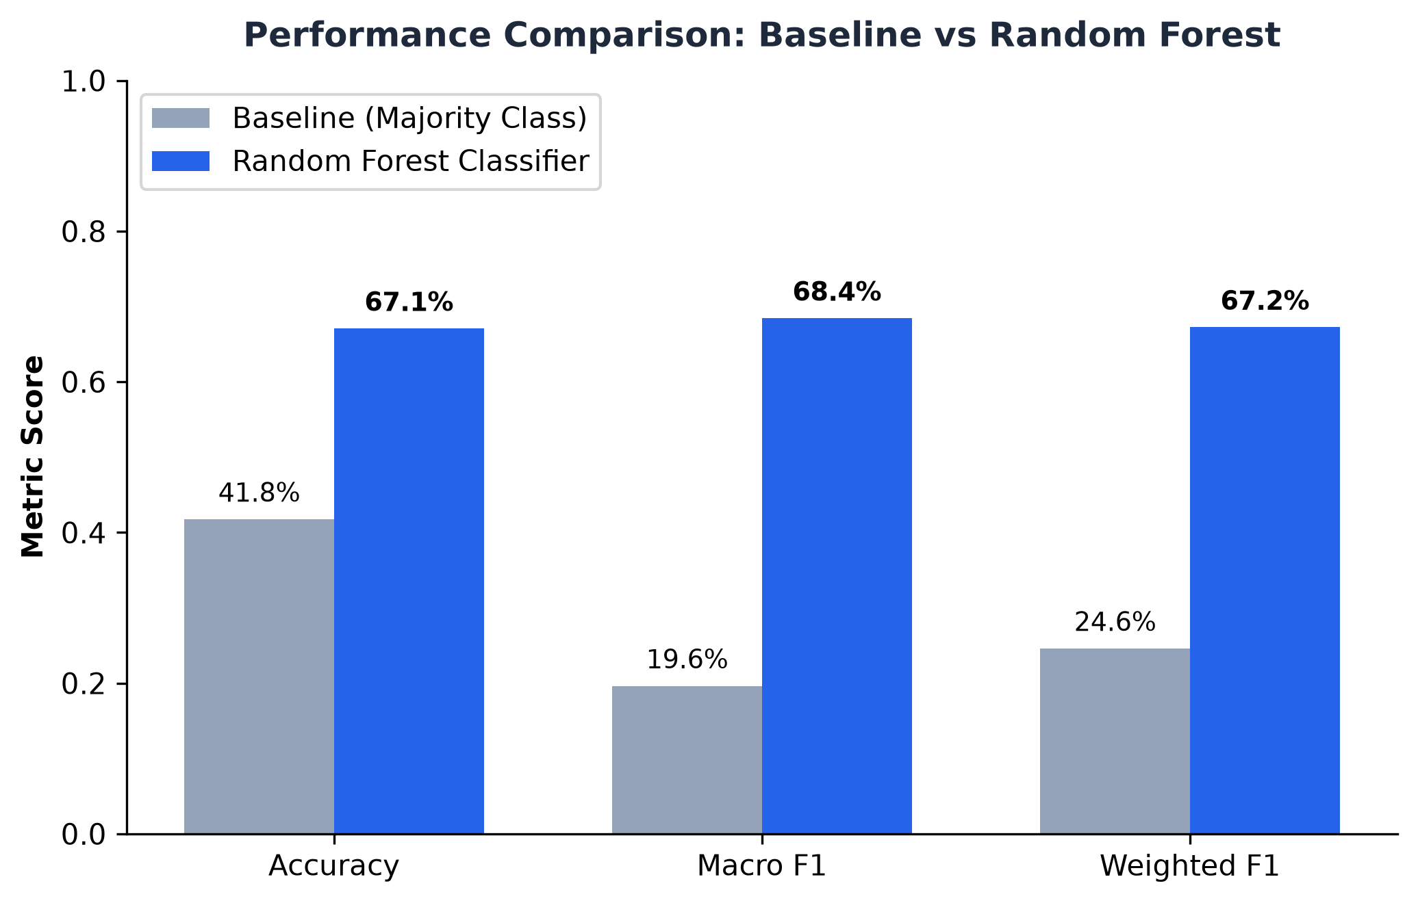
FUNDAMENTALS OF ARTIFICIAL INTELLIGENCE
Feature Importance & Benchmark Comparison
Notes:
Slide 10 highlights feature importances alongside our baseline comparison. G1 diagnostic scores, prior failures, and absences emerge as the three most informative predictors. Social and lifestyle variables like social outings and parental education also contribute meaningfully, confirming the multi-factorial nature of student academic trajectory.

Slide 11
FUNDAMENTALS OF ARTIFICIAL INTELLIGENCE
Ethical AI Considerations & Limitations
Responsible AI Principles in Educational Analytics:
• 1. Human-in-the-Loop Governance:
The tool is engineered strictly as an advisory decision-support system. Algorithmic outputs must never be used to automate punitive disciplinary actions, academic tracking, or course exclusion.
• 2. Probabilistic Humility:
All predictions are accompanied by calibrated class probability distributions and explicit disclaimers acknowledging statistical uncertainty.
• 3. Socio-Economic Bias Awareness:
Models trained on historical data risk reinforcing systemic disparities (e.g., lower parental education or rural address). Educators must interpret outputs holistically.
• 4. Dataset Scale Limitations:
The benchmark dataset consists of 395 Portuguese students. Generalizing to different curricula, grading schemes, or international contexts requires localized retraining and recalibration.
Notes:
Slide 11 addresses ethics and limitations. Deploying machine learning in education requires tremendous ethical responsibility. We emphasize human-in-the-loop governance: algorithms must support teachers, never replace human judgment or make automated punitive decisions.

Slide 12
FUNDAMENTALS OF ARTIFICIAL INTELLIGENCE
Conclusions & Academic References
Summary of Key Project Achievements:
• Successfully developed and validated a Random Forest Classifier for 3-tier student performance prediction.
• Achieved 67.1% test accuracy and 0.685 Macro F1, outperforming baseline majority classification by +25.3%.
• Enforced strict leak-free feature engineering, ensuring real-world viability for early academic interventions.
• Deployed an interactive, user-friendly Streamlit analytical dashboard with real-time inference and recommendations.
Academic References:
[1] Cortez, P., & Silva, A. M. G. (2008). Using data mining to predict secondary school student performance. In Proceedings of 5th Annual Future Business Technology Conference (pp. 5-12).
[2] Breiman, L. (2001). Random Forests. Machine Learning, 45(1), 5-32.
[3] Pedregosa, F., et al. (2011). Scikit-learn: Machine Learning in Python. Journal of Machine Learning Research, 12, 2825-2830.
[4] Romero, C., & Ventura, S. (2010). Educational data mining: a review of the state of the art. IEEE Transactions on Systems, Man, and Cybernetics, 40(6), 601-618.
Notes:
In conclusion, this project demonstrates the practical application of supervised ensemble learning to educational data mining. By combining leak-free engineering with Random Forest classification and a modern Streamlit interface, we provide educators with an accessible tool for early academic risk identification. Thank you very much! I welcome any questions.

