Slide 1
Typing Tutor
Sparsh Rawlani & Nora Riches

Slide 2
Purpose & Outline
Purpose: make a more complex version of a typing tutor that Nora and Kara worked on last semester
General Outline:
Shows the user a file
Asks the user to copy
Creates a new file with statistics about accuracy and words per minute

Slide 3
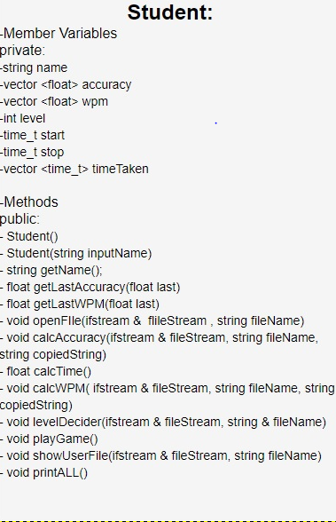
Structure
Student class contains information about the student and the methods that allow the student to play the game
Main calls a few methods
Constuctor
Playgame
print

Slide 4
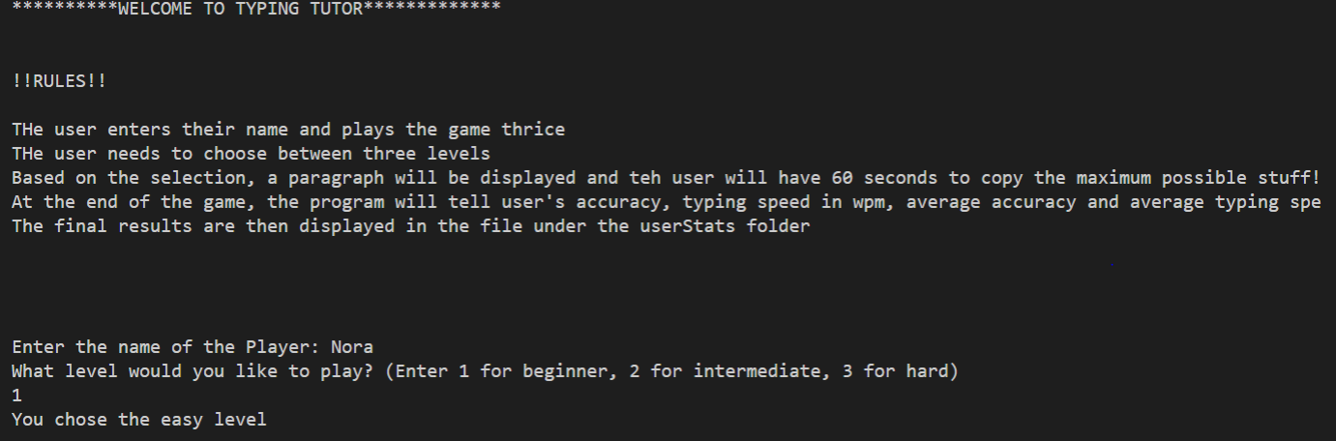
Demonstration of Code

Slide 5
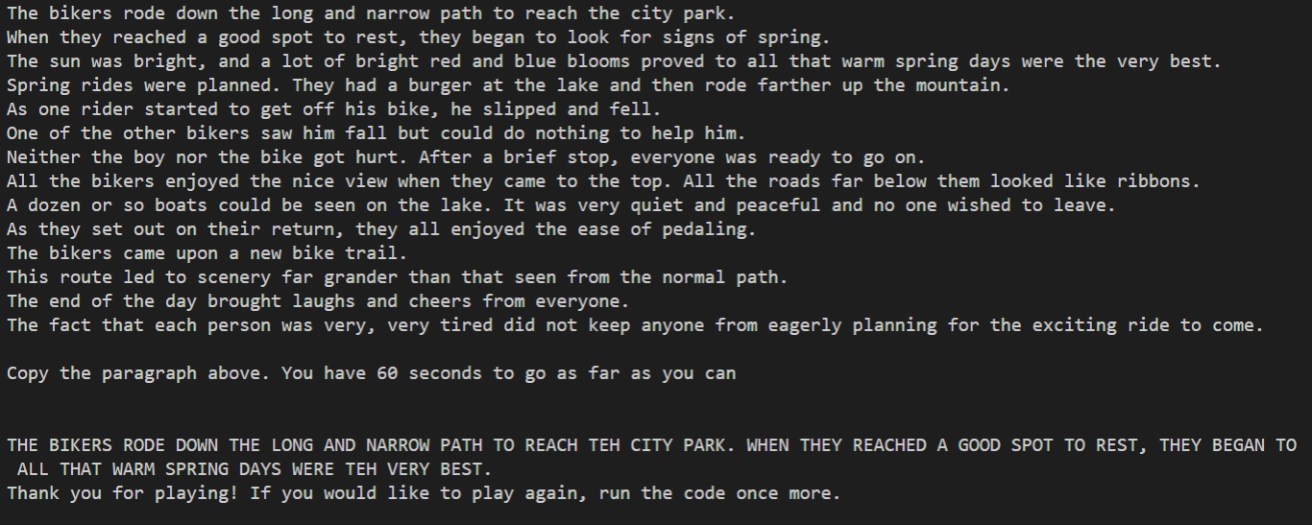
Demonstration of Code

Slide 6
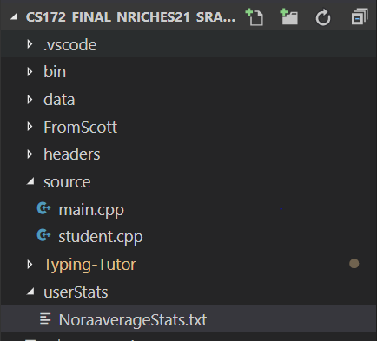
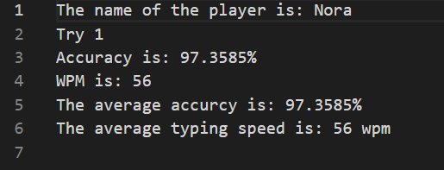

Slide 7
Important Methods
Time&GrabInput
CalcAccuracy
CalcWPM
Print
MainFunction

Slide 8
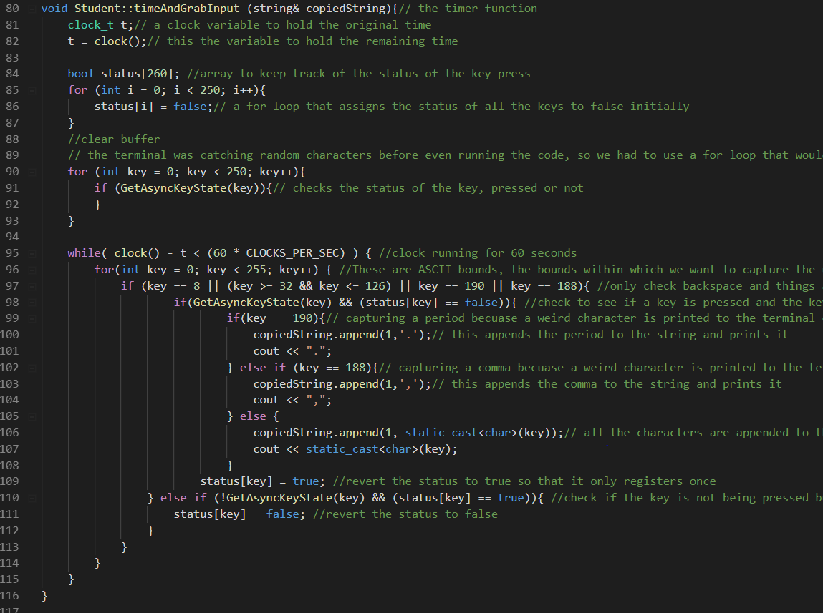

Slide 9
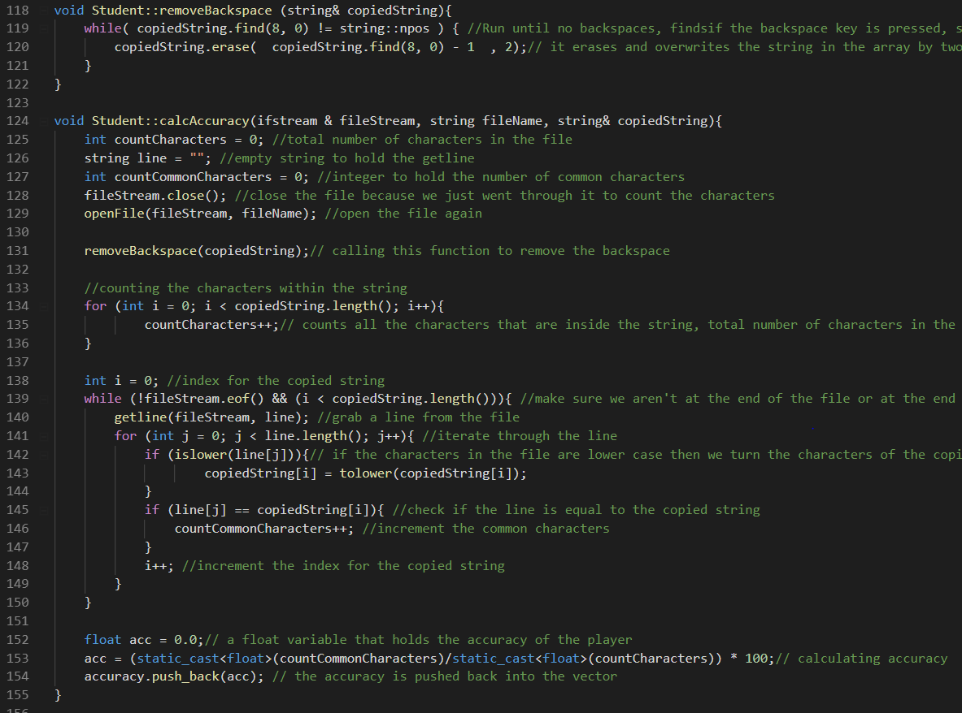

Slide 10
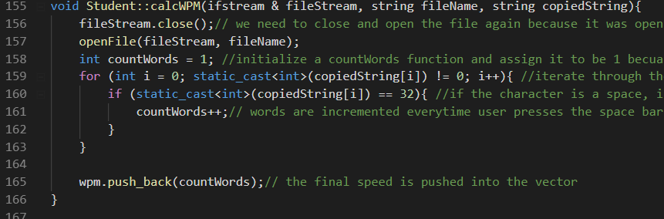
Important Methods: calcWPM

Slide 11
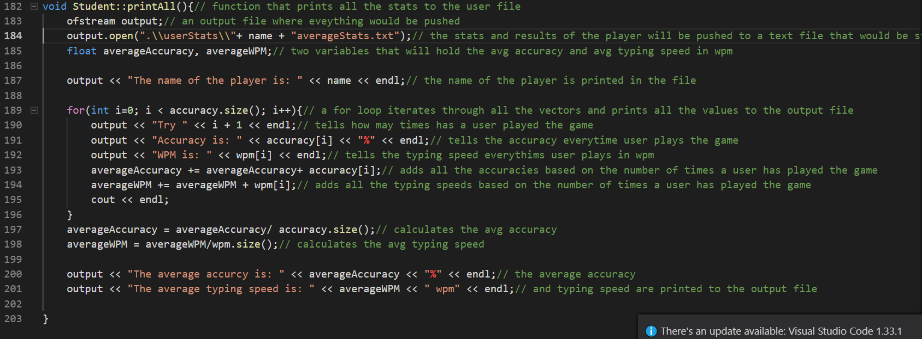
Important Methods: print

Slide 12
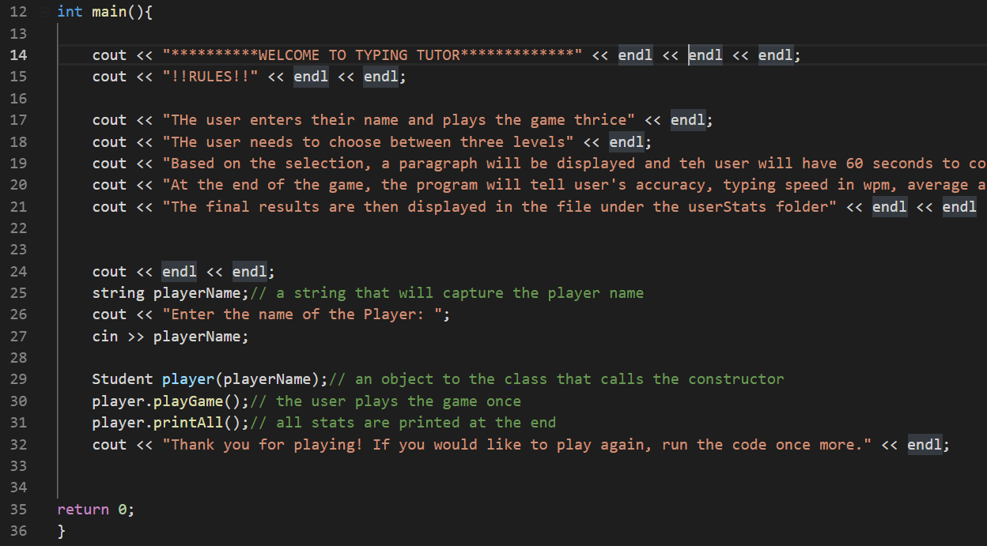
Main Function

Slide 13
Problems Faced
Can only run code once
Cin buffer
GetAsynKeyState() - Completely new method that returns a bool of whether or not a key is pressed
Initially, we appended every time any key was being pressed but then had to create exceptions for special scharacters
Key presses were not within the bounds of the ASCII table
Grabbed the keyboard input even when we weren’t running the code
Deleted student.cpp file
CalcAccuracy and CalcWPM
Our initial solution for the backspace character problem was not sufficient
Scott put about 100 lines of our code into 3 lines

Slide 14
More to be done
More complex ways to calculate accuracy
Use string methods to calculate the accuracy of each word and then by total
Grabbing input and timing at the same time can be done more efficiently
Level decider based on previous performance
Work with the shift key to cast upper and lower accordingly
Implement GetAsyncKeyState() to work around the cin buffer problem

