Slide 1



DA241M PROJECT
Sentiment Analysis
This presentation will introduce our project, Sentiment Analysis of English texts, as part of our Data Science and Artificial Intelligence Minor Course Project.
https://github.com/sray3000/minor-project

Slide 2


DA241M PROJECT
Problem Statement
Using Natural Language Processing(NLP) and ML algorithms for determining the sentiment being conveyed by English texts. This can be very useful while analyzing customer feedback of companies, or movie reviews of audience.
02
https://github.com/sray3000/minor-project

Slide 3

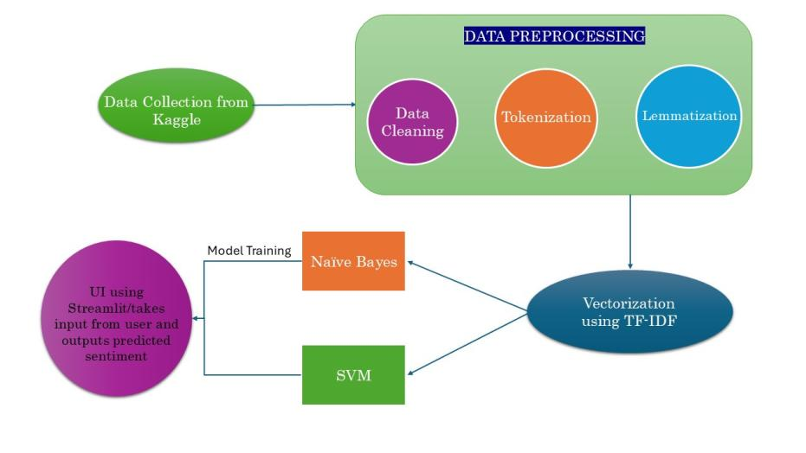
DA241M PROJECT
03
Workflow

Slide 4

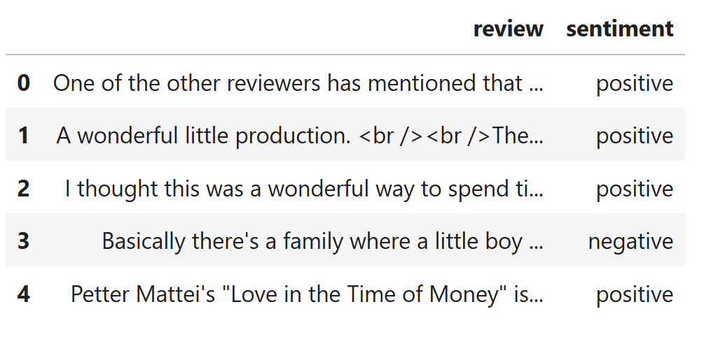
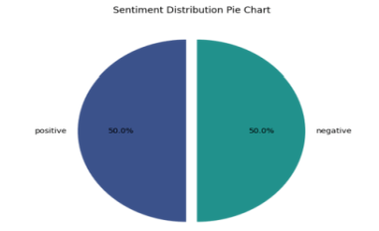
04
DA241M PROJECT
Data Collection
We obtained an IMDB movie reviews dataset(CSV file) from Kaggle consisting of 50,000 movie reviews. It was perfectly balanced i.e. consists of equal number of entries of both classes - positive and negative.
Dataset Link

Slide 5

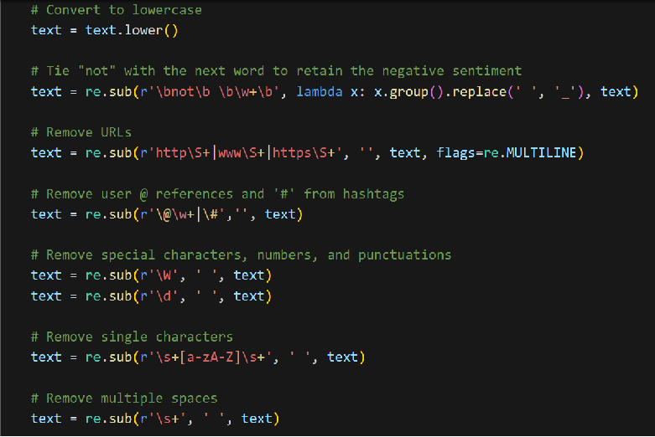
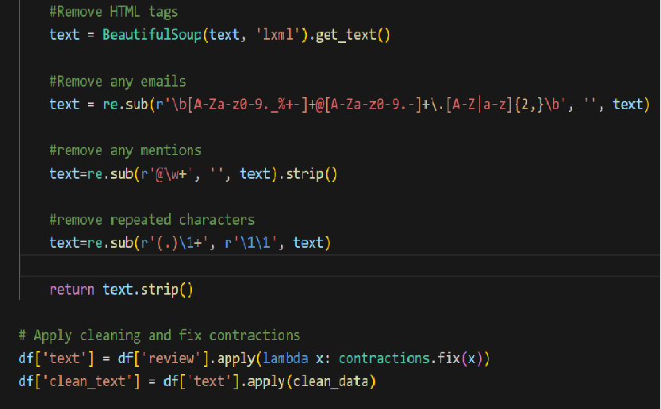
05
DA241M PROJECT
Data Cleaning
We cleaned the dataset by converting textual data to lowercase, fixing contractions, removing HTML tags, URLs and other special characters.

Slide 6
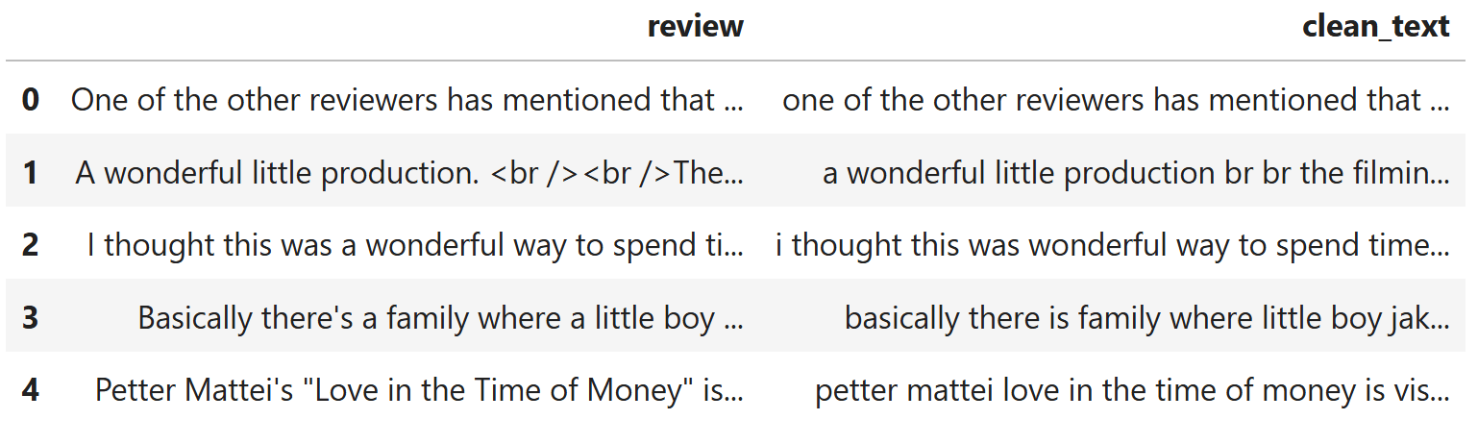
06
DA241M PROJECT
Data Cleaning

Slide 7

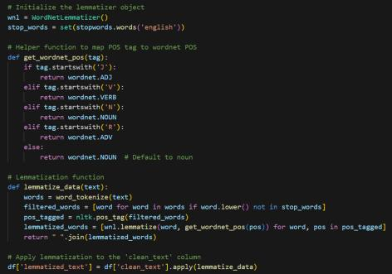
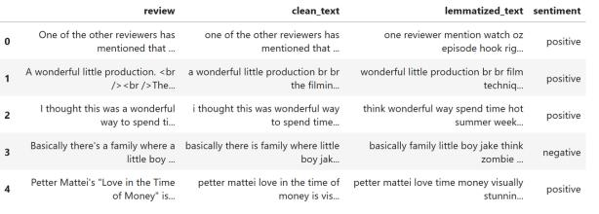
07
DA241M PROJECT
Tokenization and Lemmatization

Slide 8
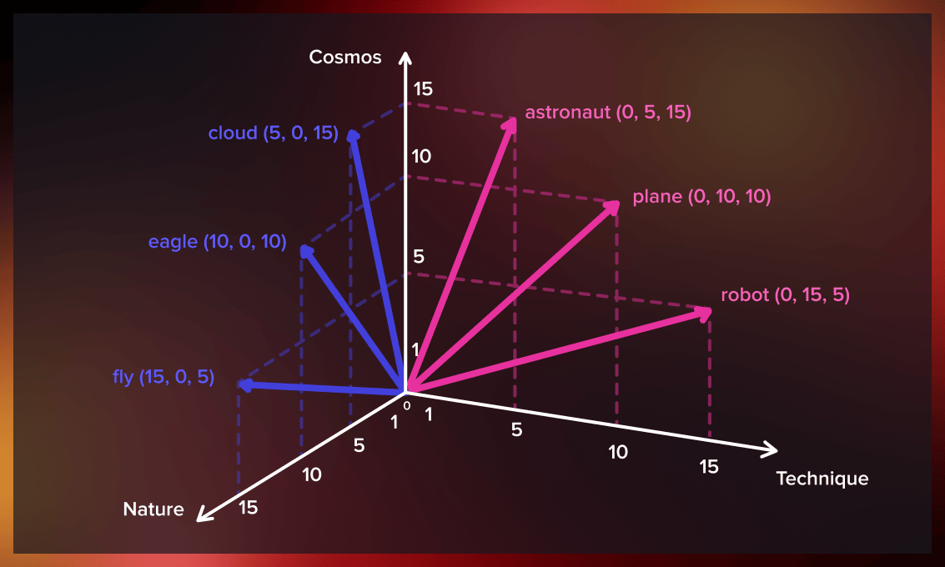
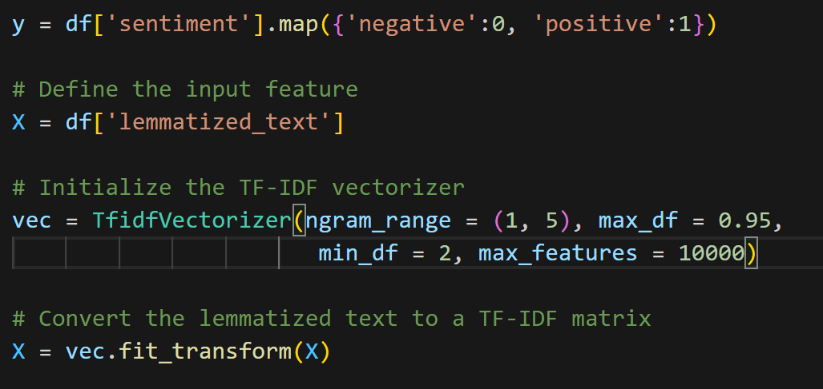
DA241M PROJECT
08
Vectorization
Vectorization is the technique of converting textual data into numeric arrays for ease of computation by machine learning algorithms.
In our project we used the TF-IDF(Term Frequency-Inverse Document Frequency) vectorizer to achieve this.

Slide 9


9
DA241M PROJECT
Model
Development
We designed and implemented two ML models - Naive Bayes and SVM. We created these two models individually and trained and tested them separately.

Slide 10

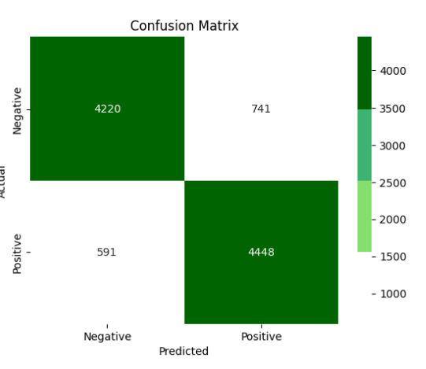
NAIVE BAYES
DA241M PROJECT
Selected for its simplicity and effectiveness in text classification tasks with balanced datasets.
Naive Bayes(Multinomial) works well under the assumption of feature independence, which was particularly effective for this project since the dataset was balanced.

Slide 11

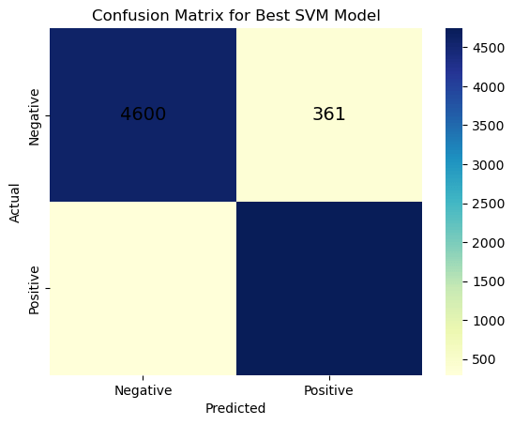
SVM(Linear kernel)
DA241M PROJECT
Used with a linear kernel to find the optimal hyperplane that separates positive and negative reviews.
SVM was chosen for its robustness and higher accuracy in handling balanced data for sentiment analysis.
243
4796

Slide 12
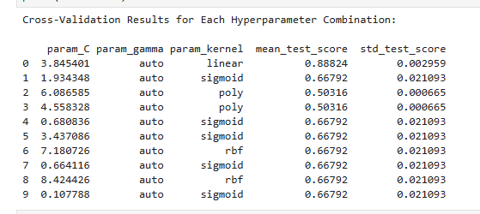
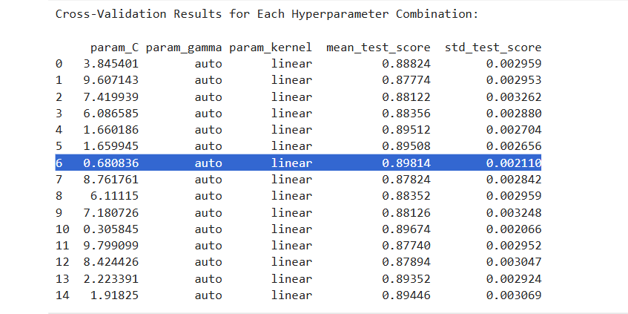
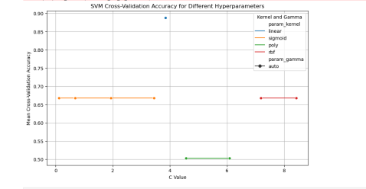
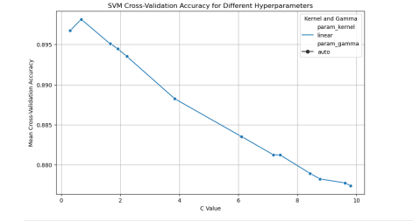
Hyperparameter Tuning
DA241M PROJECT

Slide 13

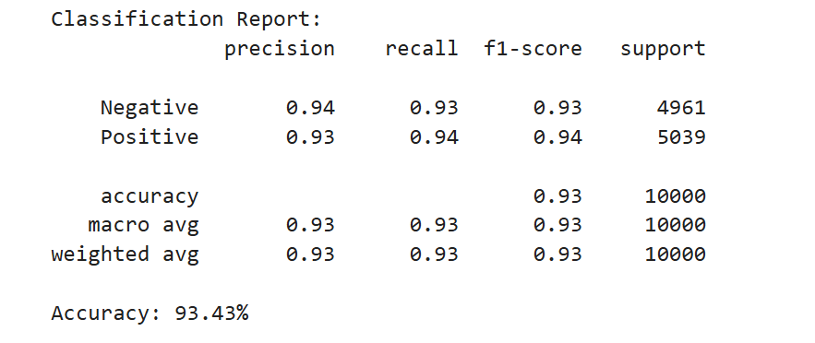
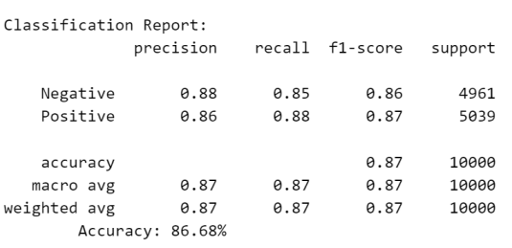
Results and Impact
DA241M PROJECT
13
SVM showed an accuracy of 93.43% as compared to Naive Bayes’ 86.68%, as well as higher precision, recall and F1 score - indicating higher effectiveness at classifying sentiments accurately within the balanced dataset.
SVM(Linear kernel)
Naive Bayes

Slide 14




Issues
14
DA241M PROJECT
Unbalanced Datasets
Neutral Statements
Complicated Reviews
In unbalanced datasets, our model showed bias towards the class with more reviews.
Since the dataset we selected does not have reviews with neutral sentiment, neutral reviews entered by user can be misclassified.
The reviews that are sarcastic or have complicated English phrases and quotes which often imply opposite meaning, can be classified wrongly.

Slide 15

DA241M PROJECT
Future Directions
We outline future directions for our project by expanding it to various other languages.
Implementing pre-trained models like BERT will improve the handling of complex language features such as idioms, sarcasm, and context-dependent sentiment that simpler models like Naive Bayes and SVM may miss.
15

