Slide 1
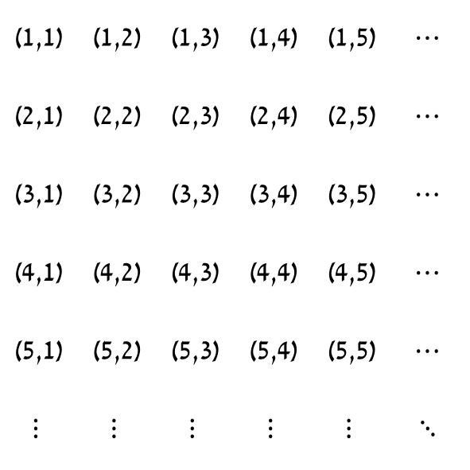
$$⋯$$ | (1,5) | (1,4) | (1,3) | (1,2) | (1,1)
$$⋯$$ | (2,5) | (2,4) | (2,3) | (2,2) | (2,1)
$$⋯$$ | (3,5) | (3,4) | (3,3) | (3,2) | (3,1)
$$⋯$$ | (4,5) | (4,4) | (4,3) | (4,2) | (4,1)
$$⋯$$ | (5,5) | (5,4) | (5,3) | (5,2) | (5,1)
$$⋱$$ | $$⋮$$ | $$⋮$$ | $$⋮$$ | $$⋮$$ | $$⋮$$

Slide 2
$$⋯$$ | (1,5) | (1,4) | (1,3) | (1,2) | (1,1)
$$⋯$$ | (2,5) | (2,4) | (2,3) | (2,2) | (2,1)
$$⋯$$ | (3,5) | (3,4) | (3,3) | (3,2) | (3,1)
$$⋯$$ | (4,5) | (4,4) | (4,3) | (4,2) | (4,1)
$$⋯$$ | (5,5) | (5,4) | (5,3) | (5,2) | (5,1)
$$⋱$$ | $$⋮$$ | $$⋮$$ | $$⋮$$ | $$⋮$$ | $$⋮$$

