Slide 1
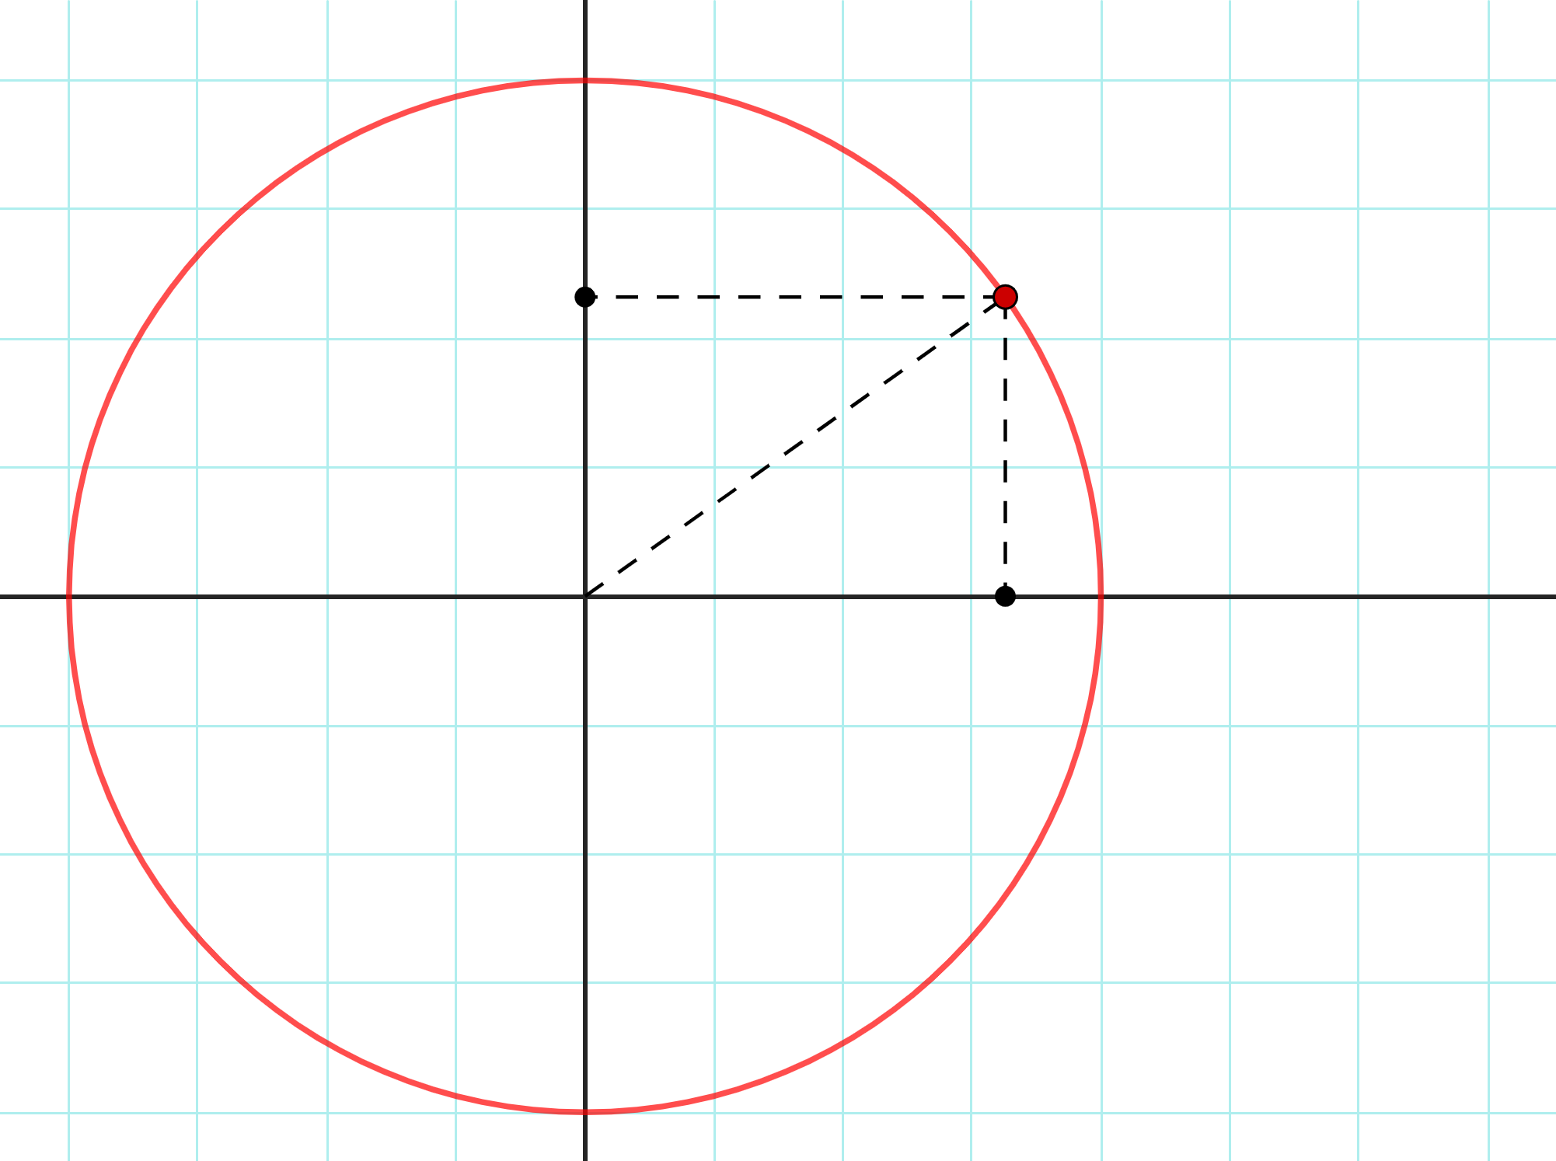



B
A
$$1$$
$$\sin\left(θ\right)$$
θ
C
$$\cos\left(θ\right)$$

Slide 2
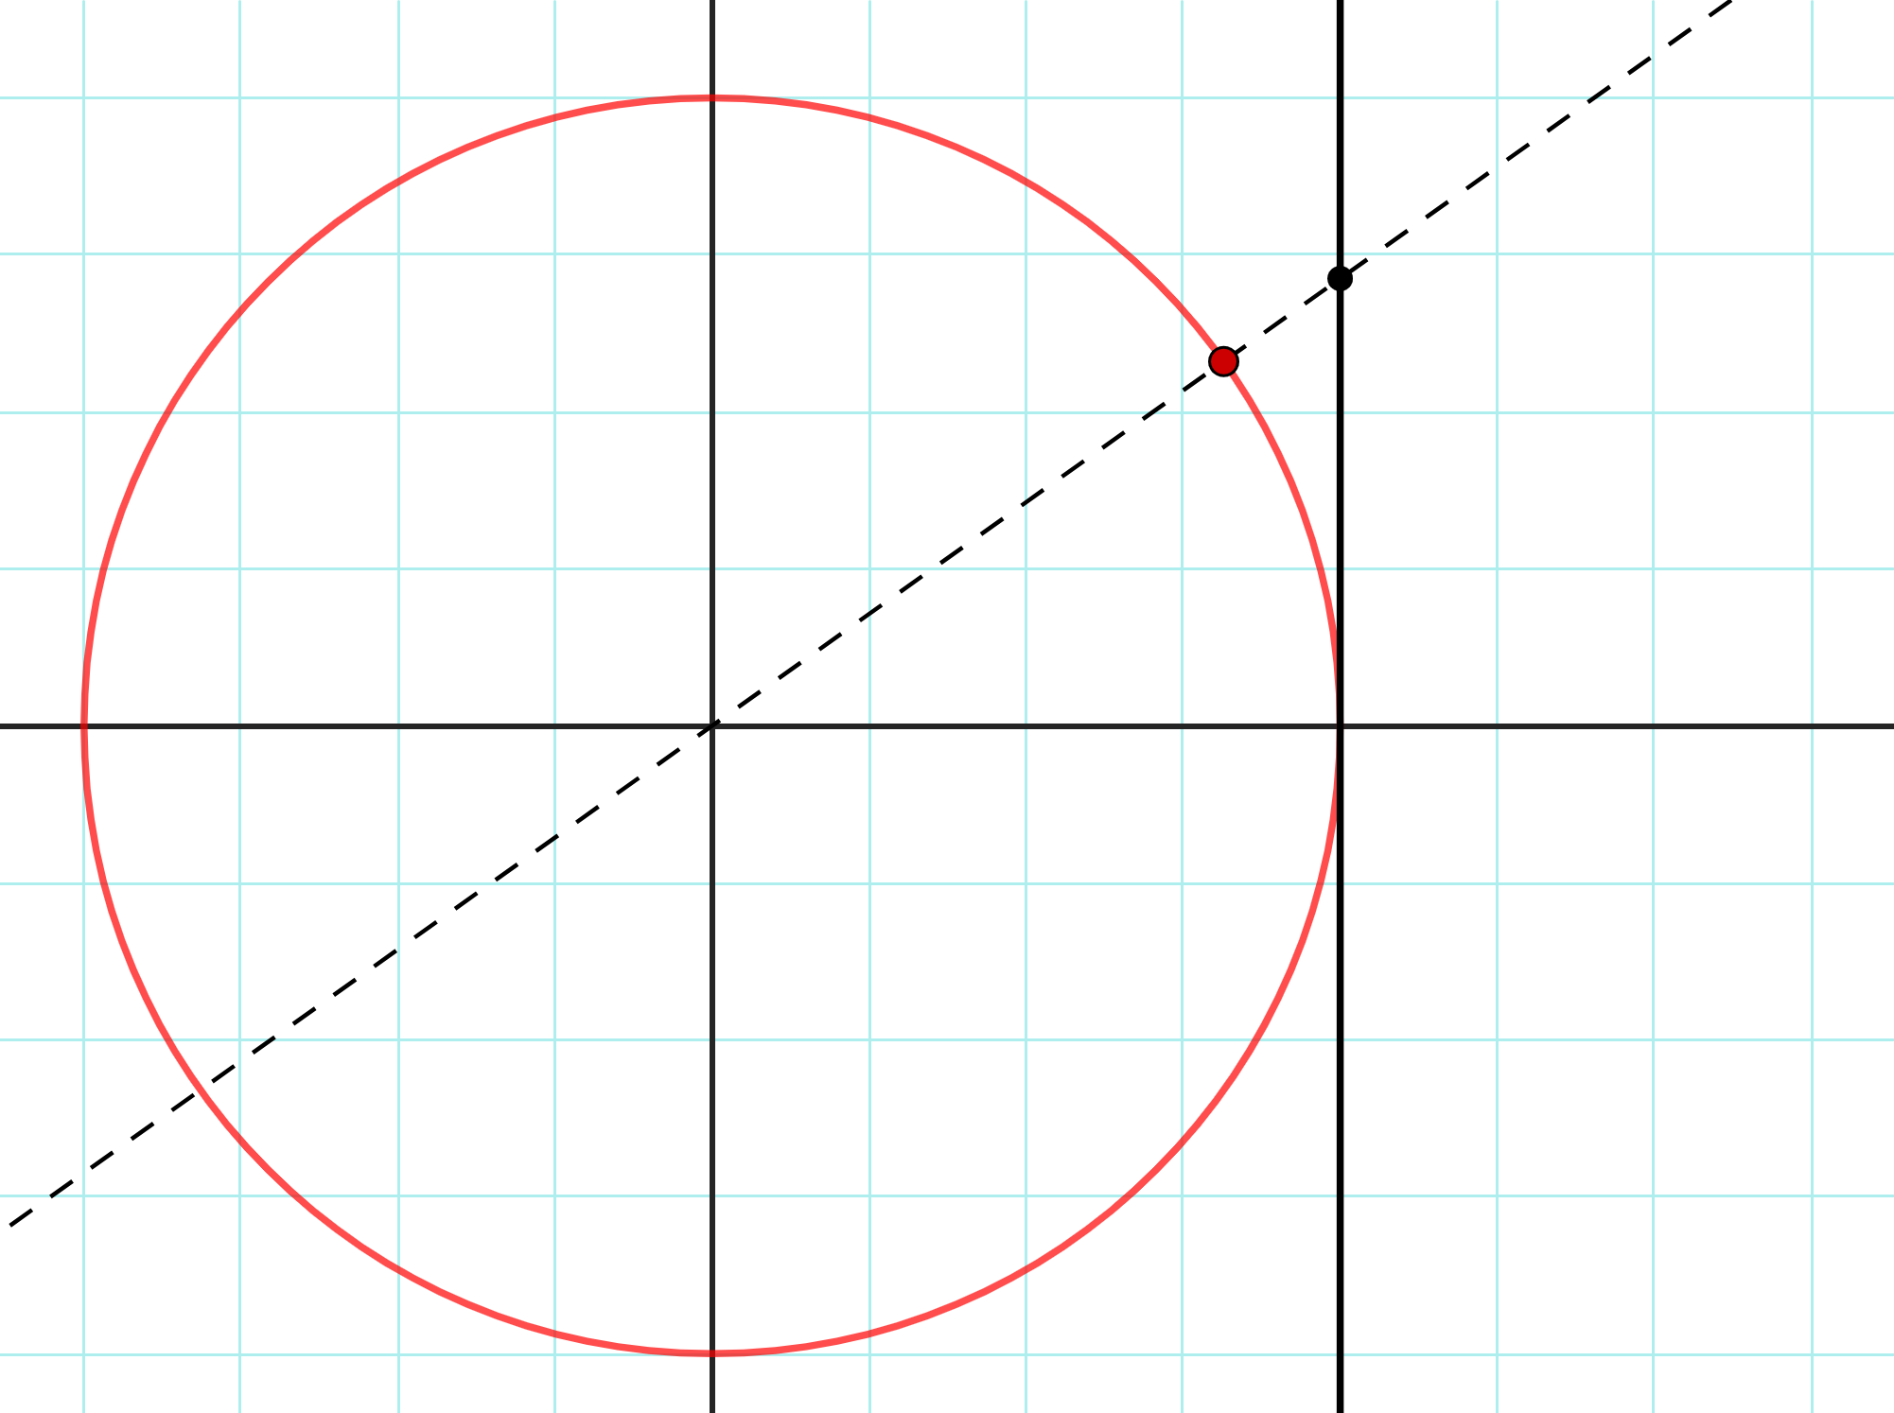



D
A
$$\sec\left(θ\right)$$
$$\tan\left(θ\right)$$
θ
$$1$$

Slide 3
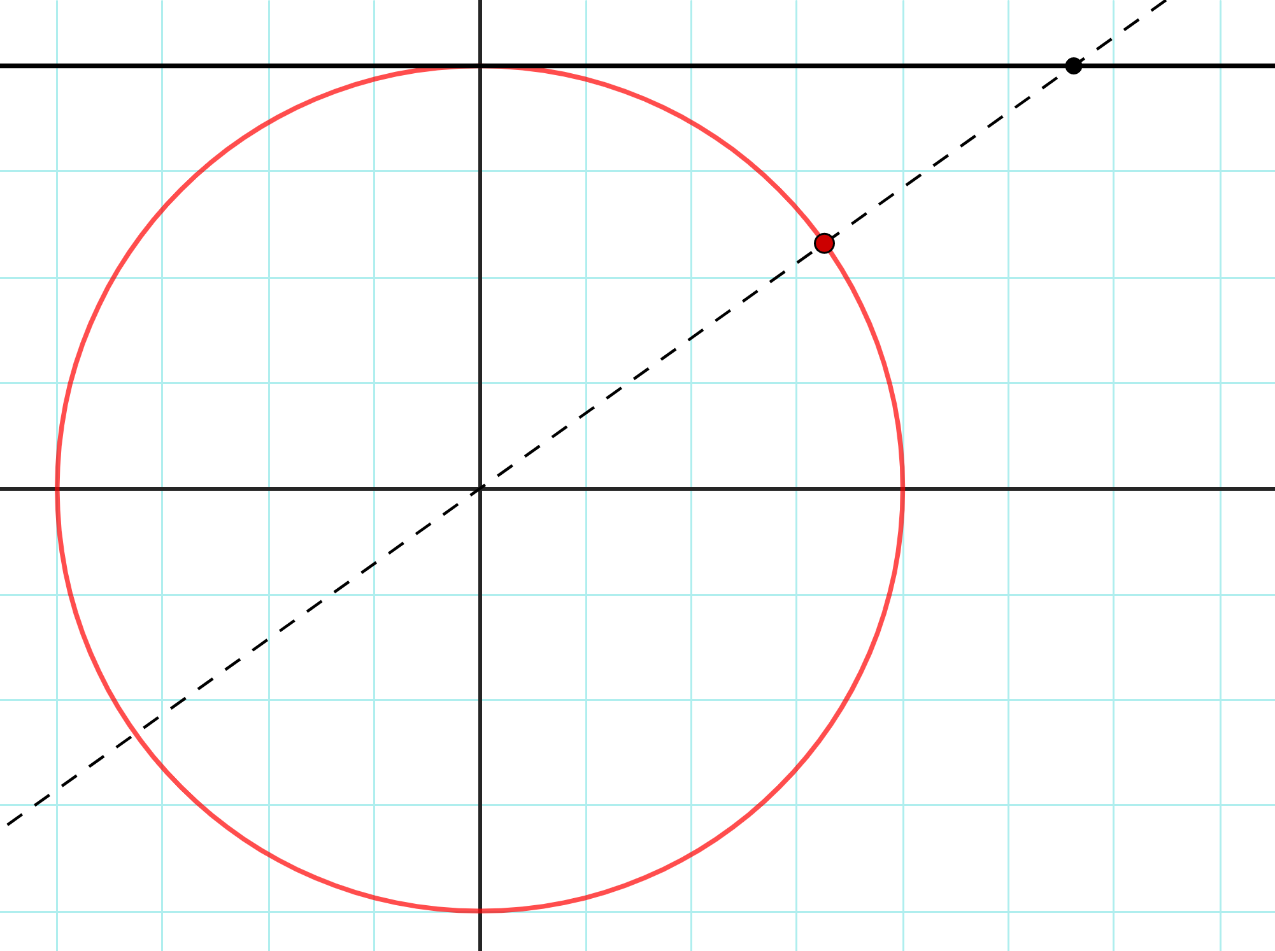



E
$$\cot\left(θ\right)$$
A
$$1$$
$$\csc\left(θ\right)$$
θ

Slide 4
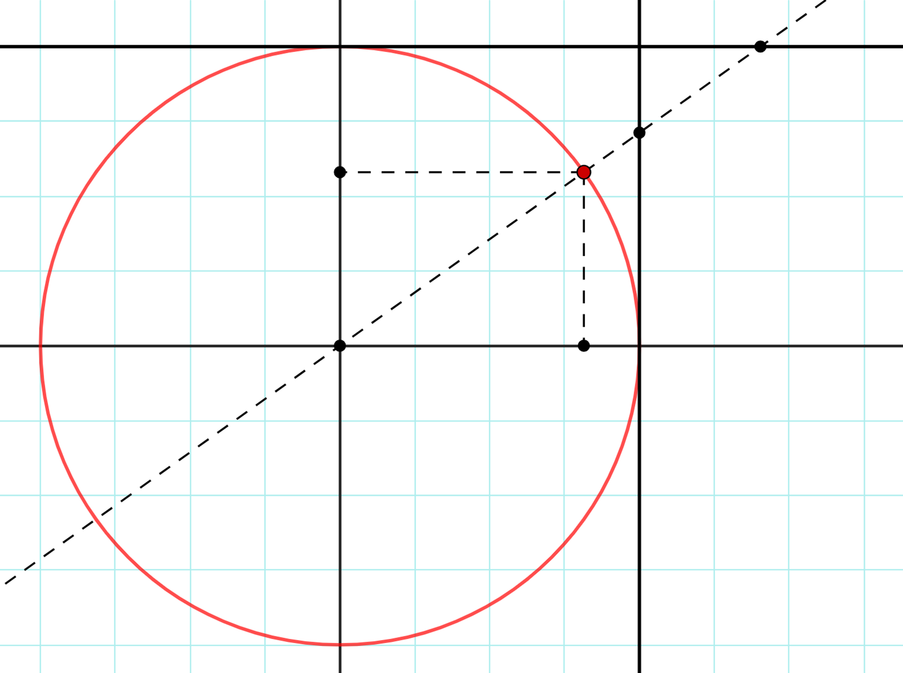
E
D
B
A
C

