Slide 1
Kubernetes Study Material

Slide 2
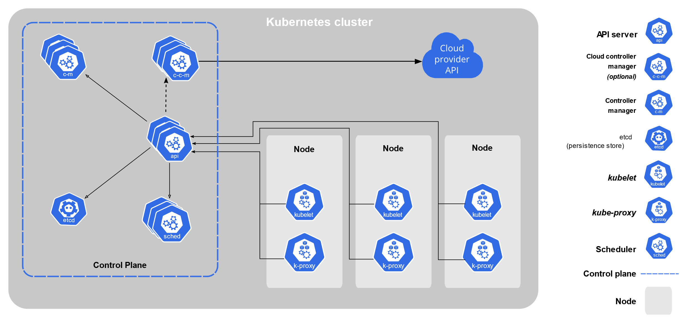
Kubernetes Architecture

