Slide 1
Problem and Audience
I am working to identify Twitter bot accounts and want to present these findings to the security team at Twitter

Slide 2
Insights
Bot followers tend to be other bots
Older Accounts tend to exhibit bot like behavior

Slide 3
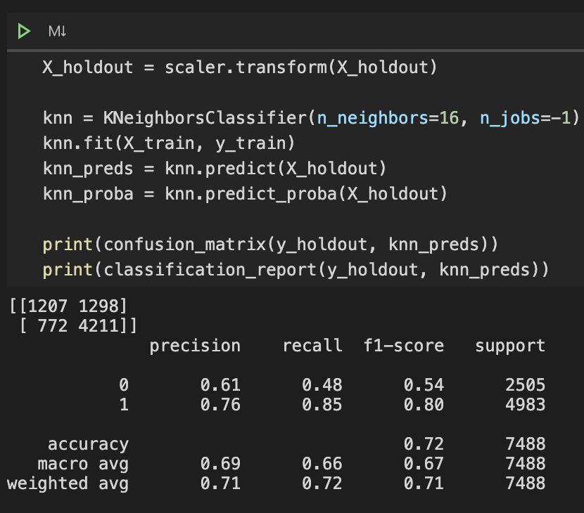
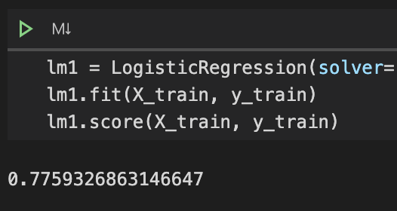
Evaluation Metrics
Right: KNN
Below: Logistic

Slide 4
Improvements
Implementing new methods
Using Count Vectorizer on self-input fields like account description to build a word profile for bots vs. humans
Possibly change location fields to English names

