Slide 1
Continuously updated literature review
It keeps a review alive without redoing it by hand
Marcelo Carrera · Universidad UTE
Segundo Benítez · UTPL
Guide 10 · Vibe Coding CEDIA 2026
Narration generated with A I voice (ElevenLabs) and reviewed by the authors
Notes:
We present our living bibliographic review register. We are Marcelo Carrera, from Universidad U T E, and Segundo Benítez, from U T P L. It keeps a review alive without redoing it by hand.

Slide 2
The problem
A review starts ageing the day it is delivered. Searching and cleaning by hand rarely happens.
2×
The same article slips in twice when the D O I comes as a web address
Vibe Coding CEDIA 2026 · Universidad UTE · UTPL
2 / 10
Notes:
A bibliographic review starts ageing the day it is delivered. New studies appear every week. Searching again and removing duplicates by hand almost never happens. There is no time. Let us look at a concrete case. We bring a new batch from Scopus. An article we already had comes back in. Its D O I identifier is written as a web address. If nobody notices, it slips in twice. This ageing is silent and easy to miss. In this way the review loses trust.

Slide 3
The tool
Receive
Process
Deliver
Batches of references with title, year and abstract
Deduplicates in code and the AI suggests relevance
Collection, pending list and a checked synthesis
Vibe Coding CEDIA 2026 · Universidad UTE · UTPL
3 / 10
Notes:
We built a living register based on guide ten of the course. A teacher or a researcher uses it. It receives batches of references with title, year and abstract. It delivers three things. A collection without duplicates. A pending list with a relevance suggestion. And a synthesis with checked citations. Everything stays in simple text files that anyone can open and review. The reviewer stays in control at every step.

Slide 4
How it works
1
2
3
4
Criteria
Deduplicate
The AI suggests
Decide
The person sets the question and criteria
A program compares in code, not the model
Proposes include or exclude and cites the abstract
The person approves and signs the decision
The model proposes. We decide.
Vibe Coding CEDIA 2026 · Universidad UTE · UTPL
4 / 10
Notes:
The flow has four steps. First the person sets the question and the inclusion criteria. Second a program deduplicates in code. It compares the normalized D O I and the similar titles. This part is not decided by the model. Third the artificial intelligence suggests including or excluding each study. It always cites the abstract and gives a short reason. Fourth the person reviews and decides. The decision is signed with their name and the date. The model proposes. We decide and we keep a record. Each step leaves a trace that can be audited.

Slide 5
Evidence
20 → 18
9 / 4 / 5
1
References imported and unique after deduplicating
Approved, rejected and pending
Citation verified against the full text, with page
We separate what is checked from what is still a proposal.
Vibe Coding CEDIA 2026 · Universidad UTE · UTPL
5 / 10
Notes:
We ran a real test with two sources. We imported twenty references. The program detected two duplicates across sources and flagged them without merging them. Eighteen unique references remained. On those we decided. Nine approved. Four rejected for being off topic. Five stayed pending for lack of an abstract. We also verified one citation against the full text, with its page. We kept the original searches with their date as well. We separate what is checked from what is still a proposal.

Slide 6
Limits and responsible use
Not a substitute
Public data
Next step
By itself it is not a systematic review
We only show public information
Add a third source and take it to the virtual classroom
Vibe Coding CEDIA 2026 · Universidad UTE · UTPL
6 / 10
Notes:
Let us be clear about the limits. This register supports screening. By itself it is not a systematic review. Google Scholar does not provide abstracts. For that reason some references stay without evaluation. We protect the data. We only show public information. The next step is to add a third source and take it to the virtual classroom.

Slide 7
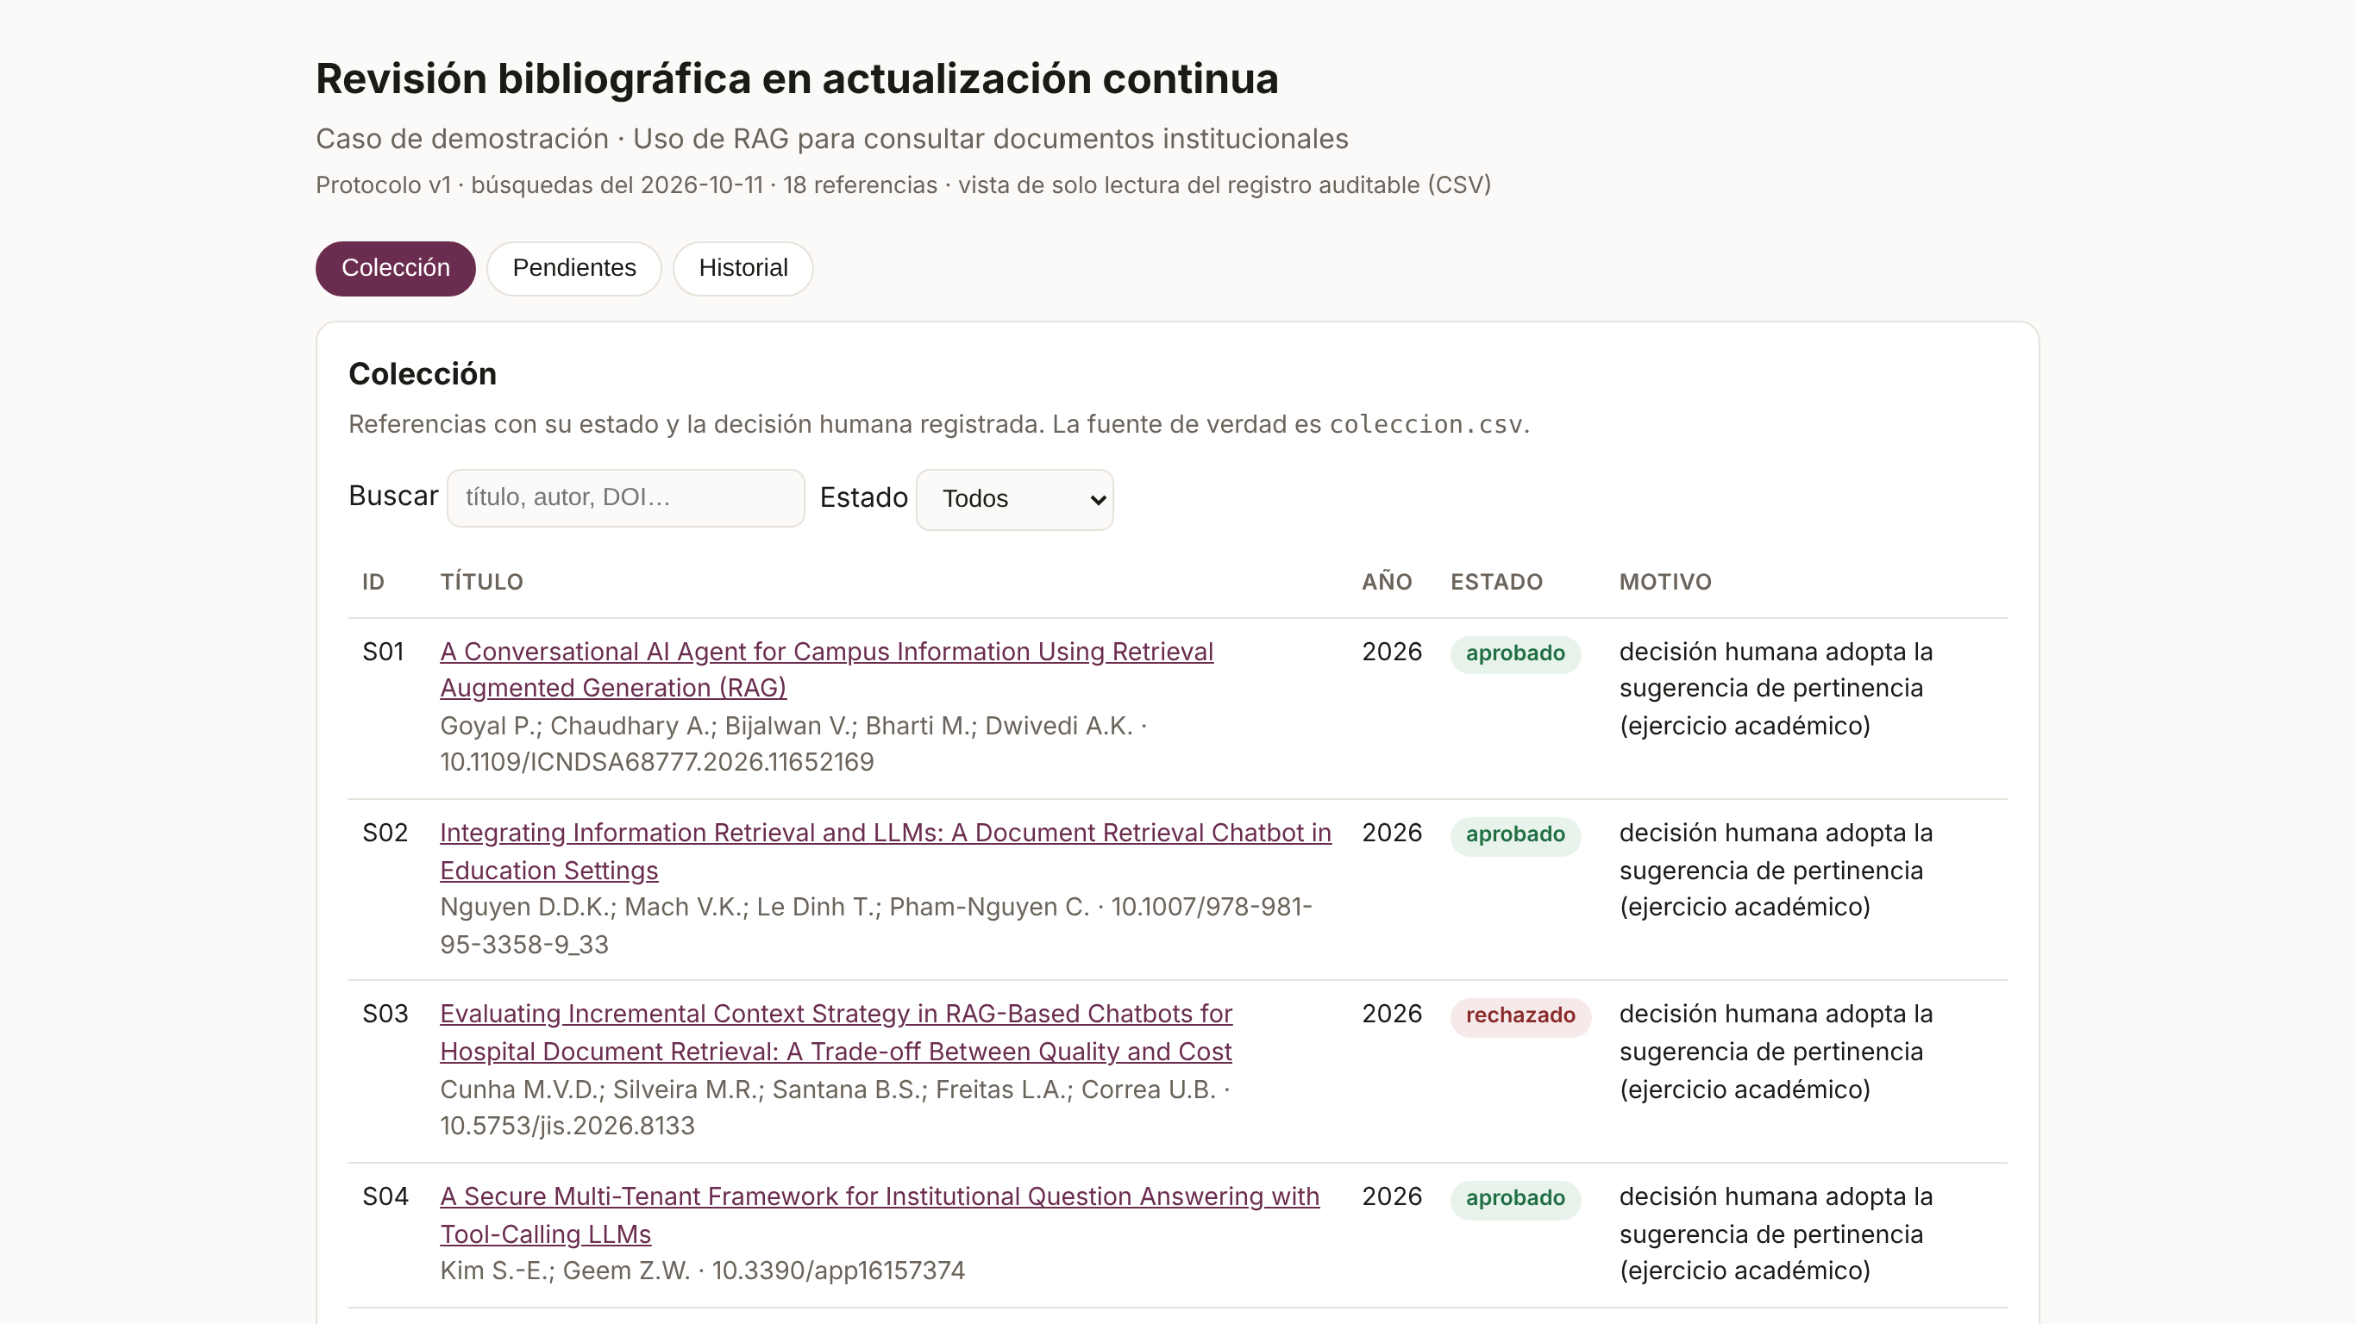
Demo: the collection
Each reference with its status and the recorded decision
Vibe Coding CEDIA 2026 · Universidad UTE · UTPL
7 / 10
Notes:
Let us see the tool on screen. This is the collection view. The interface is in Spanish. Each row is a reference with its identifier, its title and its status. At the top there is a search box and a status filter. Here the person starts from clear criteria. The viewer changes nothing. It only shows what the register contains. From this same screen you understand what came in and from which source.

Slide 8
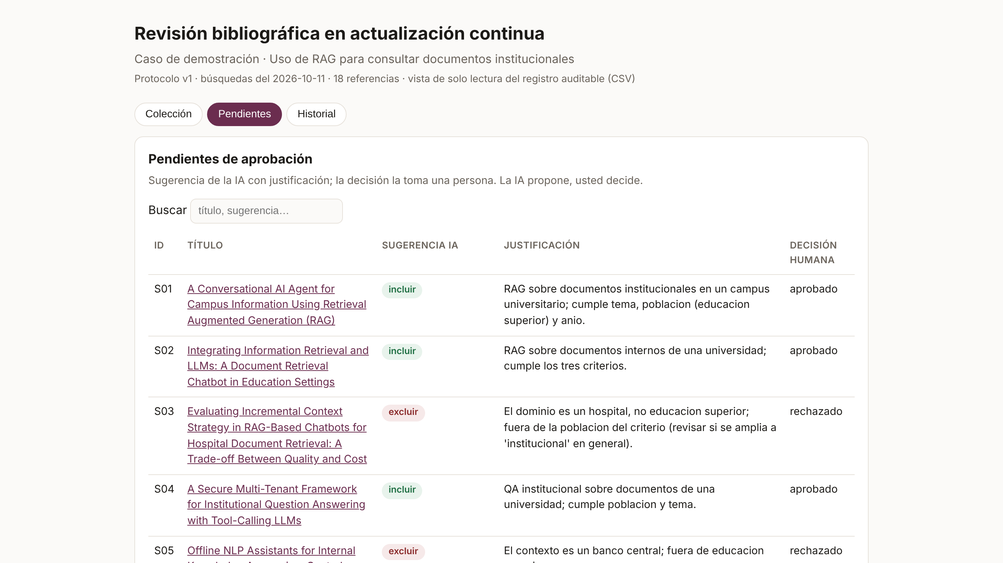
Demo: pending list
The A I suggests and justifies; the human decision stays with the person
Vibe Coding CEDIA 2026 · Universidad UTE · UTPL
8 / 10
Notes:
We move to the pending list. Here is the heart of the register. For each study the artificial intelligence proposes including or excluding. And it writes a justification that cites the abstract. When a reference has no abstract, the system marks it as insufficient evidence. It does not invent a verdict. Each suggestion also shows the link to the source. The human decision column stays empty. So no hidden study is approved by mistake. It is ready for the person to resolve.

Slide 9
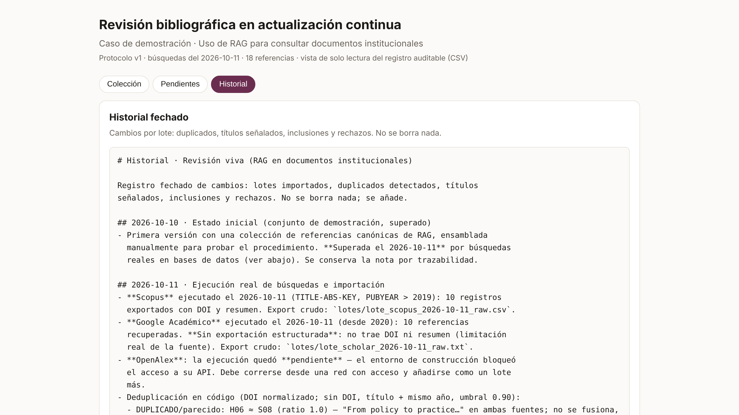
Demo: the history
A dated record of every change; nothing is deleted
Vibe Coding CEDIA 2026 · Universidad UTE · UTPL
9 / 10
Notes:
Finally the history screen. Here stays the dated record of every change. Which batch came in. Which duplicate was discarded. What was approved or rejected and who decided it. Nothing is deleted. A rejection is kept with its reason. In this way it does not reappear without warning. With this history anyone can rebuild the collection step by step. The final synthesis is exported only with the approved studies. Everything is kept in plain, dated files.

Slide 10
The decision stays human
The review stops ageing out of control and the manual work is reduced
github.com/srbenitez/revision-viva-rag-demo
Marcelo Carrera · UTE · Segundo Benítez · UTPL
Notes:
With this register the review stops ageing out of control. The manual work of cleaning up is reduced. And the decision stays human. You can see the project on our public site. Thank you for joining us. Our colleagues can reuse it in their own work. We are Marcelo Carrera and Segundo Benítez, from U T E and U T P L.

