Slide 1
Simple Library Management System

Slide 2
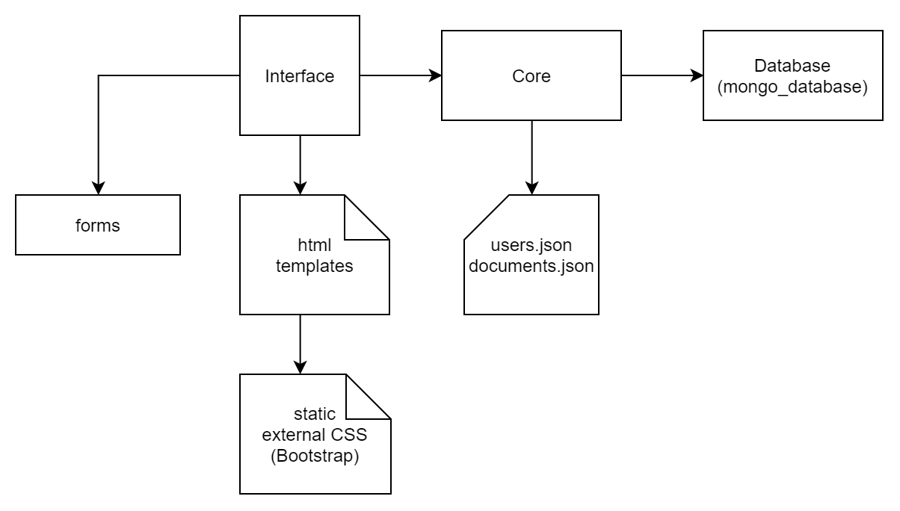
Structure, main files

Slide 3
MongoDB is used as a database, we store all data in JSON (or BSON). So are configuration files. The app is server based with multiple of routes.

Slide 4
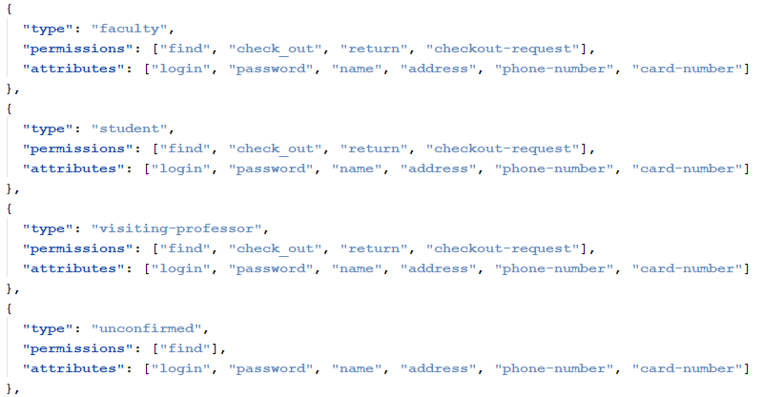
Users.json. Basically templates to store users in database.

Slide 5
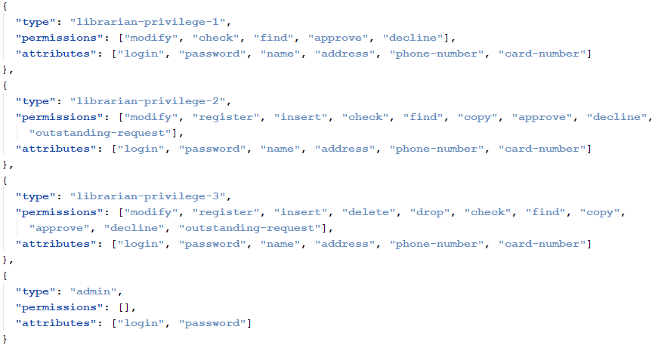
Users.json (cont.)

Slide 6
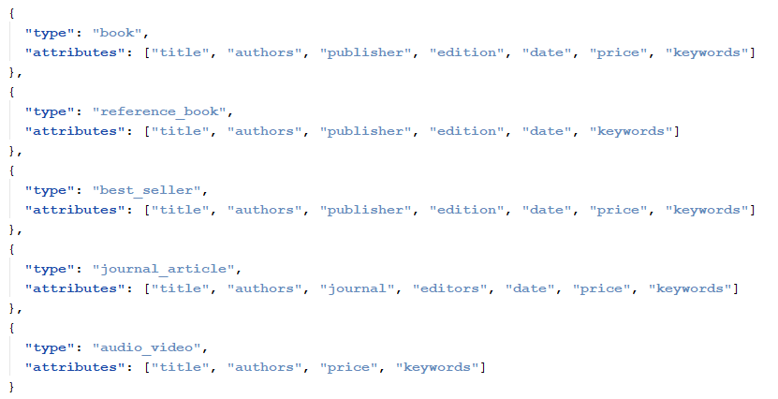
Documents.json – documents templates for database

Slide 7
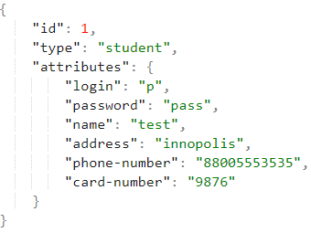
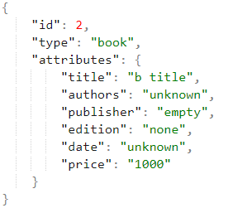
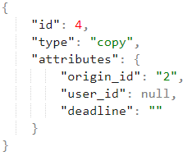
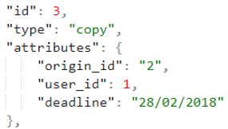
Examples of database entries
Student example
Book example
Copy of the book with id=2 in the hands of the user
Copy the book with id=2 in the library

Slide 8
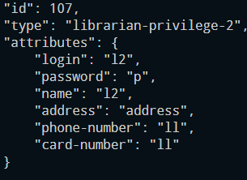
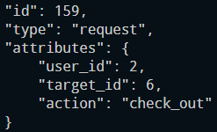
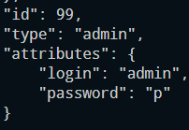
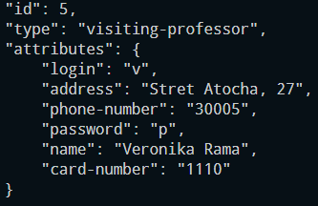
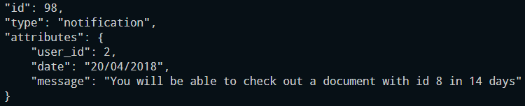
More examples

