Slide 1
Don’t Let Your Agent
Freelance Against the Warehouse
Ontologies and Progressive Disclosure

Slide 2
The Agency Curve
As autonomy rises, so does the criticality of semantic understanding
Follow
Assist
Collaborate
Pioneer
Low agency
More human oversight
High agency
Less human oversight
Rule-based RPA
Follow a set of
rules
Generative AI assistants
Achieve a specific, predefined goal
Goal-driven AI agents
Operate toward a higher-level objective, not just a task
Fully autonomous
agentic systems
Independently set and execute goals
INCREASING Criticality ON SEMANTIC Understanding
It’s not what you say, it’s what you mean

Slide 3
Two failure modes that block agentic analytics
Grounding and delivery - same problem, two surfaces
1
The agent doesn't know what the business means
2
The agent drowns in context
Text-to-SQL hallucinations
Wrong joins, wrong filters
“Active rider”: in-trip now? paid in last 28 days? logged in within 90?
Every table description, every metric loaded upfront
Real warehouses have thousands of tables
One-shot "give the LLM the schema" is impossible

Slide 4
A “data ≠ understanding” moment
Analyst asks: “What’s the average pickup time at Boston Logan Airport this quarter?” Same data, one ontology rule apart.
✗ Data-only AI
✓ Knowledge-enabled AI
SELECT AVG(pickup_min)
FROM trips
WHERE pickup_zone = 'Logan'
AND status = 'completed';
-- no compliance rule
SELECT AVG(pickup_min)
FROM trips
WHERE pickup_zone = 'Logan'
AND status = 'completed'
AND is_compliant = TRUE -- ontology
→ 2.4 min fast, confident, wrong
Counts illegal curb pickups — $200 fines, $5.50 airport fee skipped.
→ 8.1 min compliant, correct
One ontology rule filters to compliant trips — and surfaces “12% excluded per policy.”
The data was the same. The understanding was not.

Slide 5
The Thesis
Semantic layers solve grounding.
Progressive disclosure solve delivery.
You need both.

Slide 6
Semantic Layer

Slide 7
The Four Semantic Barriers
What blocks high AI agency over structured data
CONTEXT
CONNECTION
Limited information access
Relationship blindness
“Top driver markets”
agent doesn't know market_id was deprecated.
“Riders who switched payment after a low rating”
needs Trip→Rating→Rider→PaymentEvent.
REASONING
TRUST
No class/type discipline
No explainability or governance
“Show all Vehicles rated >4.7”
confuses driver, rider, trip ratings.
“Why this number?”
no lineage, no policy provenance.

Slide 8
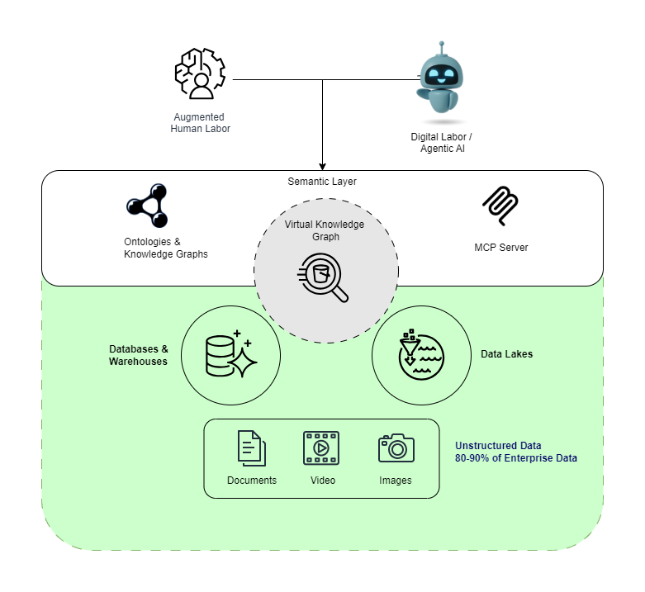
The Foundation to Scale Autonomous Agentic AI
A Semantic Layer is an abstraction layer that’s grounded in ontology to enforce structure and support inferencing, and a virtual knowledge graph provides federation and representation of enterprise data and information as graphs.

Slide 9
What Does “Semantic” Mean? Different Things
WHERE YOU SEE IT
WHAT IT BUYS YOU
LIMIT
Vector embeddings
Meaning ≈ proximity in vector space
No constraints, rules, or inference
Knowledge graphs
Labeled nodes/edges; who connects to what
Captures relationships but not why they're valid
Ontologies
First-order logic + rules + constraints
Enables inference, validation, explanation
BI semantic models
Calculation definitions (e.g., GMV)
Metric layer only — no graph, no inference

Slide 10
Vectors → Graphs → Ontology
Why you need all three
1
Vectors find similarity
RAG over text descriptions; meaning is proximity in a learned space
Driver rating and trip rating embed close — not interchangeable
2
Graphs preserve structure
Bill livesIn Paris; Eiffel Tower locatedIn Paris
3
Ontologies enforce meaning
owns has domain Person, range Asset; City is not an Asset

Slide 11
Schema vs. Ontology
Shape contract vs. meaning contract
SCHEMA says…
ONTOLOGY says…
the columns exist.
what they mean & what's valid.
CREATE TABLE trip (
trip_id BIGINT PRIMARY KEY,
rider_id BIGINT,
rating DECIMAL(2,1),
...
);
• :Trip a owl:Class .
• :rating rdfs:domain :Trip ;
rdfs:range xsd:decimal .
• SHACL: rating ∈ [1.0, 5.0] .
• :Trip subClassOf schema:Trip .
SHACL = Shapes Constraint Language — W3C standard for validating RDF graphs.

Slide 12
Why Ontology Unlocks Each Barrier
Class/property axioms
Knowledge integration
→ fixes CONTEXT
→ fixes CONNECTION
region_id is the live identifier, not deprecated market_id.
Pricing, T&S, Finance traverse the same shared Trip class.
Reasoning & consistency
Governance & trust
→ fixes REASONING
→ fixes TRUST
RidesharingTrip without serviceClass is inferred from vehicleClass; impossible states get rejected.
Every answer cites its source axiom

Slide 13
Neuro-symbolic: LLM Proposes, Ontology Disposes
The loop that makes text-to-SQL trustworthy
Ontology validates
types • ranges • cardinalities
LLM drafts
SPARQL
LLM repairs
from error
Execute or
return structured error
“The model gets to be creative; the ontology gets to be strict.”

Slide 14

Semantic Layer
A semantic layer over a bad data layer is just a fresh coat of paint on a crumbling foundation
Data Foundation

Slide 15
The Semantic Maturity Curve
From Data Silos to cognitive Intelligence
Fragmented
Organized
Intuitive
Connected
Cognitive
The Ontology and Reasoning stage
The Relationship Stage
The Semantic RAG Stage
The Metadata Stage
The Data Silo Stage

Slide 16
Bind agents to a governed semantic layer and centralize it
Text-to-SQL accuracy
Metric / measure layers
20% → 92.5%
Knowledge graphs / ontologies
Raw schema → governed semantic layer
(AtScale 2024 benchmark)
Hybrid context catalogs
Architecture pattern: semantic-layer-as-MCP-tool. Bind to the API, not the prompt.
Anti-pattern: “you can write SQL” prompt + table DDL

Slide 17
Reuse upper ontologies: inherit, don’t re-invent
Schema.org
GeoSPARQL
OWL-Time
Trip · Vehicle · Reservation · Rating · Place
Pickup zones · geofencing · service-area polygons
ETAs · surge windows · scheduling · after-hours pricing
Anchor each local class to an external IRI — RidesharingTrip subClassOf schema:Trip
Keep it repeatable: LLM-assisted ontology generation + RAG over canonical ontologies + re-trigger on source change
Anti-pattern: hand-author classes from scratch · skip IRI anchors · freeze in a wiki and discover the term means something different in every domain six months later

Slide 18
Federate definitions; don’t flatten them
“Active rider” means three different things: Operations, Finance, Trust & Safety. Pick one and you’ve broken two.
Operations
Finance
Trust & Safety
Active rider =
Active rider =
Active rider =
in-trip right now
took a paid trip in the last 28 days
logged in within 90 days, not flagged
Pattern: federation, not flattening. Each domain keeps its definition; all aligned to an upper layer.
Industry references — FIBO (finance) · SNOMED (clinical) · KGS-style federations (Bloomberg, Google)
Anti-pattern: convene a 6-week working group to ratify “the” definition · ship it · watch each domain quietly maintain a shadow definition

Slide 19
Treat the layer as evolving infrastructure
Static semantic layers rot. The ones that ship are versioned, evaluated, and observed like application code.
Version like code
Eval on every change
Plan for evolution
Optimize from logs
Observe: context-token usage · retrieval hit rate · slice size · tier mix → OTEL from day one.
Anti-pattern: ship the ontology, freeze it, declare victory · discover a year later that 30% of definitions are stale

Slide 20
Two Architectural Patterns
Start pragmatic; promote when usage justifies it
(A) Semantic RAG over a proto-ontology
(B) Virtual Knowledge Graph
Vector knowledge base
Graph database + SPARQL
Ships in weeks. Often enough.
Ships in months.
• Per-table schema docs
• Business glossary
• Domain / role ontology
• Lookup / type-code reference
Indexed → retrieved per query.
• Formal axioms in OWL
• Inference + cross-domain alignment
• Data quality and business rule constraints
• Provable reasoning
VKG = relational rows mapped to RDF
triples at query time — none materialized.
→ Promote (A) → (B) when query logs justify it.

Slide 21
Progressive Disclosure

Slide 22
Progressive Disclosure for Text-to-SQL
Civili et al., RelationalAI (2024) - validated on AT&T telecom KG (500 concepts, 1k relationships, 7,000+ axioms)
1
Approximation
Surface relevant concepts using NL labels only
Even thousands of concepts fit in context
2
Refinement
Slice ontology to candidate concepts; iterate with LLM
3
Translation
Generate SPARQL/SQL against the validated slice
Anti-pattern: build only Phase 3 · paste the full ontology into the prompt

Slide 23
Phase 1: Approximation (NL → NL)
Topic Router
Mechanics
LLM sees only NL labels of concepts/relationships from the upper ontology
Compact label index + embedding-similarity router. Cheap to run.
Example
Q: “Average surge multiplier for SF airport pickups, Friday evening rush, last quarter?”
→ {Trip, PickupZone, SurgeWindow, ServiceArea, TimeOfDay}

Slide 24
Phase 2: Refinement (NL → formal, iterative)
Slice Builder
Mechanics
External ontology service slices full ontology to subgraph; T-Box path-finding finds connecting paths
LLM iterates: “Can you translate? If not, what’s missing?” (typically 2–3 rounds)
Example
Slice expands to: SurgeWindow appliesTo ServiceArea; Trip occursIn ServiceArea, Trip hasFare Fare hasSurgeMultiplier
Follow-up: “How is ‘airport’ modeled?” → Airport subClassOf PointOfInterest, locatedIn ServiceArea

Slide 25
Phase 3: Translation (formal → SPARQL/SQL)
SPARQL/SQL Gen
Mechanics
LLM generates SPARQL (or SQL via VKG mappings) against the minimal validated slice
Validate against ontology axioms
(types, ranges, cardinalities) before execution
Example
Trip filtered on pickupZone, timeOfDay, serviceArea = SF; aggregate avg(surgeMultiplier)
Mappings translate to SQL. Most public TEXT_TO_SPARQL_PROMPT examples are Phase 3 only.

Slide 26
Tiered query resolution: cheapest deterministic path first
A lot of questions match a governed metric. They don’t need an LLM.
TIER
WHAT RUNS
LLM CALLS
RIDE-SHARE EXAMPLE
T1
“GMV by region last quarter”
Pre-determined metric lookup
0-1
T2
NL → SPARQL/SQL via 3-phase pipeline
0–3
“Avg surge for SF airport Friday evening Q4”
T3
Agentic fallback over the broader semantic layer
many
“Why did driver retention drop in Austin in March?”
Anti-pattern: every NL question gets the agentic treatment, including “GM by region last quarter,” burning tokens

Slide 27
Disambiguate before you generate
A clarifying question is cheaper than a wrong SQL run.
“Did you mean active rider in
Finance terms (paid, last 28d) or Trust & Safety (login, 90d)?”
“GM = General Motors or gross margin?”
WHERE TO INSERT IT
Between Phase 1 (concept set) and Phase 2 (slice build) of the 3-phase pipeline.
TRIGGER HEURISTICS
ambiguous term hits >1 federated definition · concept set spans >1 domain · low-confidence retrieval score
BONUS every clarification answer is a labeled training signal — feed it back into the layer.
Anti-pattern: pick the most popular definition silently · ship a wrong number to the CFO · debug the SQL instead of the question

Slide 28
Semantic layers + ontology give agents truth.
Progressive disclosure gives them attention.
You need both.
ADDITIONAL RESOURCES
Paper: Using off-the-shelf LLMs to query enterprise data by progressively revealing ontologies
Paper: Retrieval-Augmented Generation of Ontologies from Relational Databases
AWS Sample: github.com/aws-samples/sample-semantic-layer-structured
AWS Sample: github.com/aws-samples/sample-semantic-layer-using-agents

