Slide 1
Targeting Alpha
High-Probability Stock Selection via Big Data Classification & MLOps
Big Data Analytics & MLOps using Hive/Spark
Final Project Presentation

Slide 2

Executive Summary: A Paradigm Shift in Market Prediction
Challenge
Solution
Key Result
Projected Impact
Standard regression models struggle with extreme market noise, failing to accurately forecast price returns.
Pivoted to Binary Classification (Event Detection) leveraging Apache Spark for enhanced prediction capabilities.
Achieved an Out-of-Sample AUC-ROC of 0.7055.
Anticipated Long-Short Spread Alpha of +2.51% Monthly.
Achieved an Out-of-Sample AUC-ROC of 0.7055, projecting a Long-Short Spread Alpha of +2.51% Monthly.

Slide 3
The Business Problem: Asset Allocation & Screening
Inaccurate Return Predictions
Predicting absolute stock returns is notoriously inaccurate.
Objective
To determine if distributed ML can rank stocks cross- sectionally to identify the top 10% of monthly performers.
Evaluation Metrics
Assessed using over 1.02 Million panel observations spanning 20 years.
Can Distributed ML Rank Stocks Cross-Sectionally?

Slide 4
Robust Big Data Architecture
Secure Timestamp Mapping
SQL Deduplication
Dynamic Performance Labeling
Bypassed native Parquet timestamp crashes using PyArrow for explicit schema extraction.
Used Spark SQL CTEs with ROW_NUMBER() for uniqueness.
Leveraged Spark Windowing (percent_rank) to dynamically label top 10% performers.
Data persisted to Unity Catalog as an optimized Managed Delta Table.

Slide 5
Phase 3: EDA & Key Insights
Exploratory Data Analysis & Key Insights
Signal Variance
Multicollinearity Risk
Algorithm Choice
A 5% Pandas sample indicated that Alpha Winners exhibit statistically significant higher 12-month momentum.
The correlation matrix revealed extreme collinearity (greater than 0.80) among macro indicators.
High collinearity among macro indicators necessitates the use of tree- based ensembles (GBT) over standard OLS regression.

Slide 6
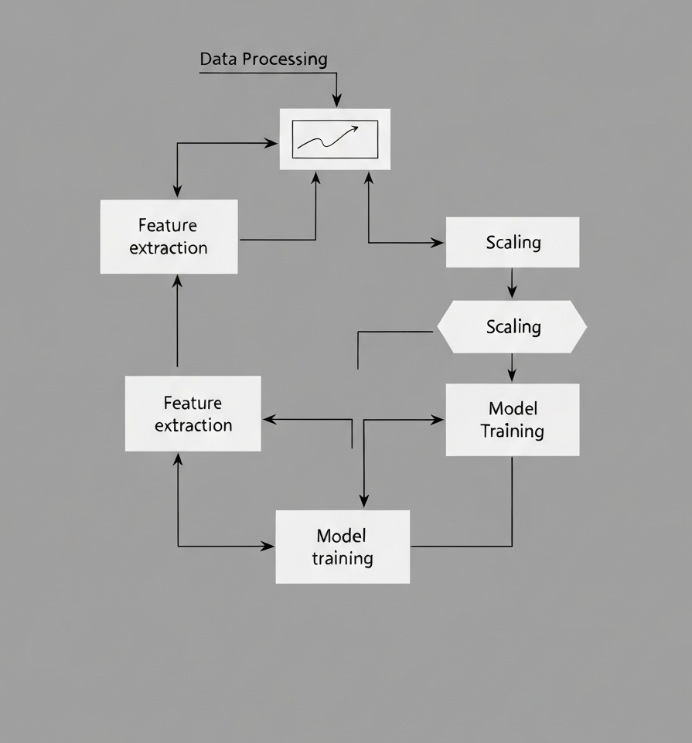
Phase 4: Predictive Modeling Setup
Dynamic Feature Engineering
Extracted 102 continuous features, applying StringIndexer and OneHotEncoder.
Numerical Stability
Applied StandardScaler to normalize financial ratios.
Chronological Split
Eliminated look-ahead bias with a chronological split (Train: 2000-2017 | Test: 2018-2021).
Pipeline Deployment
Deployed Gradient Boosted Trees (GBTClassifier) optimized via 3-fold Cross- Validation.

Slide 7



Phase 5: MLOps & Experiment Tracking
MLOps Integration
Explainable AI (XAI)
Artifact Persistence & Deployment
Leveraged Databricks MLflow to meticulously track distributed training loops, ensuring reproducibility and efficient experimentation.
Integrated XAI by logging key driving factors (Momentum, Market Beta, Earnings Yield) to demystify model predictions beyond 'black box' solutions.
Utilized MLflow Model Registry with Unity Catalog Volumes to serialize the tuned PipelineModel for seamless, one-click deployment.

Slide 8



Projected Economic Value Generation
Phase 6: Economic Value Generation
3%
1%
3%
Decile 1 (Highest Confidence) Monthly Yield
Decile 10 (Lowest Confidence) Monthly Yield
Market-Neutral Long- Short Portfolio Spread (Decile 1 - Decile 10)
The market-neutral strategy aims to capture the spread between the highest and lowest confidence deciles.

Slide 9
High-Conviction Institutional Strategy
Phase 6
Top 1% Probability Scores
Alpha Selectivity Edge
Baseline Market Probability
28.19%
2.82x
10.01%
Model Top 1% Hit-Rate
Top Decile Winner Pick
This represents a 2.82x Alpha Selectivity Edge.

Slide 10


Addressing Challenges & Concept Drift
Phase 6: Challenges & Concept Drift
Financial Non-Stationarity
Programmatic Drift Detection
Future Improvement
Tree-based models are susceptible to decay in new economic regimes.
Out-of-sample testing revealed a -1.43% shift in average Dividend-Price ratios post-2020.
Implement automated KS Feature Drift Triggers for automatic retraining when macro thresholds are breached.
Implement automated KS Feature Drift Triggers for automatic retraining when macro thresholds are breached.

Slide 11
THANK YOU!
Big Data Analytics & MLOps using Hive/Spark
Final Project Presentation

