Slide 1

Automobile price estimation
Presented by:
Vazgen and Srbuhi
IESM 1st

Slide 2

How much close to actual price can a crowd estimate of car price be?

Slide 3

What factors have the most impact on the price setting decision?

Slide 4
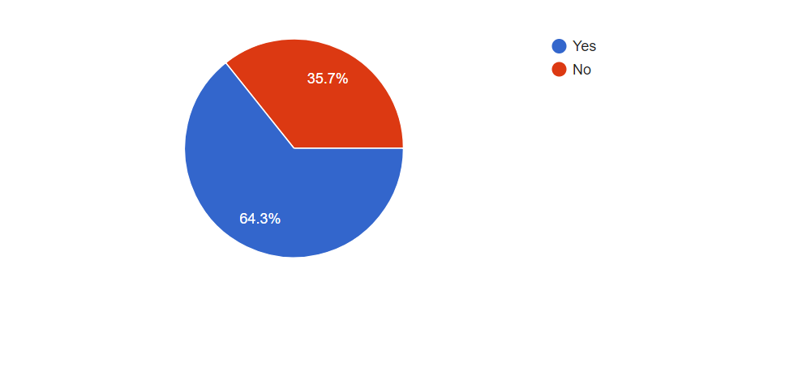
We have 112 responses
Driver vs Non Driver
Drivers estimation is 10% > Non Driver.

Slide 5
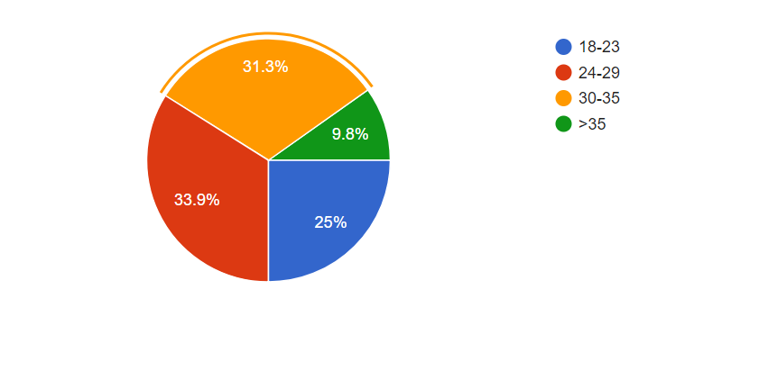
Distribution of respondents by age.

Slide 6
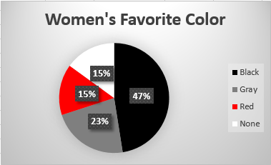
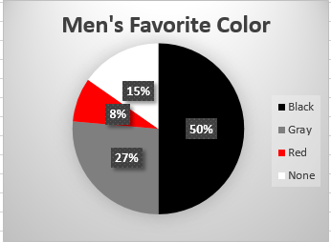

Slide 7
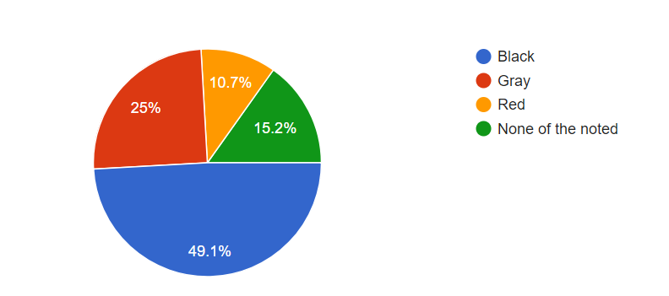
People’s preferred colors

Slide 8
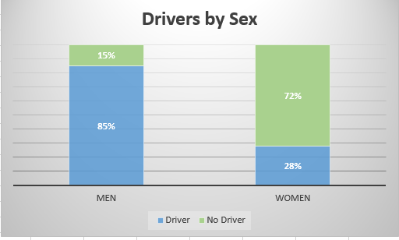
Sex does not matter.

Slide 9
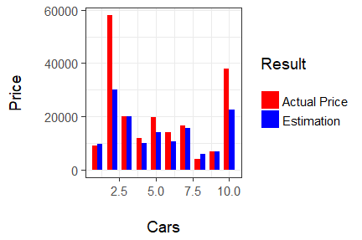
50% of the answers are close to the actual price.

Slide 10
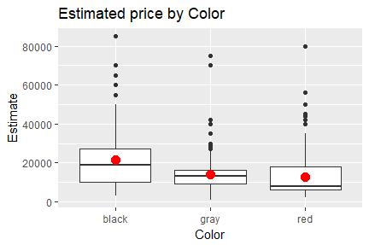
Effect of Color

Slide 11
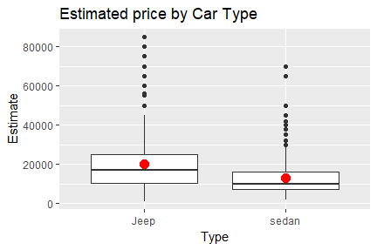
Effect of Type

Slide 12
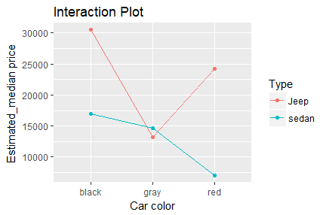
Interaction between Color and Type
Black is the most preferred color. From the result it is seen that color and type have effects and there is interaction.
In all cases where car is red it decreases estimation except the case when it is Jeep.

Slide 13
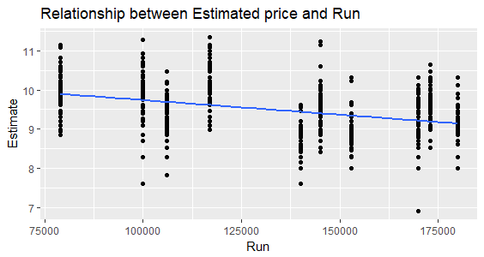
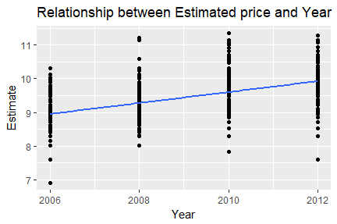
Estimate vs Run,Estimate vs Year
Run is not a significant factor
Unit increase in Year brings 16% increase in Estimate

Slide 14


