Slide 1
Hybrid Recommendation System
Hybrid approach-based Movie Recommendation system
Saurabh Chaudhary (23BM6JP50) & Subhav Chauhan (23BM6JP55) PGDBA BATCH 2023-2025
CS60020 Foundations of Algorithm Design & Machine Learning
Abstract
This research project proposes a novel hybrid recommender system designed to enhance movie recommendation accuracy by leveraging pre-trained word embeddings and graph-based techniques. The system integrates Collaborative Filtering (CF), based on user-movie interaction data (ratings), with a knowledge graph constructed from movie descriptions, actors, directors, genres, and other relevant entities. Movie descriptions are transformed into numerical representations using pre-trained Glove embeddings, enabling the identification of semantically similar movies beyond explicit genre categories. This enriched knowledge graph, along with CF incorporating Surprise's SVD implementation, forms the foundation of the hybrid system. By considering both user preferences and the thematic relationships between movies derived from the embeddings, the system personalizes movie recommendations.
Our work offers a promising approach for recommender system development. The proposed hybrid system leverages pre-trained word embeddings and graph structures to capture nuanced user preferences and movie characteristics, potentially leading to a more personalized movie discovery
experience.
Keywords: recommender system, graphs, collaborative, content-based, hybrid, NLP, Adamic-Adar

Slide 2
Hybrid Graph Recommendation System
2
Introduction
The rapid growth of online movie databases has created a plethora of choices for users making it extremely difficult for the user to select something good to watch [1]. To solve this problem Recommender systems (RS) were deployed, guiding users towards relevant and engaging movies [2]. Collaborative filtering (CF) remains a foundational technique within RS. By identifying users with similar taste profiles, CF recommends movies those users have rated highly [3]. However, despite demonstrably improving user experience, CF can struggle to capture the intricate and multifaceted relationships between users, movies, and other relevant movie-related entities [4, 5].
To address these limitations and enhance the recommendation experience, researchers have actively explored hybrid approaches that combine the strengths of multiple RS techniques [6]. This paper delves into a hybrid recommender system for movies that leverages the complementary strengths of content-based filtering (CBF) and collaborative filtering (CF). Let us deep dive into concepts of both Content based filtering and collaborative filtering.
Content based recommendation system:
Content-based recommendation systems operate by suggesting items similar to a user's preferences based on specific item characteristics. These systems utilize item metadata like genre, director, description, and actors for movies to craft personalized recommendations. The fundamental concept is that if a user has shown interest in a particular item, they are likely to enjoy other items that share similar attributes. This approach excels in scenarios with rich item metadata, allowing for accurate assessments of item similarity and tailored suggestions to users' tastes.

Slide 3
Hybrid Graph Recommendation System
3
An advantage of content-based systems is their independence from other users' data, making them
suitable for privacy-conscious environments or for new users with limited interaction history. However, they can face challenges like overspecialization, where recommendations may become too focused on a narrow range of items. Combining content-based methods with collaborative filtering or hybrid approaches can mitigate these limitations and improve the overall recommendation quality by balancing personalized suggestions with diversity and serendipity.
Collaborative filtering recommendation system:
Collaborative filtering is our solution to the limitations faced by our content-based recommendation engine. While content-based systems excel at suggesting similar items based on specific attributes like genre or director, they struggle to capture users' diverse tastes across different genres. Additionally, they lack personalization, as every user querying for recommendations based on the same item receives identical suggestions, regardless of their unique preferences.
To address these challenges, we have adopted collaborative filtering for our recommendation
system. Collaborative filtering works by leveraging the collective preferences and behaviors of similar users to make personalized recommendations. It's like having a group of like-minded friends who guide your choices based on what they've enjoyed, even if it's outside your usual interests.
We have integrated the Surprise library, which utilizes advanced algorithms such as Singular Value Decomposition (SVD) to minimize Root Mean Square Error (RMSE) and provide accurate recommendations. This approach allows us to go beyond just item attributes and tap into the rich landscape of user interactions, ensuring that our recommendations are not only relevant but also tailored to individual tastes. By implementing collaborative filtering, we aim to enhance the user experience by delivering more diverse and personalized recommendations, ultimately increasing user satisfaction and engagement with our platform.

Slide 4
Hybrid Graph Recommendation System
4
Types of Collaborative filtering
1. User - user based collaborative filtering:
User-based collaborative filtering is a recommendation technique that suggests products to a user based on what similar users have liked. To measure the similarity between users, common metrics like Pearson correlation or cosine similarity are utilized. In our illustration, we will use a matrix format to showcase this filtering technique, with each row representing a user and each column representing a different movie. The last column in the matrix records the similarity between that user and the target user.
For instance, considering User E as the target user, we observe that User D and User C have high similarity scores (0.90 and 0.75, respectively) with User E. This implies that User D and C have similar preferences to User E regarding the rated movies. Therefore, based on user-based collaborative filtering, we can recommend movies liked by User D and C to User E for which they haven't provided ratings yet. This approach leverages the collective wisdom of similar users to offer personalized recommendations, enhancing the user experience and engagement on our platform.
2. Item-item based collaborative filtering:
Item-item collaborative filtering (IBCF) is a recommendation method that suggests items based on a user's past interactions with similar items. Developed by Amazon in 1998, IBCF has been crucial to their success. It works by identifying items a user has interacted with and then recommending other items similar to those based on user preferences.
For example, if a user has liked movies A, B, and C, IBCF will find other movies similar to these, such as movie D, and recommend them to the user. This process prioritizes items based on their similarity to items the user has already liked, enhancing the accuracy of recommendations and improving user satisfaction.

Slide 5
Hybrid Graph Recommendation System
5
Hybrid recommended system
Hybrid RS approaches combine the strengths of multiple techniques to provide more comprehensive and personalized recommendations [11]. In the context of movie recommendation, a hybrid system could leverage CF to identify users with similar tastes and CBF to refine recommendations based on movie features preferred by those similar users. Additionally, graph-based CBF approaches have the potential to uncover content-based connections that might not be readily apparent in traditional methods, further enhancing recommendation personalization.
This research investigates a hybrid movie recommender system that integrates graph-based CBF and Surprise's SVD implementation for CF. We hypothesize that this approach will yield more accurate and personalized movie recommendations compared to standalone CBF and CF methods. The subsequent sections delve deeper into the objectives of this project, the dataset used, and the design and implementation details of our hybrid system, followed by testing of the system.
Motivation
As discussed in the previous section, recommendation systems were introduced to tackle the problem of making the right choice among the sea of options available. Traditional RS have limitation, while CBF fails to take user interactions into account, CF can struggle to capture the intricate and multifaceted relationships between users, movies, and other relevant movie-related entities (actors, directors, genres) [4, 5]. This limitation can lead to generic recommendations that fail to fully resonate with a user's nuanced preferences.
This research is motivated by the potential of hybrid RS approaches that combine the strengths of multiple recommendation techniques to deliver more comprehensive and personalized recommendations [6]. Specifically, we explore the integration of graph-based techniques within a hybrid system for movie recommendations.

Slide 6
Hybrid Graph Recommendation System
6
Graph-based methods offer a powerful approach to model complex relationships between entities [7]. By
representing movies, actors, directors, genres, and other relevant entities as nodes in a graph, and the connections between them as edges, we can capture the intricate web of influences that shape user preferences. For instance, a graph can model the connection between a user who enjoyed a movie directed by a specific director and other movies directed by the same person. Additionally, graph-based methods can leverage movie descriptions as text data to identify thematic similarities between movies, even if they don't explicitly belong to the same genre. This allows for the discovery of more nuanced connections beyond traditional genre classifications.
By integrating graph-based techniques with established CF methods, we aim to create a hybrid system that leverages both explicit user-movie interaction data (ratings) and the inherent relationships between movies to provide more accurate and personalized movie recommendations.
Objectives
This research investigates a novel hybrid recommender system that leverages the power of pre-trained word embeddings and graph-based techniques to deliver enhanced movie recommendations. By combining these approaches, the system aims to create a more comprehensive understanding of user preferences and movie characteristics, leading to a more personalized recommendation experience.
The key objectives achieved in this research are:
Objective 1: Extracting Meaningful Features from Movie Descriptions with Glove Embeddings
Traditional content-based filtering (CBF) methods often rely solely on individual movie features like genre or actors. This approach can overlook the nuanced relationships between these features that can significantly influence user preferences. To address this limitation, we employed pre-trained word embeddings from Glove. Glove, trained on a massive dataset of text and code

Slide 7
Hybrid Graph Recommendation System
7
from Wikipedia, effectively encodes semantic relationships between words. By applying Glove to
movie descriptions, we were able to convert this textual information into numerical representations that capture the thematic content of each movie. Averaging the word embeddings within a description creates a unique vector representation for each movie. These embedding vectors were then incorporated as node features within the constructed knowledge graph. This allows the system to measure similarity between movies based on the thematic content of their descriptions, even if they don't explicitly belong to the same genre category.
Objective 2: Constructing a Knowledge Graph for Movie Recommendations
Knowledge graphs offer a powerful way to model the complex relationships between entities. In this research, we constructed a knowledge graph to capture the relationships between users, movies, actors, directors, genres, and other relevant entities within the movie domain. This graph goes beyond explicit connections, such as a user rating a movie, by also incorporating implicit relationships. For instance, the graph can model the connection between two movies directed by the same person or written by the same screenwriter. By integrating the Glove-derived embedding vectors from movie descriptions as node features, the knowledge graph becomes even more sophisticated. This allows the system to not only consider explicit connections and genres but also leverage the thematic similarities between movies captured by the embeddings.
Objective 3: Hybrid Recommendation System with Graph-Based Techniques and Collaborative Filtering
The final objective involved developing a hybrid recommender system that integrates the constructed knowledge graph with Surprise's Singular Value Decomposition (SVD) implementation for Collaborative Filtering (CF). CF remains a cornerstone technique within recommender systems, identifying users with similar taste profiles based on user-movie

Slide 8
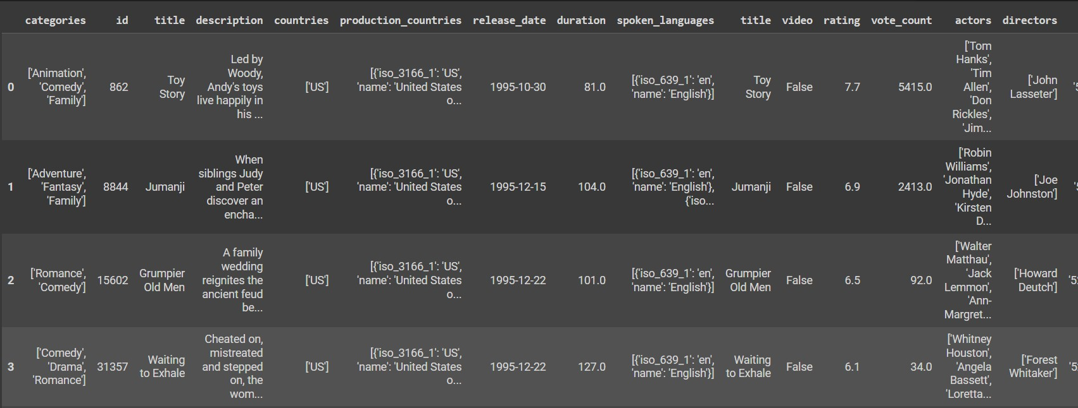
Hybrid Graph Recommendation System
8
interaction data (ratings). In our hybrid system, the CF component utilizes user-movie interaction
data to identify users with similar taste profiles. The graph-based component leverages the rich network of relationships and thematic similarities within the knowledge graph to identify movies that are similar to a user's preferred films. By combining the strengths of CF, which captures users' explicit preferences, and the graph-based approach, which incorporates both explicit connections and thematic content, the hybrid system aims to provide a more comprehensive and personalized recommendation experience.
This research demonstrates the effectiveness of pre-trained word embeddings and graph-based techniques within a hybrid recommender system. By creating a more nuanced understanding of user preferences and movie characteristics, this approach has the potential to significantly improve the accuracy and personalization of movie recommendations.
Dataset
We acquired our dataset from the provided link: https://grouplens.org/datasets/movielens/latest/.
The dataset encompasses details on 45,000 movies included in the Full MovieLens dataset. It includes various features such as categories(genres), id, title, countries, release date, duration, spoken_language, rating, vote_count, actors, directors & crew details.
Figure 1: Snapshot of the dataset (starting rows) used for graph construction

Slide 9
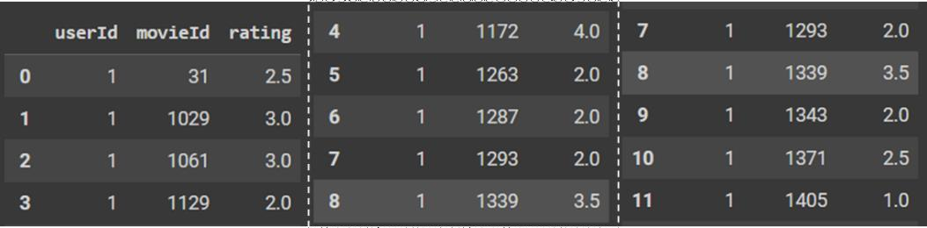
Hybrid Graph Recommendation System
9
In total, the dataset comprises 15 features and incorporates 100,000 ratings and 1,300 tag applications,
applied to 9,000 movies by a community of 700 users.
Figure 2: Snapshot of the dataset (starting rows) used for collaborative filtering.
We have a rating dataset that we used for item-item collaborative filtering. Our goal is to predict the top k movies for a user by calculating the average rating for movies the user hasn't yet rated. For example, if User 1 hasn't rated movies with IDs 10 to 15, we will predict the ratings of these movies based on similar users to User 1 and what ratings they have given for movies 10 to 15.
Design Details
In this section, we delved into the preliminary design details for our graph-based recommender system. Here, we'll outline the core components and their functionalities:
Data Representation:
Entity Modeling: We represented different relevant entities as nodes inside the graph. Each node includes attributes that contain essential information about the entity.
People (Actors and Directors): Actors and directors associated with each movie/show will be represented as separate nodes labeled ‘person’. Edges labelled ‘acted-in’ and ‘directed-by’ will connect these nodes to the corresponding movie/show node.
Categories: Movie categories are represented as nodes labeled ‘cat’. Edges connect these nodes to the corresponding movie/show node.

Slide 10
Hybrid Graph Recommendation System
10
Countries: Countries associated with the production of a movie/show are represented as nodes
labeled “cntry” and same as above edges are created between countries and related movies.
Similar Description: Node to connect to movies with similar stories. This is not a necessary node as such movies can be connected directly by an edge. But doing s will quickly create a
Relationship Modeling: We’ll leverage various edge labels to capture the relationships between entities in the graph:
‘ACTED_IN’ and ‘DIRECTED_BY’: These edges connect actors/directors to the movies/shows they participate in.
‘CAT_IN’: This edge indicates a movie/show belongs to a specific category.
‘COU_IN’: This edge indicates a movie/show is produced in a particular country.
‘SIMILARITY: This edge connects a movie/show node to similar items identified through one of the candidate models for embedding generation (Glove embeddings).
Graph Construction: We employed incremental graph construction (going row by row of the dataset). More details on the same are presented in the next section.
Algorithms
This section delves into the core algorithms that power our movie recommender system. These algorithms are responsible for analyzing user preferences and movie characteristics to generate personalized recommendations.
1. Calculating similarity between movie descriptions using cosine similarity and constructing graph
The graph was constructed using the features discussed in the previous section. The algorithm for the same is described here using pseudo code. See Figure 3 for a subgraph showing the structure of graph around a movie.

Slide 11

Hybrid Graph Recommendation System
11
Pseudo code:
embeddings_matrix <- make embedding matrix using the movies description data and glove-wiki-gigaword-100
embeddings.
FUNCTION find_similar(embeddings_matrix, index, n=5):
cosine_similarities = Compute cosine similarities between the embedding at index and all other embeddings in the matrix
sorted_indices = Sort cosine similarities in descending order and get the corresponding document indices #We used a custom function here to limit ‘n’ based on similarity score see actual code)
RETURN the top n related document indices from sorted_indices
#Graph Construction
Create an empty graph G with label 'MOVIE' FOR EACH rowi in df2:
Add a node to G with attributes:
title: rowi['title']
key: rowi['id']
label: 'MOVIE'
year: rowi['year']
FOR EACH actor in rowi['actors']:
Add a node to G with label 'PERSON' if not already present
Add an edge between rowi['title'] and the actor with label 'ACTED_IN' FOR EACH category in rowi['categories']:
Add a node to G with label 'CAT' if not already present
Add an edge between rowi['title'] and the category with label 'CAT_IN' FOR EACH director in rowi['directors']:
Add a node to G with label 'PERSON' if not already present
Add an edge between rowi['title'] and the director with label 'DIRECTED' FOR EACH country in rowi['countries']:
Add a node to G with label 'COU' if not already present
Add an edge between rowi['title'] and the country with label 'COU_IN' Compute similar indices using find_similar function
Create a node for description in G with label 'SIMILAR'
Add an edge between rowi['title'] and the description node with label 'SIMILARITY' FOR EACH element in indices:
Add an edge between the description node and the movie title at index 'element' with label 'SIMILARITY'code)

Slide 12
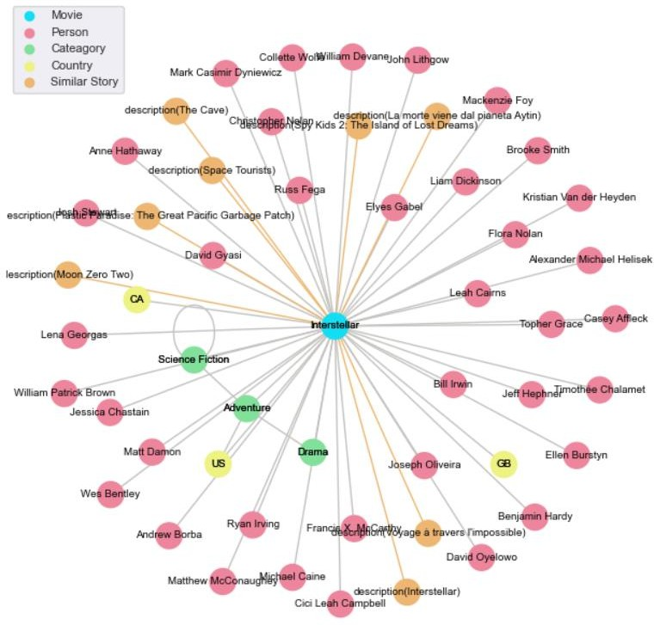
Hybrid Graph Recommendation System
12
Figure 3 3: Graph representation for movie 'Interstellar'. Color coding of the nodes is as per the legend shown on the top left corner.
2. Finding similar movies using on Adamic-Adar index (CBF)
We used Adamic-Adar index to calculate the similarity between the movies. The Adamic-Adar index, introduced in 2003 by Lada Adamic and Eytan Adar, is a technique used for predicting links in social

Slide 13

Hybrid Graph Recommendation System
13
networks. It focuses on the concept that common neighbors between two nodes (users) can be an
indicator of the likelihood of a connection existing between them. Underlying Idea:
The strength of a connection between two users (nodes) in a social network is based on the number of shared neighbors they have.
The intuition behind this approach is that users with many common neighbors are more likely to be connected due to shared interests, social circles, or common activities.
The Adamic-Adar index (w) for a potential link between two nodes x and y is calculated as the sum of the inverse logarithmic degree centrality of the neighbors they share:
𝑤(𝑥, 𝑦) = ∑
𝑢∈𝑁(𝑥)∩𝑁(𝑦)
1
𝑙𝑜𝑔|𝑁(𝑢)|
𝑁(𝑢) represents the set of neighbors for node 𝑢.
|𝑁(𝑢)| denotes the number of neighbors for node 𝑢 (its degree).
The summation iterates over all common neighbors 𝑢 of nodes 𝑥 and 𝑦.
Pseudo code:
Initialize an empty dictionary `commons_dict`.
For each neighbor `e` of the root node in the graph `G`:
a. For each neighbor `e2` of `e`:
If `e2` is equal to the root node, continue to the next iteration.
If the label of node `e2` is 'MOVIE':
If `e2` is not already in `commons_dict`, add it as a key with value [e].
Otherwise, append `e` to the list of values associated with `e2` in `commons_dict`.
Initialize empty lists `movies` and `weight`.
For each key-value pair (movie, edges) in `commons_dict` calculate the weights using Adamic-Adar index:
Initialize weight `w` to 0.
For each edge `e` in `edges`:
Increment `w` by 1 divided by the logarithm of the degree of `e`.
Append `movie` to the `movies` list and `w` to the `weight` list.
Create a pandas Series `result` with `weight` as data and `movies` as index.
Sort the Series `result` in descending order of weights.
Return the sorted `result`.

Slide 14


Hybrid Graph Recommendation System
14
3. Collaborative Filtering (CF)
We used Singular Value Composition(SVD) for matrix decomposition (user-user relation). By decomposing the matrix into lower-dimensional representations, SVD can effectively capture underlying patterns and relationships between users and items.
Algorithm:
Initialize SVD algorithm.
Fit algorithm to training set.
Function collaborative_recommendations(user_id, user_ratings, n=5):
Get all unique movie IDs from user_ratings.
Get IDs of items rated by user from trainset.
Identify items unseen by user.
Generate predictions for unseen items.
Sort predictions based on estimated ratings.
Return top n recommended items.
4. Hybrid model
Algorithm:
Get collaborative filtering results for user u
List=[]
For m ∈ top k movies watched by user:
movies_wirh_scores= [content_based_recommendation(m)]
𝑁𝑒𝑤 𝑠𝑐𝑜𝑟𝑒 𝑓𝑜𝑟 𝑚𝑜𝑣𝑖𝑒𝑠 𝑖𝑛 𝑙𝑖𝑠𝑡 = 𝑚𝑜𝑣𝑖𝑒𝑠_𝑤𝑖𝑡ℎ_𝑠𝑐𝑜𝑟𝑒[‘𝑠𝑐𝑜𝑟𝑒’] ∗ 𝑠𝑞𝑟𝑡(𝑟𝑎𝑡𝑖𝑛𝑔 𝑜𝑓 𝑚𝑜𝑣𝑖𝑒 𝑚)
update the List with these movies
Select top n1 and n2 results from both the filtering
Table 1: Time complexity of all major algorithms used in this project.
Algorithms/Code | Time Complexity | Description
Cosine Similarity Calculation | 𝑂(𝑛²) | Matrix multiplication of order 𝑛²
Graph Construction (also takes 𝑐𝑛²space) | 𝑂(𝑛³) | 𝑛 ∗ (4 ∗ 𝑂(𝑛) + 𝑂(𝑛²) 𝑓𝑜𝑟 𝑐𝑜𝑠𝑖𝑛𝑒 𝑠𝑖𝑚𝑖𝑙𝑎𝑟𝑖𝑡𝑦)
CBF | 𝑂(𝑛²) | Search into neighbors of neighbors: 𝑂(𝑛 ∗ 𝑛)

Slide 15
Hybrid Graph Recommendation System
15
CF | O(n^2 * m + n * m * k) | where n is the number of items, m is the number of users & k is the number of similar items considered.
Hybrid | = O(n^2 * m + n * m * k) | O(Hybrid) = O(CF) + O(CBF) = 𝑂(𝑛^2 ∗ 𝑚 + 𝑛 ∗ 𝑚 ∗ 𝑘) + 𝑂(𝑛^2) = 𝑂(𝑛^2 ∗ 𝑚 + 𝑛 ∗ 𝑚 ∗ 𝑘)
Machine Learning Methods
Our graph-based recommender system will leverage a combination of machine learning techniques to extract insights from user-item interactions, movie descriptions, and the network structure itself.
Pre-trained Word Embeddings (Glove): We leverage pre-trained Glove embeddings to capture the semantic meaning of movie descriptions. Glove assigns numerical vectors to words, where similar words have similar vectors. By applying Glove to descriptions and averaging word vectors, we create a single embedding vector representing a movie's thematic content. This allows the system to identify thematically similar movies, even beyond genres.
KMeans clustering: We also clustered the movies using the Kmeans algorithms using the description similarities. However, pre-trained word embeddings like Glove already capture semantic similarity between words and hence using similarities based on these embeddings directly in the graph performs better than using the clusters made using KMeans. Still KMeans act as good visualizing tool for analyzing the closeness of different movies
SVD: Singular Value Decomposition (SVD) is a powerful technique used in collaborative filtering algorithms to enhance recommendation systems. It operates by reducing the dimensionality of the user-item interaction matrix, capturing essential patterns and relationships in a lower- dimensional latent space. This transformation enables the representation of users and items based on latent factors, which are abstract concepts reflecting user preferences and item characteristics. By mapping users and items into this latent space, SVD improves the measurement of similarity between users and items, making it more meaningful and accurate.

Slide 16
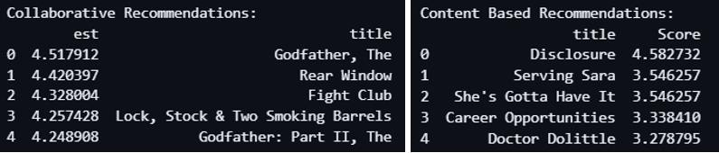
Hybrid Graph Recommendation System
16
This enhanced similarity computation facilitates predicting user ratings for items they haven't
interacted with, leveraging similarities with items they have rated and those of similar users. In essence, SVD optimizes collaborative filtering algorithms by transforming the recommendation problem into an optimization task focused on minimizing prediction errors and improving the overall accuracy and effectiveness of recommendation systems.
Results
We have tested our hybrid recommendation system on the movielens data. In this section we present the test run result for recommendation for user with userId=3. We have selected top 5 recommendation from both recommendation techniques (see Figure 4).
Figure 44: Recommendations for user with ID=3. On the left are the recommendations based on the collaborative filtering and on the right are the recommendations based on graph based CBF.
For content-based filtering, we calculated the top recommendations for each of the top movies of the selected user. The neighborhood graph for one of those movies is shown in Figure 5. Similarly, the subgraph for each of these top movies are plotted and the final weighted score (Figure 4) is calculated according to the method presented in the Algorithm section.

Slide 17
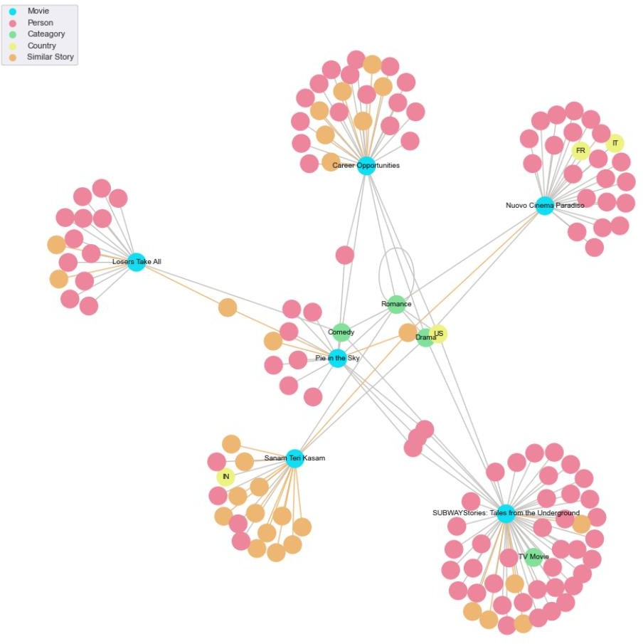
Hybrid Graph Recommendation System
17
Figure 55: Graph construction in the vicinity of movie 'Pie in the Sky'. Similar graphs (and corresponding recommendations) are generated for each movie liked by a user (here for user id=3). We defined 'liked' movie as movie with rating>=4 by the user. Further, we limited the number of liked movies to top 10 for a user (this keeps the running time as constant multiple of 𝑛² instead of 𝑛³).
Future Work
This research demonstrates the potential of hybrid recommender systems that combine graph-
based techniques with pre-trained word embeddings for enhanced movie recommendations. However,

Slide 18
Hybrid Graph Recommendation System
18
there are several exciting avenues for further exploration to refine recommendations and address
scalability challenges.
Enhancing User Profiling and Contextualization:
While this research focused on movie descriptions and relationships, future work could integrate user demographics (age, location, occupation) or implicit feedback (watch history, ratings) to create more comprehensive user profiles. This richer profile information could be leveraged to personalize recommendations further, catering not only to thematic preferences but also to potential demographic
biases or genre-specific interests within watch history.
Modeling Temporal Dynamics:
User preferences may evolve over time. Future systems could explore techniques to capture these dynamics by incorporating time-based information (release year, watch history timestamps) into the recommendation process. This would enable the system to recommend movies that align with a user's evolving tastes.
Addressing Scalability Challenges:
Model Optimization for Efficiency: As movie data continues to grow, the scalability of the current approach becomes increasingly important. Future work could explore techniques for optimizing the graph construction process, dimensionality reduction of embedding vectors, and potentially distributed computing approaches to handle larger datasets efficiently.
Incremental Learning and Model Update Strategies: Since movie data is constantly evolving with new
releases, developing strategies for incremental learning and model updates is crucial. This could involve techniques that allow the system to efficiently integrate new movies and update existing recommendations without requiring a complete model retraining process.

Slide 19
Hybrid Graph Recommendation System
19
By pursuing these avenues of future work, we can further refine recommender systems, enabling
them to not only provide highly personalized and accurate movie recommendations but also efficiently handle the ever-growing volume of movie data. As the field of recommender systems progresses, the development of effective hybrid approaches that leverage sophisticated graph structures, advanced feature representations, and efficient model optimization techniques will be critical in delivering a truly personalized and enriching content discovery experience for users.

Slide 20
Hybrid Graph Recommendation System
20
References
Adomavicius, Gediminas, Aleksandras Tuzhilin, Wiltmuth Bakken, Yuening Wang, and AJ Smola. "User driven collaborative filtering for recommending information." In *Proceedings of the ninth ACM SIGKDD international conference on Knowledge discovery and data mining*, pp. 136-144. ACM, 2005.
Adomavicius, Gediminas, and Aleksandras Tuzhilin. "Toward the next generation of recommender systems: A survey of the state-of-the-art and possible extensions." *IEEE transactions on
knowledge and data engineering* 17.6 (2005): 734-749.
Koren, Yehuda, Robert Bell, and Chris Volinsky. "Matrix factorization techniques for recommender systems." *IEEE Transactions on pattern analysis and machine intelligence* 35.4 (2013): 1097- 1111.
Adomavicius, Gediminas, and Aleksandras Tuzhilin. "Toward the next generation of recommender
systems: A survey of the state-of-the-art and possible extensions." *IEEE transactions on knowledge and data engineering* 17.6 (2005): 734-749.
Adomavicius, Gediminas, Aleksandras Tuzhilin, Wiltmuth Bakken, Yuening Wang, and AJ Smola. "User-driven collaborative filtering for recommending information." In *Proceedings of the ninth ACM SIGKDD international conference on Knowledge discovery and data mining*, pp. 136-144. ACM, 2005.
Adomavicius, Gediminas, and Aleksandras Tuzhilin. "Toward the next generation of recommender
systems: A survey of the state-of-the-art and possible extensions." *IEEE transactions on knowledge and data engineering* 17.6 (2005): 734-749.
Koren, Yehuda, Robert Bell, and Chris Volinsky. "Matrix factorization techniques for recommender systems." *IEEE Transactions on pattern analysis and machine intelligence* 35.
https://www.kaggle.com/datasets/shivamb/disney-movies-and-tv-shows

