Slide 1
Stochastic Processes and Applications
Time Series Project
Forecasting the number of daily NEFT transactions
Group - 8
Atharva Kulkarni (23BM6JP63)
Saurabh Chaudhary (23BM6JP50)

Slide 2
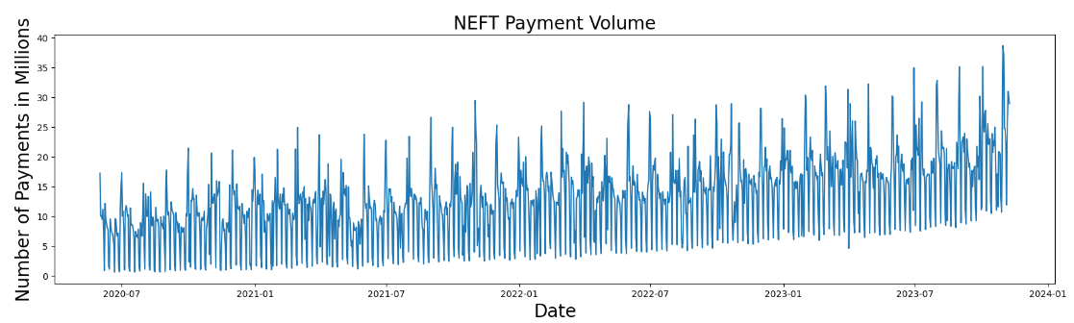
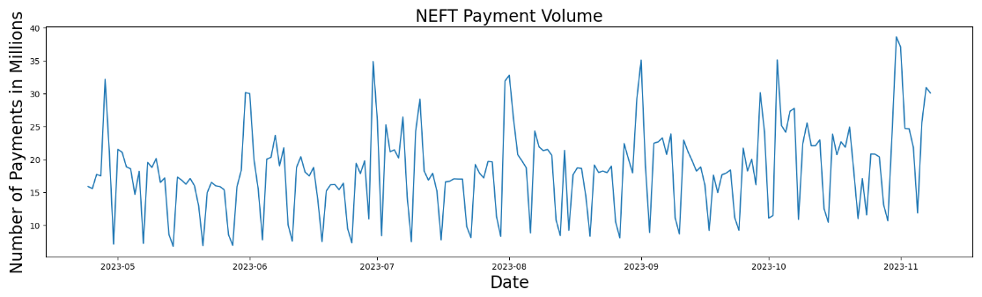
Daily Number of NEFT Transactions
Objective : To analyze the future NEFT transaction by observing trend and seasonality of NEFT data.
Benefits of analyzing NEFT data:
Identifying trends: Analyzing NEFT data can help identify trends and patterns in payment behavior, such as seasonal fluctuations or regional disparities. This information can be used by stakeholders to develop targeted initiatives and improve the overall efficiency of the NEFT system.
Resource allocation: NEFT data can be used to allocate resources more efficiently based on expected demand. For example, banks can use data to determine which branches need additional resources to handle increased transaction volumes.
Fraud detection: NEFT data can be used to identify suspicious transactions and potential fraud. This information can be used by banks and financial institutions to prevent financial losses and protect their customers.

Slide 3
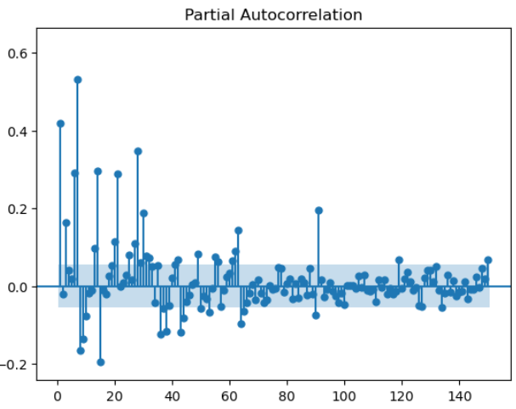
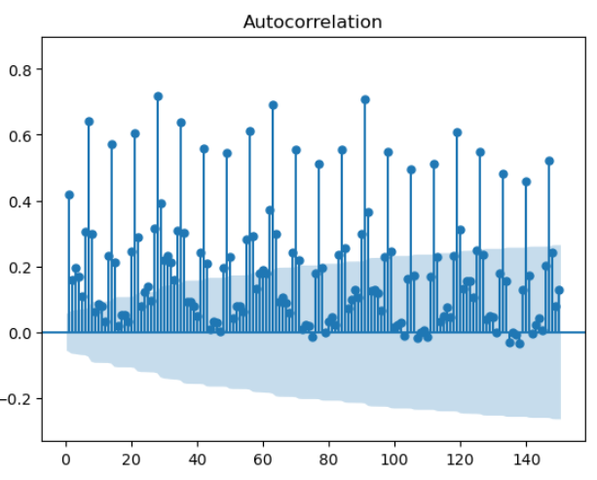
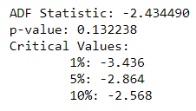
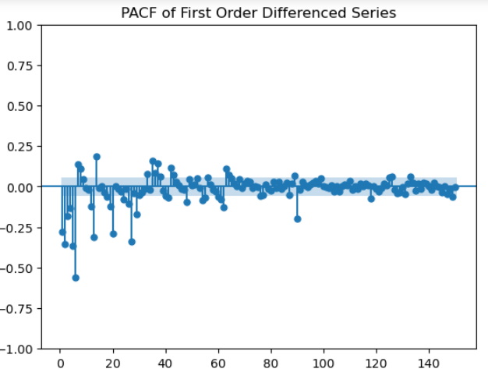
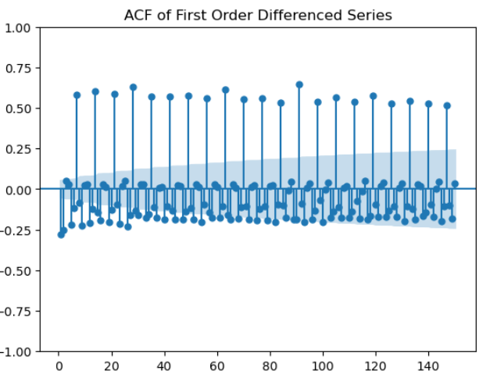
ACF and PACF Plot of the original Data
Observations
Series is non-stationary (also evident from the time series plot)
Presence of strong correlation on,
Lag 1
Multiples of Lag 7
Lags close to multiples of 30
ACF and PACF Plot of first difference
X(t) – X(t-1)
Observations
Presence of strong correlation on multiples of Lag 7.
Correlation at lags close to multiples of 30 slightly pacified.

Slide 4
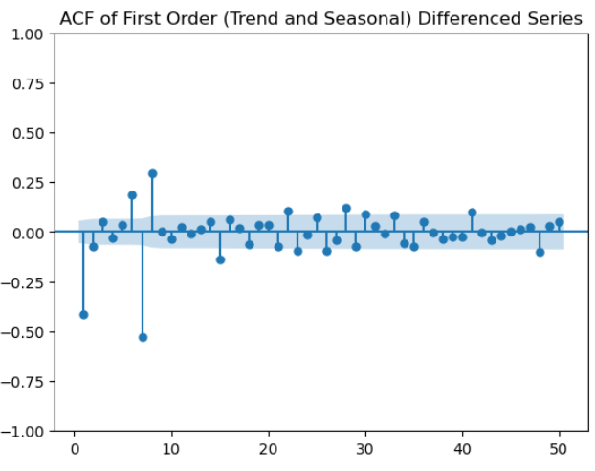
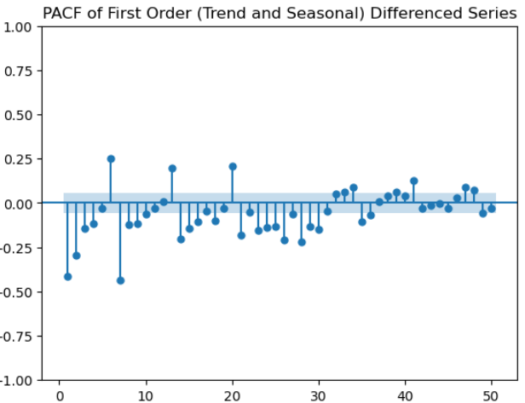
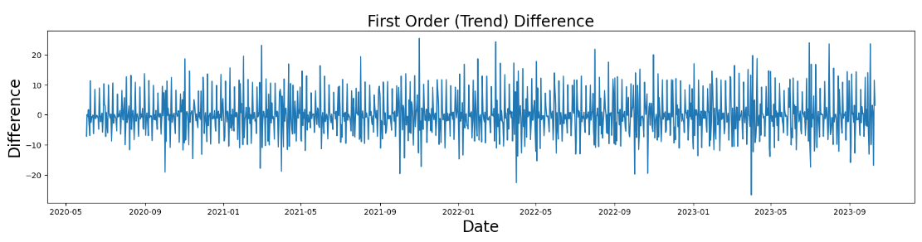
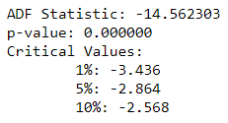
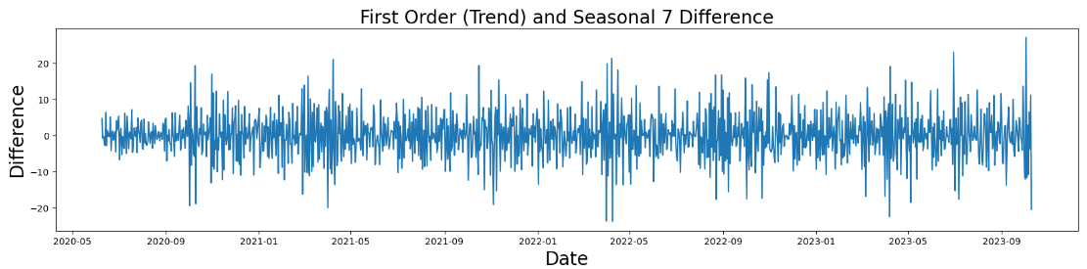
ACF and PACF Plot of de-trended and de-seasonalized (seasonality 7) series
Observations
A major spike in ACF plot, followed by a small significant spike coupled with a tapering trend in PACF plot – Non-seasonal MA 1 or MA 2 (q)
Repetition of pattern in PACF plot for close to 3 / 4 times – Possibility of a seasonal AR 3 / 4 (P)
Important:
We still considered the possibility of having a Non-Seasonal AR term and a Seasonal MA term. Hence, we assumed p and Q as 1 each.
Note: ADF test results after seasonal and non-seasonal differencing
Initial Guess About the Model
ARIMA (1, 1, 1 or 2) X (3 or 4, 1, 1, 7)
Considering the AIC score and the P-Values of the possible models, the model with low AIC was:
ARIMA(1, 1, 1)x(3, 1, 1, 7)

Slide 5
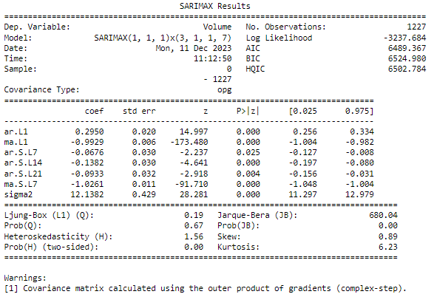
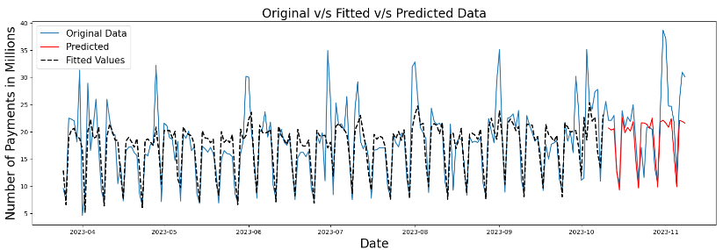
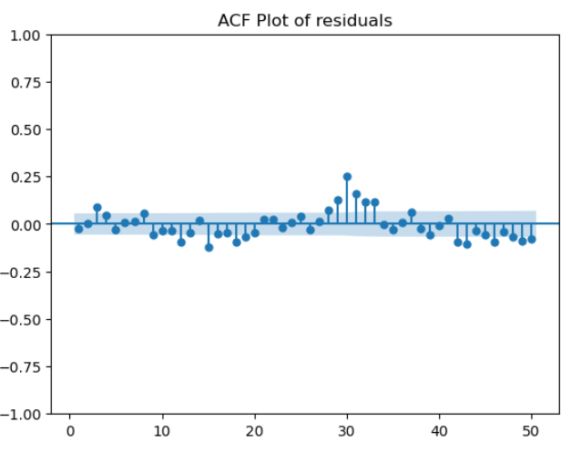
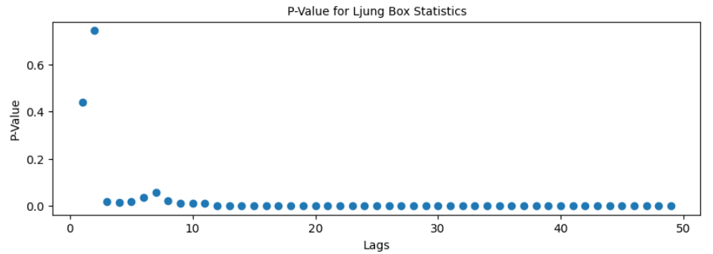
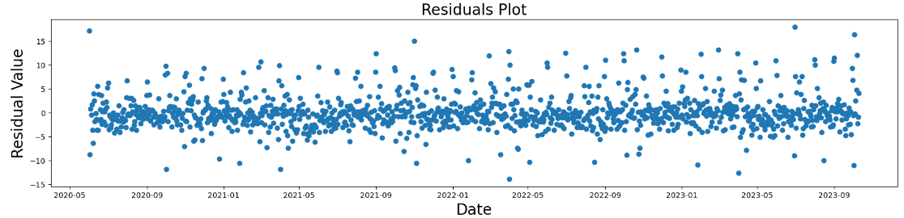
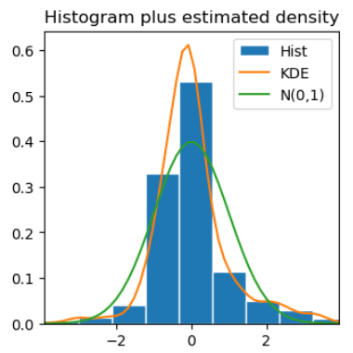
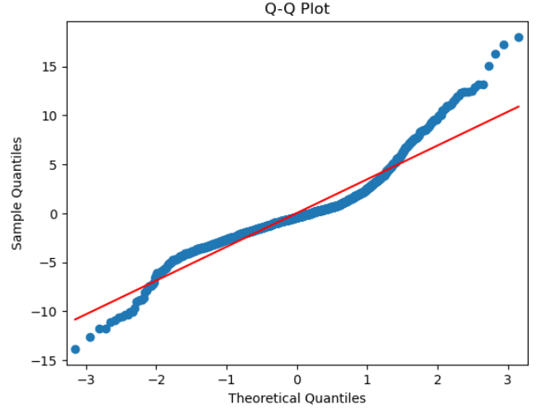
Results
Model Summary
Forecasted Values
Behaviour of Residuals
Behaviour of Residuals

Slide 6
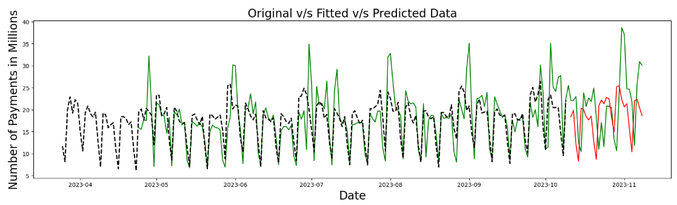
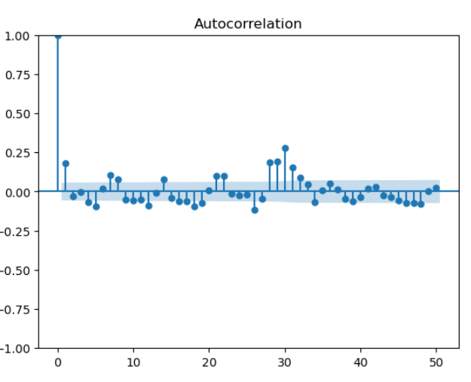
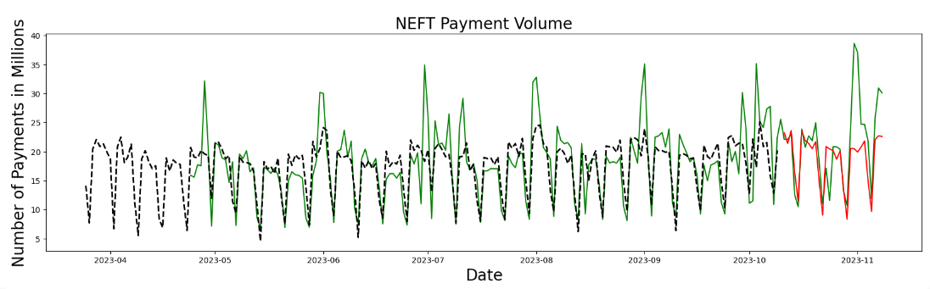
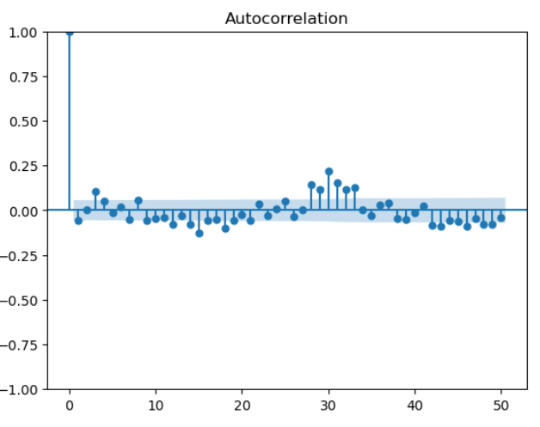
Other Approaches Taken
Description | Forecasted Values | ACF of Residuals | Error
Take first order difference, Apply SARIMA (Seasonality 7) on the resultant series (Discussed Previously) |  |  | MAE: 4.73 MSE: 42.24 RMSE: 6.50 MAPE: 20.52% sMAPE: 21.79%
* Splitting the series into two components (using seasonal_decompose) Seasonal 7 component Seasonal 30 component + trend Apply SARIMA on the second component and forecast the values. Add the seasonal 7 component to the forecasted values |  |  | MAE: 4.67 MSE: 34.84 RMSE: 5.90 MAPE: 22.35% sMAPE: 23.02%
* Splitting the series into two components (using seasonal_decompose) Seasonal 30 component Seasonal 7 component + trend Apply SARIMA on the second component and forecast the values. Add the seasonal 7 component to the forecasted values |  |  | MAE: 4.32 MSE: 35.41 RMSE: 5.95 MAPE: 19.73% sMAPE: 20.35%
* We are yet to evaluate if these techniques are mathematically sound or not.

Slide 7
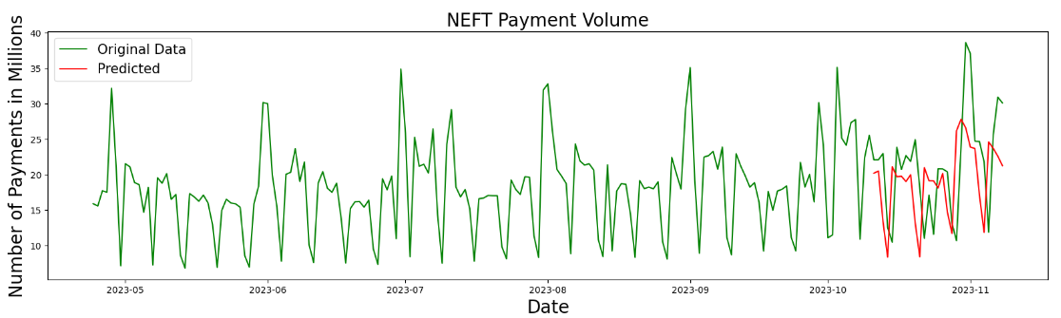
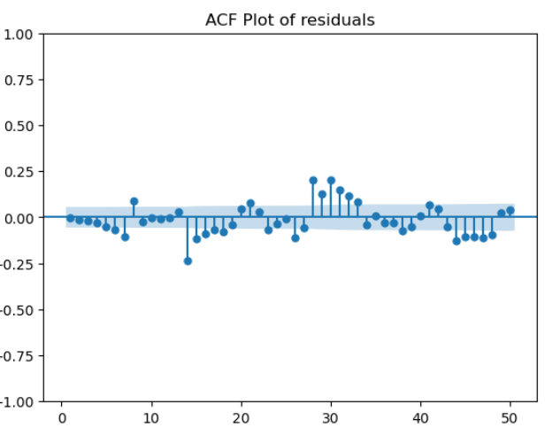
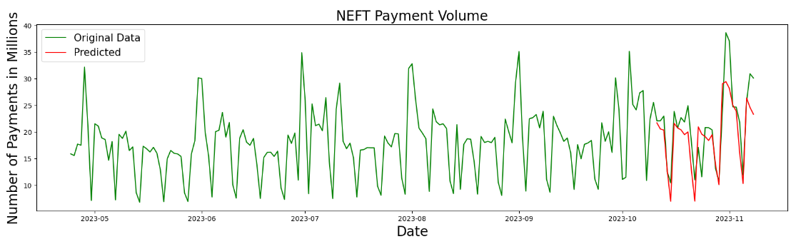
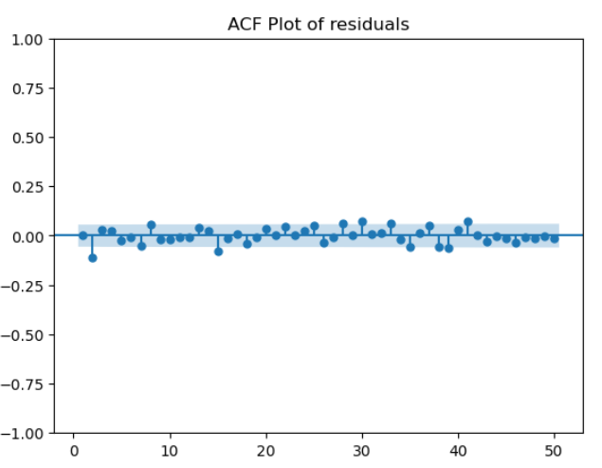
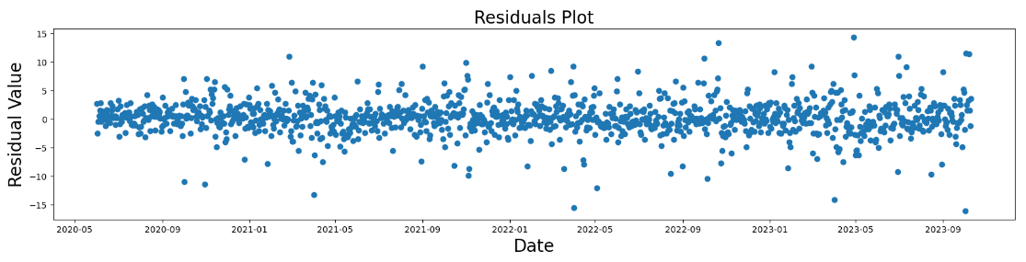
Other Approaches Taken
Description | Forecasted Values | ACF of Residuals | Error
SARIMAX - model second seasonality (30 days) as an exogenous effect with Fourier terms. https://tanzu.vmware.com/content/blog/forecasting-time-series-data-with-multiple-seasonal-periods https://otexts.com/fpp2/complexseasonality.html |  |  | MAE: 3.35 MSE: 19.57 RMSE: 4.42 MAPE: 15.64% sMAPE: 16.20%
TBATS Model - https://medium.com/intive-developers/forecasting-time-series-with-multiple-seasonalities-using-tbats-in-python-398a00ac0e8a https://otexts.com/fpp2/complexseasonality.html |  |  | MAE: 3.21 MSE: 17.49 RMSE: 4.18 MAPE: 15.73% sMAPE: 16.43%

Slide 8
Thank You

