Slide 1


Medical Insurance Approval using Decision Tree
Kapil (23BM6JP20)
Saurabh
(23BM6JP50)

Slide 2
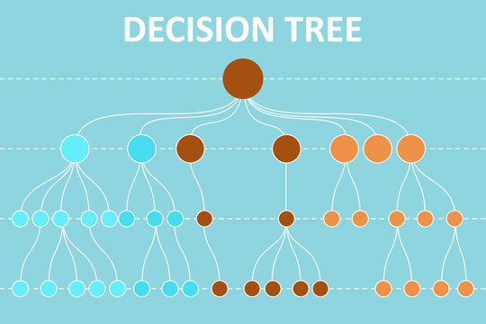

Motivation & Objectives
Medical Insurance approval is critical components of healthcare sector to provide better medical infrastructure facility to everyone.
Every year companies suffer a lot financially due to fraudalent approvals of fake medical claims by hospitals and fraudsters

Slide 3
Data description
Data consists of 1728 observations having 6 variables along with target class.
Variables: Age, Smoking, BMI, ACC-H, Income, Med-H and all variables are categorical
Target class contains 4 classes: bad, ok, good, vgood
Age : 3 age groups
Smoke : 4 classes
BMI : 4
ACC-H : 3
Income : 3
Med-H : 3

Slide 4
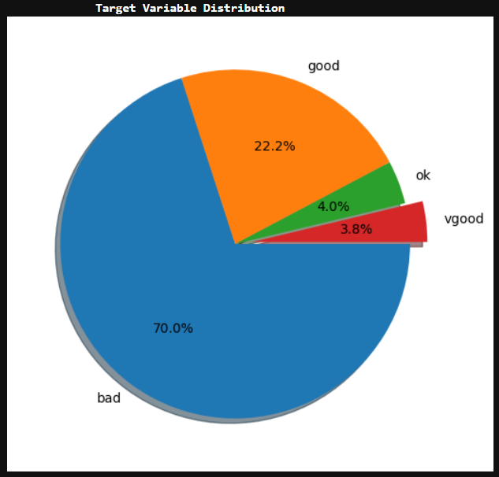
Exploratory data analysis
70% of the data points are under "bad" category, i.e, around 1200 out of 1728.
"vgood" class is in minority, less than 4%.

Slide 5
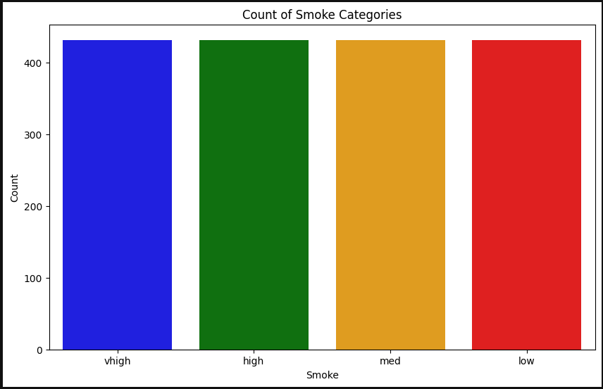
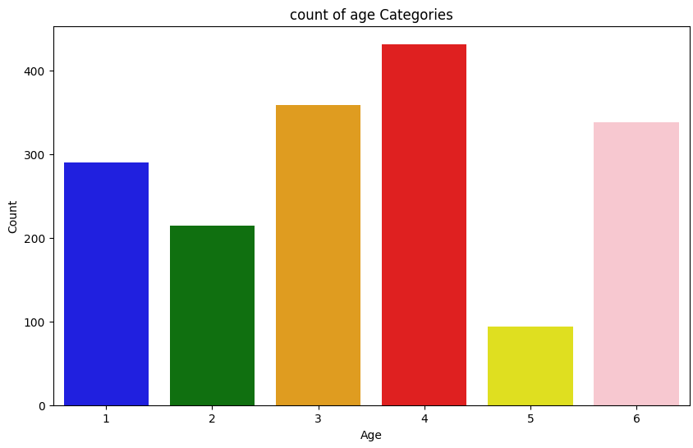
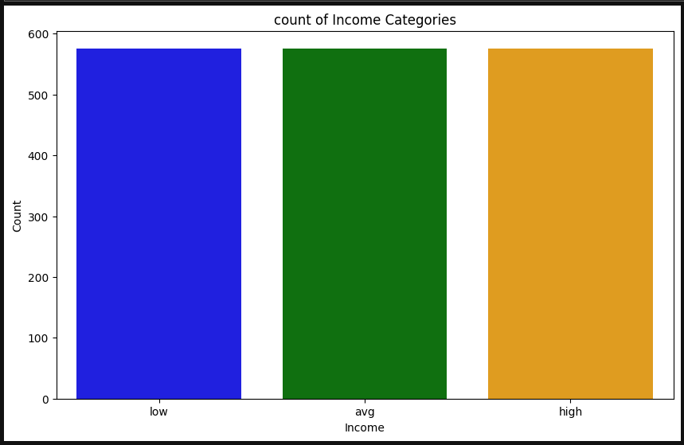
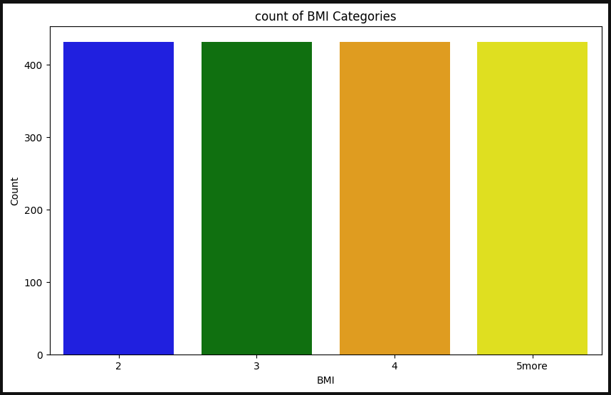

Slide 6
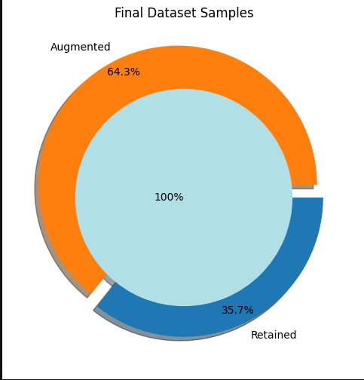
EDA
Data had a class imbalance, so we got an overfitted model by the target class "bad"
To resolve class imbalance, we applied Smote.
New data now has 4800 observations, with equal distribution of target classes.

Slide 7
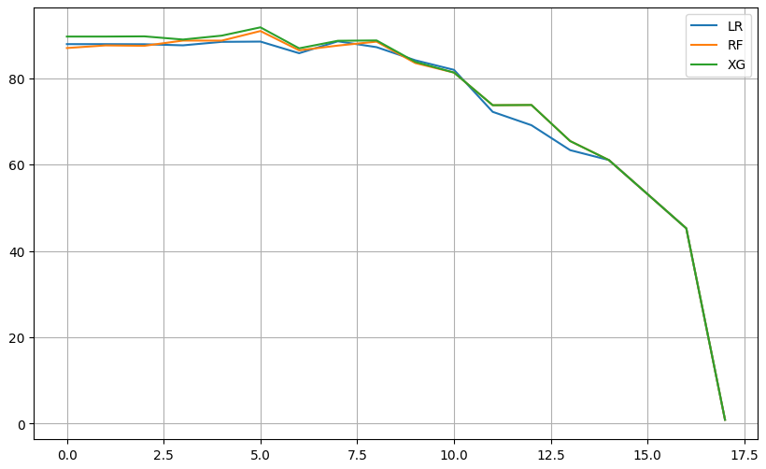
Feature Elimination
Tried feature elimination using RFE, but since all our variables are categorical, so did not got much improvement in the final accuracy of the models.
We tried 3 different models to test the accuracy: Logistic, RF classifier, Xgboost classifier
ACCURACY
Features dropped --->>

Slide 8
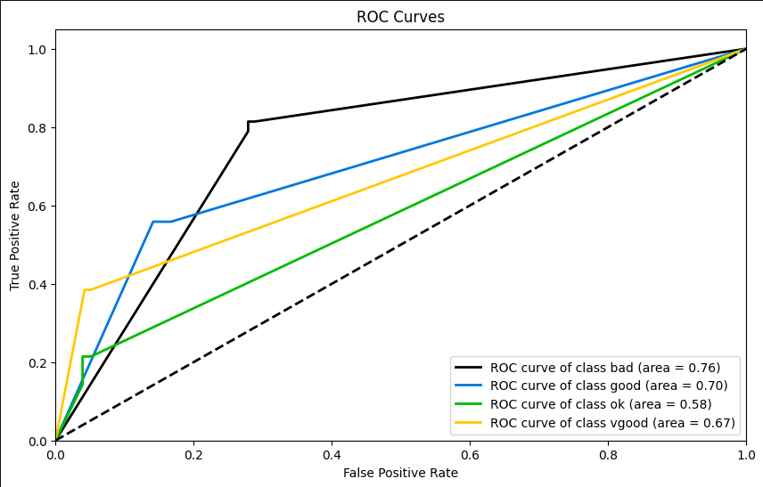
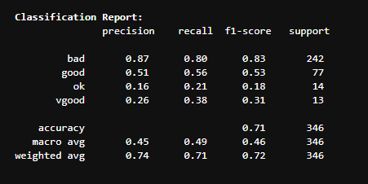
Decision Tree

Slide 9
Models
Decision Tree
Logistic Regression
Random Forest Classifier
Naïve Bayes
XgBoost
And few others....

Slide 10
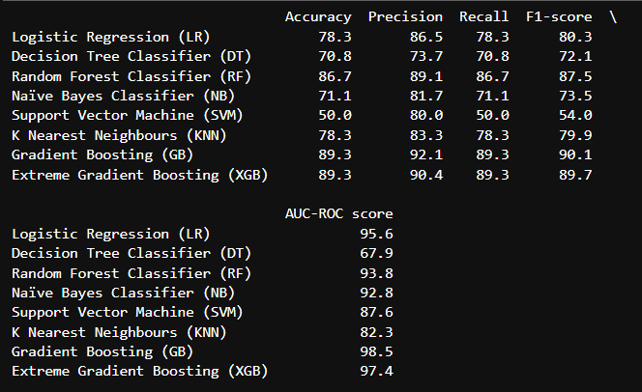
Results

Slide 11
Thank you!!

