Slide 1
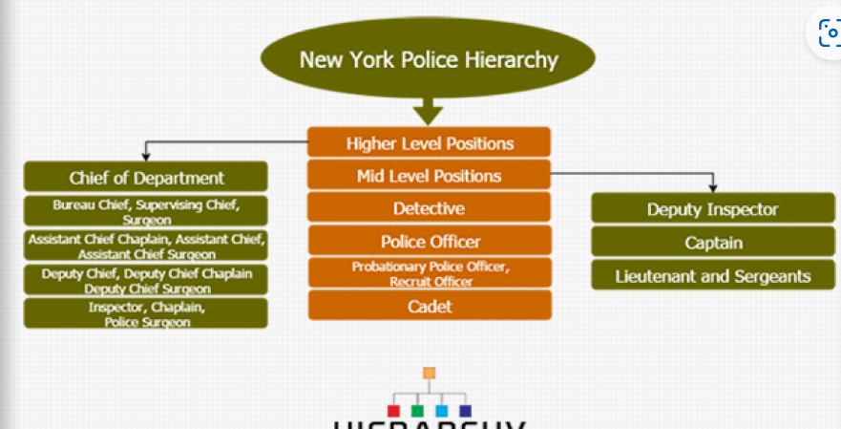
New York Police
Chief of Department
Higher-Level Positions
Bureau Chief
Supervising Chief
Surgeon
Mid-Level Positions
Deputy Inspector
Assistant Chief Chaplain
Assistant Chief
Assistant Chief Surgeon
Detective
Captain
Deputy Chief
Deputy Chief Chaplain
Deputy Chief Surgeon
Police Officer
Lieutenant
Sergeants
Inspector
Chaplain
Police Surgeon
Probationary Police Officer, Recruit Officer
Cadet

