Slide 1
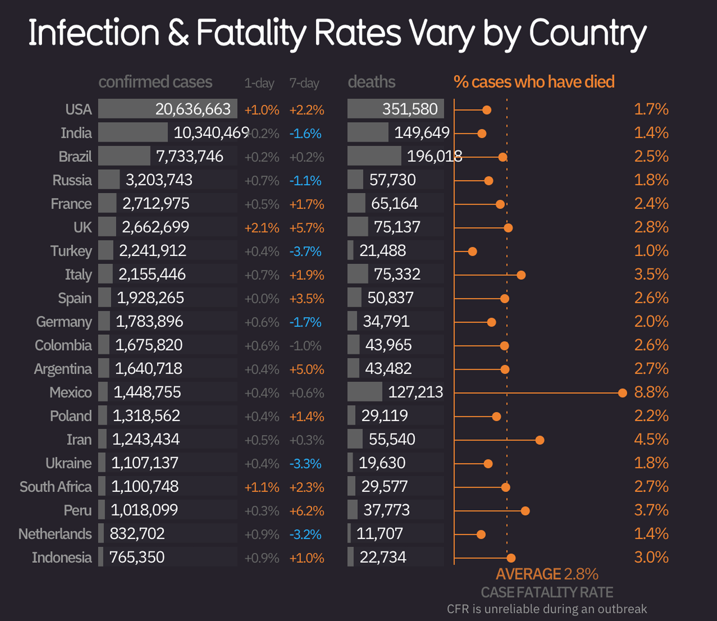
1A Analyze and Redraw a Graph
Jin Gao
Source: Johns Hopkins University, https://informationisbeautiful.net/visualizations/covid-19-coronavirus-infographic-datapack/

Slide 2
What works well
What could be improved
Clear number presentation and organization: Given the complexity of massive data on one single page, the chart effectively shows them in well-organized structures with proper combination of two styles of bar charts.
Visual Distinction: Effective color contrast: orange for death rate, blue for contrast cases, and grey for general information, on top of a dark-blue canvas, clearly differentiated the data types.
Integrated Analysis: The dotted line shows the average fatality rate is effectively conveying the idea of high fatality rate worldwide.
Effective Sorting Logic: The chart is sorted by confirmed cases by the first column, which is clear and direct for first-time readers.
Good Alignment: complies with Gestalt principles, its’ easy to classify the data in groups
Redundant color: The below-zero rates, marked in blue in the chart, may not necessarily helpful convey the idea
Overloaded Numbers: The whole chart is designed for showing numbers, not showing the pandemic death problem, causing difficulty in understanding the meaning without extensive number readings.
Accessibility: the current design may not be suitable for print, presentation, and elder reading. Some font size is small and dark-grey texts are hard to read on dark backgrounds.
Unproportional bar chart: Given the same length, the death side’s bar chart represents the significantly lower number, which exaggerated the death cases.
Source and date: The provided chart doesn’t include the data source and date.
Missing Legends and necessary explanation: There are no indicators for the purpose of using colors and shapes. There is no explanation for professional terms like “CFR” and what sequence unreliable CFR will bring.
Redundancy: The death data are represented twice, in the form of absolute value and proportions, which is redundant.
Why I Made the Changes I did
Intended Target Audience: In the Post-pandemic era, a new audience that reads the article or related data for the first time, a less educated elderly audience with basic context knowledge but less reading and reasoning ability, needs high contrast color and big font to read properly.
New color pattern: The dark blue background and orange as contrast color may be suitable in the context of the whole article’s design, it may not suitable for stage presentation and elderly reading. I change it to high-contrast color scheme with white background, red for death and orange-yellow for infection, leaving other elements black or dark grey, to highlight the core data.
Bar chart integration with built-in error bars: Instead of showing the number of 1-day and 7-day changes, I chose to use error bar to represent this minor differences. From my perspective, such data is unnecessary for new audiences.
Adjust sorting logic: Instead of sorting by the total number of deaths, I sort the data by fatality rate. This gives us a clearer picture of the effectiveness of epidemic prevention and control and is directly related to the result between the number of deaths divided by total infection numbers.

Slide 3
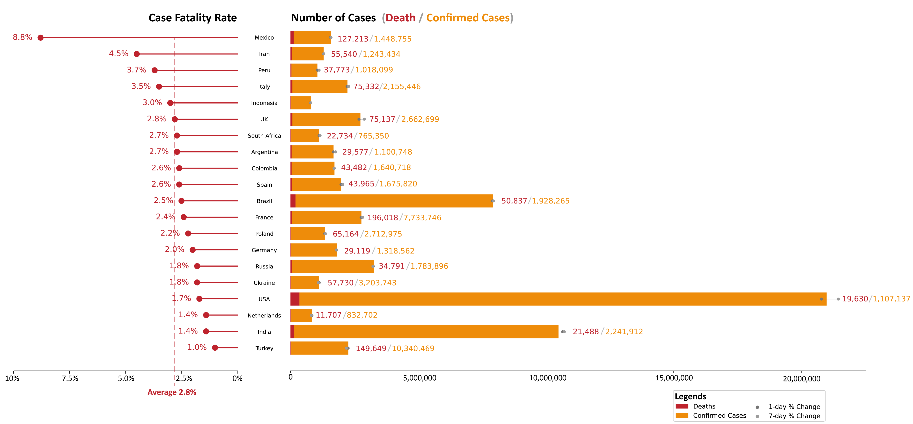
Infection & Fatality Rates Vary by Country
COVID-19 Fatality Rates + Infection Analysis
Source: Johns Hopkins University, https://informationisbeautiful.net/visualizations/covid-19-coronavirus-infographic-datapack/

Slide 4
From complete to precise : Extract key data, focus more on the rate.
 | Strengths | Areas of Development
TOP-T | A quick overview of the context of the chart, leads to easier understanding and empathy The expression of the points was clear Clear division between title and point | Need more logical orientation for complex chart I misunderstood the assignment prompt. I thought the point should remain the same as the given chart. So I need to re-find the key point for the re-drawing.
Verbal Delivery | The overall delivery is smooth The information from the chart is complete and understood by the audience Highlighted several key points, like the high death rate of Mexico, and the US’s high infection numbers Pointed out the possible reasons behind the number to support the point | My volume was decreasing gradually. Should keep increasing the volume in mind There was some jargon and pauses during the speech. Need more verbal orientation to guide the audience Improve grammar correctness and avoid long sentences with clauses Slow down the speech speed, stress on the key data
Non-Verbal Delivery | Used body gestures to help orient the audience, like pointing at axis by hand Targeted multiple audiences, and get their eye contact for in-time feedbacks Constant eye contact, nodding my head when the audience was providing feedback | My facial expression was not confident enough to express the idea of the severity of the covid situation Unnecessary look toward the screen at the back of me, reduced the eye-contact with the audiences Body language when hitting key points
Graph Design | Avoid excessive numbers while keeping readability Consistent color hue and design language Good alignment complies with Gestalt principles Clear contrast between red and yellow Easy to read on big projected screens | Too much information to convey in one chart Too much non-data ink that is irrelevant to the key point, consider removing countries that are unnecessary for the point Red and yellow colors can be confusing, should target two greyscale and one highlight color.

Slide 5
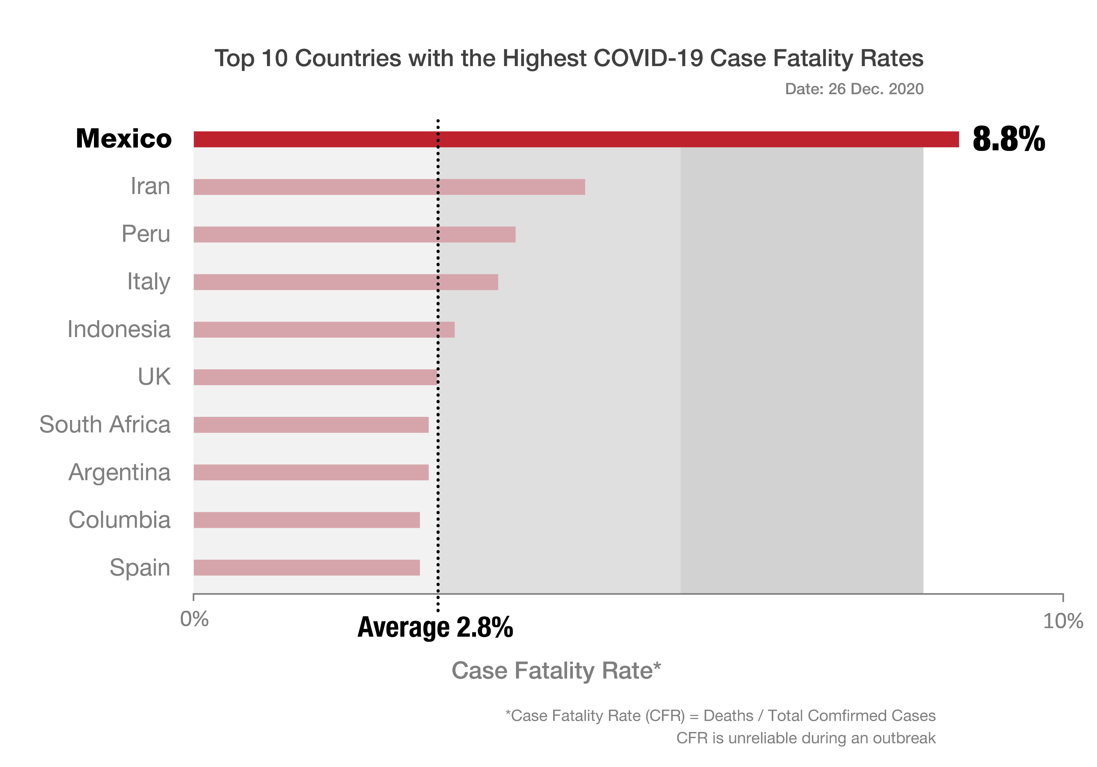
Mexico Tripled the Average Fatality Rate, Ranks First Among Major Countries
Source: Johns Hopkins University, Data Date 26 December 2020

