Slide 1
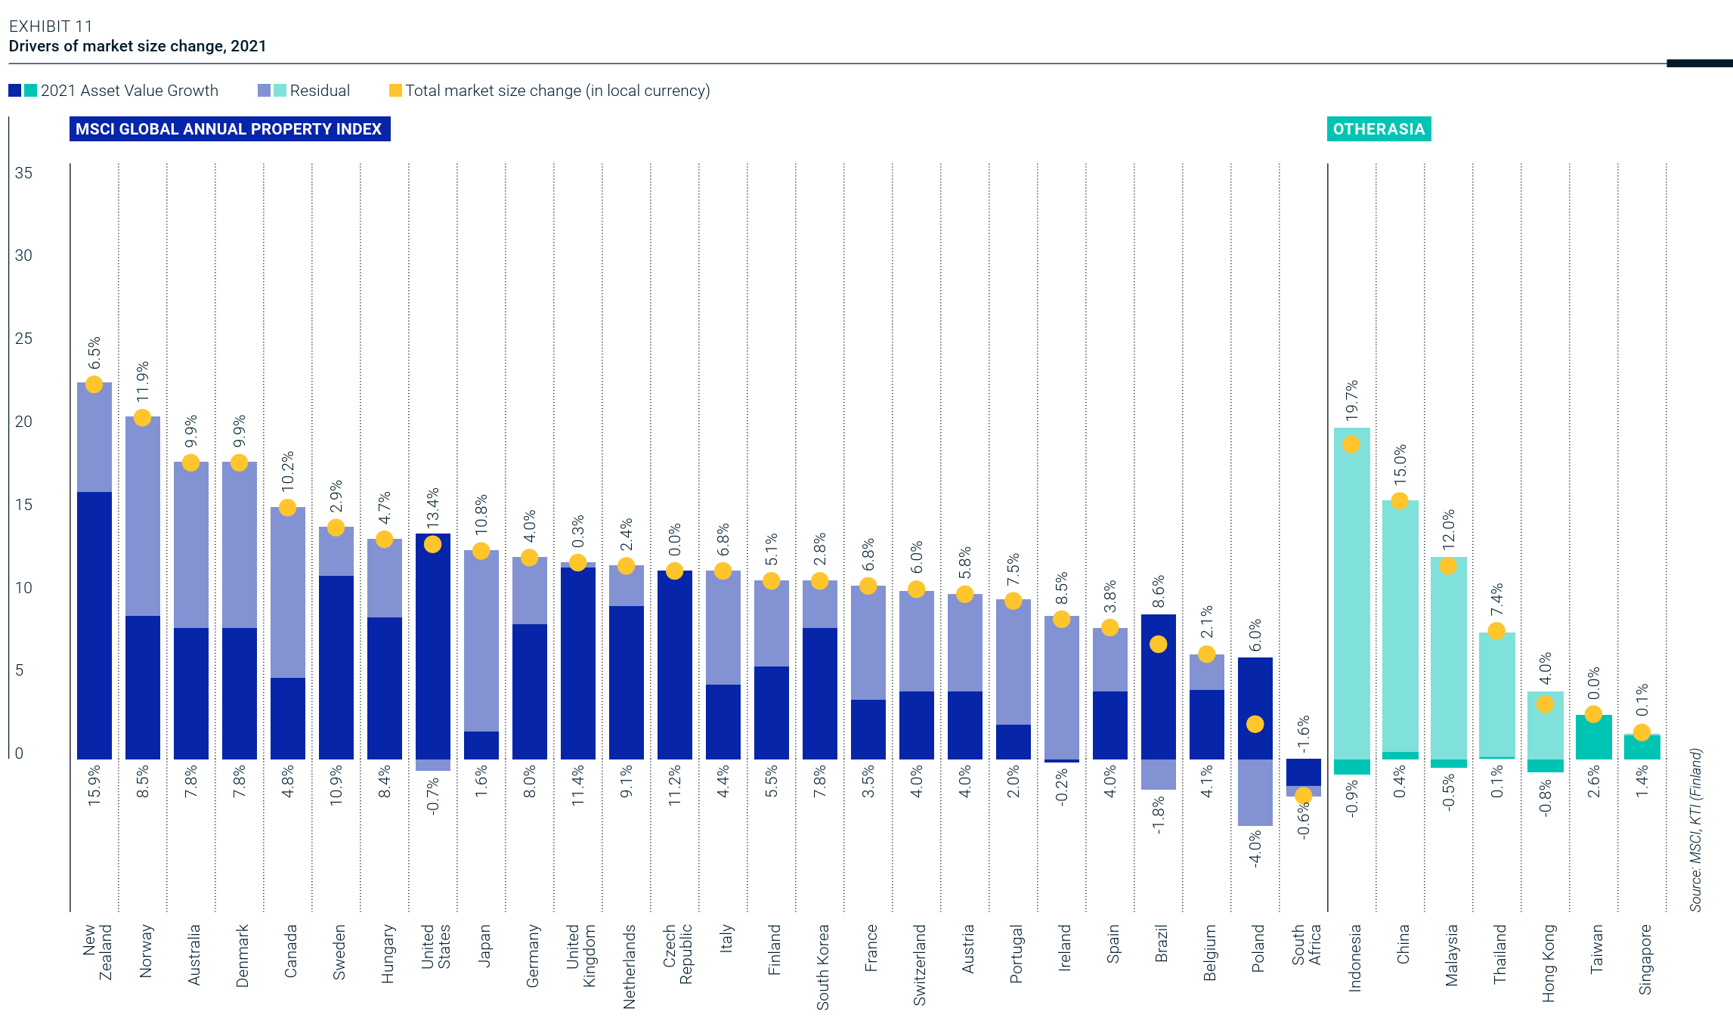
MSCI Real Estate Market Size Report 21/22
MSCI, Page 20
Link to the Full Report
Notes:
https://www.wsj.com/economy/consumers/grocery-prices-inflation-coffee-milk-903aead6

Slide 2
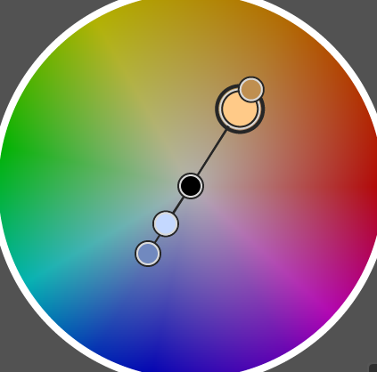
What works well
What could be improved
Clean Design: The overall design follows minimal design principles, with a high data-ink ratio and reduced unnecessary elements, like borderline, shadow, etc
Good Information Hierarchy: using different font sizes, font weights, and distinguished line weights and line types, the information organization is clear and easy to read.
Color Contrast: Great usage of hue contrast and brightness contrast to distinguish between different regions and the difference between asset value growth and residual growth.
Tidy layout: Each bar follows the same width and spacing, with division lines guiding the sight, making it very easy to read.
Overloaded Numbers: The whole chart is equipped with numbers, while it’s a good practice for report format that allows readers to spend more time to closely read, it is not suitable for our purpose.
Y-axis missing unit and excessive length: The y-axis seems to express a value, not a percentage. And since all the growth rate is not above 25%, we can get rid of the y-axis above 25%.
Source and date: The source was provided in vertical format, hard to read.
Text direction: The titles are in landscape format while the countries and percentages are rotated 90 degrees, making the chart hard to read.
Too much data and no highlight: the purpose of this chart may be to present a complete set of data. But for our purpose, it’s better to highlight the data that matches our point.
Why I Made the Changes I did
Intended Target Audience: A senior manager who is seeking global investment opportunities, in both Western countries and Asia. They have limited professional knowledge of real estate investment but have general understanding of business concepts.
Highlighting two top growth countries in the market: just highlight New Zealand and Indonesia to stress on key information
Adjusted color pattern: Adjust the color for better contrast while avoiding high saturation color. (See color wheel on the right)
Removing data columns and focus on top countries: only show the top five for Western countries, and the top three for Asia countries, to reduce unnecessary data that doesn’t help us convey the points.
Keep professional information but remove unnecessary ornaments: Because we are targeting real-world business decisions, I think it is useful to keep both asset growth and residual growth, for a better indicator of total market growth. I also provided an explanation on “residual” in the footnote, allowing non-professionals to understand the chart.
Pivot the chart by 90 degrees: Country names are long, and it’s easy to be not readable for the current layout. We’ll also merge text with bars to make it more intuitive.

Slide 3
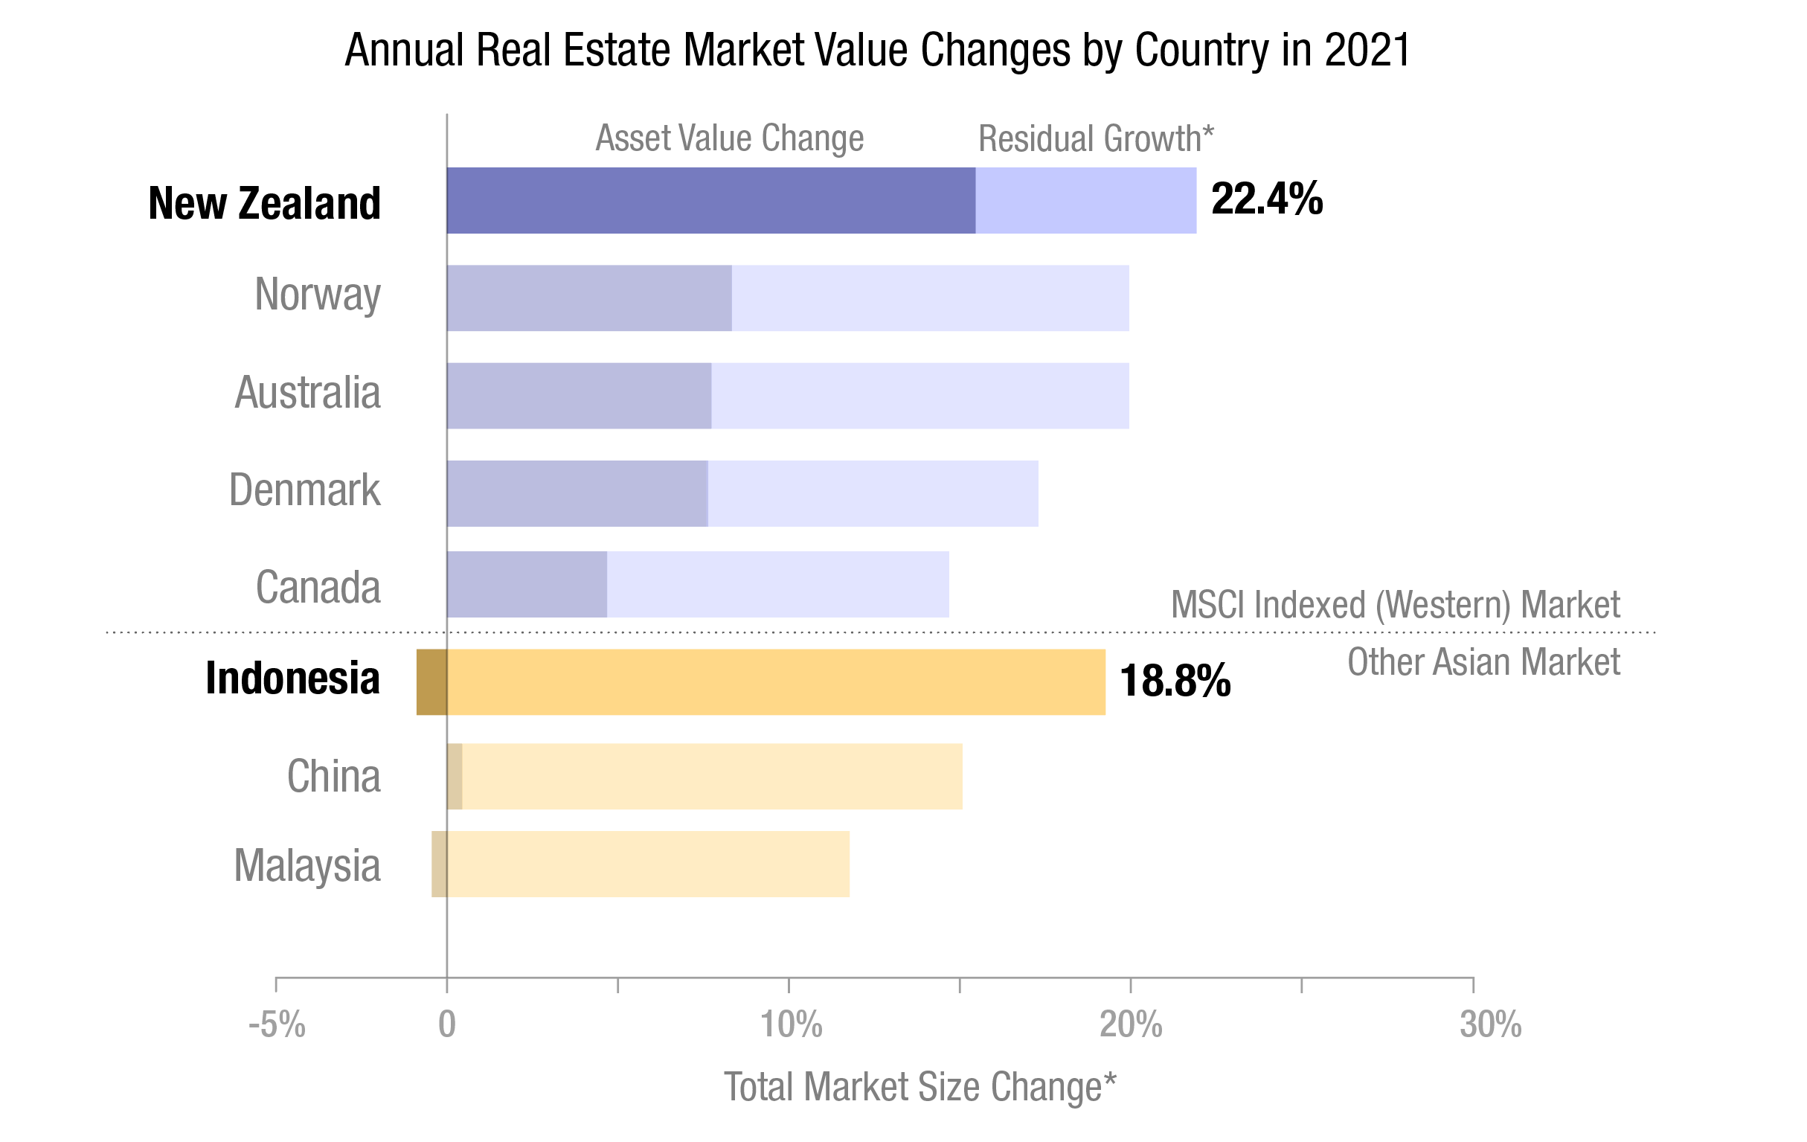
New Zealand and Indonesia Lead Regional Real Estate Market Growth in 2021
Source: MSCL KTI (Finland)
* Total Market Size Change = Asset Value Change + Residual
* Residual refers to other factors that affect the size of the market that are not captured by the simple appreciation or depreciation of asset values.

