Slide 1
Decoding & encoding with imaging data
UCSD Neuroscience Bootcamp 2015
Data Analysis workshop
Vy Vo & Scott Cole

Slide 2
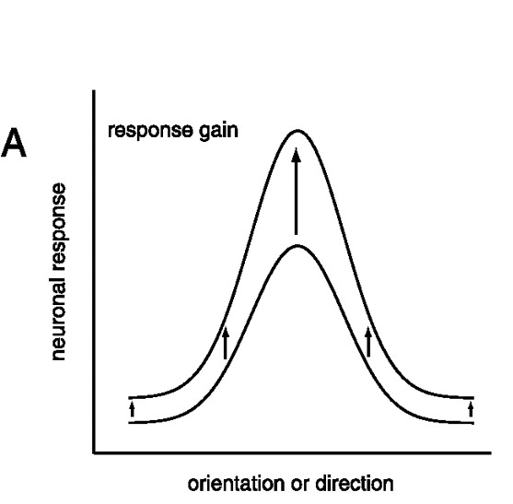
Visual tuning functions
Present an animal or human with visual stimuli that vary along a single dimension (in this case, direction of motion or orientation)
Measure neural responses at points along this stimulus dimension
Plot tuning functions (e.g., at which point in the axis is the cell or voxel most responsive?)
Do these vary with behavioral state? (running or attending)
This is a univariate analysis because it is based on ONE unit
Adapted from Williford & Maunsell, 2006

Slide 3
What can we gain from multivariate data?
Are there clusters in the data?
Are there classes or types of units that respond in stereotypical ways?
What can the pattern of data represent?
With several cells or units, you can encode a multidimensional stimulus space, or behavioral states that alter stimulus representations
A single orientation-tuned cell can discriminate between a few different orientations.
What happens when you combine the tuning of several cells?

Slide 4
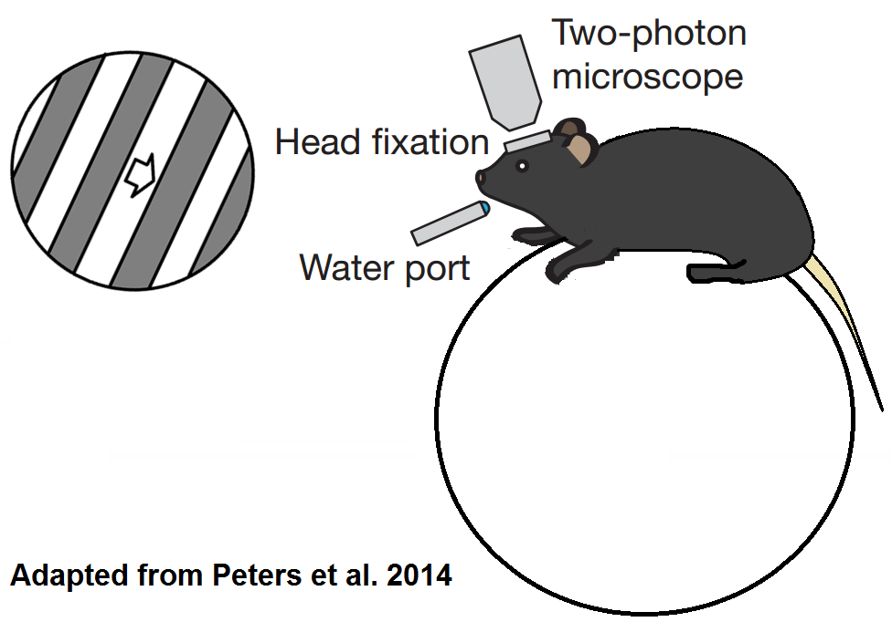
Calcium imaging experiment
V1 (layer 2/3)
Thanks to Hiroshi Makino from Takaki Komiyama’s lab for providing us this data!
grating
mouse
wheel

Slide 5
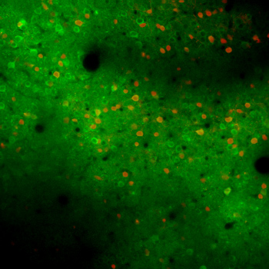
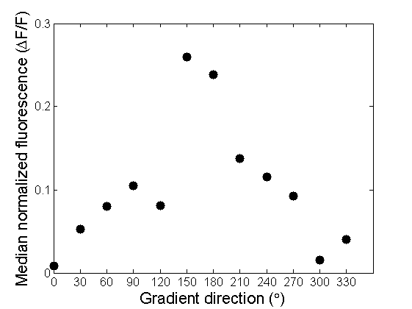
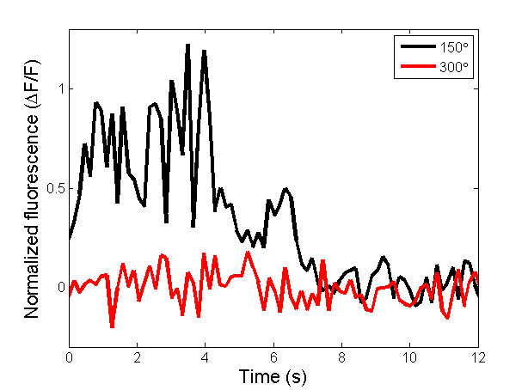
Calcium tuning curves
Komiyama
Notes:
Locate a neuron for which you want to calculate the tuning curve.
Each neuron has change in fluorescence while stimulus is being presented
Measure activity of the neuron (median fluorescence during stimulus presentation) for each gradient direction
Note: the numbers do not match up because the dots on the tuning curve are averages for all trials

Slide 6
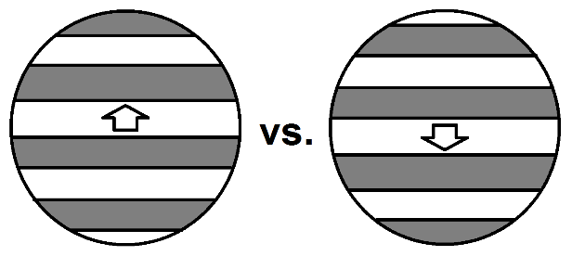
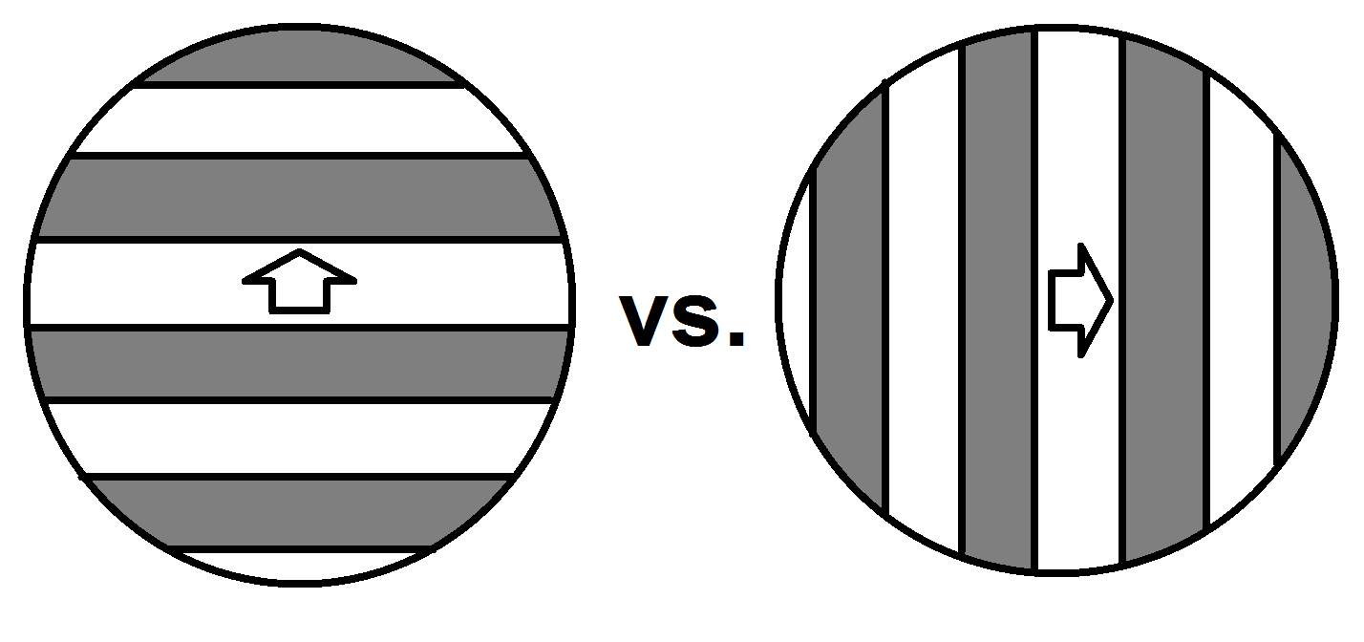






Selectivity measures
Direction selectivity index (DSI)
Orientation selectivity index (OSI)
$$DSI= \frac{μ_{max}−μ_{opp}}{μ_{max}+μ_{opp}}$$
$$μ_{opp}=μ_{max+180}$$
$$OSI= \frac{μ_{max}−μ_{orth}}{μ_{max}+μ_{orth}}$$
$$μ_{orth}= \frac{μ_{max−90}+μ_{max+90}}{2}$$
$$DSI= \frac{0.26−0.04}{0.26+0.04}=0.73$$
$$OSI= \frac{0.26−0.10}{0.26+0.10}=0.44$$
Adapted from Marshel et al., 2011
Notes:
Characterize tuning curves. Varies between 0 and 1.
Umax = Mean activation for the maximally favored direction

Slide 7
Calcium imaging analysis paths
Plot tuning functions & measure direction selectivity
Are these altered with running speed? (a proxy for attention/alertness)
Use a built-in MATLAB classifier to decode which motion direction the animal observed
Create a simple encoding model to reconstruct motion direction

Slide 8
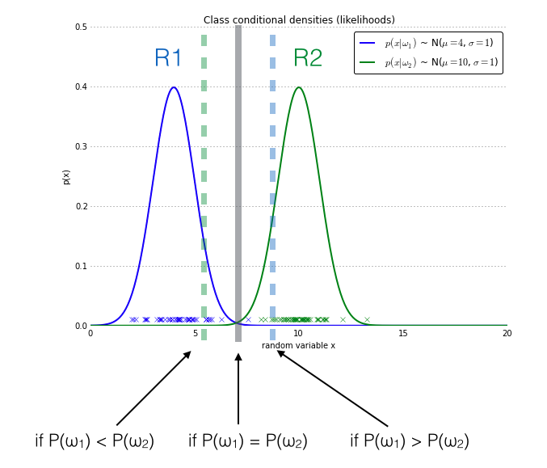
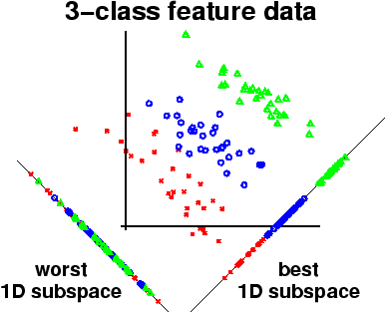
Decoding analyses
Linear discriminant analysis
Naïve Bayes analysis

Slide 9
Encoding models
First define a set of filters, or basis functions, which tile the stimulus space
Regress the data onto these filters to get weights on each of the basis functions
Use this weight profile to reconstruct the stimuli using a test data set
Adapted from Heeger & Brouwer, 2009

Slide 10
Things to remember about decoding & encoding analyses
The data used to train the model or classifier must be INDEPENDENT of the data used to test the model or classifier.
You cannot use standard parametric statistical tests to evaluate the performance of these models.
Decoding and encoding stimuli do not necessarily reveal how the brain truly represents a stimulus – it just reveals that the information is recoverable using these techniques.

Slide 11
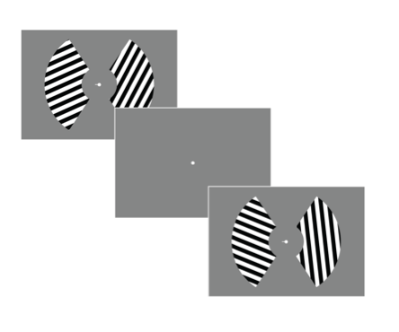
fMRI experiment
Subjects performed an attention task (spatial frequency change) on the left or right grating
All data are from significantly responsive V1 voxels (left or right hemisphere)
Thanks to Mary Smith from John Serences’ lab for providing us this data!

Slide 12
fMRI analysis paths
Plot tuning functions & measure orientation selectivity for each voxel
Are these altered with attention?
Use a built-in MATLAB classifier to decode which orientation was on the left or right
Create a simple encoding model to reconstruct orientation

