Slide 1
AUDITTRAK
The story behind
the transaction
MVP walkthrough · Fictional examples · October 2026
Notes:
AuditTrak connects the records behind a job: what was agreed, billed, paid, delivered and confirmed. This is a local MVP, with fictional demonstration data.

Slide 2
People and problem
01
Initial audience hypothesis: freelancers and small service businesses.
02
A reviewer needs to connect a payment to the work it represents.
03
Chats, invoices and bank lines may disagree or omit context.
04
The MVP collects records and explains what needs checking.
02
Notes:
The first audience is an assumption to test with pilot users, not a validated market. Institutional reviewers are a second user role. Matching money alone cannot establish the commercial story.

Slide 3
The five evidence questions
01
Agreement: what work and price did the parties agree to?
02
Invoice and payment: what was billed, and what arrived?
03
Delivery: what work was completed, with supporting evidence?
04
Confirmation: what does the intended client say about this revision?
03
Notes:
The product shows five stages: agreement, invoice, payment, fulfillment and confirmation. The second line groups invoice and payment only to keep this slide readable. Files and structured fields belong to the same event.

Slide 4
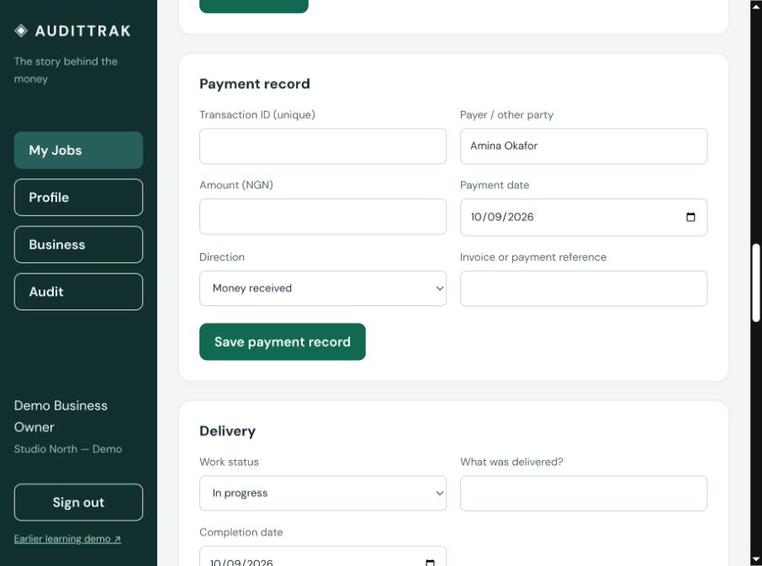
The business workspace
One job gathers
the related records.
Open a job, inspect its conversation, add evidence, then run the check.
04
Notes:
Sign in as the demo business owner and load the five fictional jobs. Create a job to start from scratch. The screenshot is from the local MVP, not a live customer deployment. Source: docs/images/assessment.jpg.

Slide 5
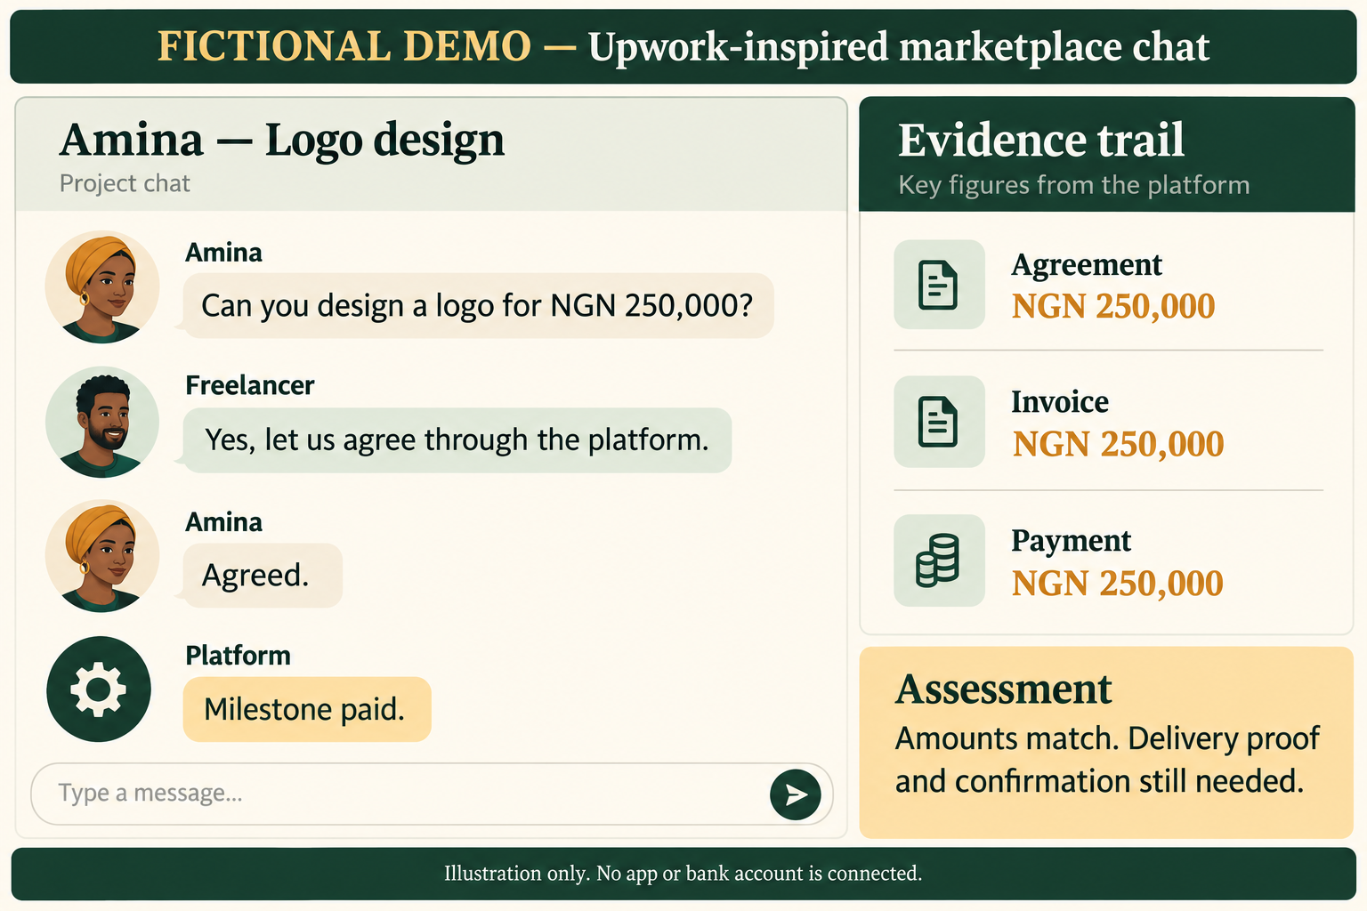
Amina — Amounts match
All three supplied amounts are NGN 250,000. Delivery and confirmation are still missing.
05
Notes:
Fictional scenario from data/five-scenarios.json. All three supplied amounts are NGN 250,000. Delivery and confirmation are still missing. The illustration is AI-generated educational artwork; no named app or account is connected. Platform styling is illustrative, not a claim about actual workflows.

Slide 6
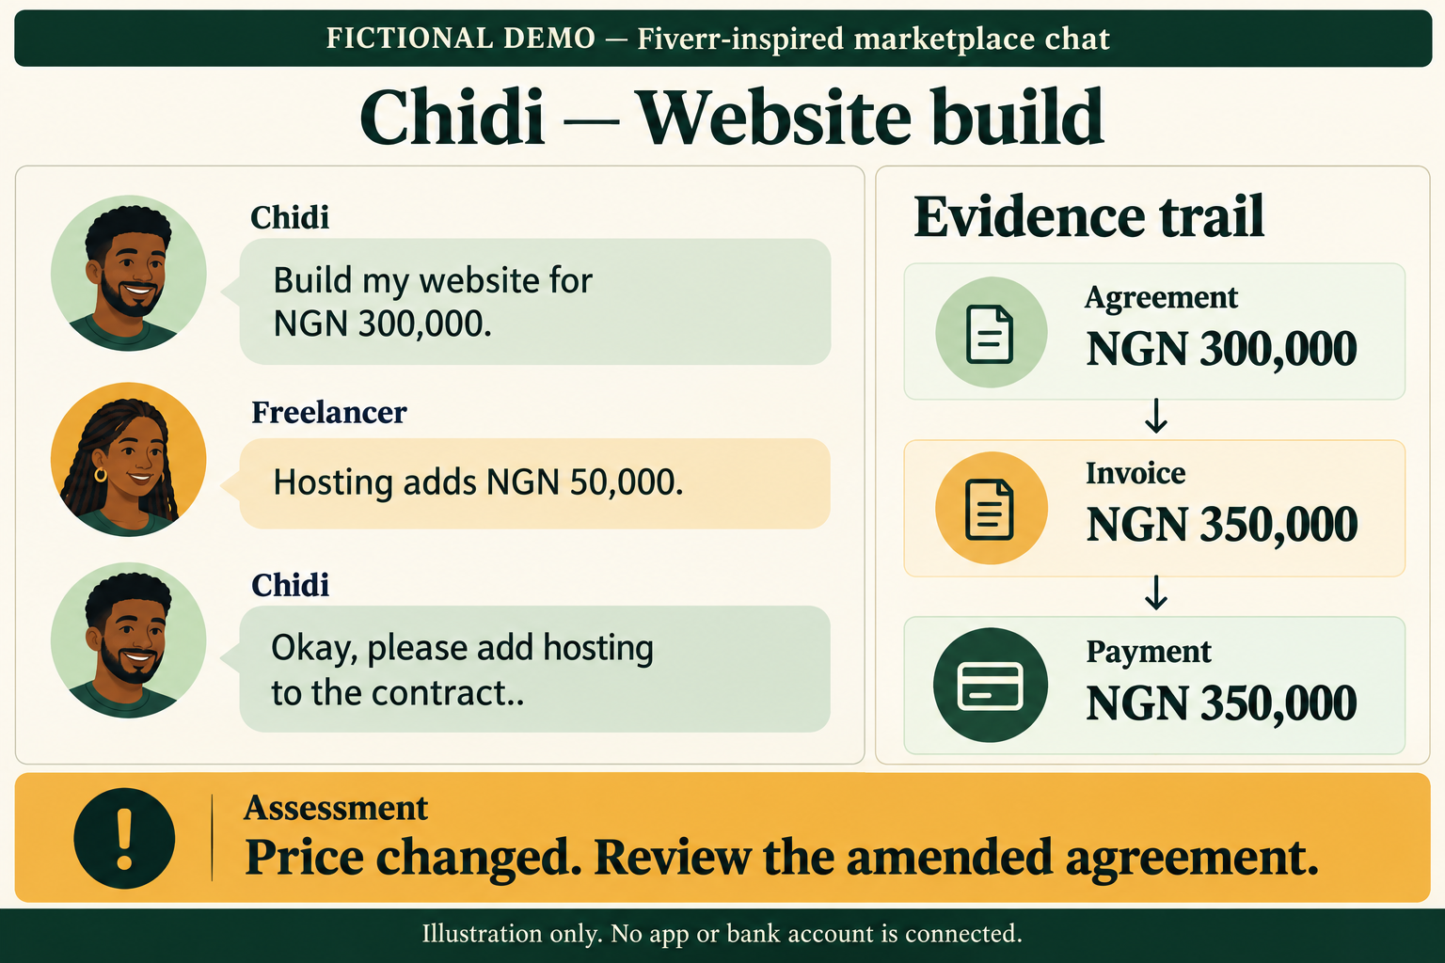
Chidi — Price changed
The original agreement is NGN 300,000; invoice and payment are NGN 350,000. Review the hosting amendment.
06
Notes:
Fictional scenario from data/five-scenarios.json. The original agreement is NGN 300,000; invoice and payment are NGN 350,000. Review the hosting amendment. The illustration is AI-generated educational artwork; no named app or account is connected. Platform styling is illustrative, not a claim about actual workflows.

Slide 7
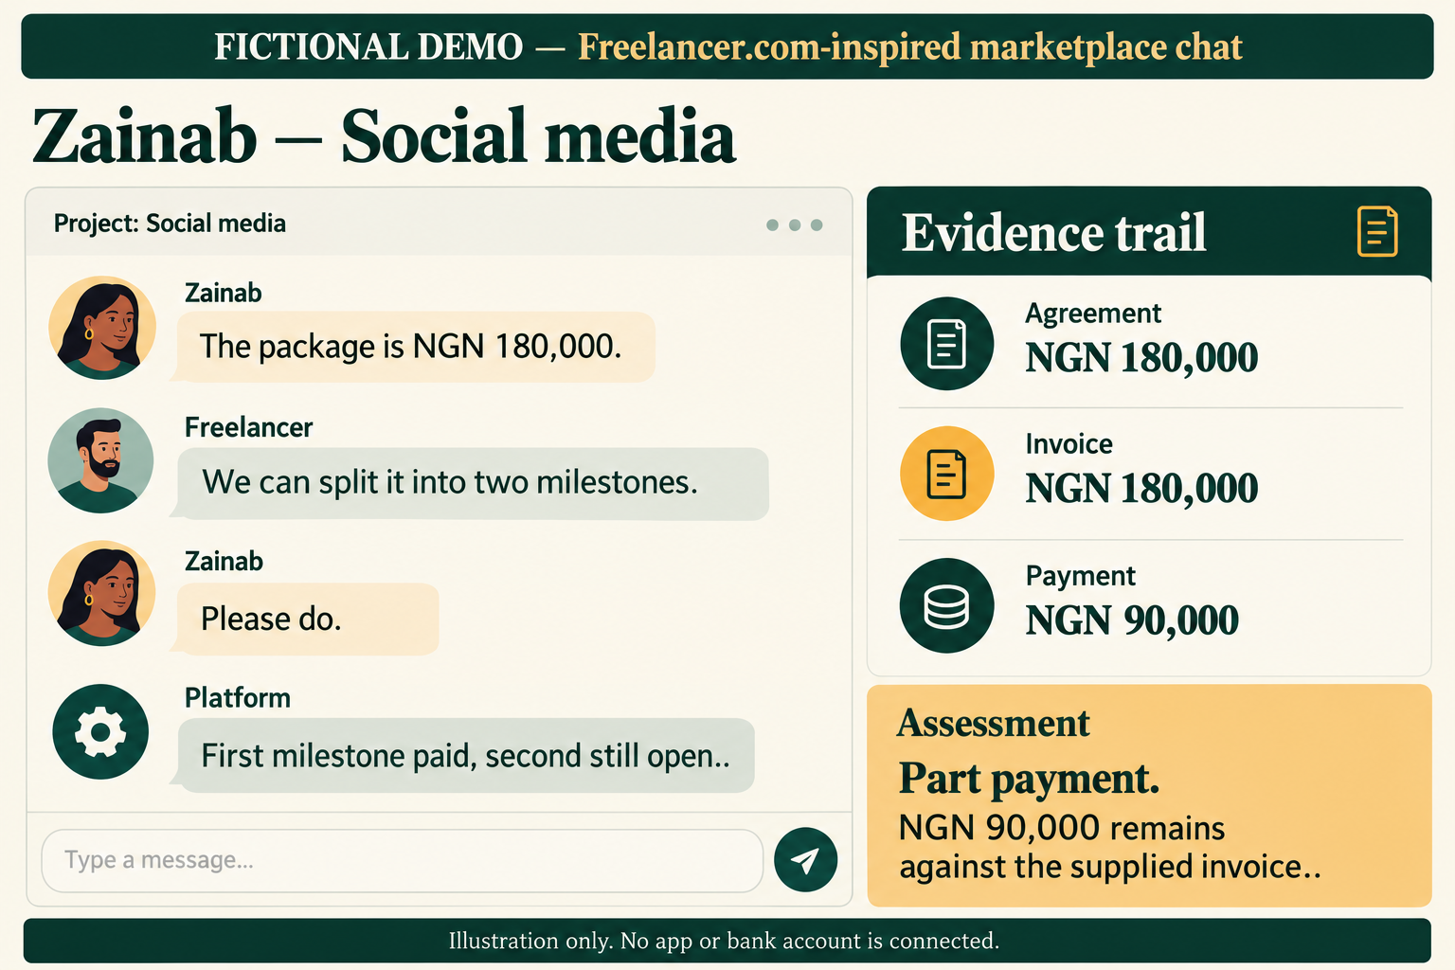
Zainab — Part payment
NGN 90,000 is linked against a NGN 180,000 invoice. Review the installment terms.
07
Notes:
Fictional scenario from data/five-scenarios.json. NGN 90,000 is linked against a NGN 180,000 invoice. Review the installment terms. The illustration is AI-generated educational artwork; no named app or account is connected. Platform styling is illustrative, not a claim about actual workflows.

Slide 8
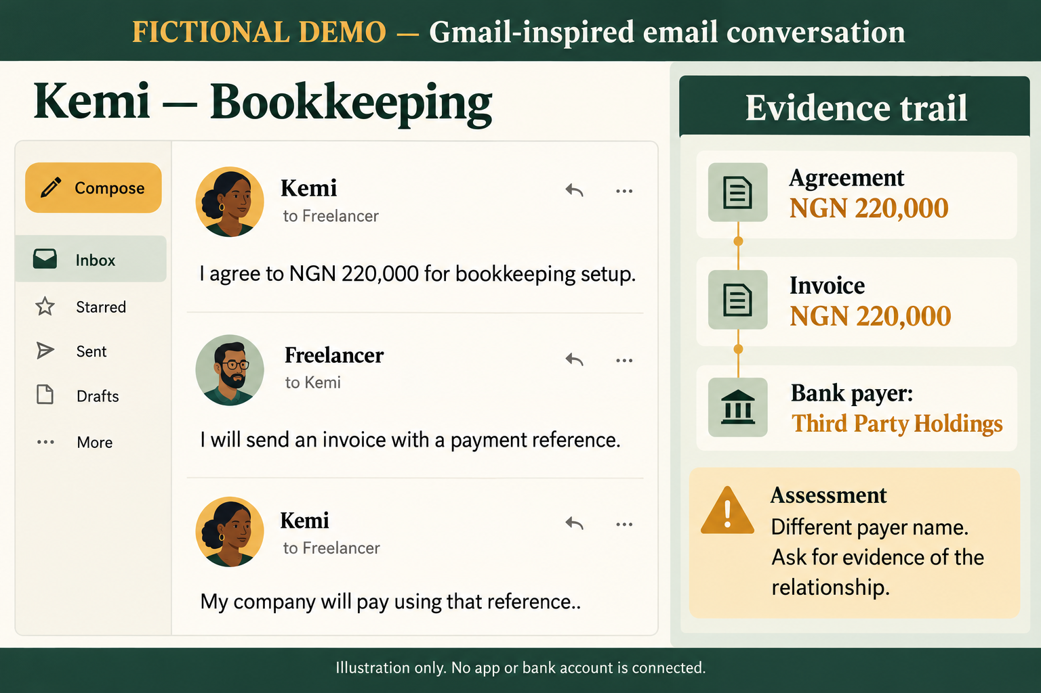
Kemi — Different payer
The invoice names Kemi; the bank record names Third Party Holdings. Confirm their relationship.
08
Notes:
Fictional scenario from data/five-scenarios.json. The invoice names Kemi; the bank record names Third Party Holdings. Confirm their relationship. The illustration is AI-generated educational artwork; no named app or account is connected. Platform styling is illustrative, not a claim about actual workflows.

Slide 9
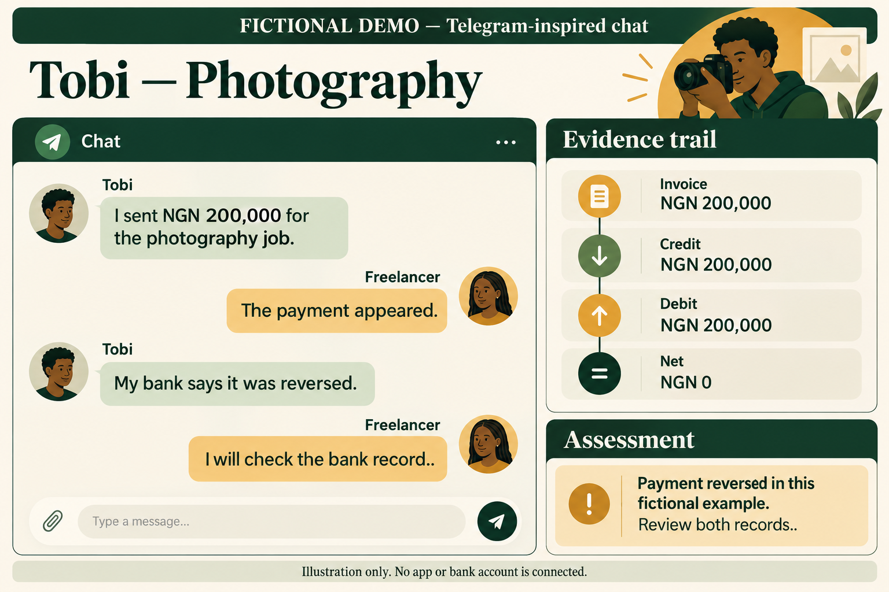
Tobi — Credit and debit
A NGN 200,000 credit and NGN 200,000 debit leave net zero. Review their relationship.
09
Notes:
Fictional scenario from data/five-scenarios.json. A NGN 200,000 credit and NGN 200,000 debit leave net zero. Review their relationship. The illustration is AI-generated educational artwork; no named app or account is connected. Platform styling is illustrative, not a claim about actual workflows.

Slide 10
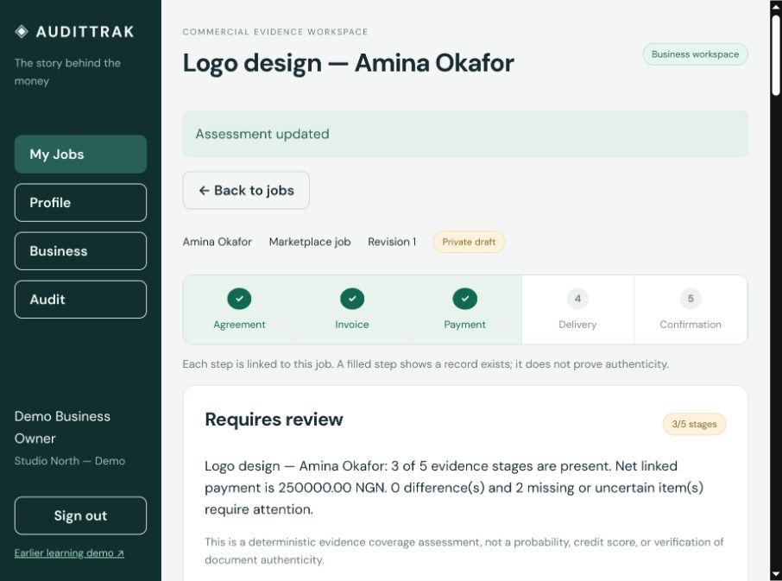
The assessment explains its reasons
Matches, differences
and missing evidence
Every result stays tied to supplied records. A person decides what the evidence means.
10
Notes:
Amina has three stages present. Agreement, invoice and payment match, but delivery proof and current confirmation are missing, so the result remains Requires review. Coverage is not a calibrated probability or credit score. Source: docs/images/workspace.jpg.

Slide 11
Confirmation and review
01
Finish editing evidence, then create a client confirmation link.
02
The link permits one response for that revision and expires after 14 days.
03
Run a fresh assessment before sharing with the reviewer workspace.
04
Any evidence edit withdraws sharing and invalidates the old assessment.
11
Notes:
No message is sent automatically. Link possession is not independent identity verification. Reviewers add observations rather than credit decisions. All seeded reviewers can see all explicitly shared jobs in this local MVP; institutional grants are a production requirement.

Slide 12
Implementation and provider boundaries
01
React UI → Fastify API → SQLite records and evidence files.
02
Mono adapter: operator credentials and a consented account binding required.
03
AI extraction: optional HTTP provider, source excerpts and manual review.
04
No built-in OCR, trained model or live app connections are claimed.
12
Notes:
The evidence model includes business, counterparty, commercial event, agreement, invoice, transaction, fulfillment, attestation, evidence item, assessment, flags, profile and audit history. The Mono adapter exists but no live sandbox account was validated. AI proposals never overwrite records or deterministic rules.

Slide 13
Pilot preparation
01
Try the five examples, then a consented real job with its owner.
02
Measure time to assemble a record and reviewer questions left unresolved.
03
Add production identity, institution permissions, backups and file scanning.
04
Keep credit decisions, fraud labels and fabricated evidence outside the product.
13
Notes:
This is a local MVP, not a production financial system. A pilot must validate the audience hypothesis and operational safeguards. No traction, market size or revenue figures are claimed.

