Slide 1
<Name of Method> in:
<full reference of the article>
<Your Name>
EDEP 625

Slide 2
What did the study investigate? (1 SLIDE MAX)
Keep this very brief
You only need to introduce the topic at a basic level

Slide 3
Participants or Subjects
Describe the participants/subjects sampled and observed in the study
What are they? Learners? Teachers? Classes? Texts?
How many were there?
How were they selected or recruited?
Include any details about the subjects you think is important

Slide 4
Variables
List all of the variables used to answer the RQs/objectives
You don’t have to list every demographic variable that is only used to describe the sample, etc.
Note the level of measurement for each variable (nominal, ordinal, continuous)
Describe how each variable was measured (e.g., a survey, a test, a reaction time measurement)
(can use multiple slides if needed)

Slide 5
Research Question(s)/Objective(s)
<copy and paste RQs or objective from article; may paraphrase if these are long>
<clear screenshots are fine, too>
Discuss any hypotheses the authors claimed to have
Highlight which RQ/objective is answered by <Name of Method>

Slide 6
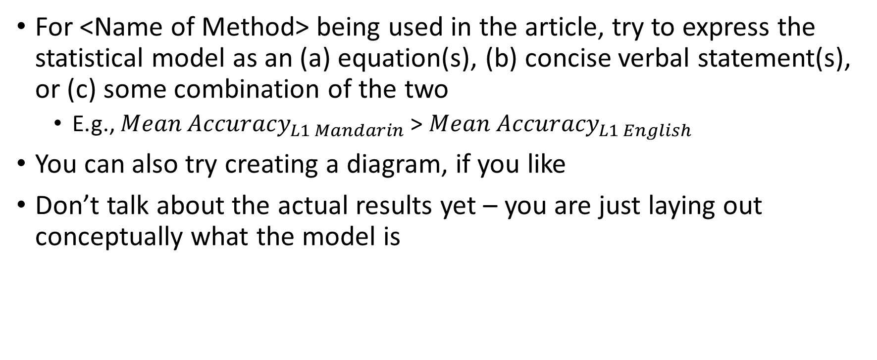
Statistical Model
For <Name of Method> being used in the article, try to express the statistical model as an (a) equation(s), (b) concise verbal statement(s), or (c) some combination of the two
E.g., ${Mean Accuracy}_{L1 Mandarin}$ > ${Mean Accuracy}_{L1 English}$
You can also try creating a diagram, if you like
Don’t talk about the actual results yet – you are just laying out conceptually what the model is

Slide 7
Statistical Reporting
Show the results of the statistical analysis (screenshots okay)
How do you interpret the results? Think in terms of the model

Slide 8
Statistical Assumptions
Did the authors discuss any assumptions for the statistical test?
If so, what information did they provide?
If not, what *should* they have included?

Slide 9
Brief Review
Discuss the considerations for quantitative research design that we developed in W3. Does the paper align? Are there things we need to add based on this paper?

Slide 10
Questions and Comments
Include any questions you had that were not clear from your reading of the article
<classmates can also ask questions and make comments at this time>

