Slide 1
US earnings predictability (Based on census data)

Slide 2
Agenda
The problem we're trying to solve
The data we have
Some initial observations/trends/guidelines
Feature engineering
First few models – results
Predictive power of various features
Advantages and disadvantages
Potential further work

Slide 3
The problem
"Given information on a range of socio-economic factors about a US individual, can we predict
(with reasonable accuracy) whether or not they earn more than $50,000 per year?"
How accurate are our predictions?
What are the main factors driving the prediction?

Slide 4
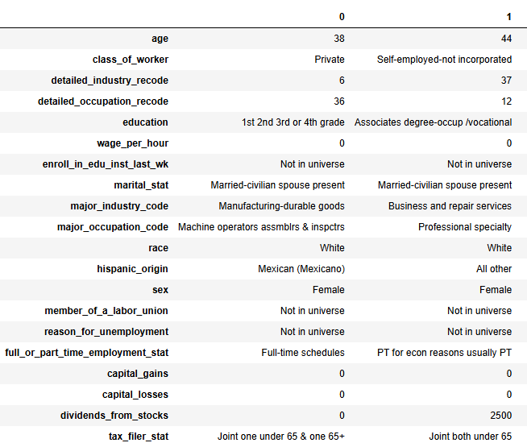
The data
We have a sample of 300k records of US census data
200k records to be used for training (and validation), 100k for testing (holdout)
40 pieces of information for each record
7 numerical
33 categorical
Examples of the sort of information we have:
Age
Gender
Residence details (duration at address, main householder/child, etc.)
Level of education
Tax information (filing status, capital gains/losses)
Employment status & industry codes
All-in-all, a good quantity and broad spectrum of potential determining factors for predicting annual income!

Slide 5
EDA (initial questions)
Inevitably though, the more information you have, the more questions to answer before making sensible use of the data
What sort of class imbalance do we have in our "target variable"?
A: only about 6.2% of data is in the "positive" (earnings over $50k) class
How much duplication/correlation is there between features?
A: of around 500 exploded (OHE) categorical columns, there is only about 20 columns' worth of information*
Can we quickly establish a set of candidate factors that are most likely to be predictive?
A: comparing per-class feature distributions certainly gives an early indication of what could be promising
Within categorical factors, are some categories more useful to us than others?
A: comparing per-class feature distributions here also implies "yes"
(discussed on next slides)
*Based on eigenvalues of Principal Components

Slide 6
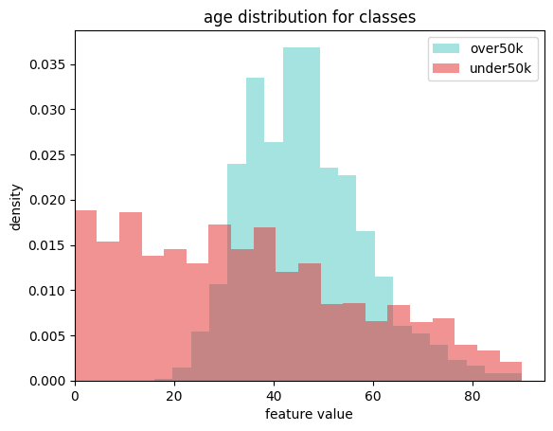
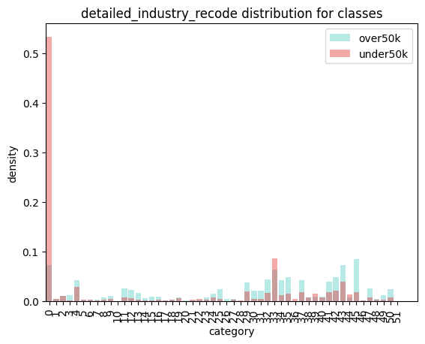
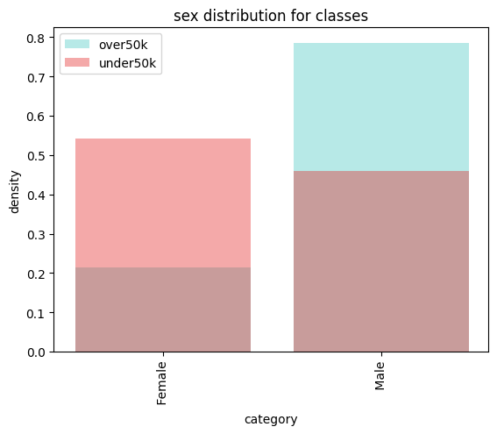
EDA (some curated results)

Slide 7
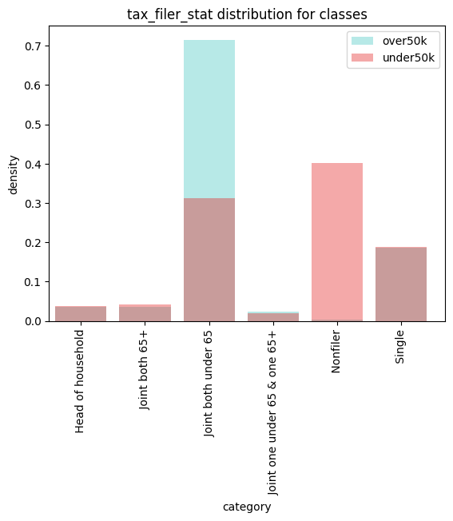
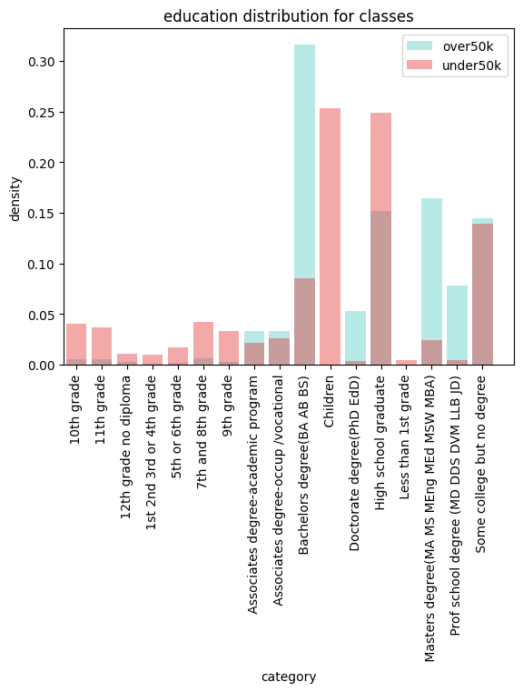
EDA (some curated results)

Slide 8
Feature engineering – first iteration
All numerical features (age, wage_per_hour, capital_gains, capital_losses, dividends_from_stocks, num_persons_worked_for_employer, weeks_worked_in_year)
class_of_worker (processed as a binary flag to show workers that were hard to classify)
detailed_industry_recode (p/a binary flag to identify agriculture industry)
education (p/a binary flag to identify individuals with (at least) a university degree)
enroll_in_edu_inst_last_wk (p/a binary flag to show individuals still studying)
marital_stat (p/a an (opinionated) ordinal feature, with "never married" on one end, "married spouse present" on the other, and other values between)
major_industry_code (p/a binary flag – though only really again identifying minors)
sex (p/a binary flag for male individuals)
full_or_part_time_employment_stat (p/a an (opinionated) ordinal feature with children/armed forces on one end, and full-timers on the other)
tax_filer_stat (p/a an (opinionated) ordinal feature with nonfilers – other – joint filers under 65)
detailed_household_summary_in_household (p/a an (opinionated) ordinal feature, but again mostly identifying minors)
country_of_birth_mother (p/a binary flag to flag individuals whose mother was born in Mexico or Puerto Rico)

Slide 9
Modelling (and initial results)
5 different model (specifically, binary classifier) types were evaluated
All models trained with class weight applied to counteract the class imbalance
Quick basic baselining and HP adjustments
Rough overfitting sanity check – AUC on train vs validation
Main metric used was Area-under-Curve (AUC)*
F1 score and precision on the positive class also considered
Chosen with the class imbalance in mind
Model | Logistic Regressor | Random Forest Classifier | Gradient Boosting Classifier | XGBoost Classifier | XGBoost RF
AUC | 0.905 | 0.941 | 0.945 | 0.945 | 0.939
pos_precision | 0.20 | 0.30 | 0.28 | 0.29 | 0.27
pos_F1 | 0.33 | 0.45 | 0.42 | 0.43 | 0.41
*AUC measures the area under the Receiver Operating Characteristic curve – detail in appendix

Slide 10
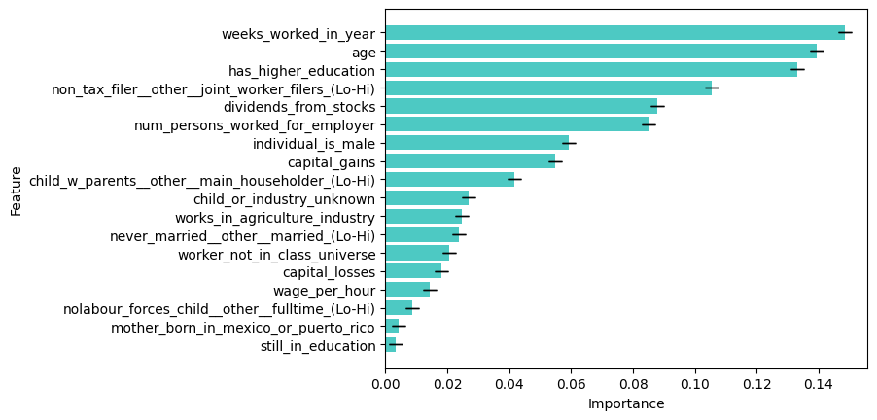
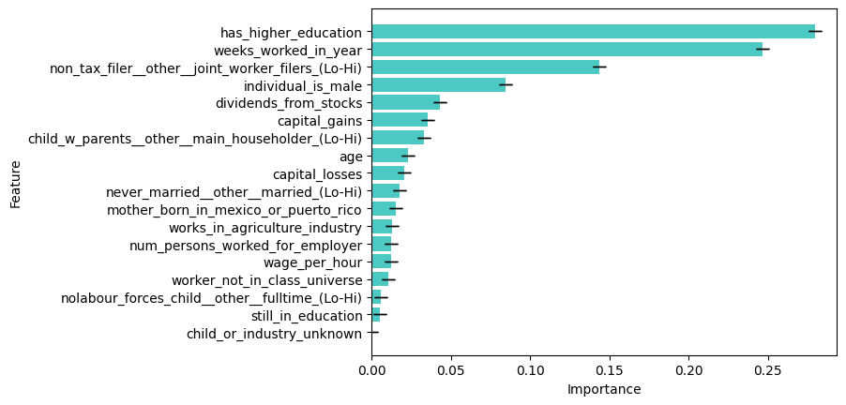
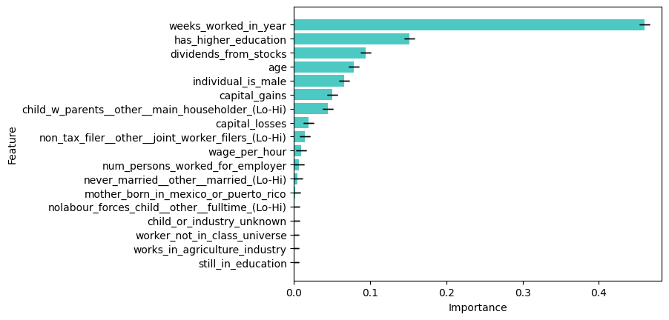
Feature importance (aka predictive power!)
RandomForestClassifier
XGBoost Classifier
Gradient Boosting Classifier
XGBoost RF

Slide 11
Advantages & disadvantages of the approach
TBC

Slide 12
Potential further work
TBC

Slide 13
Questions?

Slide 14
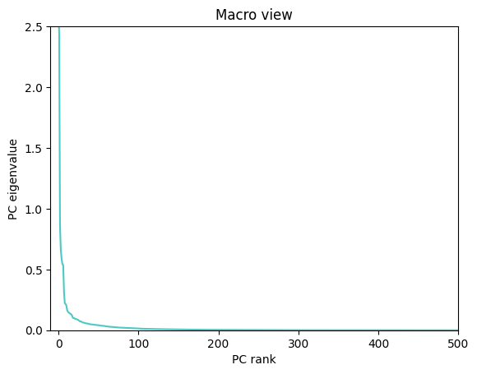
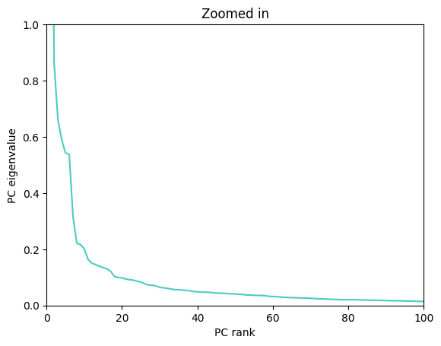
Appendix
PCA/Scree plot

Slide 15
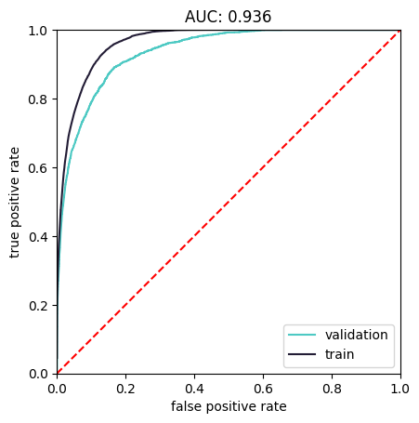
Appendix
AUC curve

